Slide 1
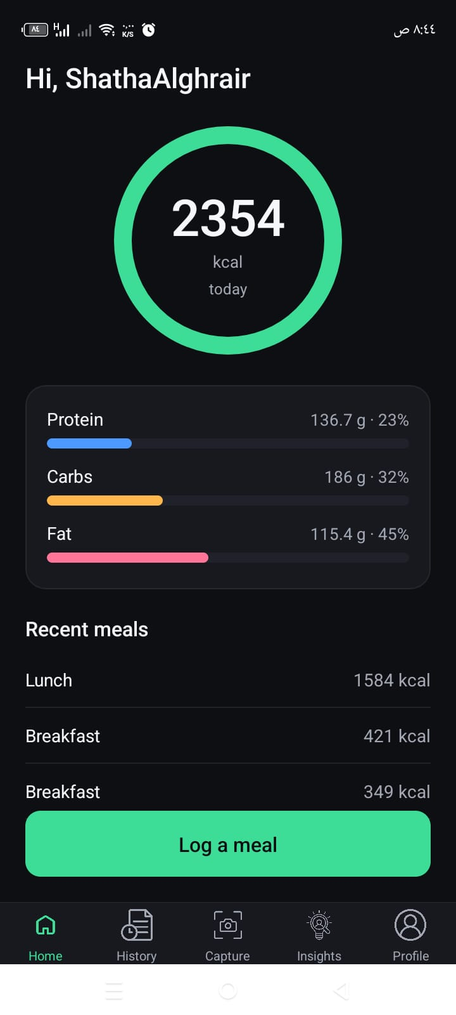
N
NutriLens
AI Food Recognition System
Photograph a meal. Get an AI-verified nutrition breakdown and personalised guidance — no manual food search.
Mohannad Alhemsi & Shatha Alghrair
Middle East University · Faculty of Information Technology
Supervised by Prof. Maria Yousef

Slide 2




AGENDA
What we'll cover
01
02
The Problem & Our Solution
Architecture & the AI Model
Why dietary tracking apps fall short, and what NutriLens does differently
How the system is built, and how the classifier was trained and evaluated
03
04
The Vision Pipeline in Depth
The App, Testing & What's Next
Input gates, portion estimation, USDA nutrition, and personalised insights
A tour on real hardware, the evidence it works, and its honest limits
01

Slide 3



THE PROBLEM
Manual food logging doesn't work
Diet-related disease is a global crisis, and the tools people are given to track their own intake are stuck in the past.
1.9B+
~3×
0
Adults classified as overweight worldwide (WHO)
Rise in global obesity rates since 1975
Deployed apps that auto-estimate portion size from a photo
Slow
Inaccurate
Unverified
Manual text search for every ingredient of every meal
Portion sizes are guessed, not measured
Many apps rely on user-submitted, uncorrected nutrition data
02

Slide 4
RELATED WORK
Existing apps don't close the gap
Auto Portion
Multi-Dish
Verified Data
Personalised
MyFitnessPal
–
–
–
–
FoodVisor
–
–
✓
–
Lose It!
–
–
✓
–
NutriLens
✓
–
✓
✓
Multi-dish recognition remains future work (see Limitations) — every other capability here is implemented and tested end-to-end.
03

Slide 5


OUR SOLUTION
NutriLens: three ideas working together
Recognise
Estimate
Guide
A fine-tuned EfficientNet-B4 model identifies the food in a photo across 101 categories, with an honest fallback when it isn't sure.
A 3-stage computer-vision pipeline — container type, reference objects, shape priors — returns a calibrated portion range, never a fake-precise number.
Once enough meals are logged, a content-based recommendation engine surfaces personalised, goal-aligned dietary insights.
04

Slide 6
ARCHITECTURE
A clean three-tier system
A native React Native (Expo) app for iOS and Android, talking HTTPS/JSON to a FastAPI backend that hosts the recognition, portion, nutrition and recommendation modules over PostgreSQL 15, PyTorch, and USDA FoodData Central.
CLIENT LAYER
iOS App
React Native · Expo
Android App
React Native · Expo
One TypeScript codebase · camera, gallery, on-device resize
HTTPS / JSON
BACKEND LAYER
REST API Gateway
FastAPI · JWT + bcrypt
Image Preprocessing
validation · quality · food gate
Food Recognition
EfficientNet-B4 · 101 classes
Portion Estimation
segment · scale · shape priors
Nutrition Lookup
USDA query · portion scaling
Recommendation Engine
BMR/TDEE · goal gap analysis
DATA LAYER
Model Store
.pth weights · 5 models
USDA FoodData Central
REST API + 180-day cache
PostgreSQL 15
Docker · Alembic · 3NF
05

Slide 7


HOW IT WORKS
One pipeline, start to finish
From a captured photo to a personalised insight — every step exercised end-to-end on a physical device.
1
2
3
4
5
6
Capture
Food-Gate
Classify
Estimate Portion
USDA Lookup
Log & Learn
Photo from camera or gallery
Open-set check: is this food at all?
EfficientNet-B4, 101 classes
Segment → scale → volume → mass
Verified calories & macros
Saved; insights after 7 meals
A confidence check sits between Classify and Estimate Portion: at or above 60% the top prediction is shown directly; below it, the user picks from three alternatives. And because a 101-class model can be confidently wrong on a dish it has no word for, the user can overrule any prediction from the full label set — not only a low-confidence one.
06

Slide 8
THE AI STACK
Five models, not one
Recognition is the headline, but four more models run alongside it — three fine-tuned for this project, two off the shelf.
MODEL
ARCHITECTURE
WHAT IT DOES
PROVENANCE
Food classifier
EfficientNet-B4 · 380 px · 19 M params
Identifies the dish across the 101 Food-101 categories.
TRAINED · 91.4% top-1
Food segmenter
DeepLabV3-MobileNetV3-L · 512 px
Separates food pixels from plate and background so the food's area can be measured.
TRAINED · FoodSeg103
Container classifier
MobileNetV3-Small
Plate vs bowl — supplies the size prior the scale calculation depends on.
TRAINED · Open Images V7
Food gate
MobileNetV3-Large
Open-set check that the photograph shows food at all, before classification runs.
OFF THE SHELF · ImageNet-1k
Reference detector
Faster R-CNN MobileNetV3
Finds a fork, spoon or knife in frame to calibrate real-world scale.
OFF THE SHELF · COCO
Only the classifier is on the accuracy headline. The other four exist to stop it being asked the wrong question, or to give its answer a scale.
07

Slide 9
THE AI MODEL
EfficientNet-B4, fine-tuned on Food-101
101 classes, 101,000 images
Food-101 — the standard benchmark, so the number is comparable to published work
Training Facts
Backbone
EfficientNet-B4 (ImageNet pretrained)
Two-phase transfer learning
3 warm-up epochs, backbone frozen, head only at LR 1e-3 — then the whole network fine-tuned at 3e-4
Input size
380 × 380 px
Deliberately heavy regularisation
Optimiser
AdamW · weight decay 1e-4 · cosine decay
750 images/class are easily memorised: RandAugment(2, m9), RandomResizedCrop 0.65–1.0, RandomErasing p=0.25, MixUp α=0.2 + CutMix α=1.0, label smoothing 0.1
Augmentation
RandAugment · MixUp · CutMix · Erasing
EMA weights, cosine schedule, flip TTA
Platform
Colab Pro GPU · mixed precision + grad accumulation
Weight EMA at 0.999 evaluated alongside the raw weights; LR warms up linearly then decays on a cosine curve; horizontal-flip TTA at final eval
Held-out test set
25,250 images (250 / class)
08

Slide 10
MODEL SELECTION
Why EfficientNet-B4 over ResNet-50
Both architectures were fine-tuned on identical data, augmentation, and test split — isolating architecture as the only variable.
ResNet-50
EfficientNet-B4
SELECTED
ImageNet Top-1
76.1%
ImageNet Top-1
83.0%
Parameters
25 M
Parameters
19 M
Food-101 (fine-tuned)
~83%
Food-101 (fine-tuned)
91.4%
Role
Comparison baseline
Role
Deployed model
The verdict: 24% fewer parameters, yet 8.4 points higher accuracy on Food-101 — EfficientNet-B4's compound scaling earns its complexity rather than overfitting.
09

Slide 11
MODEL EVALUATION
91.4% accuracy — double the industry norm
91.4%
83%
~46%
NutriLens (EfficientNet-B4)
macro-avg top-1 accuracy
ResNet-50 baseline
(same data & training)
Published commercial apps
(FoodVisor, Lose It!)
10

Slide 12
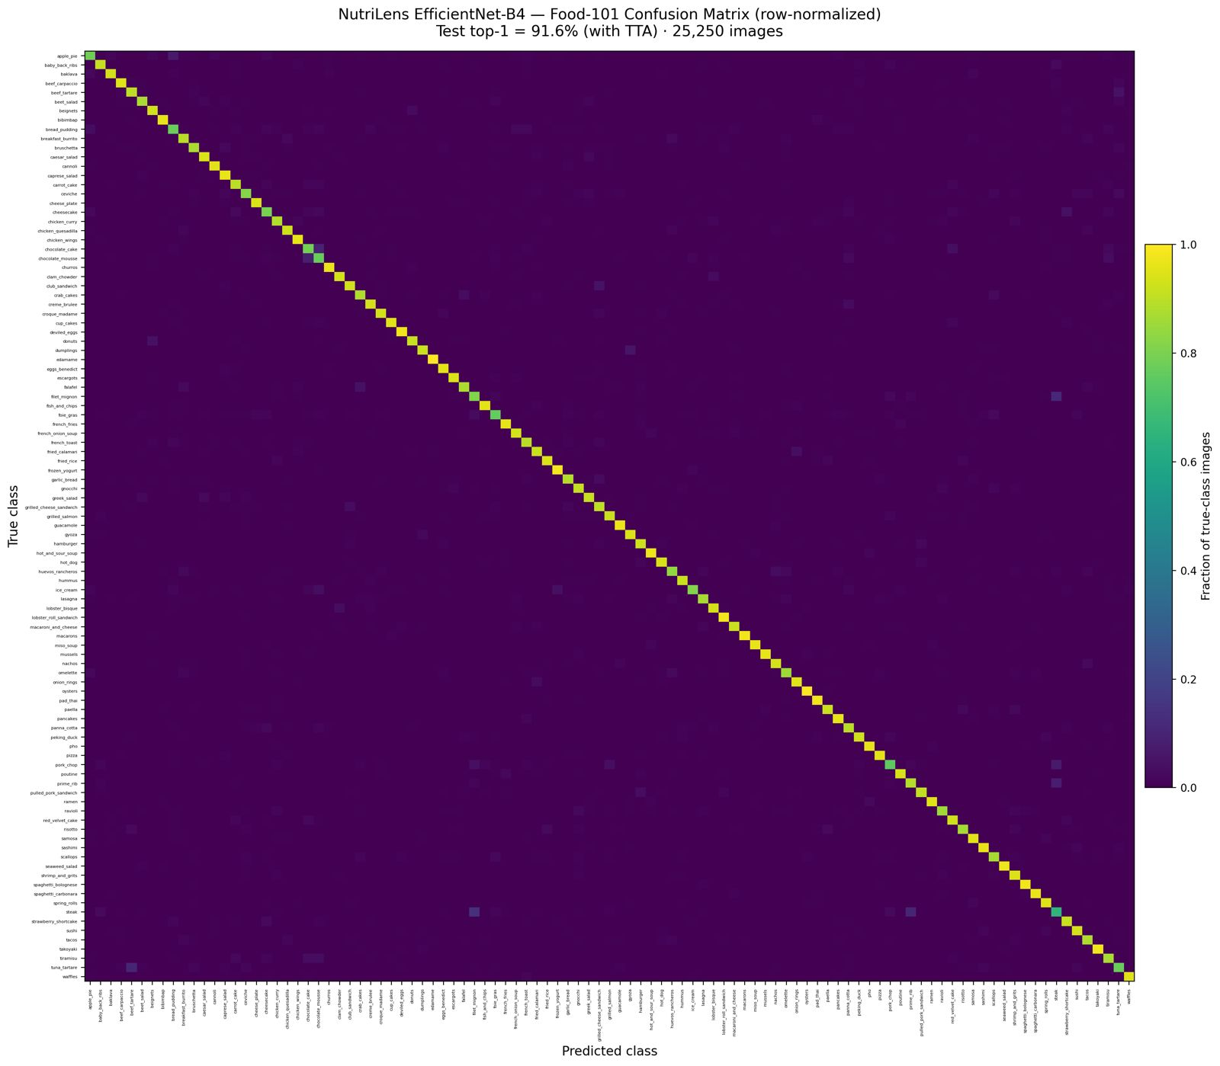
MODEL EVALUATION
Strong, near-perfect class separation
Row-normalised confusion matrix across all 101 Food-101 classes — 25,250 test images the model never trained on.
Solid diagonal = correct predictions. Confusion is confined to close visual relatives — steak ↔ prime rib ↔ filet mignon, chocolate mousse ↔ chocolate cake, bread pudding ↔ apple pie — exactly what Risk R1 in the project plan anticipated.
11

Slide 13
INPUT GATES
Two gates before the model ever runs
EfficientNet-B4 is closed-set: its softmax is defined over 101 foods and must sum to 1 no matter what the camera is pointed at. It cannot say “not food”.
Gate 1 — Validation & quality
Gate 2 — Open-set food gate
· Format confirmed by decoding the bytes — never by the client's Content-Type header, which is trivially spoofed
· ≤ 10 MB · ≥ 640 × 480 px
· Mean luma 30–235 rejects too dark and washed out; variance of Laplacian > 60 rejects blur
· Rejects only — never relights or sharpens. Enhancing at serve time is train/serve skew and lowers accuracy
· MobileNetV3-Large on ImageNet-1k — a model that has actually been shown non-food
· Sums softmax mass over ~45 food classes plus 14 dining-context classes (plate, bowl, dining table, wok, frying pan)
· Context matters: shawarma has no ImageNet label, but “plate” and “dining table” still fire
· Below 0.05 → NO_FOOD_DETECTED. A few milliseconds next to B4 inference
Why not just raise the confidence threshold?
One laptop photo scored 0.05 — any floor catches it. A second, closer shot scored 0.46 on “apple pie” with the runner-up at 0.09: high score, wide margin, plainly not food. Confidence answers which of the 101, never whether any of the 101. The gate put 0.79 on “space bar” and effectively nothing on food.
12

Slide 14
PORTION ESTIMATION
A photograph has no ruler in it
Mass = volume × density. Volume needs area. Area needs centimetres-per-pixel. A single 2D photo gives none of the three — and we assumed no depth sensor, so it has to work on any phone camera.
1
2
3
4
Segment
Scale
Volume
Mass
Isolate the food pixels from the plate and the background
Resolve centimetres-per-pixel from the best cue in the frame
Lift the measured area to a volume via the food's shape prior
× density, clamp, then widen into an honest range
Step 1 in detail — segmentation
Why a trained segmenter earns its place
· DeepLabV3-MobileNetV3-Large, trained on FoodSeg103 — 104 classes collapsed to food / not-food
· Mask resized back to full resolution with nearest-neighbour, so it stays strictly binary
· Falls back to Otsu + GrabCut, then a centre box — a portion is always returned
· Classical thresholding grabs the plate, not the food — and the plate is far larger
· That error is systematic: every mass reads high, every time
· Recognition already named the dish, so a binary silhouette is all we need — a cleaner target and a higher IoU
13

Slide 15
PORTION ESTIMATION
Three ways to find the ruler, in order of trust
The estimator tries the strongest cue first. Whichever one succeeds also sets how wide the final range is — the band never claims more precision than the cue it came from.
±12%
range-derived
±35%
Reference object
Container prior
Framing only
· cm/px = real size ÷ pixel length
· Off-the-shelf COCO detector finds fork, spoon, knife — zero training needed
· Pixel length is the box diagonal √(w²+h²): a utensil at 45° makes an almost-square box, and one side under-reads by ~30%
· MobileNetV3-Small on Open Images V7 crops → plate or bowl
· OpenCV rim detector measures its pixel area, thresholding at both polarities
· cm/px = √(A_real ÷ A_px) — area-based, so a square takeaway box works like a round plate
· No reference and no container: assume the frame spans roughly 26 cm
· Deliberately the widest band in the pipeline
· Reported as shape_only, so it is never mistaken for a measurement
Reference priority — most reliable first
Credit card 8.56 cm (ISO/IEC 7810 — zero variance) › Smartphone 14.7 › Coin 2.4 › Fork 19 · Spoon 18 · Knife 21 › Chopsticks 24 › Hand 8.4 (varies per person)
Two references in frame? The higher-priority one governs; if the next agrees within 15% they are averaged, otherwise the more reliable one is trusted alone. Each entry records which dimension its value refers to, so a fork's width is never measured against its length.
14

Slide 16
PORTION ESTIMATION
From pixels to grams — with an honest error bar
One measured area drives everything downstream: six shape models, 104 tuned food classes, and a per-class density table.
mask area (cm²) → shape prior → volume (cm³) → × density → mass (g) → clamp → min / point / max
Six shape models, tuned per class
What the API actually returns
· flat disc (47) · ellipsoid (18) · irregular pile (16) · liquid in bowl (13) · cylinder (8) · dome (2)
· pizza = flat disc, h 1.5 cm · hamburger = ellipsoid, h 6 cm, density 0.45 g/cm³
· fries = irregular pile: h_eff = k·√A, so a heap grows taller as it spreads
· A per-class mass clamp rejects a mask that has leaked onto the plate
min_g / max_g / point_g
the band and its midpoint
method
reference_object · container_prior · shape_only
reference
the object used, if any
scale_source
“measured from a fork” · “assumed plate”
→ The app shows a 10 g stepper. The user always confirms (FR06).
Measured, not assumed
16% mean absolute percentage error against kitchen-scale weights, where 20–40% is typical for monocular portion estimation. Range coverage is reported alongside it, because for a range estimate “does the band contain the truth” matters as much as the midpoint.
15

Slide 17
NUTRITION DATA
Two vocabularies that don't speak to each other
The classifier says grilled_salmon. USDA says “Fish, salmon, Atlantic, farmed, cooked, dry heat.” Nothing in either system bridges them — so the bridge is ours.
1
The class name carries the wrong cooking method
Keeping it standing up
grilled_salmon logged as baked would return grilled values. The adjective is a Food-101 artefact; the method the user confirmed is the fact. Strip it and substitute → “salmon cooked baked”.
· An hourly rate limiter sized deliberately below USDA's published cap — we throttle before they do
· 180-day PostgreSQL cache; a cached row serves the request when USDA is slow or unavailable
· Values held per 100 g and scaled to the confirmed portion at lookup, so one cached row serves any portion
· Macros are computed server-side — the client cannot submit its own calorie figures
· Every number on screen traces to a laboratory-verified USDA row
2
USDA has never indexed the dish
beignets, takoyaki and croque_madame return nothing — a 404 on food the user can plainly see. A hand-written override table maps them: escargots → snail, guacamole → avocado.
3
Every search term is optional by default
USDA ranks on the whole query, so the short, extremely common cooking words outrank the food itself. Food terms are marked required — a fix learned by running live queries, not by reasoning about them.
16

Slide 18
PERSONALISATION
From seven meals to a target of your own
No advice until there is enough data to justify it — then a target derived from the user's own body, rather than a fixed number off a chart.
7 meals → 7-day macro profile → Mifflin–St Jeor BMR → × activity = TDEE → goal adjustment → gap analysis → up to 5 insights
The gate
The target
The output
· Below seven logged meals the Insights screen shows a locked state with a progress counter (“4 / 7 meals logged”)
· That is a deliberate refusal, not a missing feature — advice from three meals is noise
· Mifflin–St Jeor basal metabolic rate from height, weight and age
· × an activity factor for total daily energy expenditure
· Adjusted for the stated goal: deficit, maintenance, or surplus
· Missing metrics are named back to the user; the engine falls back to goal-based macro ratios
· Up to five plain-language insights per generation, each tied to one nutrient and the user's goal
· Each carries the statutory disclaimer verbatim from the API, never hard-coded in the app
· Cached for six hours and regenerated as new meals land
Content-based filtering, not collaborative: the system has one user's history to work with, and a cold-start recommendation drawn from other people's diets would be advice nobody asked for. The engine compares the user against their own goal, and nothing else.
17

Slide 19
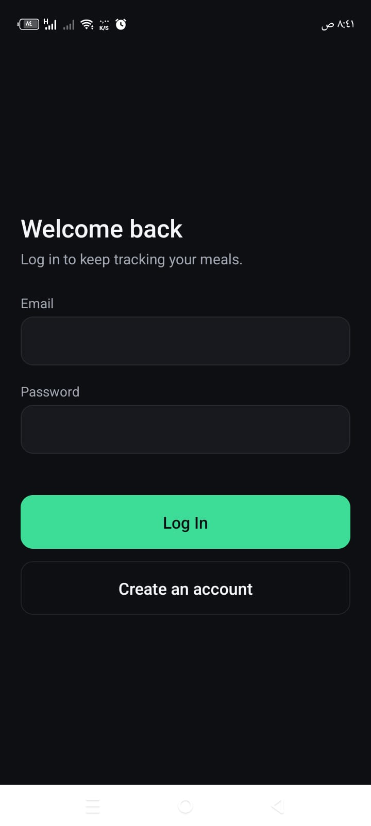
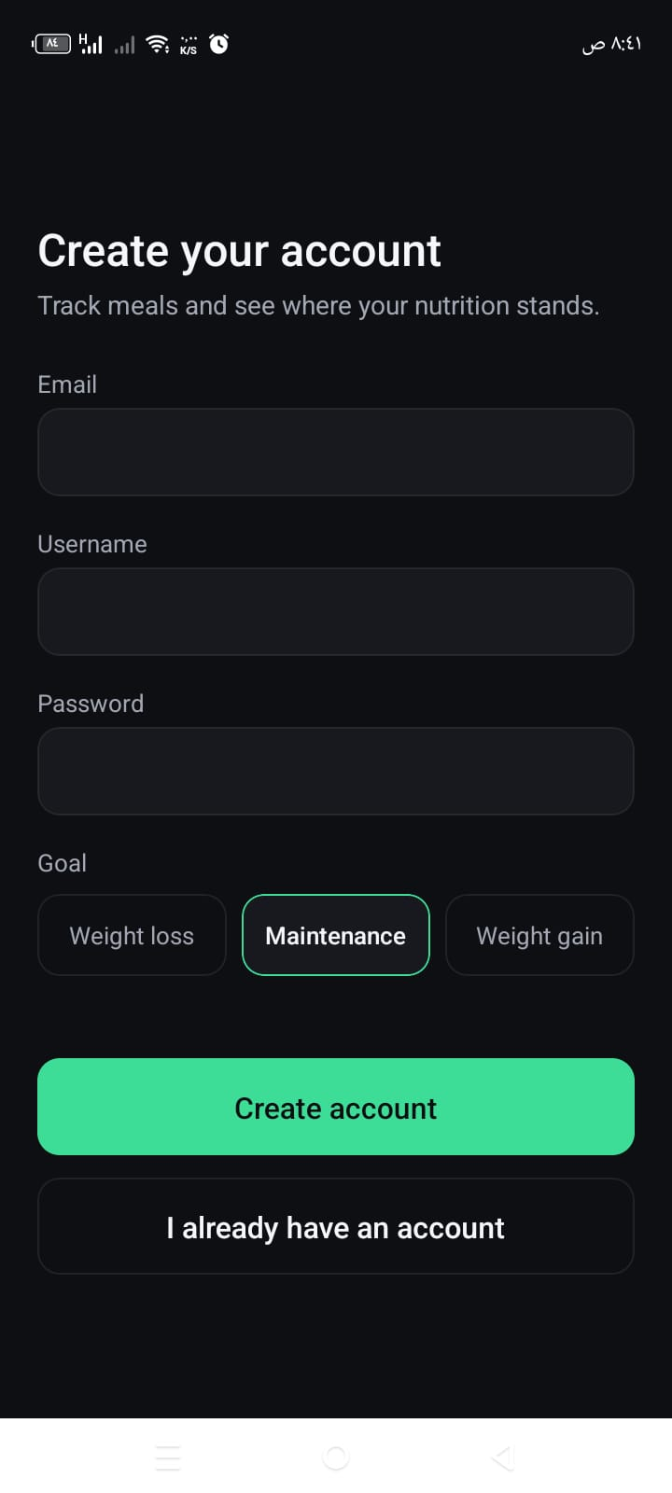
APP WALKTHROUGH
Get started in seconds
Login
Create account with a health goal
18

Slide 20

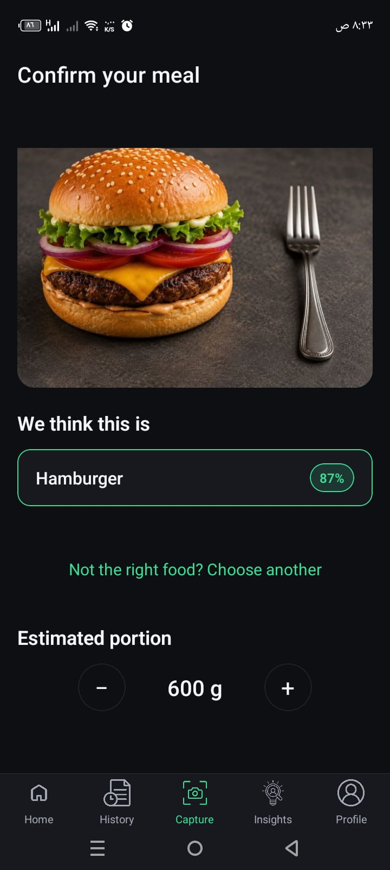
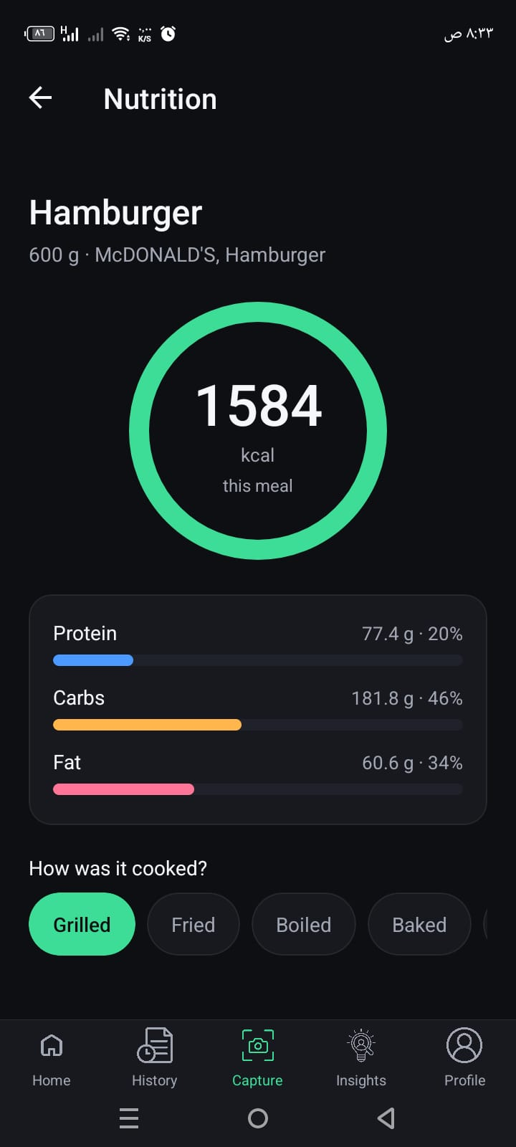
APP WALKTHROUGH
Photo in, nutrition out
The entire recognition-to-nutrition journey in three taps.
→
→
1. Capture
2. Confirm & adjust portion
3. Review & log
19

Slide 21
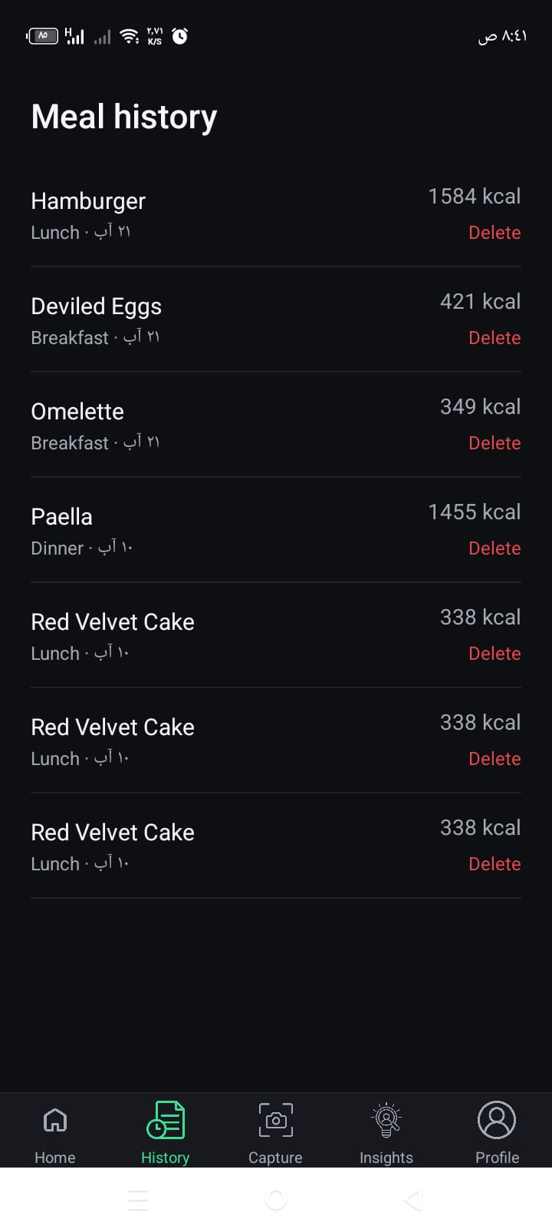
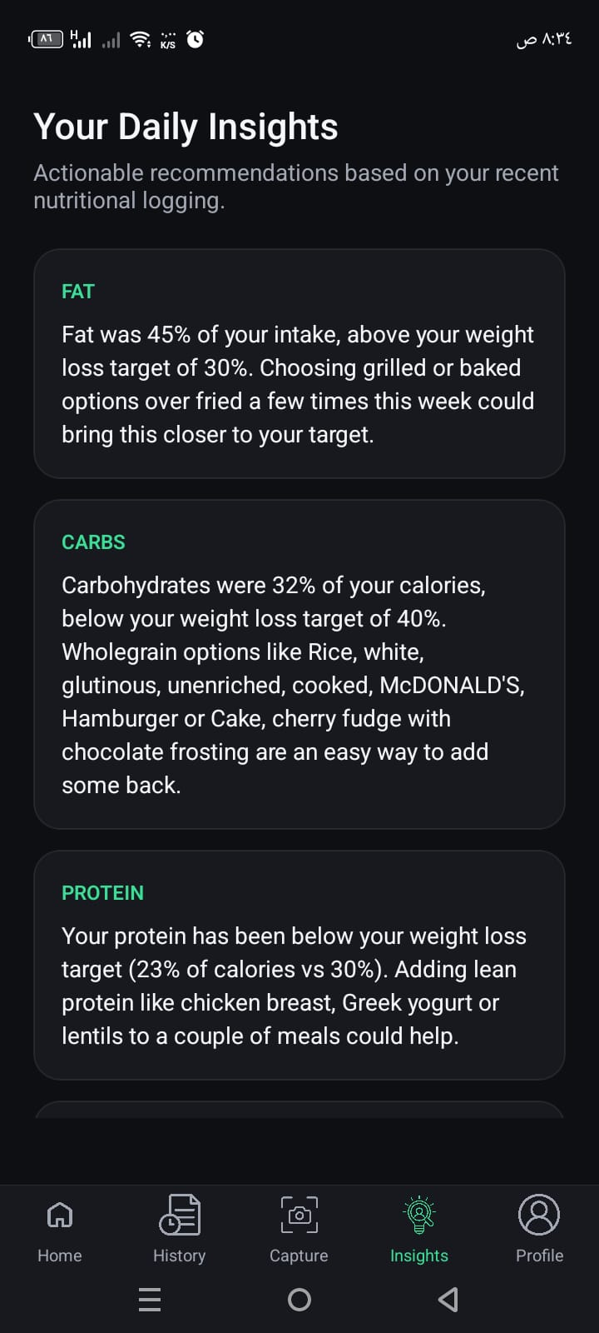
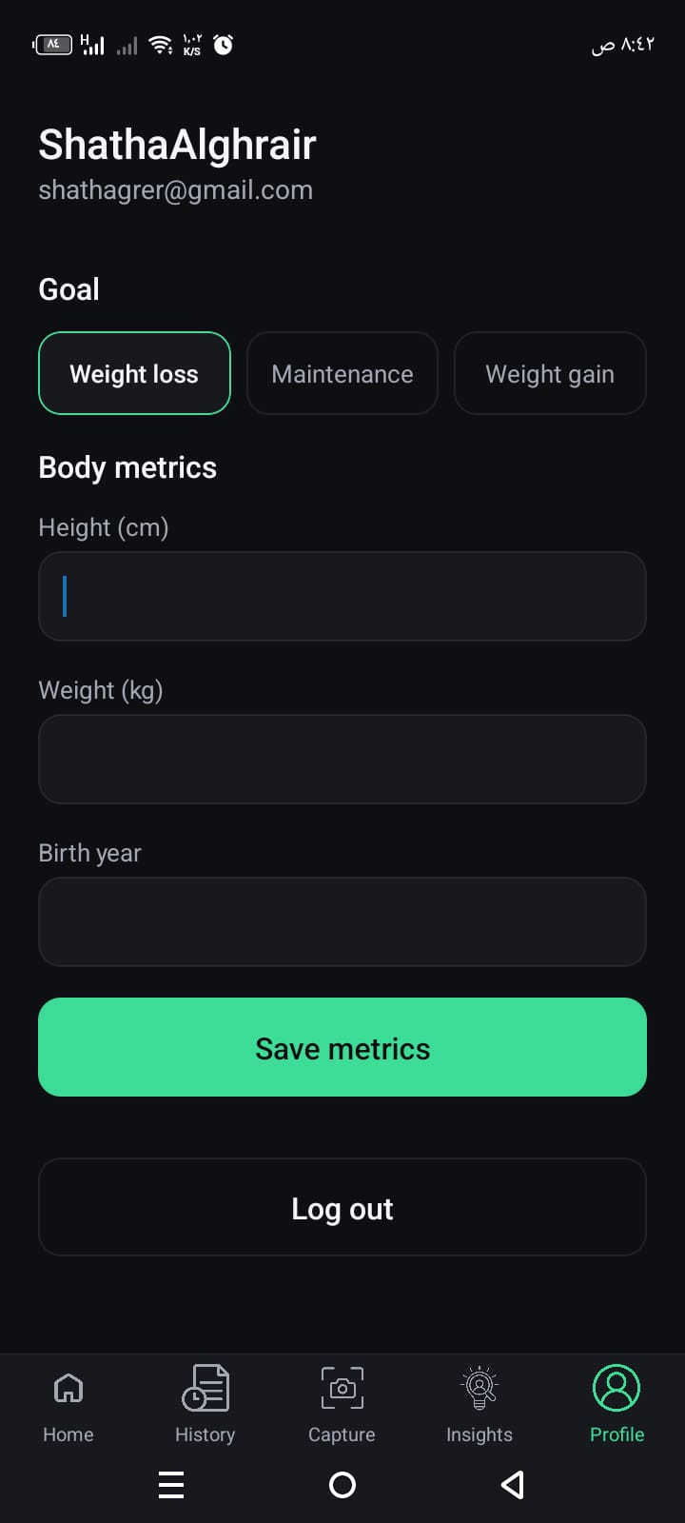
APP WALKTHROUGH
Track history, get personalised insights
Meal History
Daily Insights
Profile & Goals
20

Slide 22
TESTING & VALIDATION
Tested at four levels, not just claimed
483
15
16%
13 / 14
Automated backend tests
Manual end-to-end test cases
Portion error (MAPE)
Functional requirements verified
20 pytest modules, against a real database
incl. the 60% boundary and a non-food refusal
vs kitchen-scale weights; 20–40% is typical in the literature
the 14th — account deletion — is documented future work
What the numbers actually rest on:
Tests run through the real FastAPI request cycle against a real database, so routing, validation, auth and the ORM all have to agree. Meal-logging tests assert that a client cannot submit its own calorie values. The ML components sit behind injected protocols, so the portion geometry is pinned exactly with synthetic masks at known scale — no weights loaded. One photo landed at exactly 60% confidence and correctly showed the direct result; a laptop photo scoring 0.46 on “apple pie” was refused outright by the food gate.
21

Slide 23


HONEST ASSESSMENT
What's left to do
Limitations
Future Work
Portion validated on a small, developer-collected sample (16% MAPE) — not an independent one
1
Extend portion validation to a larger, independently-collected weighed sample
Single-dish recognition only — no composite/mixed-plate support
2
Multi-dish recognition via segmentation or multi-label classification
Closed 101-class set — no Arabic/regional cuisine, and a dish with no class is confidently mislabelled
3
Fine-tune on a regional Arabic / Levantine dataset
CPU inference — several seconds per request without a GPU; reference-object scaling ships opt-in
4
Complete the account-deletion endpoint (FR14)
Account deletion (FR14) not yet implemented
5
Open-set LLM fallback for foods Food-101 cannot name (designed, not built)
22

Slide 24
N
Thank you
NutriLens turns a photo into a verified, personalised nutrition record — built, tested, and running end-to-end.
Mohannad Alhemsi & Shatha Alghrair
Middle East University · Faculty of Information Technology
Questions?

