Slide 1
Solar trek
Bmos

Slide 2
challenge
Creating an Orrery web app
The selected challenge is to create an interactive orrery web application that visualizes celestial
bodies, including planets, Near-Earth Asteroids (NEAs), Near-Earth Comets (NECs), and
Potentially Hazardous Asteroids (PHAs). Traditional mechanical orreries are unable to interactively display the orbits and movements of these objects.
Given the increasing importance of space exploration, our solution aims to address this gap by
building a dynamic, interactive, and educational platform

Slide 3

Orrery web space websites are lack in the open resources in the world. So, our team decided to come out with spreading knowledge of web spaces to encourage the student to learn more about the space
Problem

Slide 4
Research
Inspiration of Project came from NASA Eyes on Earth and solar system that we made our project to treat the lack of dynamic orrery Websites .
We do researches about whole solar system then specified planets Mercury till Pluto so Asteroids so Comets.
We’ve got information for the solar system that our idea requires.

Slide 5
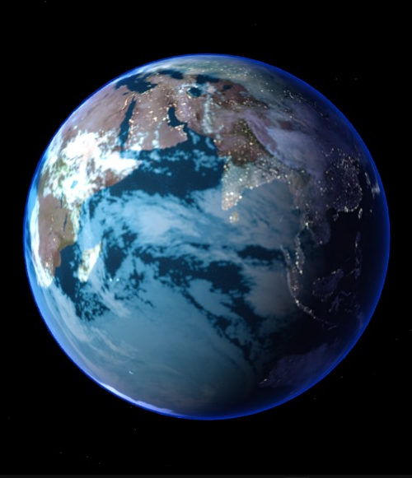
Preview of texture of the specified planet
Planetary View

Slide 6

solution
Our proposed solution is an interactive 3D web app built using Three.js and WebGL. We will
create an imbedded game that demonstrates that with the web app with solar system. This app
will allow users to view the solar system and its objects from multiple perspectives, fast forward
or rewind through time, and see orbital paths based on real data. The platform will feature user-
friendly controls, labels for celestial objects. By making NASA’s data visually accessible, our
solution meets the challenge of creating an educational, interactive orrery that can be used for

Slide 7
THANK YOU
  Our Team
Sara Mohammed
Yehia Ahmed
Mohanned Mohammed
Mohanned Essam
OUR DEMO: solar_trek

