Slide 1


Slide 2
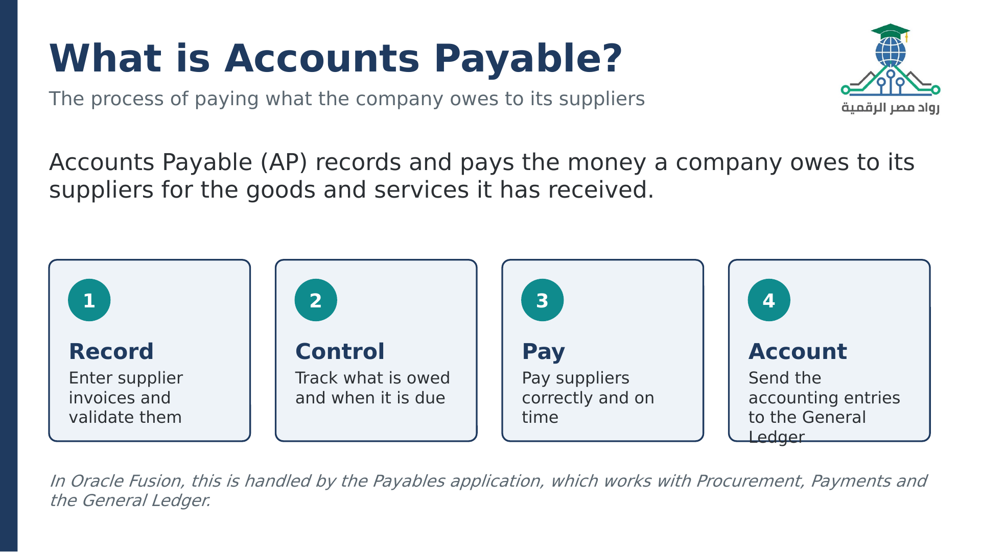

Slide 3
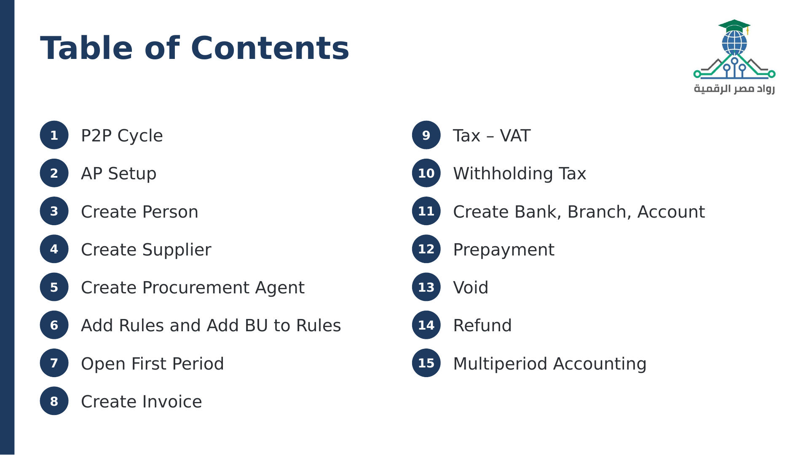

Slide 4
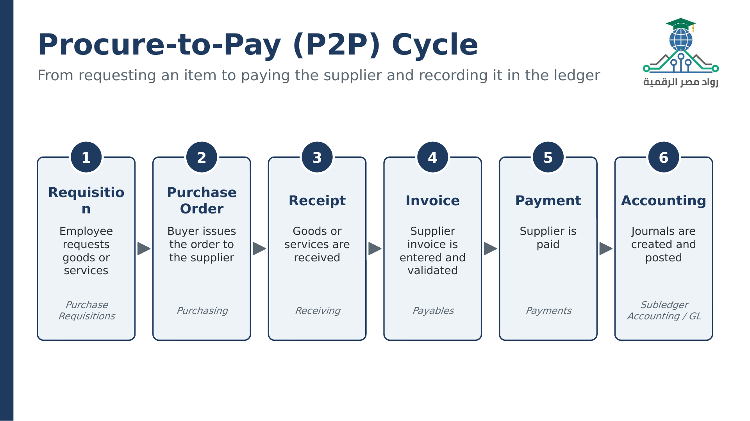

Slide 5
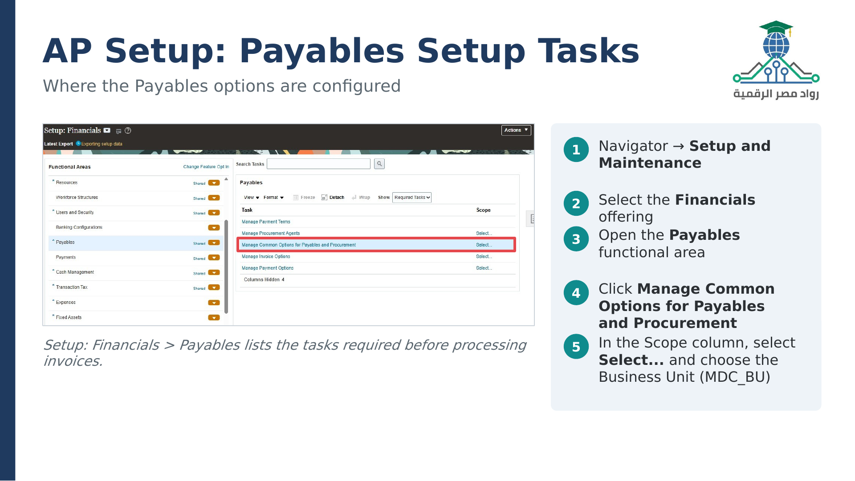

Slide 6
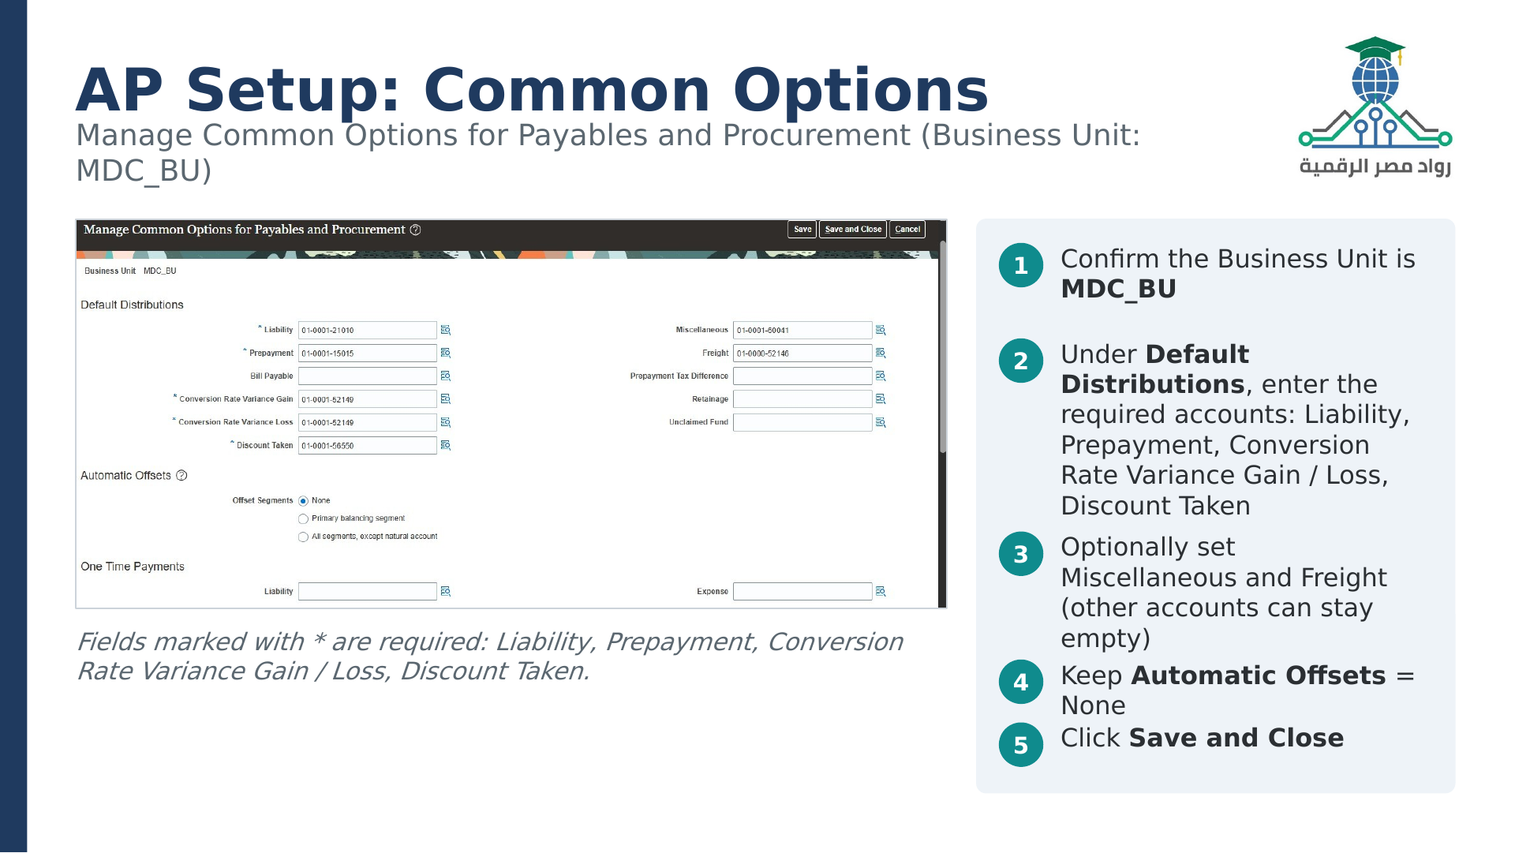

Slide 7
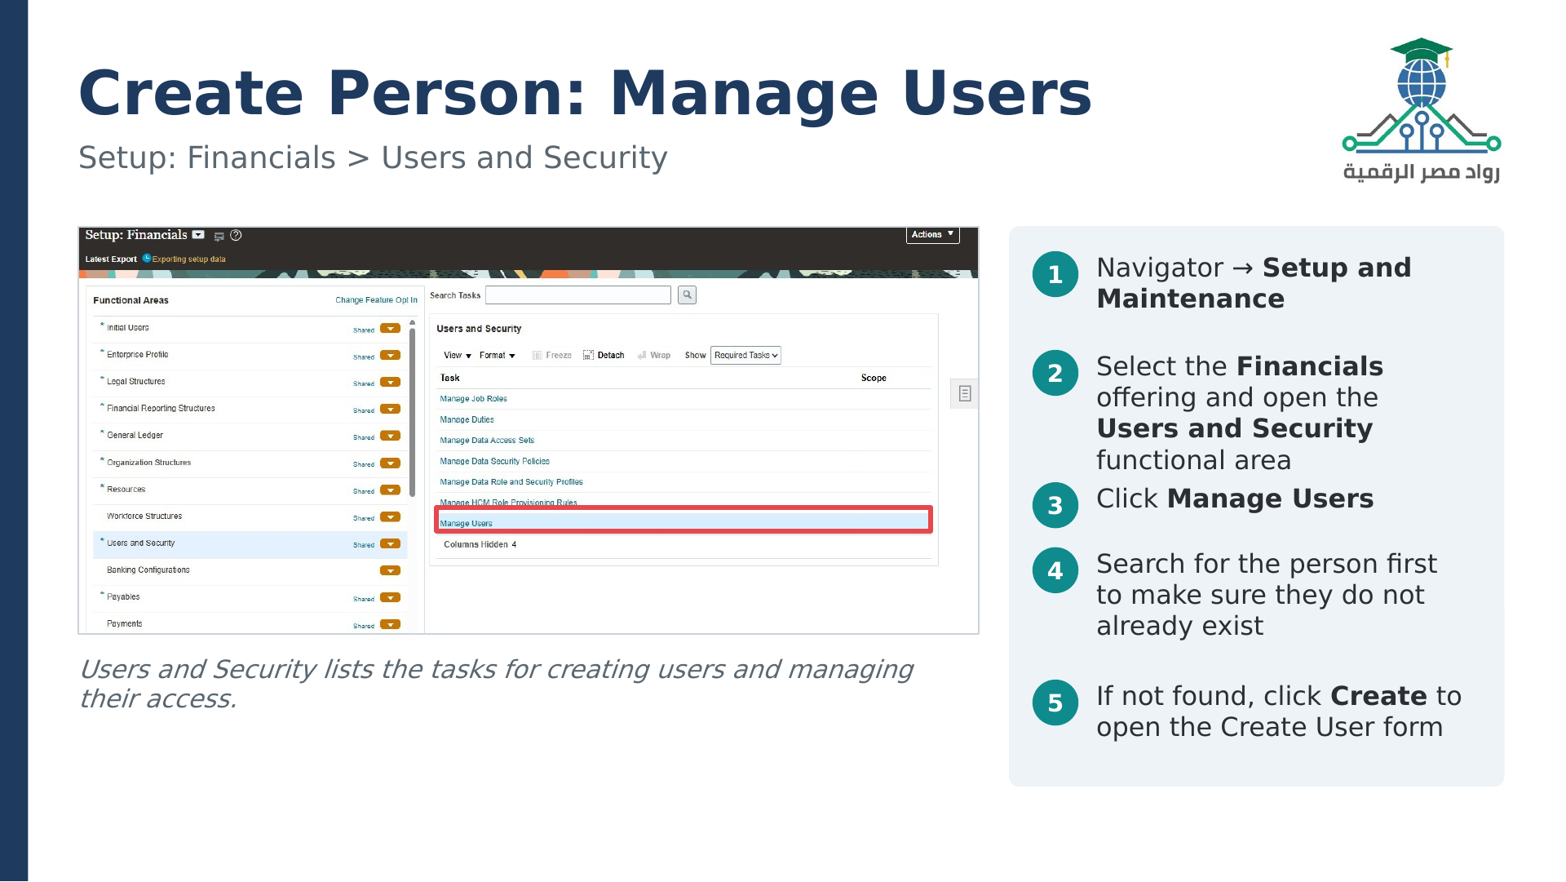

Slide 8
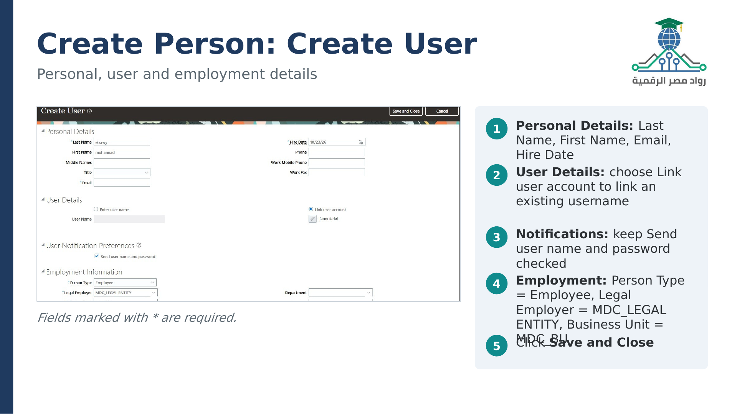

Slide 9
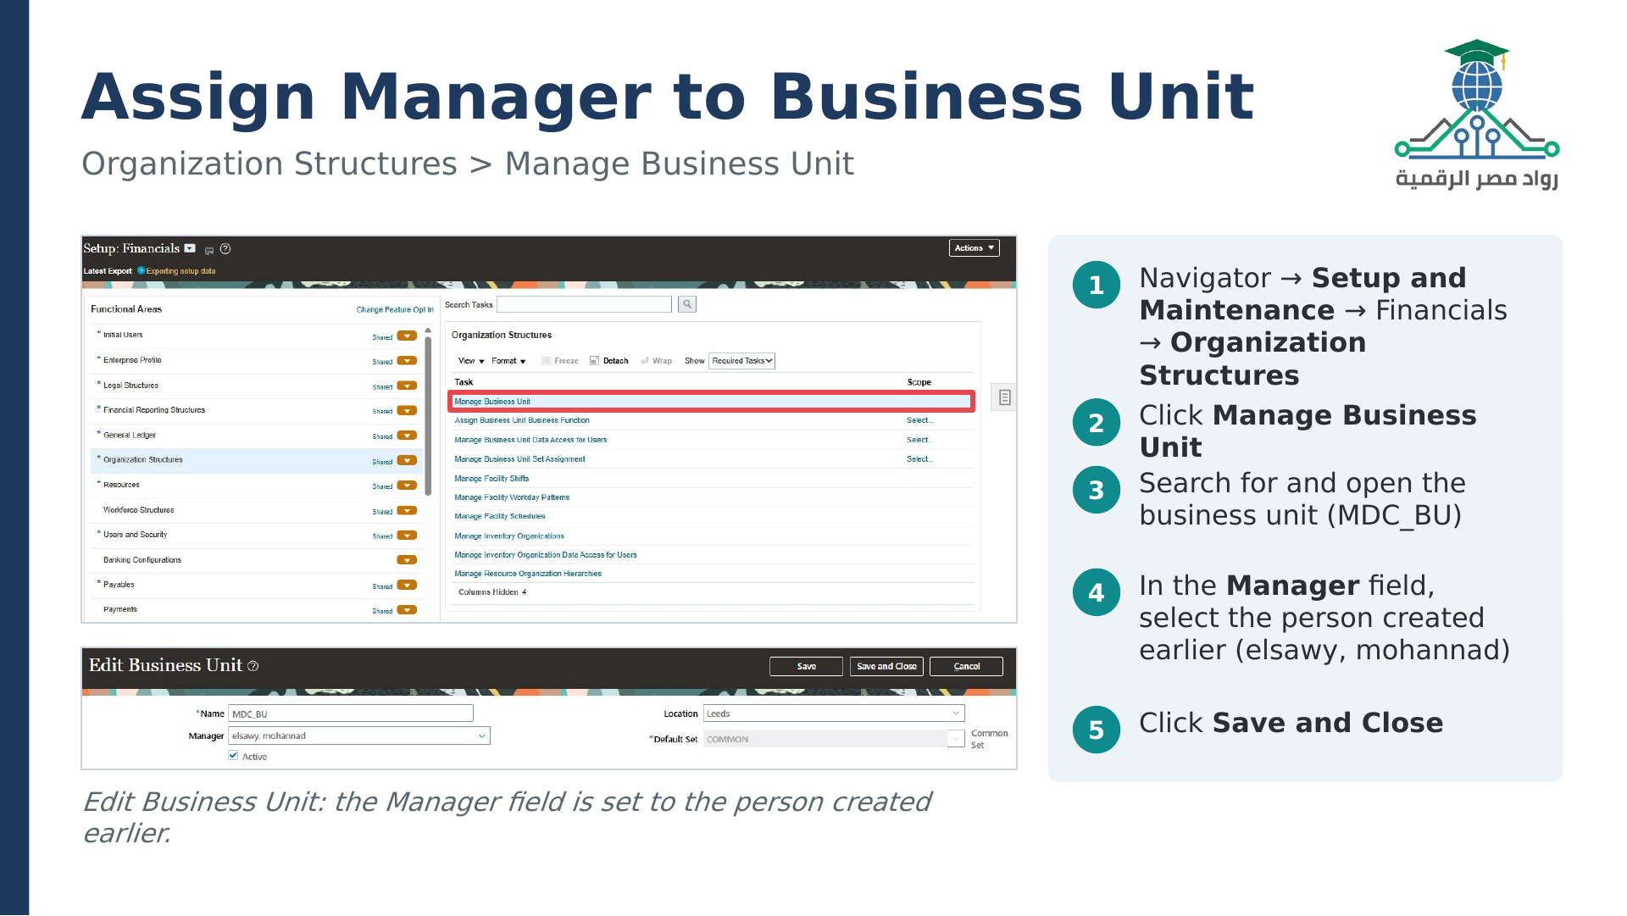

Slide 10
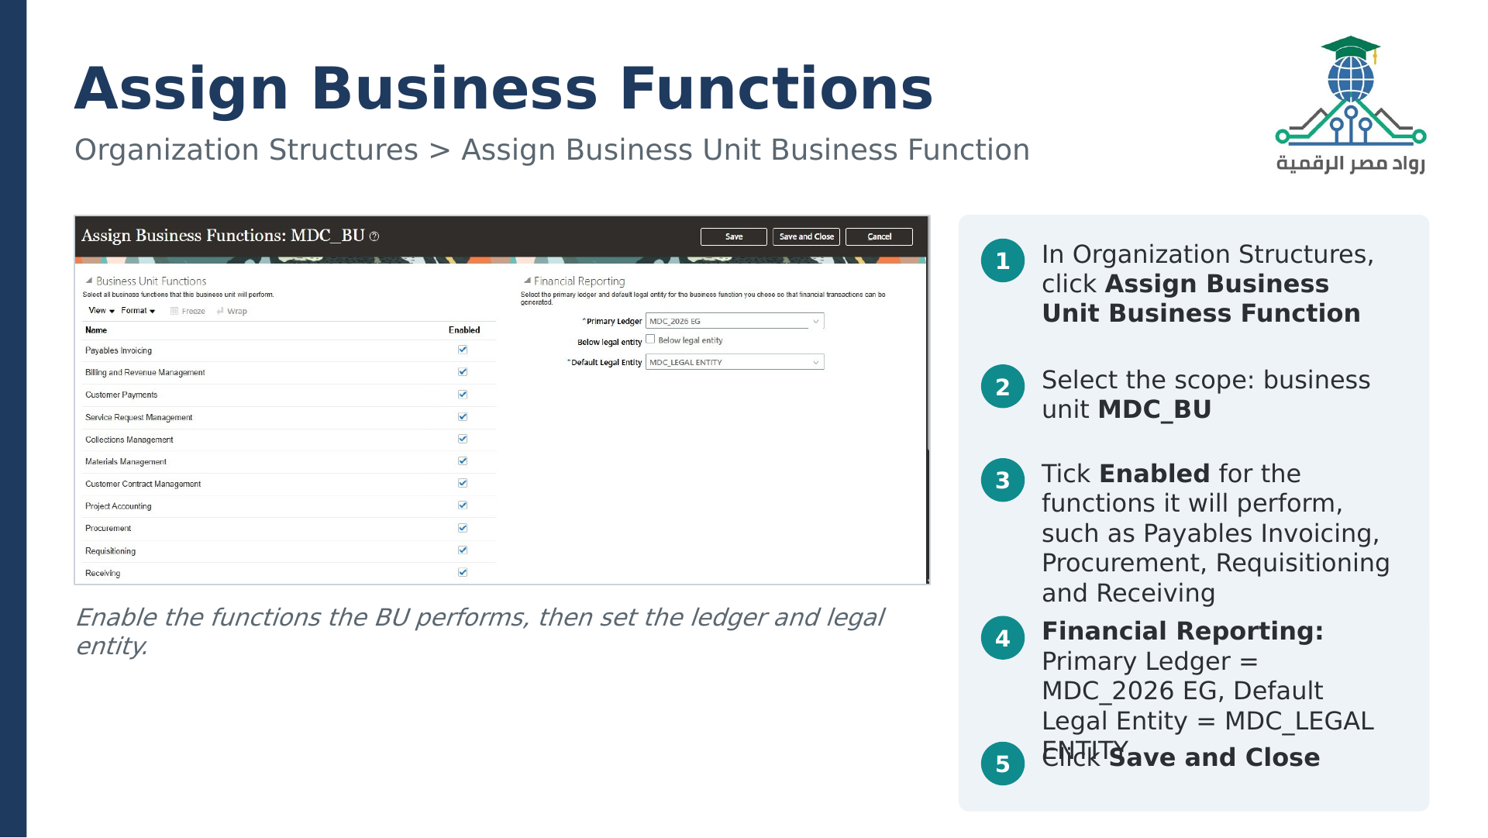

Slide 11
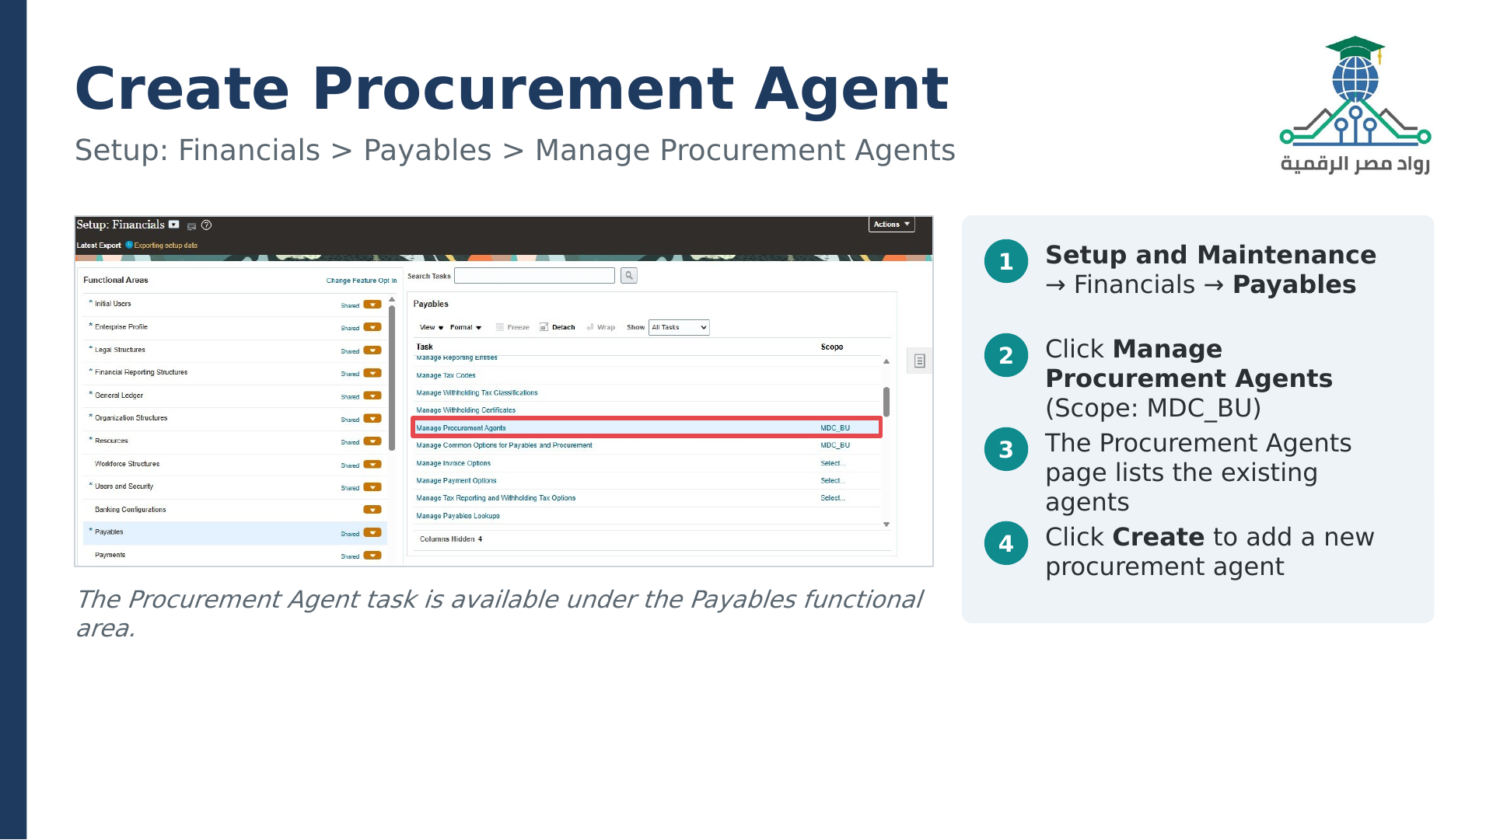

Slide 12
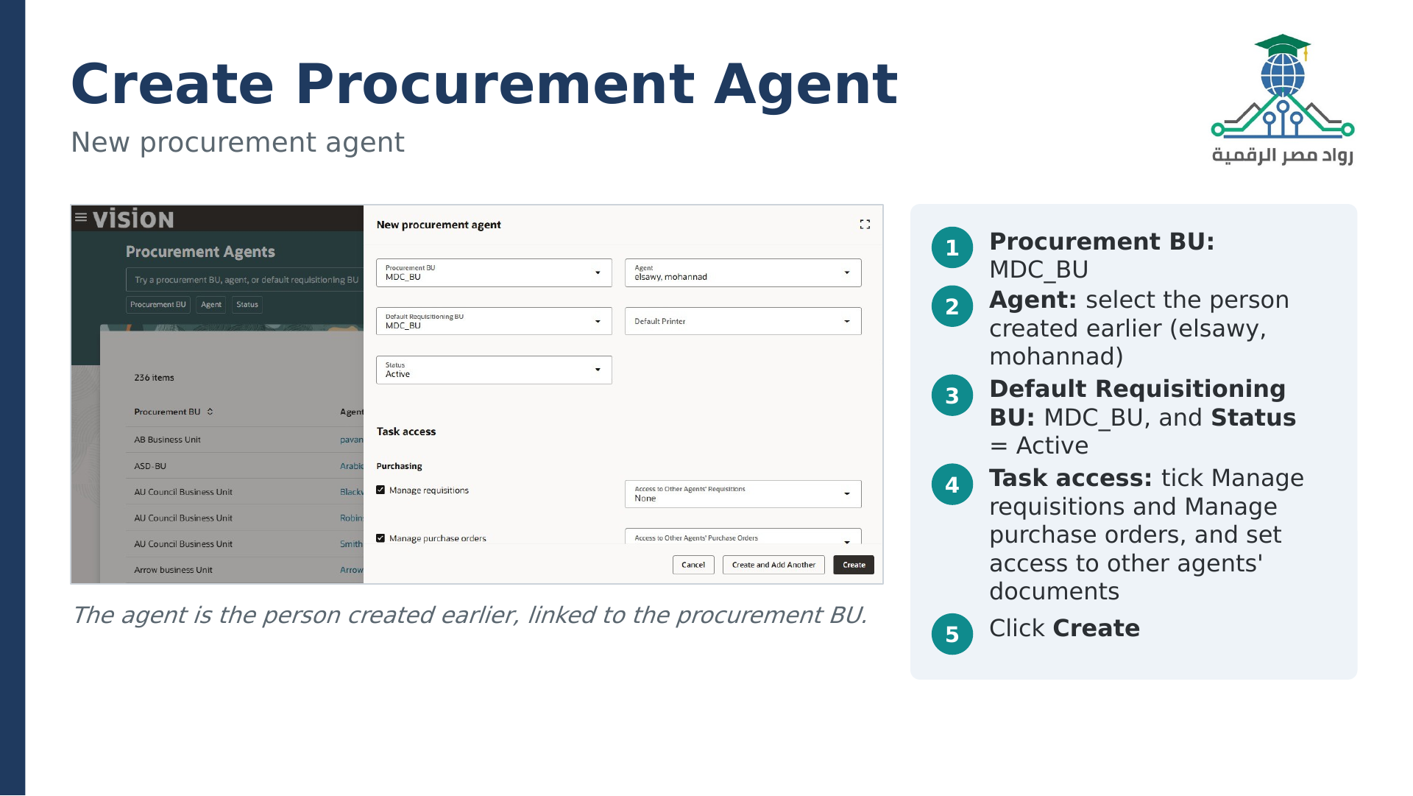

Slide 13
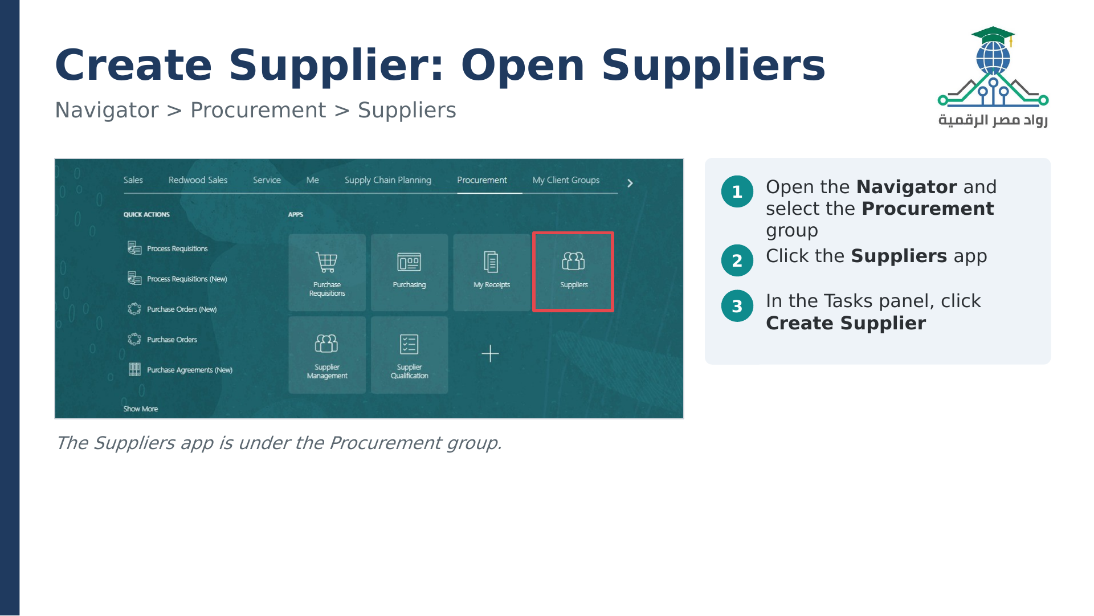

Slide 14
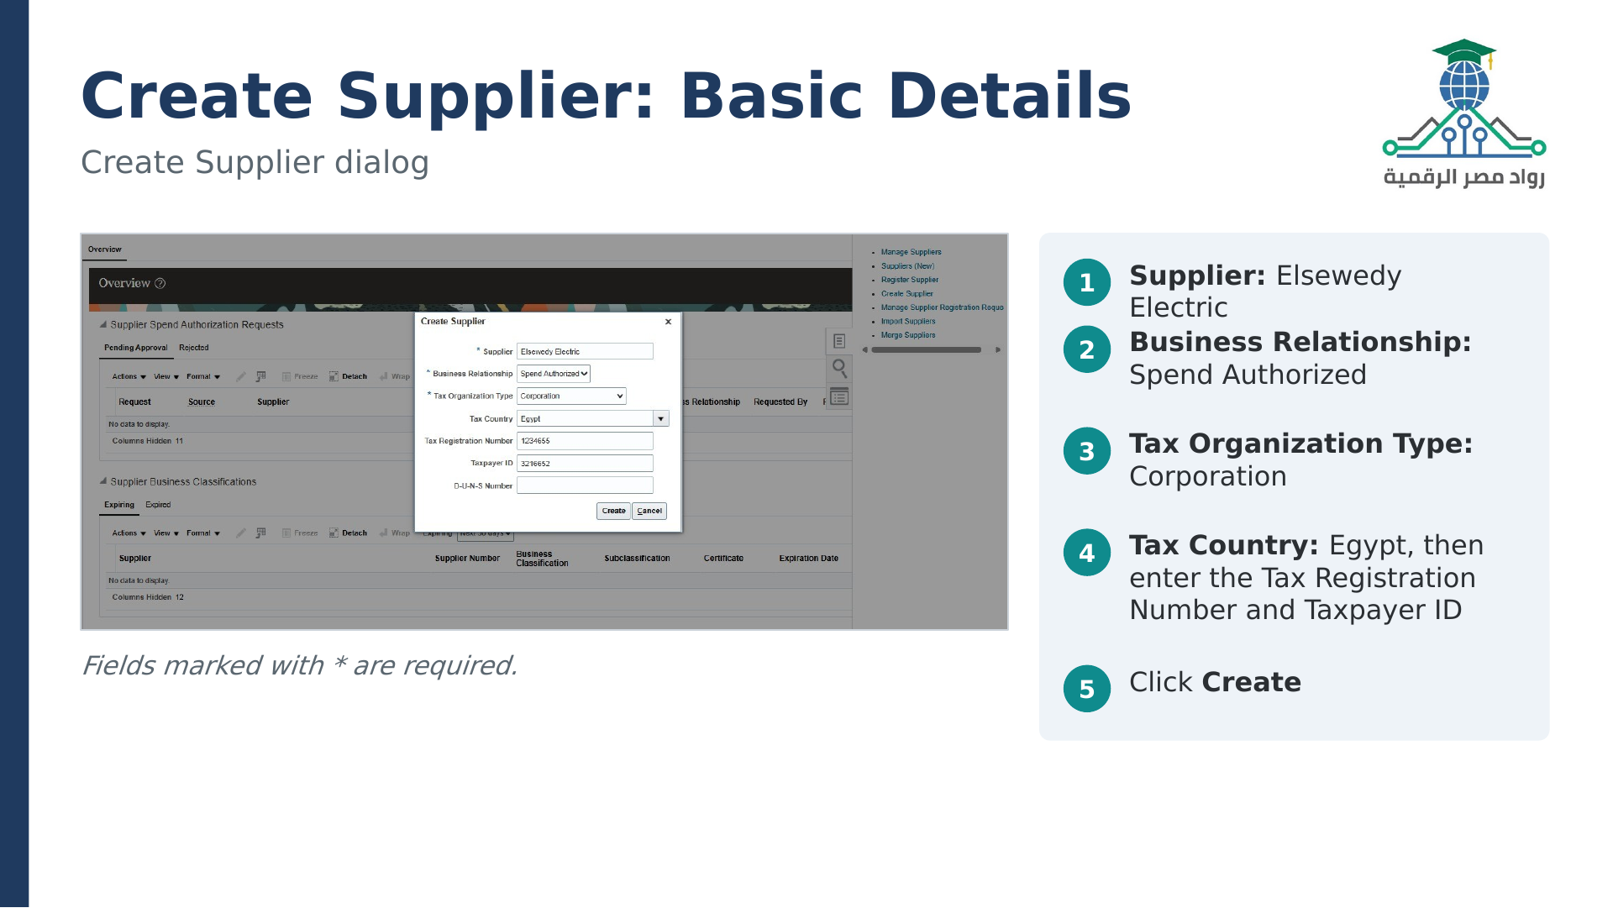

Slide 15
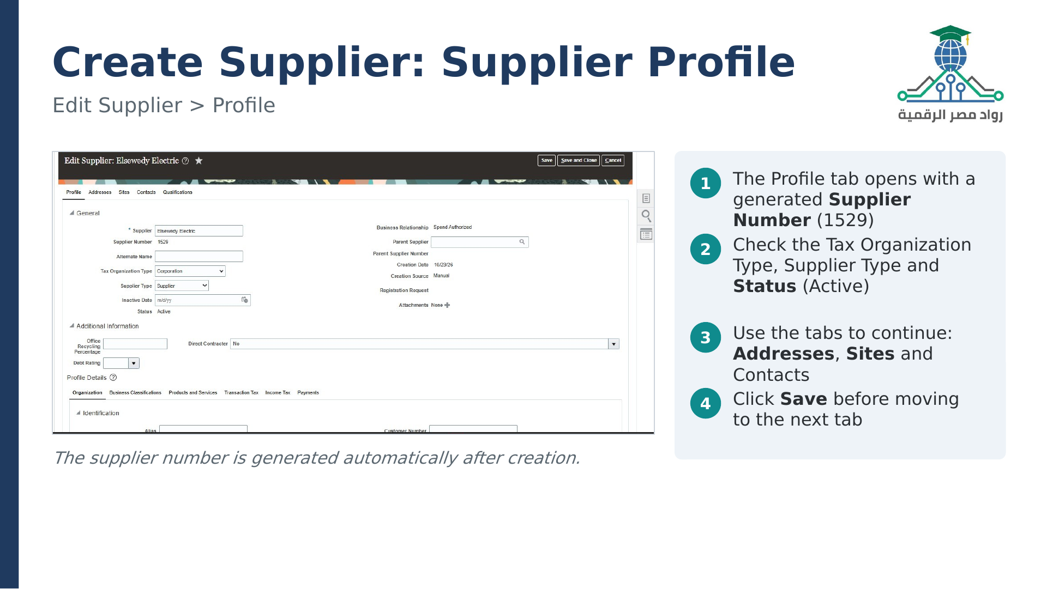

Slide 16
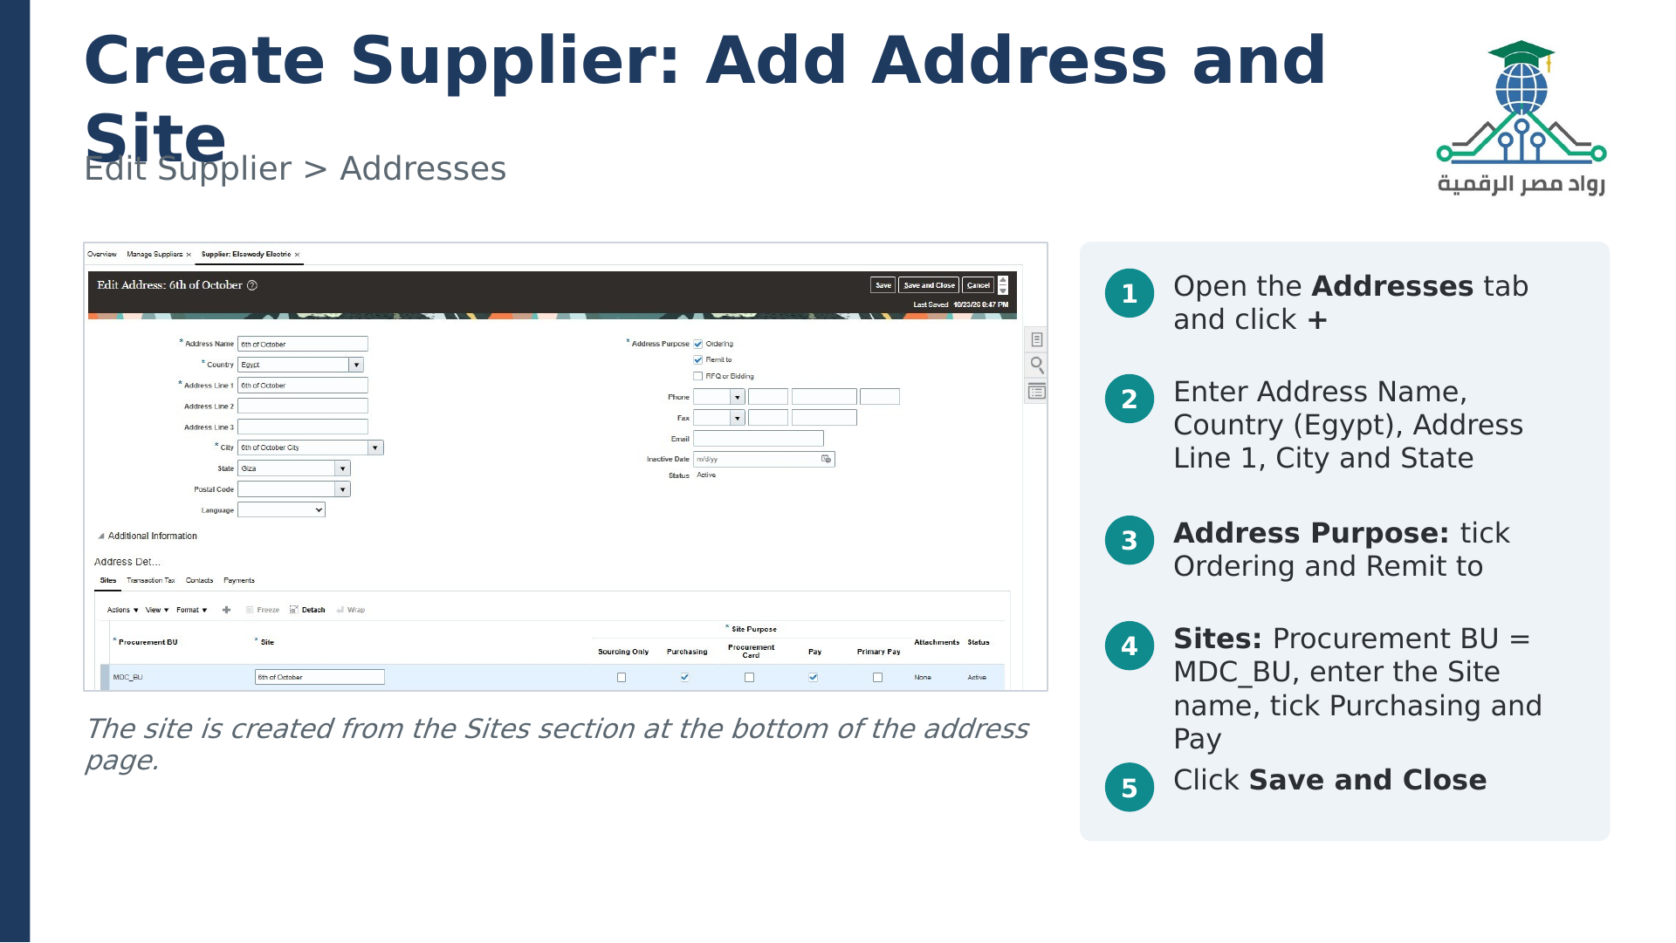

Slide 17
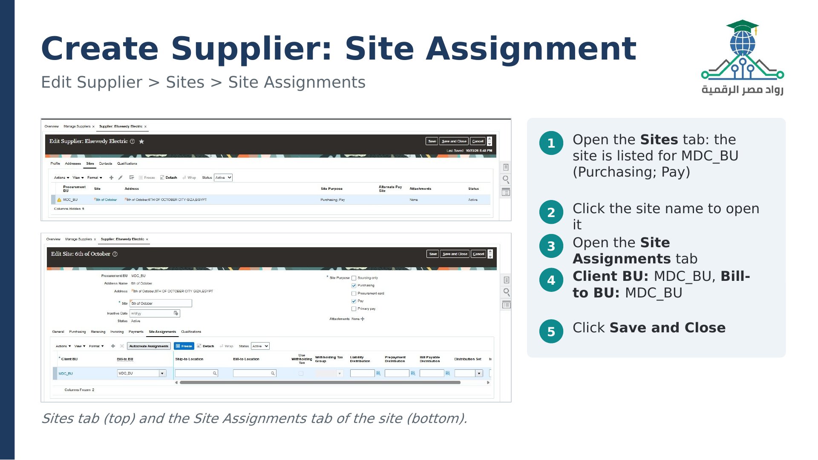

Slide 18

SECTION 02 / 04
AP Setup
ORACLE FUSION
Accounts Payable
Configure user access, business-unit permissions, accounting periods, and banking.
IN THIS SECTION
User roles • Data access • Accounting periods • Banks and accounts
NEXT Technology Development • Oracle Fusion Financials

Slide 19
SETUP · 01 / 06
User Roles
Navigator / Tools / Security Console / Users
USER ROLE SETUP PATH
KEY ACTIONS
1
Search for the user and
select Edit.
01
02
03
04
2
Add the required Accounts
Payable role.
Navigator
›
Tools
›
Security
Console
›
Users
3
Add role membership, then
select Done.
4
Select Save and Close.
ROLE EXAMPLE
Accounts Payable Manager
Example role: Accounts Payable Manager
Oracle Fusion AP · Setup
01 / 06

Slide 20
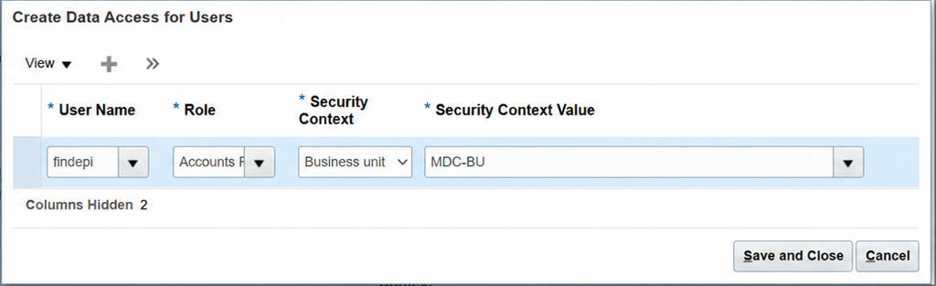
SETUP · 02 / 06
Data Access for Users
Setup and Maintenance / Manage Data Access for Users
KEY ACTIONS
1
Select the user and the
assigned AP role.
2
Set the Business Unit
context to MDC-BU.
3
Select Save and Close.
Access is scoped to Business Unit MDC-BU.
Oracle Fusion AP · Setup
02 / 06

Slide 21
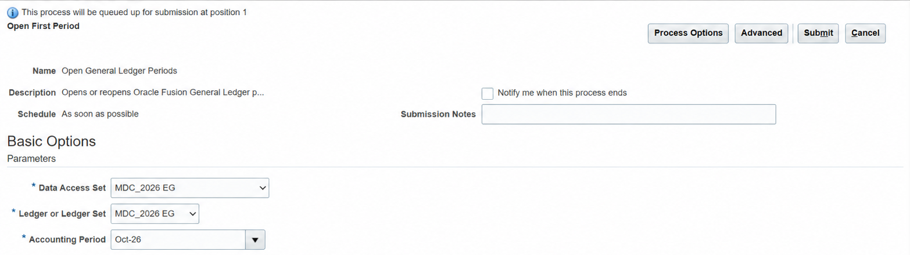
SETUP · 03 / 06
Open First Period
Setup and Maintenance / Open First Period
KEY ACTIONS
1
Select the data access set
and ledger MDC_2026 EG.
2
Choose the accounting
period Oct-26.
3
Select Submit and check the
process status.
Ledger: MDC_2026 EG • Period: Oct-26
Oracle Fusion AP · Setup
03 / 06

Slide 22
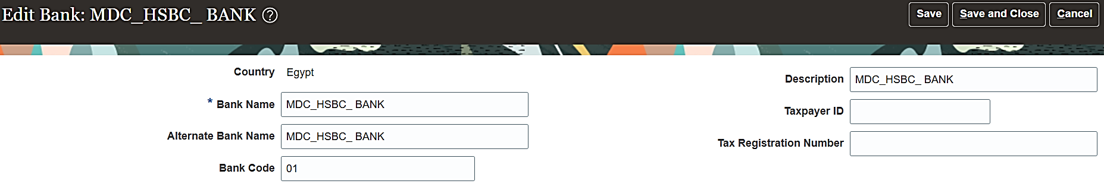
SETUP · 04 / 06
Bank Setup
Setup and Maintenance / Manage Banks
KEY ACTIONS
1
Set the country to Egypt
and enter bank
MDC_HSBC_BANK.
2
Enter and verify bank code
01.
3
Select Save and Close.
Bank code: 01
Oracle Fusion AP · Setup
04 / 06

Slide 23
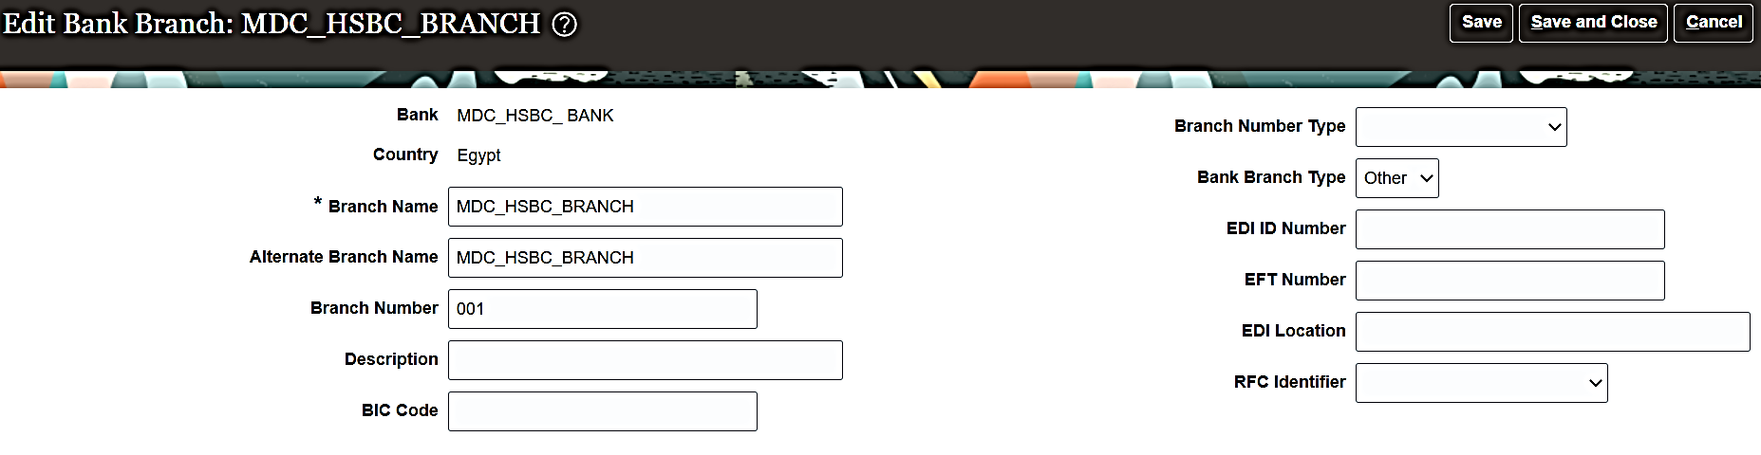
SETUP · 05 / 06
Bank Branch Setup
Setup and Maintenance / Manage Bank Branches
KEY ACTIONS
1
Select bank
MDC_HSBC_BANK and
branch MDC_HSBC_BRANCH.
2
Enter branch number 001
and type Other.
3
Select Save and Close.
Branch: MDC_HSBC_BRANCH • Number: 001
Oracle Fusion AP · Setup
05 / 06

Slide 24
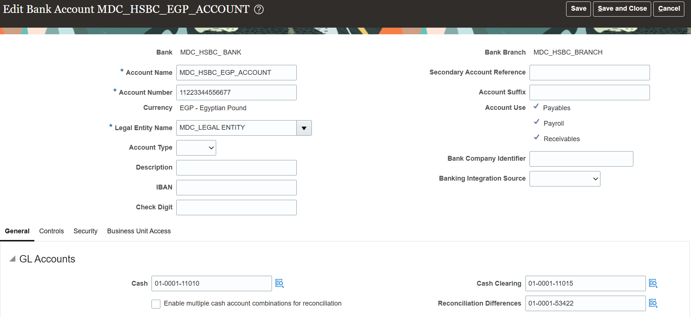
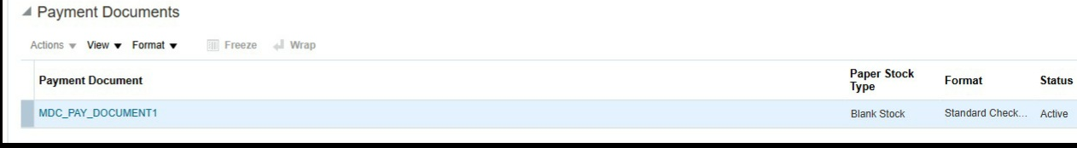
SETUP · 06 / 06
Bank Account Setup
Setup and Maintenance / Manage Bank Accounts / Create
KEY ACTIONS
1
Enter account
MDC_HSBC_EGP_ACCOUNT,
number 11223344556677,
currency EGP, and owner
MDC_LEGALENTITY.
2
Enable Payables; Payroll
and Receivables are also
selected.
3
Set Cash 01-0001-11010,
Cash Clearing
01-0001-11015, and
Differences 01-0001-53422.
4
Add MDC-BU to Business
Unit Access, then save and
close.
Account: MDC_HSBC_EGP_ACCOUNT • Currency: EGP
Oracle Fusion AP · Setup
06 / 06

Slide 25
SECTION 03 / 04
Tax & Withholding
ORACLE FUSION
Accounts Payable
Configure VAT and withholding tax, review invoice tax, and confirm accounting.
IN THIS SECTION
VAT setup • Invoice tax • Withholding rates • Ledger posting and payment
NEXT Technology Development • Oracle Fusion Financials

Slide 26
TAX · OVERVIEW
VAT & Withholding Tax
A practical guide to tax setup, invoice review, payment, and ledger posting.
VAT WORKFLOW
WITHHOLDING TAX
PROCESS OVERVIEW
1
Configure VAT rules,
confirm the jurisdiction and
tax rates, then review VAT
on invoices and ledger
entries.
01
02
Configure VAT
Configure withholding
Tax definition
Rule defaults
Invoice review
Ledger posting
Payment
2
Set the withholding tax
authority and rate, validate
the withheld amount, and
pay the supplier net
amount.
Register authority
Set tax rate
Review invoice
Post liability
Pay net amount
Business Unit: MDC-BU • Primary Ledger: MDC_2026 EG
Oracle Fusion AP · Tax
OVERVIEW

Slide 27
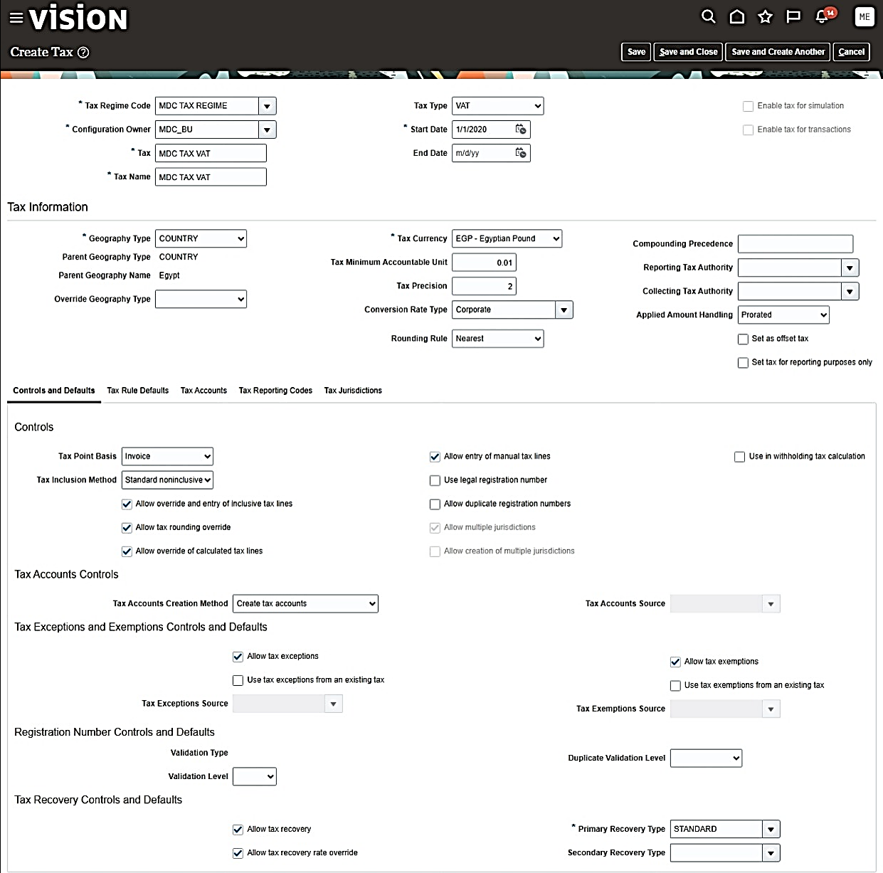
VAT · 01 / 05
Create VAT Tax
Create a VAT tax definition
KEY ACTIONS
1
Create a new VAT tax.
2
Assign it to MDC TAX
REGIME.
3
Set the currency to EGP.
4
Confirm the owner is
MDC_BU.
Configuration owner: MDC_BU
Oracle Fusion AP · Tax
01 / 10

Slide 28
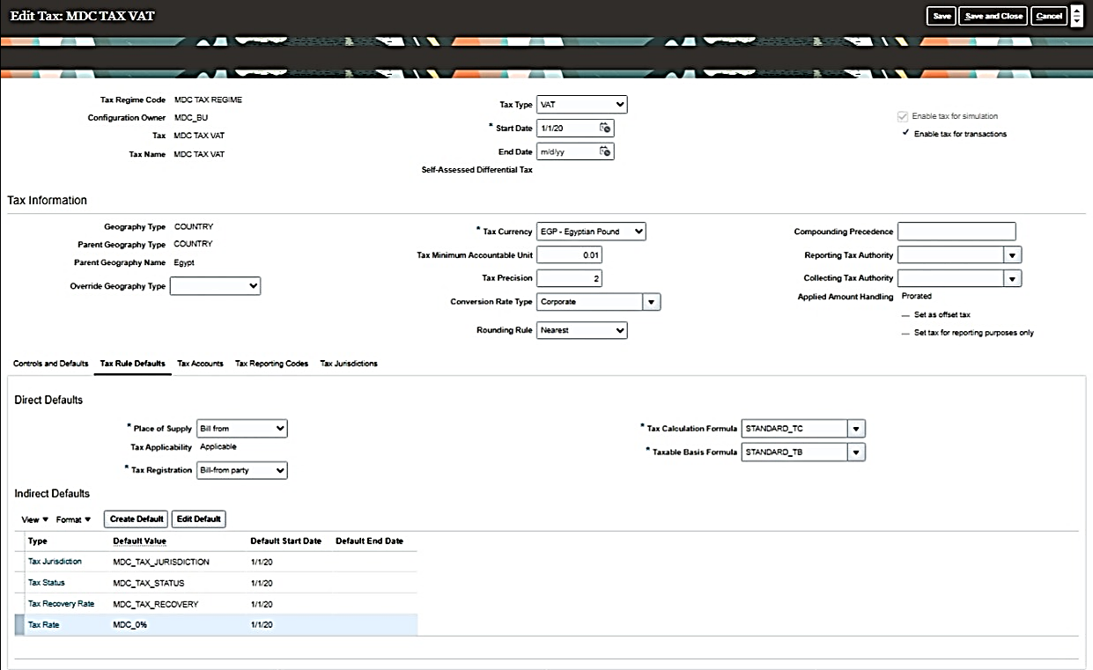
VAT · 02 / 05
VAT Tax Rule Defaults
Set the VAT tax rule defaults
KEY ACTIONS
1
Select the tax jurisdiction.
2
Set the tax status.
3
Choose the recovery and
tax rates.
Defaults: Jurisdiction · Status · Recovery Rate · Tax Rate
Oracle Fusion AP · Tax
02 / 10

Slide 29
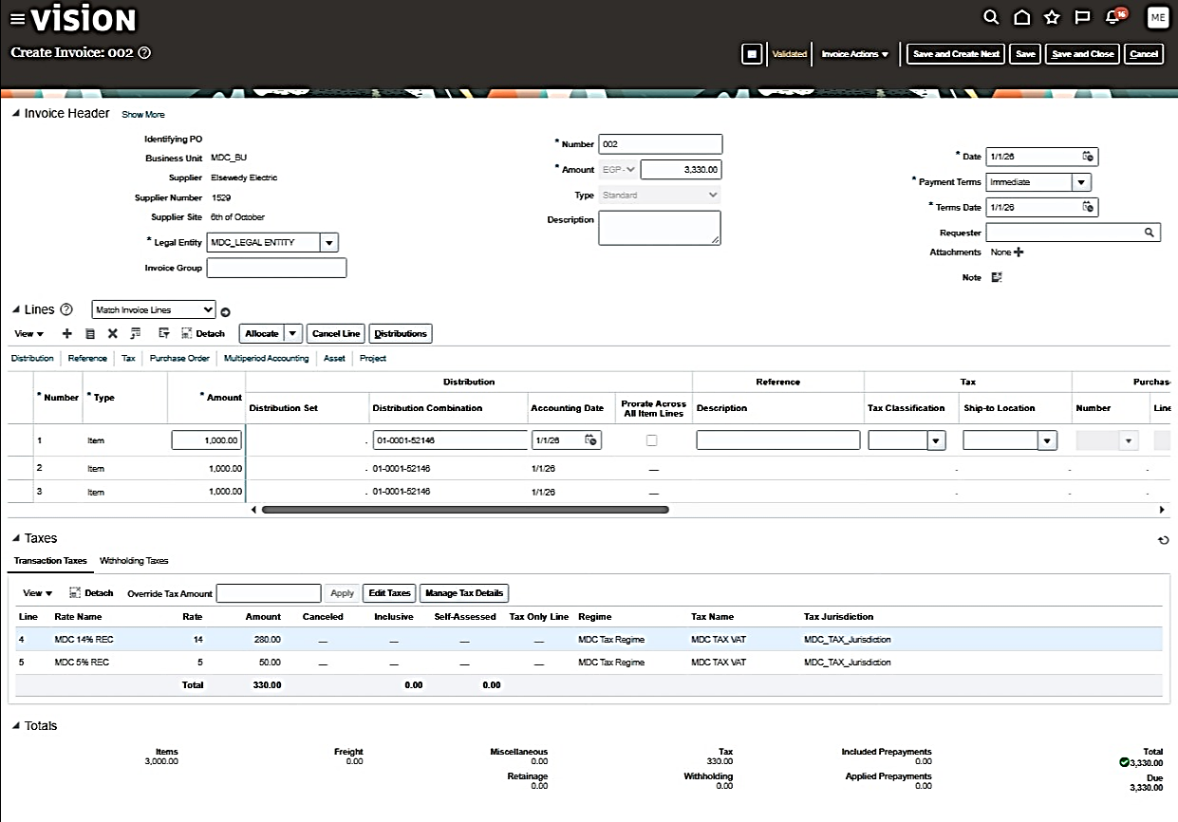
VAT · 03 / 05
Tax Invoice — VAT
Review the invoice VAT lines
KEY ACTIONS
1
Check VAT lines on invoice
002.
2
Confirm rates of 14% and
5%.
3
Verify total VAT of EGP 330.
Invoice 002: EGP 3,330 total • EGP 330 VAT
Oracle Fusion AP · Tax
03 / 10

Slide 30
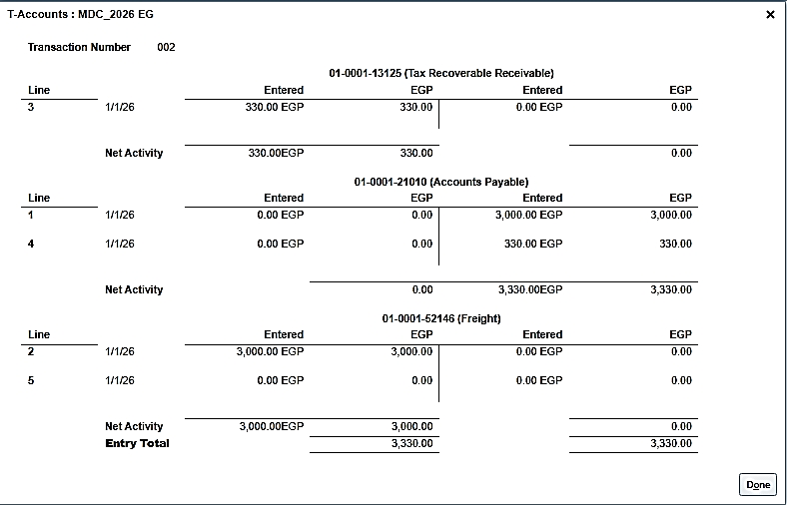
VAT · 04 / 05
VAT Posting to Ledger
Review the VAT ledger entry
KEY ACTIONS
1
Review the entry after
approval.
2
Record recoverable VAT of
EGP 330.
3
Charge EGP 3,000 to
expense.
4
Verify debits and credits.
Accounting lines: recoverable VAT EGP 330 • Expense EGP 3,000
Oracle Fusion AP · Tax
04 / 10

Slide 31
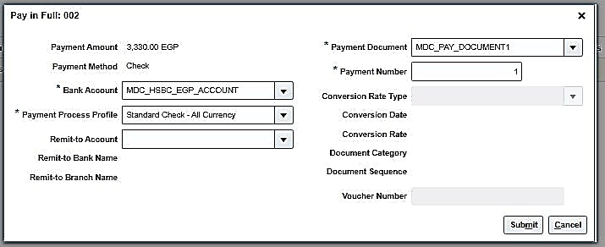
VAT · 05 / 05
Pay in Full — VAT Invoice
Pay the VAT invoice in full
KEY ACTIONS
1
Select invoice 002 for
payment.
2
Confirm the total is EGP
3,330.
3
Choose Check as the
payment method.
Bank account: MDC_HSBC_EGP_ACCOUNT
Oracle Fusion AP · Tax
05 / 10

Slide 32
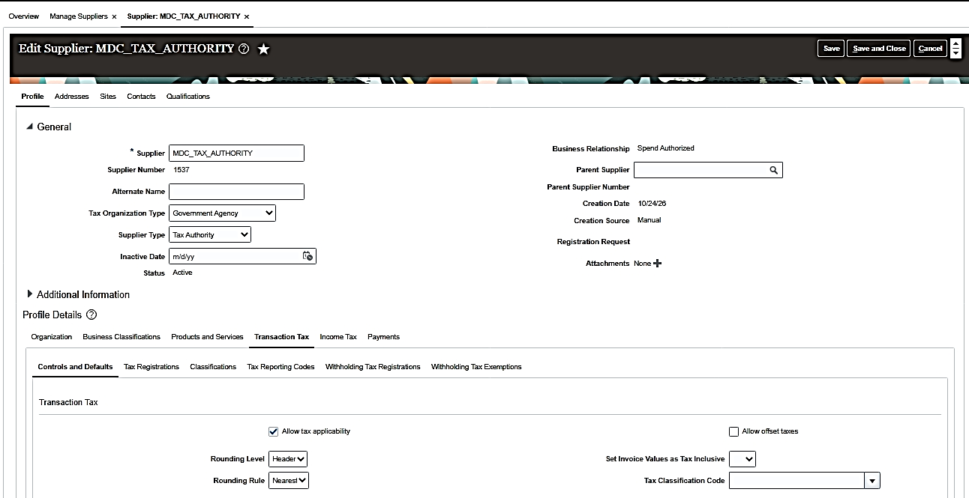
WITHHOLDING TAX · 01 / 05
Supplier Tax Authority
Add the tax authority as a supplier
KEY ACTIONS
1
Register the tax authority
as a supplier.
2
Set its supplier type to Tax
Authority.
3
Use supplier
MDC_TAX_AUTHORITY.
4
Verify supplier number
1537.
Supplier number: 1537
Oracle Fusion AP · Tax
06 / 10

Slide 33
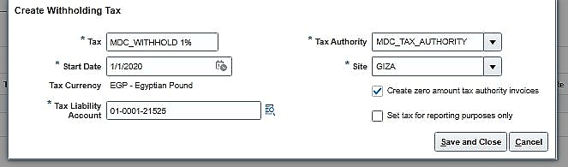
WITHHOLDING TAX · 02 / 05
Withholding Tax Rate
Configure the withholding rate
KEY ACTIONS
1
Create rate
MDC_WITHHOLD at 1%.
2
Link the rate to the
authority and site.
3
Assign the tax liability
account.
Tax liability account: 01-0001-21525
Oracle Fusion AP · Tax
07 / 10

Slide 34
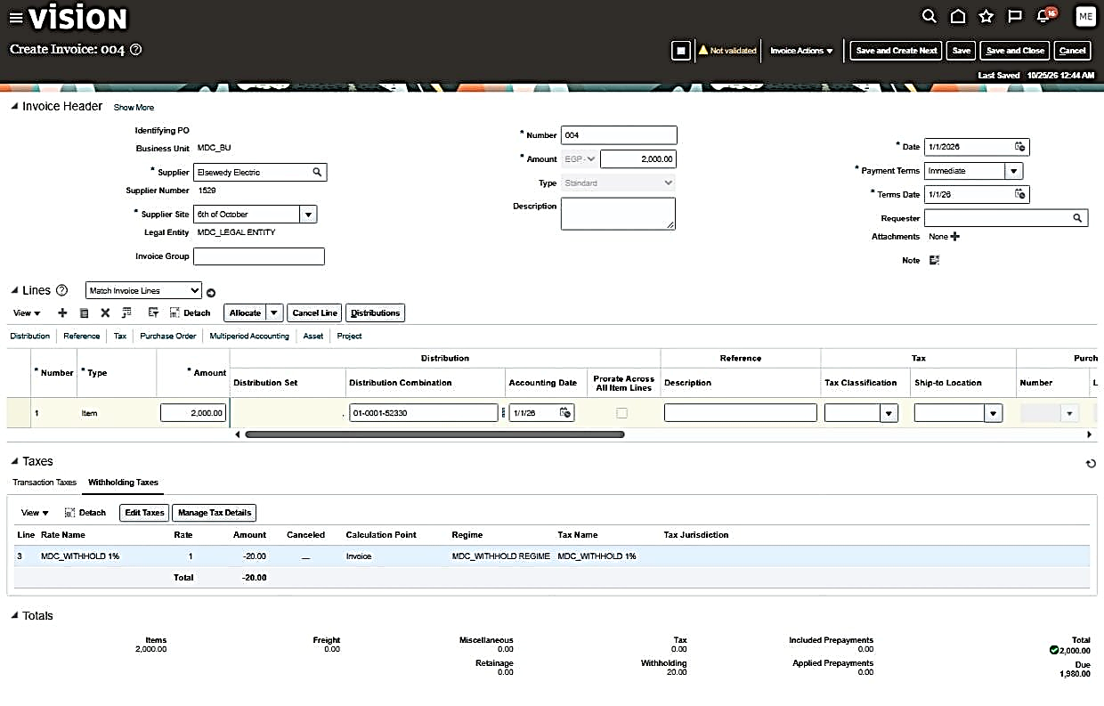
WITHHOLDING TAX · 03 / 05
Invoice with Withholding Tax
Review the withholding invoice
KEY ACTIONS
1
Review invoice 004 for EGP
2,000.
2
Apply withholding tax at
1%.
3
Confirm EGP 20 is withheld.
Net amount due: EGP 1,980
Oracle Fusion AP · Tax
08 / 10

Slide 35
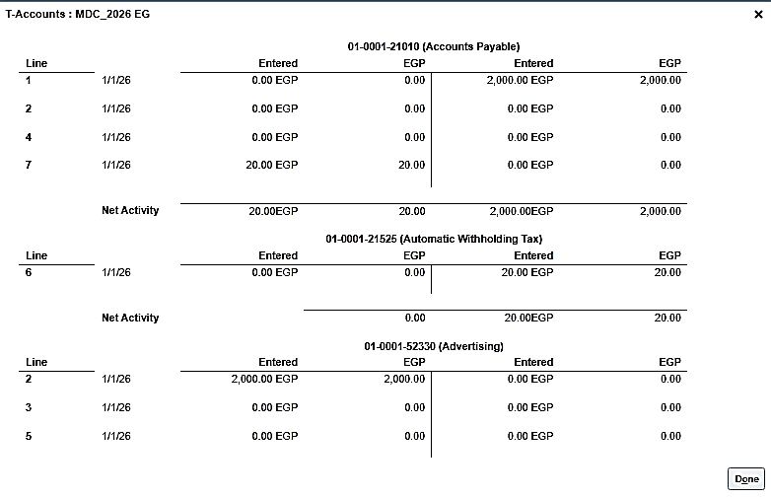
WITHHOLDING TAX · 04 / 05
Withholding Tax Posting
Post withholding tax to the ledger
KEY ACTIONS
1
Record EGP 20 as
withholding tax.
2
Post it to the tax liability
account.
3
Use account 01-0001-21525.
Posting account: 01-0001-21525
Oracle Fusion AP · Tax
09 / 10

Slide 36
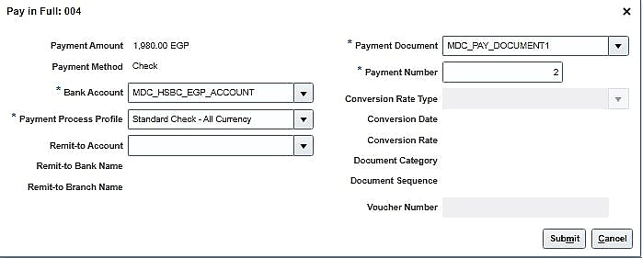
WITHHOLDING TAX · 05 / 05
Pay in Full — Withholding
Pay the net amount due
KEY ACTIONS
1
Deduct EGP 20 withholding
tax.
2
Pay the net amount of EGP
1,980.
3
Use the HSBC EGP bank
account.
Payment method: Check • MDC_HSBC_EGP_ACCOUNT
Oracle Fusion AP · Tax
10 / 10

Slide 37
SECTION 04 / 04
AP Workflows
ORACLE FUSION
Accounts Payable
Follow the Accounts Payable transaction sequence from prepayment through refunds, voids, and period recognition.
IN THIS SECTION
Prepayment • Refund • Void • Multi-Period Accounting
NEXT Technology Development • Oracle Fusion Financials

Slide 38
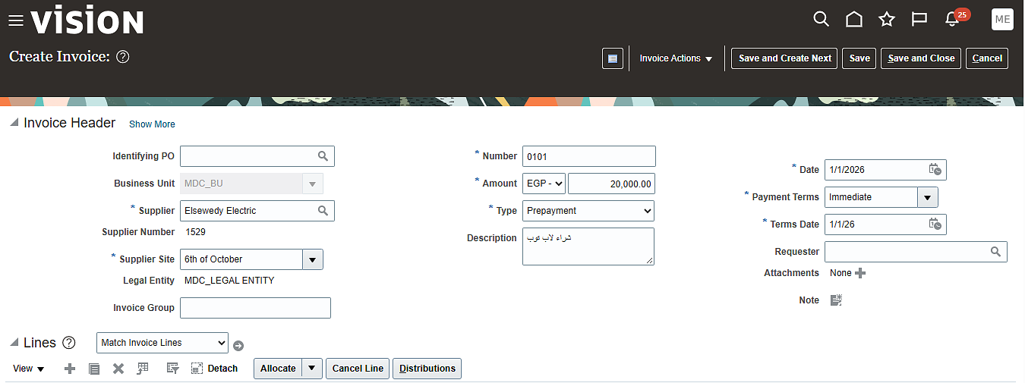
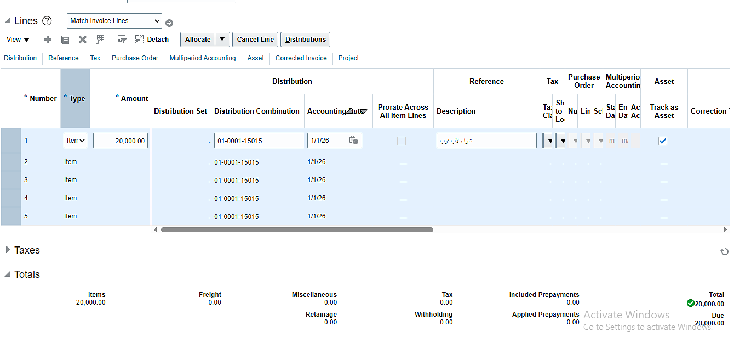
PREPAYMENT · 01 / 13
Create Prepayment Invoice
Oracle Fusion AP · Transaction workflow
KEY ACTIONS
1
Create invoice 0101 as a
prepayment.
2
Enter EGP 20,000 and
supplier details.
3
Review the distribution
lines before saving.
Invoice 0101 • Prepayment • EGP 20,000
Oracle Fusion AP · Workflows
01 / 13

Slide 39
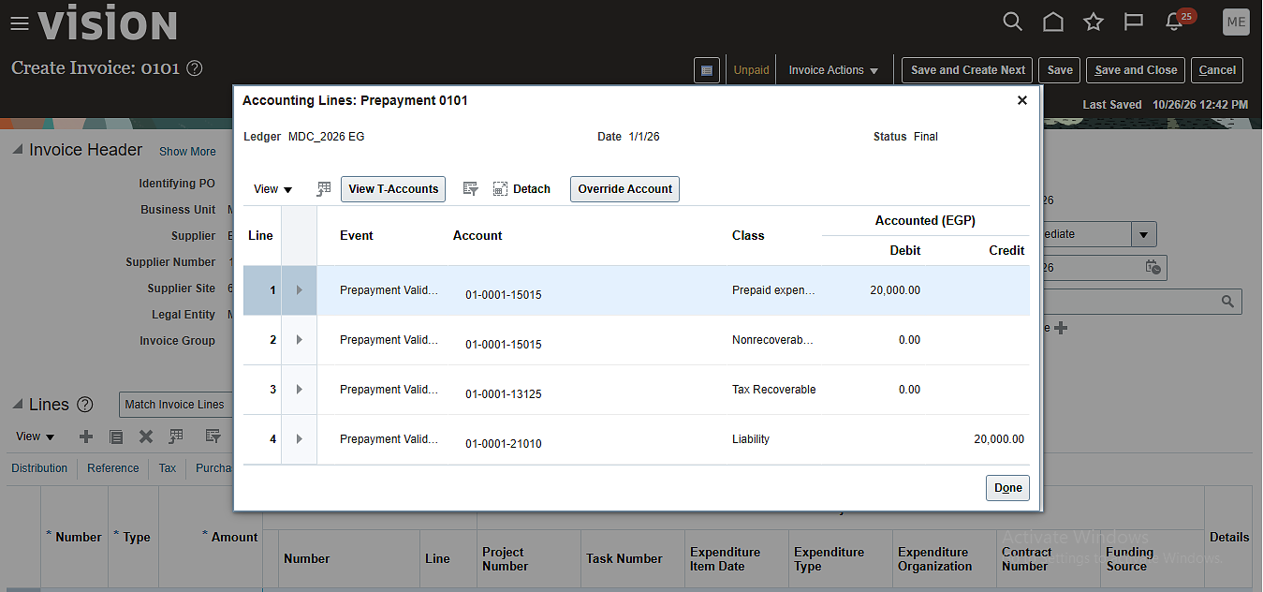
PREPAYMENT · 02 / 13
Review Prepayment Accounting
Oracle Fusion AP · Transaction workflow
KEY ACTIONS
1
Confirm invoice 0101 is
validated.
2
Review the EGP 20,000
prepayment line.
3
Check the related tax and
liability accounts.
Invoice 0101 • Review the prepayment account and related tax lines
Oracle Fusion AP · Workflows
02 / 13

Slide 40
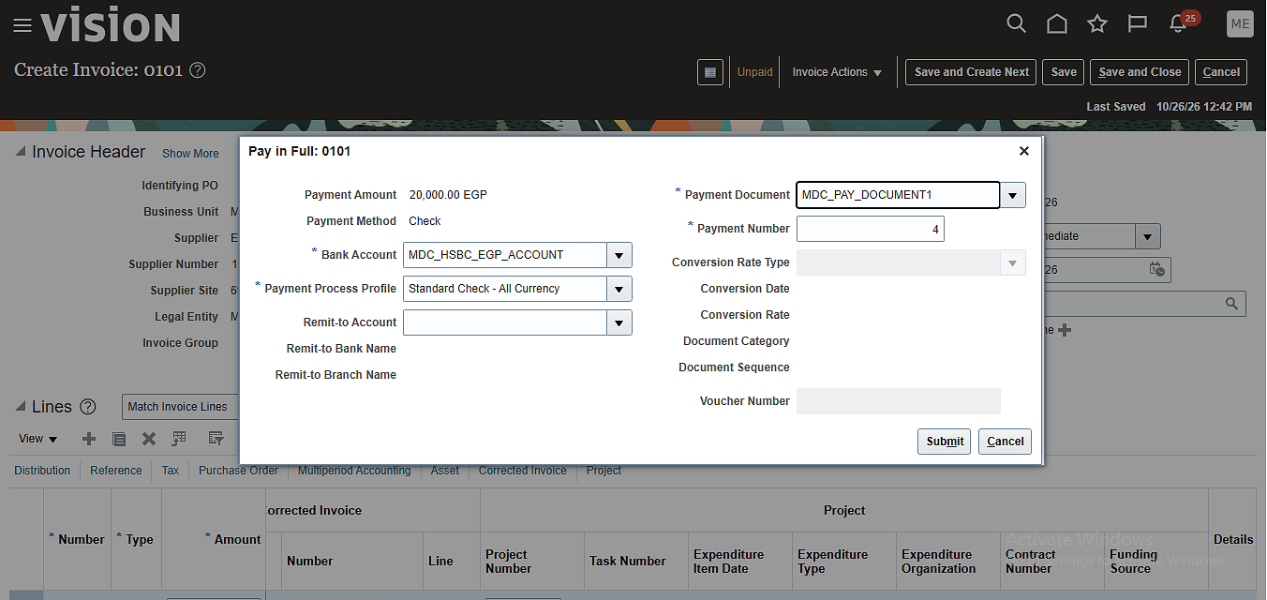
PREPAYMENT · 03 / 13
Pay Prepayment in Full
Oracle Fusion AP · Transaction workflow
KEY ACTIONS
1
Pay invoice 0101: EGP
20,000.
2
Select Check as the
payment method.
3
Use the
MDC_HSBC_EGP_ACCOUNT
bank account.
Payment: EGP 20,000 • Method: Check
Oracle Fusion AP · Workflows
03 / 13

Slide 41
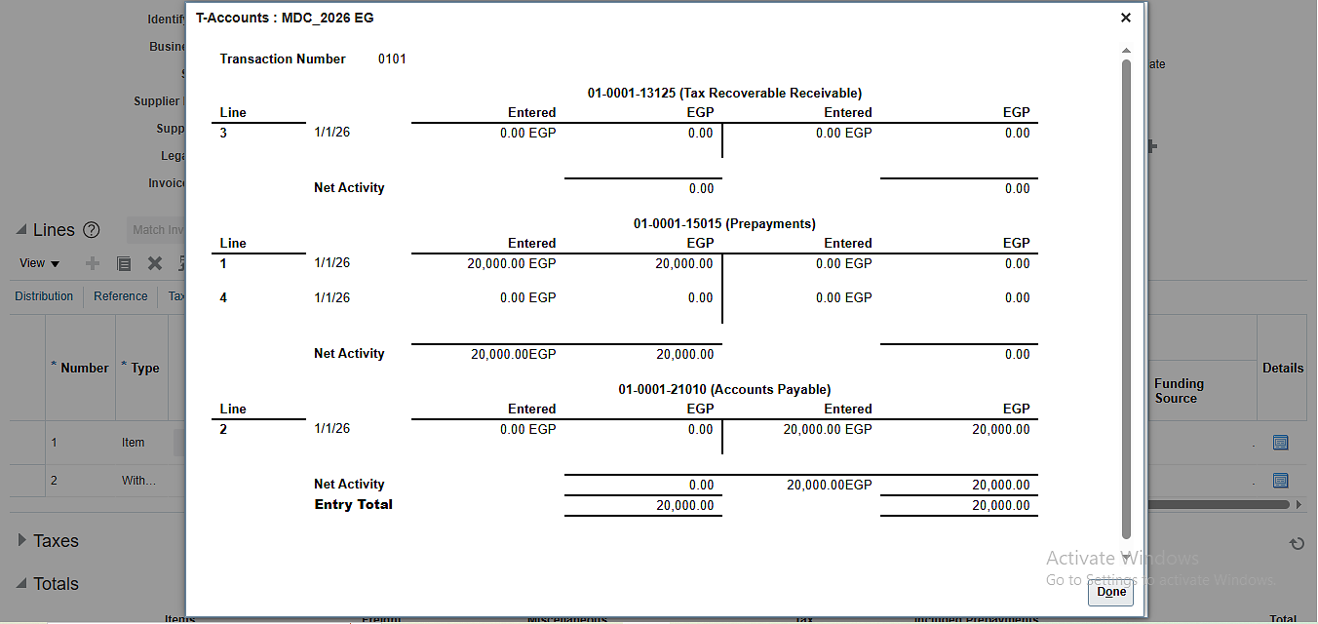
PREPAYMENT · 04 / 13
Review T-Accounts
Oracle Fusion AP · Transaction workflow
KEY ACTIONS
1
Open T-Accounts for
transaction 0101.
2
Confirm EGP 20,000 in
Prepayments.
3
Check that debit and credit
totals balance.
Transaction 0101 • Confirm debit and credit totals balance
Oracle Fusion AP · Workflows
04 / 13

Slide 42
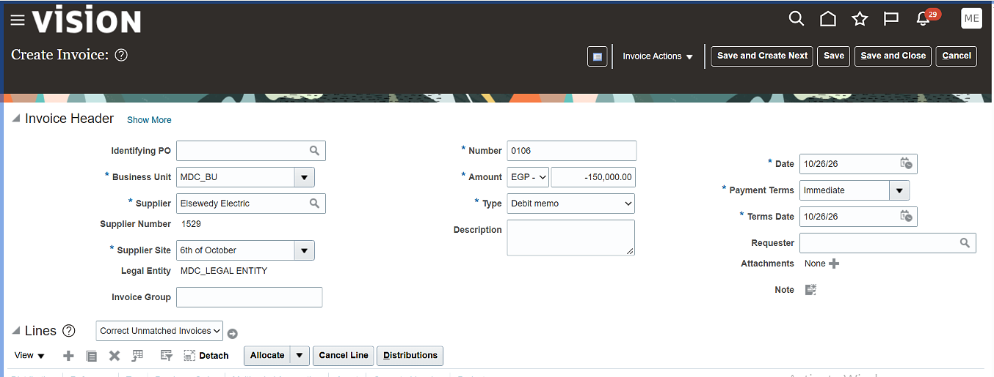
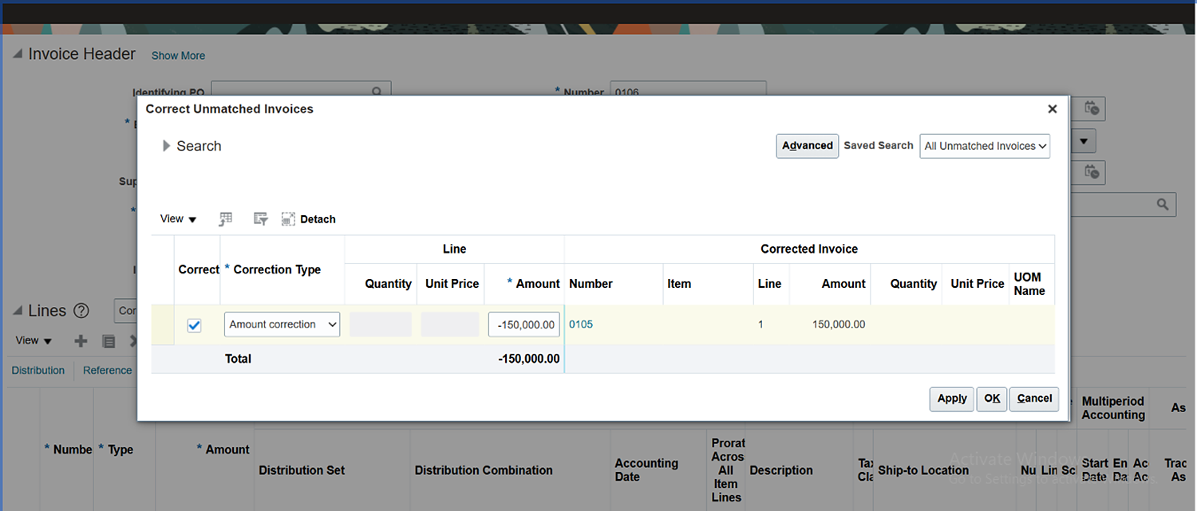
REFUND · 05 / 13
Create a Debit Memo
Oracle Fusion AP · Transaction workflow
KEY ACTIONS
1
Create debit memo 0106 to
correct invoice 0105.
2
Confirm the correction
amount: EGP -150,000.
3
Review supplier and
correction details.
Debit memo 0106 • Correction to invoice 0105 • EGP -150,000
Oracle Fusion AP · Workflows
05 / 13

Slide 43
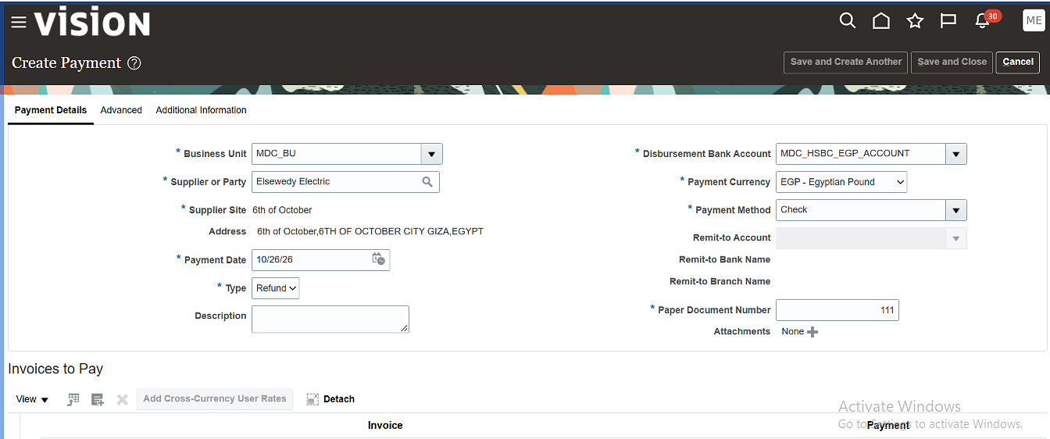
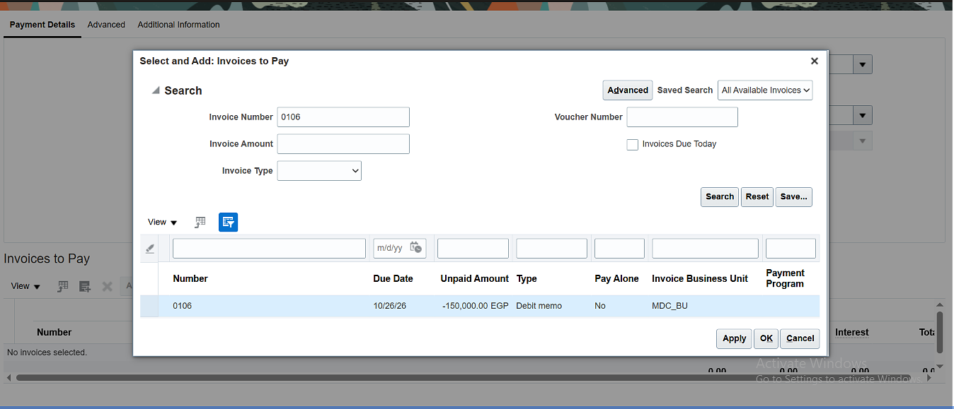
REFUND · 06 / 13
Enter the Refund Payment
Oracle Fusion AP · Transaction workflow
KEY ACTIONS
1
Select debit memo 0106 in
Add Payment.
2
Verify the negative EGP
150,000 balance.
3
Review the supplier, date,
and payment method.
Debit memo 0106 • Refund balance: EGP -150,000
Oracle Fusion AP · Workflows
06 / 13

Slide 44
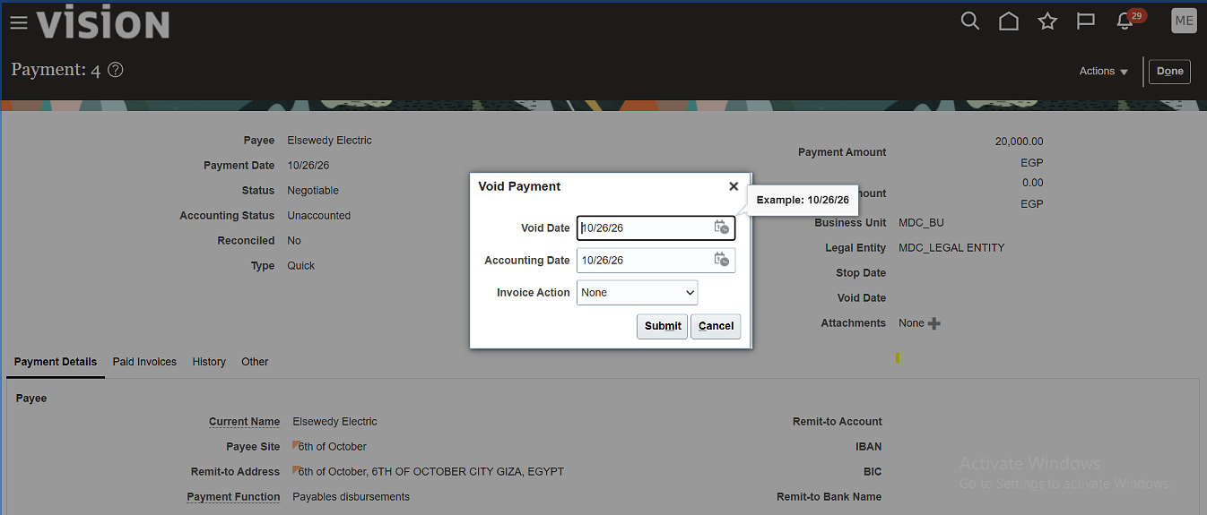
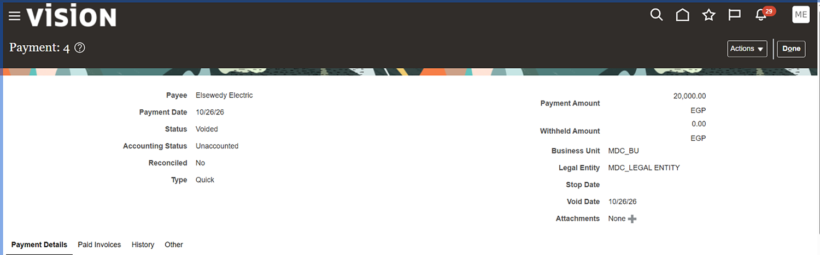
VOID · 07 / 13
Void Payment 4
Oracle Fusion AP · Transaction workflow
KEY ACTIONS
1
Open payment 4 for EGP
20,000.
2
Enter the void date and
accounting date.
3
Submit and confirm the
status changes to Voided.
Payment 4 • EGP 20,000 • Confirm status is Voided
Oracle Fusion AP · Workflows
07 / 13

Slide 45
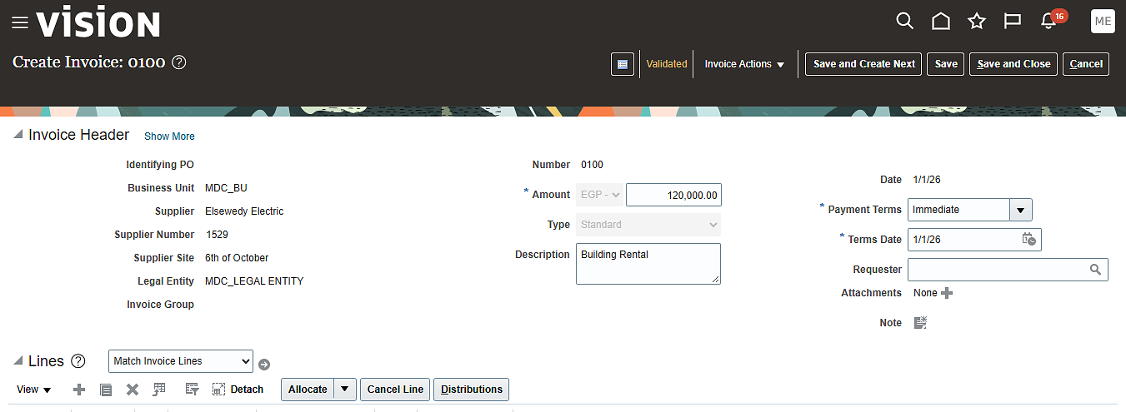
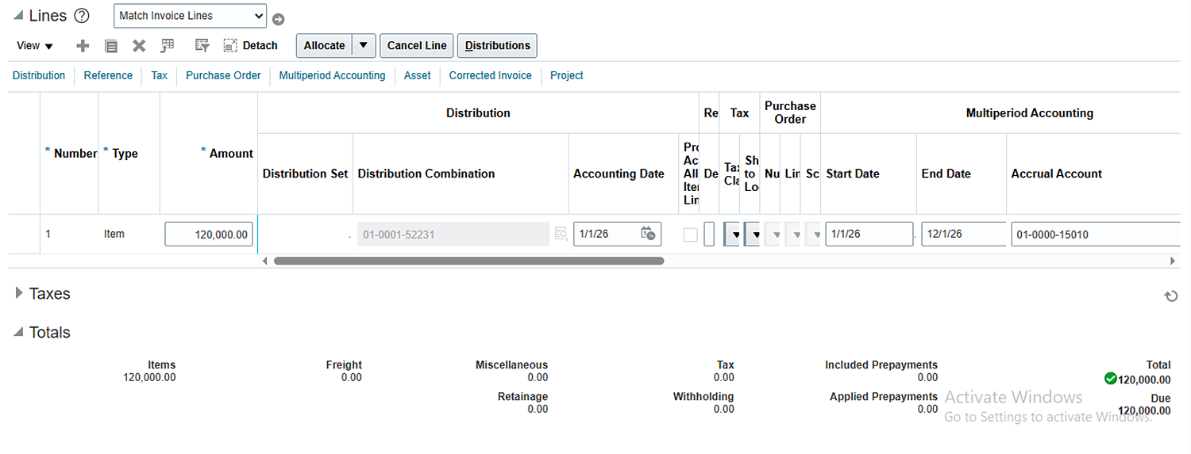
MULTI-PERIOD ACCOUNTING · 08 / 13
Prepare Invoice 0100
Oracle Fusion AP · Transaction workflow
KEY ACTIONS
1
Create standard invoice
0100 for EGP 120,000.
2
Enter the supplier and
Building Rental details.
3
Review the Multi-Period
Accounting tab.
Invoice 0100 • Building Rental • EGP 120,000
Oracle Fusion AP · Workflows
08 / 13

Slide 46
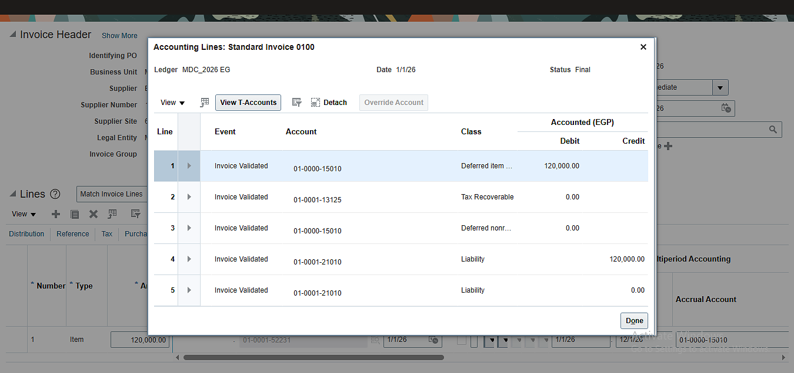
MULTI-PERIOD ACCOUNTING · 09 / 13
Review Accounting Lines
Oracle Fusion AP · Transaction workflow
KEY ACTIONS
1
Inspect accounting lines for
invoice 0100.
2
Review deferred-item, tax,
and liability accounts.
3
Confirm distributions before
scheduling accounting.
Invoice 0100 • Review distributions before accounting
Oracle Fusion AP · Workflows
09 / 13

Slide 47
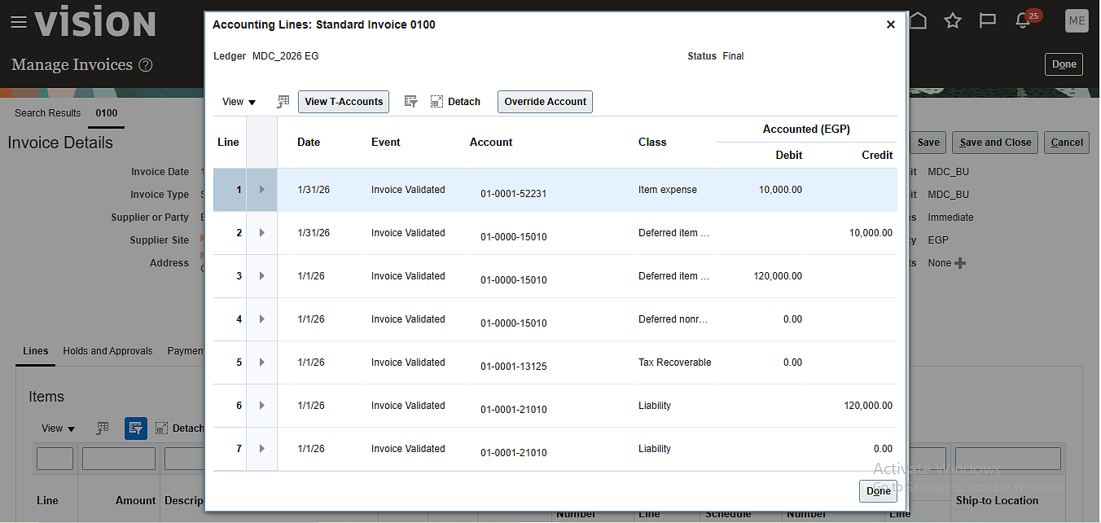
MULTI-PERIOD ACCOUNTING · 10 / 13
Reconcile Accounting Lines
Oracle Fusion AP · Transaction workflow
KEY ACTIONS
1
Review the accounting lines
for invoice 0100.
2
Check deferred-item and
tax classifications.
3
Reconcile the entry totals
to the ledger.
Invoice 0100 • Reconcile the recognition entry to the ledger
Oracle Fusion AP · Workflows
10 / 13

Slide 48
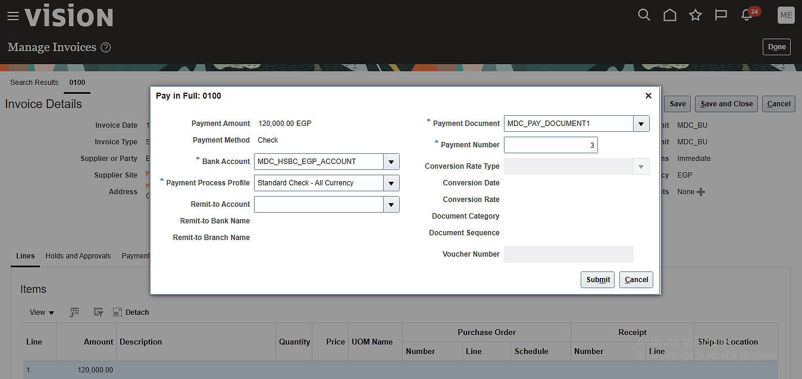
MULTI-PERIOD ACCOUNTING · 11 / 13
Pay Invoice 0100
Oracle Fusion AP · Transaction workflow
KEY ACTIONS
1
Pay invoice 0100 for EGP
120,000.
2
Select Check and the HSBC
EGP bank account.
3
Confirm the payment
document and number.
Payment for invoice 0100 • EGP 120,000
Oracle Fusion AP · Workflows
11 / 13

Slide 49
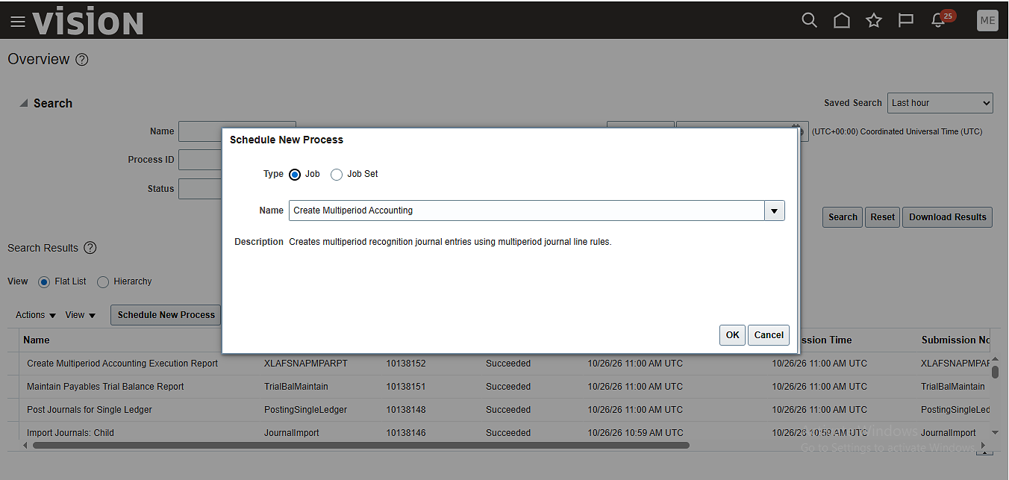
MULTI-PERIOD ACCOUNTING · 12 / 13
Schedule the Process
Oracle Fusion AP · Transaction workflow
KEY ACTIONS
1
Choose Create Multiperiod
Accounting.
2
The job creates recognition
journal entries.
3
Schedule the process and
review its status.
Create Multiperiod Accounting • Review the process status
Oracle Fusion AP · Workflows
12 / 13

Slide 50
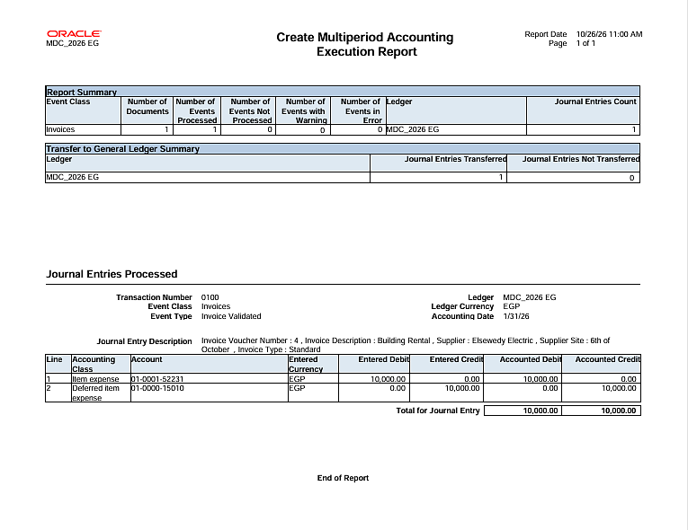
MULTI-PERIOD ACCOUNTING · 13 / 13
Review the Execution Report
Oracle Fusion AP · Transaction workflow
KEY ACTIONS
1
The process completed with
0 errors and 1 entry.
2
EGP 10,000 was recorded as
item expense.
3
EGP 10,000 was credited to
the deferred item.
Execution result • 0 errors • 1 journal entry • EGP 10,000 recognized
Oracle Fusion AP · Workflows
13 / 13

