Slide 1

Deforestation Estimator
Borealis AI
Group – Data Pirates
Mentor – Muhammad Safa
Shayan Mohammadi Kubijari
Rastin Rassoli
Mohanna Shahrad

Slide 2
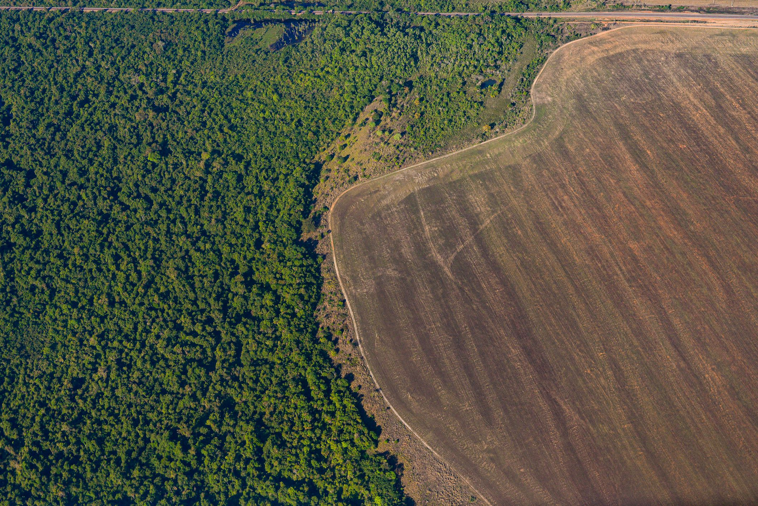
Agenda
Problem Statement
Use Case | How & What
Step 1 – Data & Tools
Step 2 – Model
Step 3 – Boosting & Polishing
Barriers
Insights
Recommendations & Future Actions

Slide 3
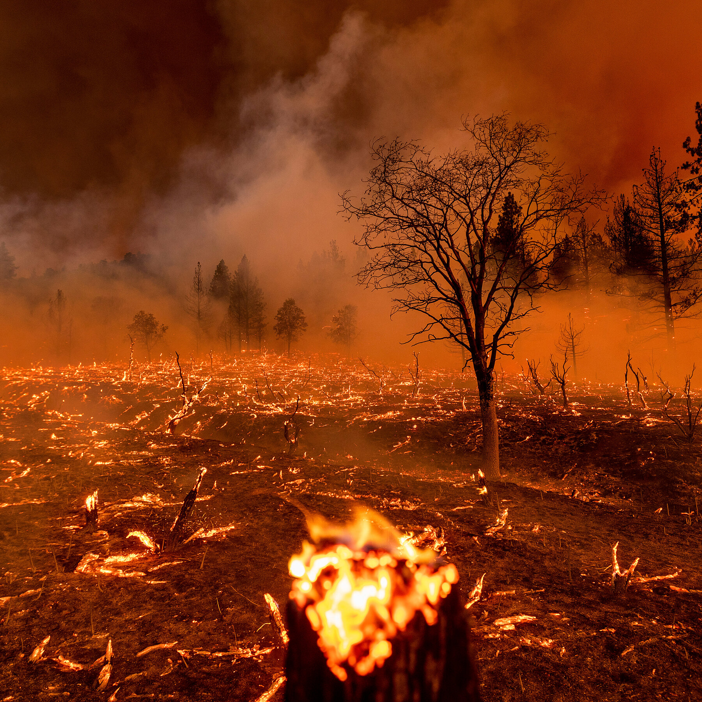
Problem Statement
climate scientists have warned there are only a dozen years for stopping global warming and climate change
Largest sources of greenhouse gas emissions from human activities are transportation and fossil fuels
By absorbing carbon dioxide from the atmosphere, storing carbon in the soil, and releasing oxygen into the air, trees assist to mitigate climate change.

Slide 4
x
Problem Statement
The goal of planting trees should be measurable
There are many other questions which are unanswered
How many trees should be planted?
Where should these trees be planted?
Which places are in more danger?

Slide 5
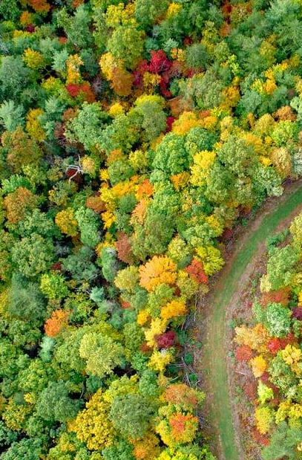
Use Case | How & What
How AI & ML could help?
What is Deforestation Estimator?
Artificial Intelligence (AI) can help us to find the answers
Many Machin learning (ML) algorithms can predict future data using past information
Our ML model can be divided into two sub-models
Deforestation rate
Disforestation distribution

Slide 6
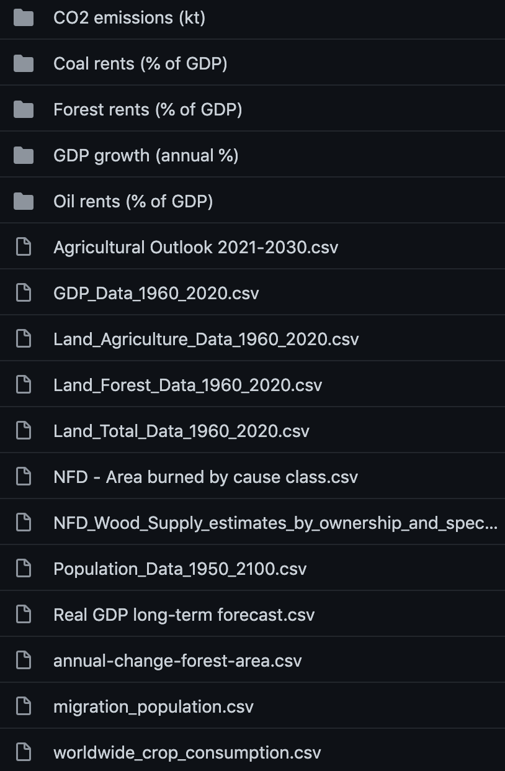
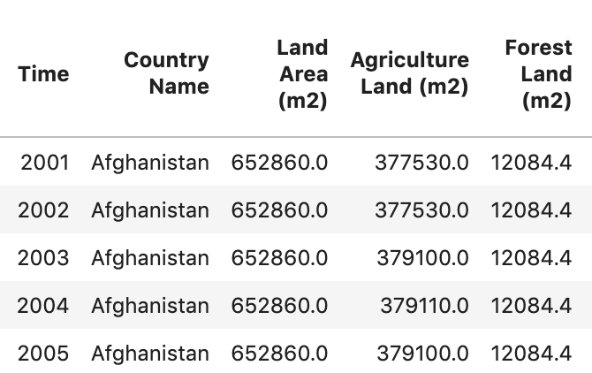

Step 1 – Data & Tools
Sources & Tools
Kaggle
GitHub
TheWorldBank Data
OECD Stats
Challenges
Finding Appropriate Data
Finding Inclusive Data
Finding Accurate Data
Preparation
Scale
Removing Useless values

Slide 7
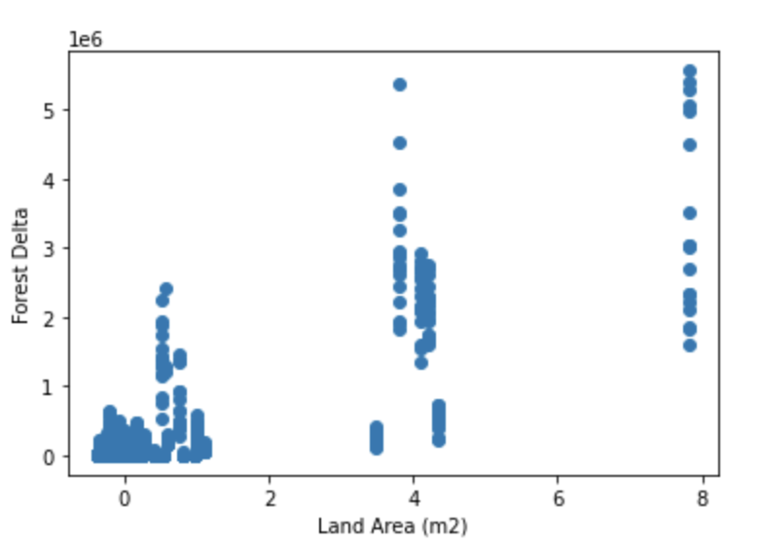
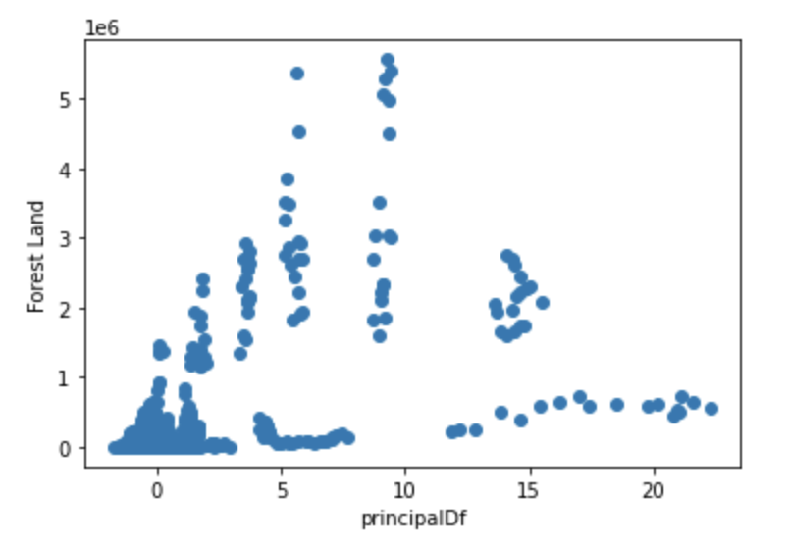
Step 2 – Model
Candidates
Linear Regression
Ensemble Trees
Arima
XGBoost
LightGBM
Selection & Strategies
Feature Analysis
R2 Score

Slide 8

Step 3 – Boosting & Polishing
Boosting
Polishing

Slide 9
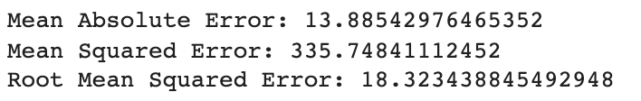
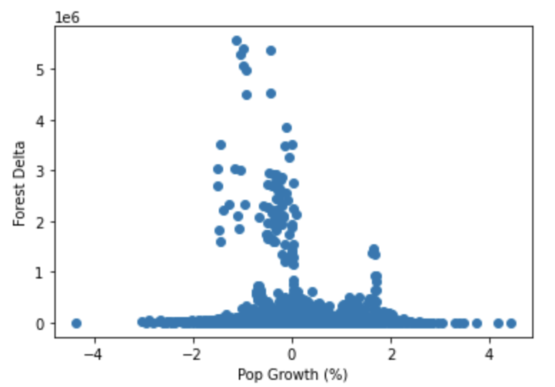
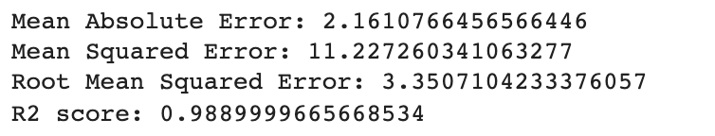
Barriers

Slide 10
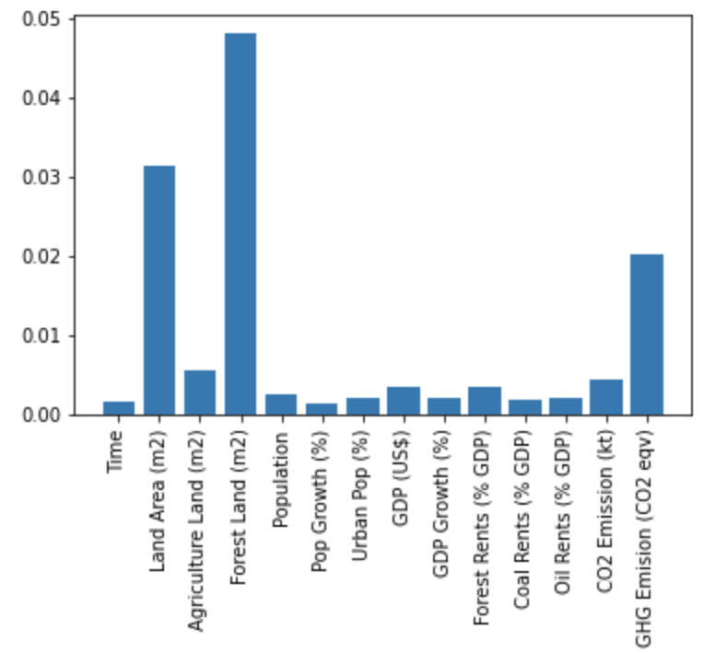
Insights

Slide 11

Recommendations & Future Steps

