Slide 1
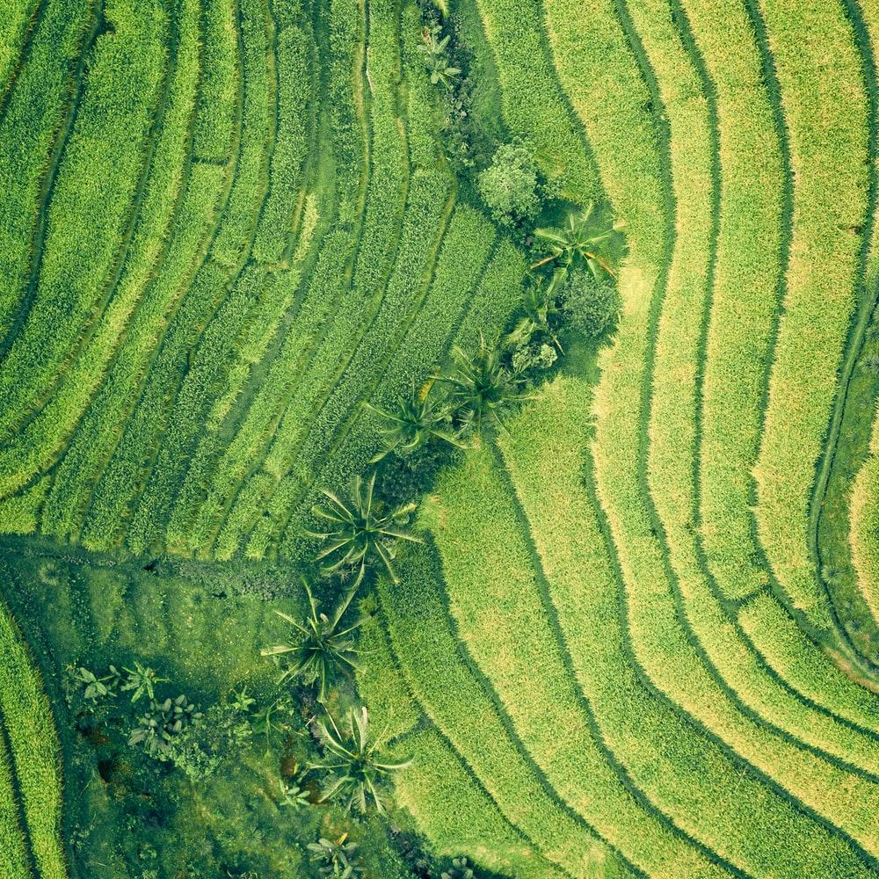
Deforestation Estimator
Borealis AI
Group – Data Pirates
Mentor – Muhammad Safa
Shayan Mohammadi Kubijari
Rastin Rassoli
Mohanna Shahrad

Slide 2
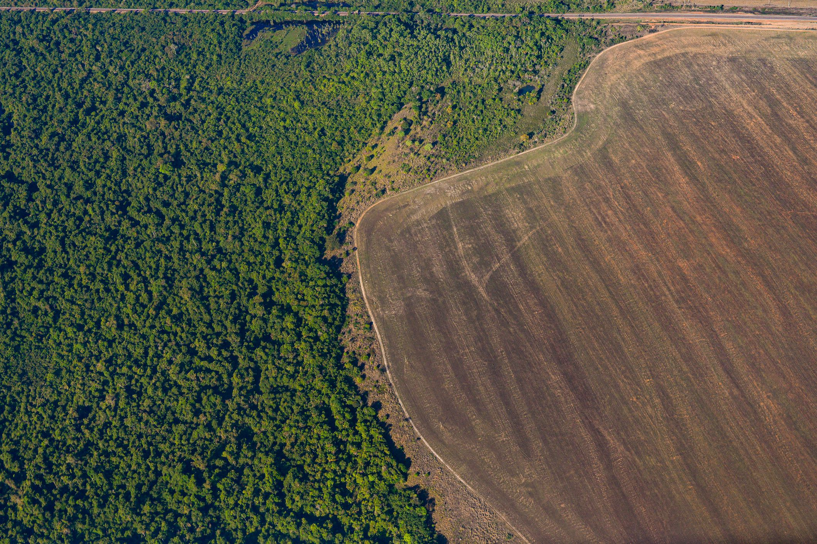
Agenda
Problem Statement
Use Case | How & What
Step 1 – Data & Tools
Step 2 – Model
Step 3 – Boosting & Polishing
Barriers
Insights
Recommendations & Future Actions

Slide 3
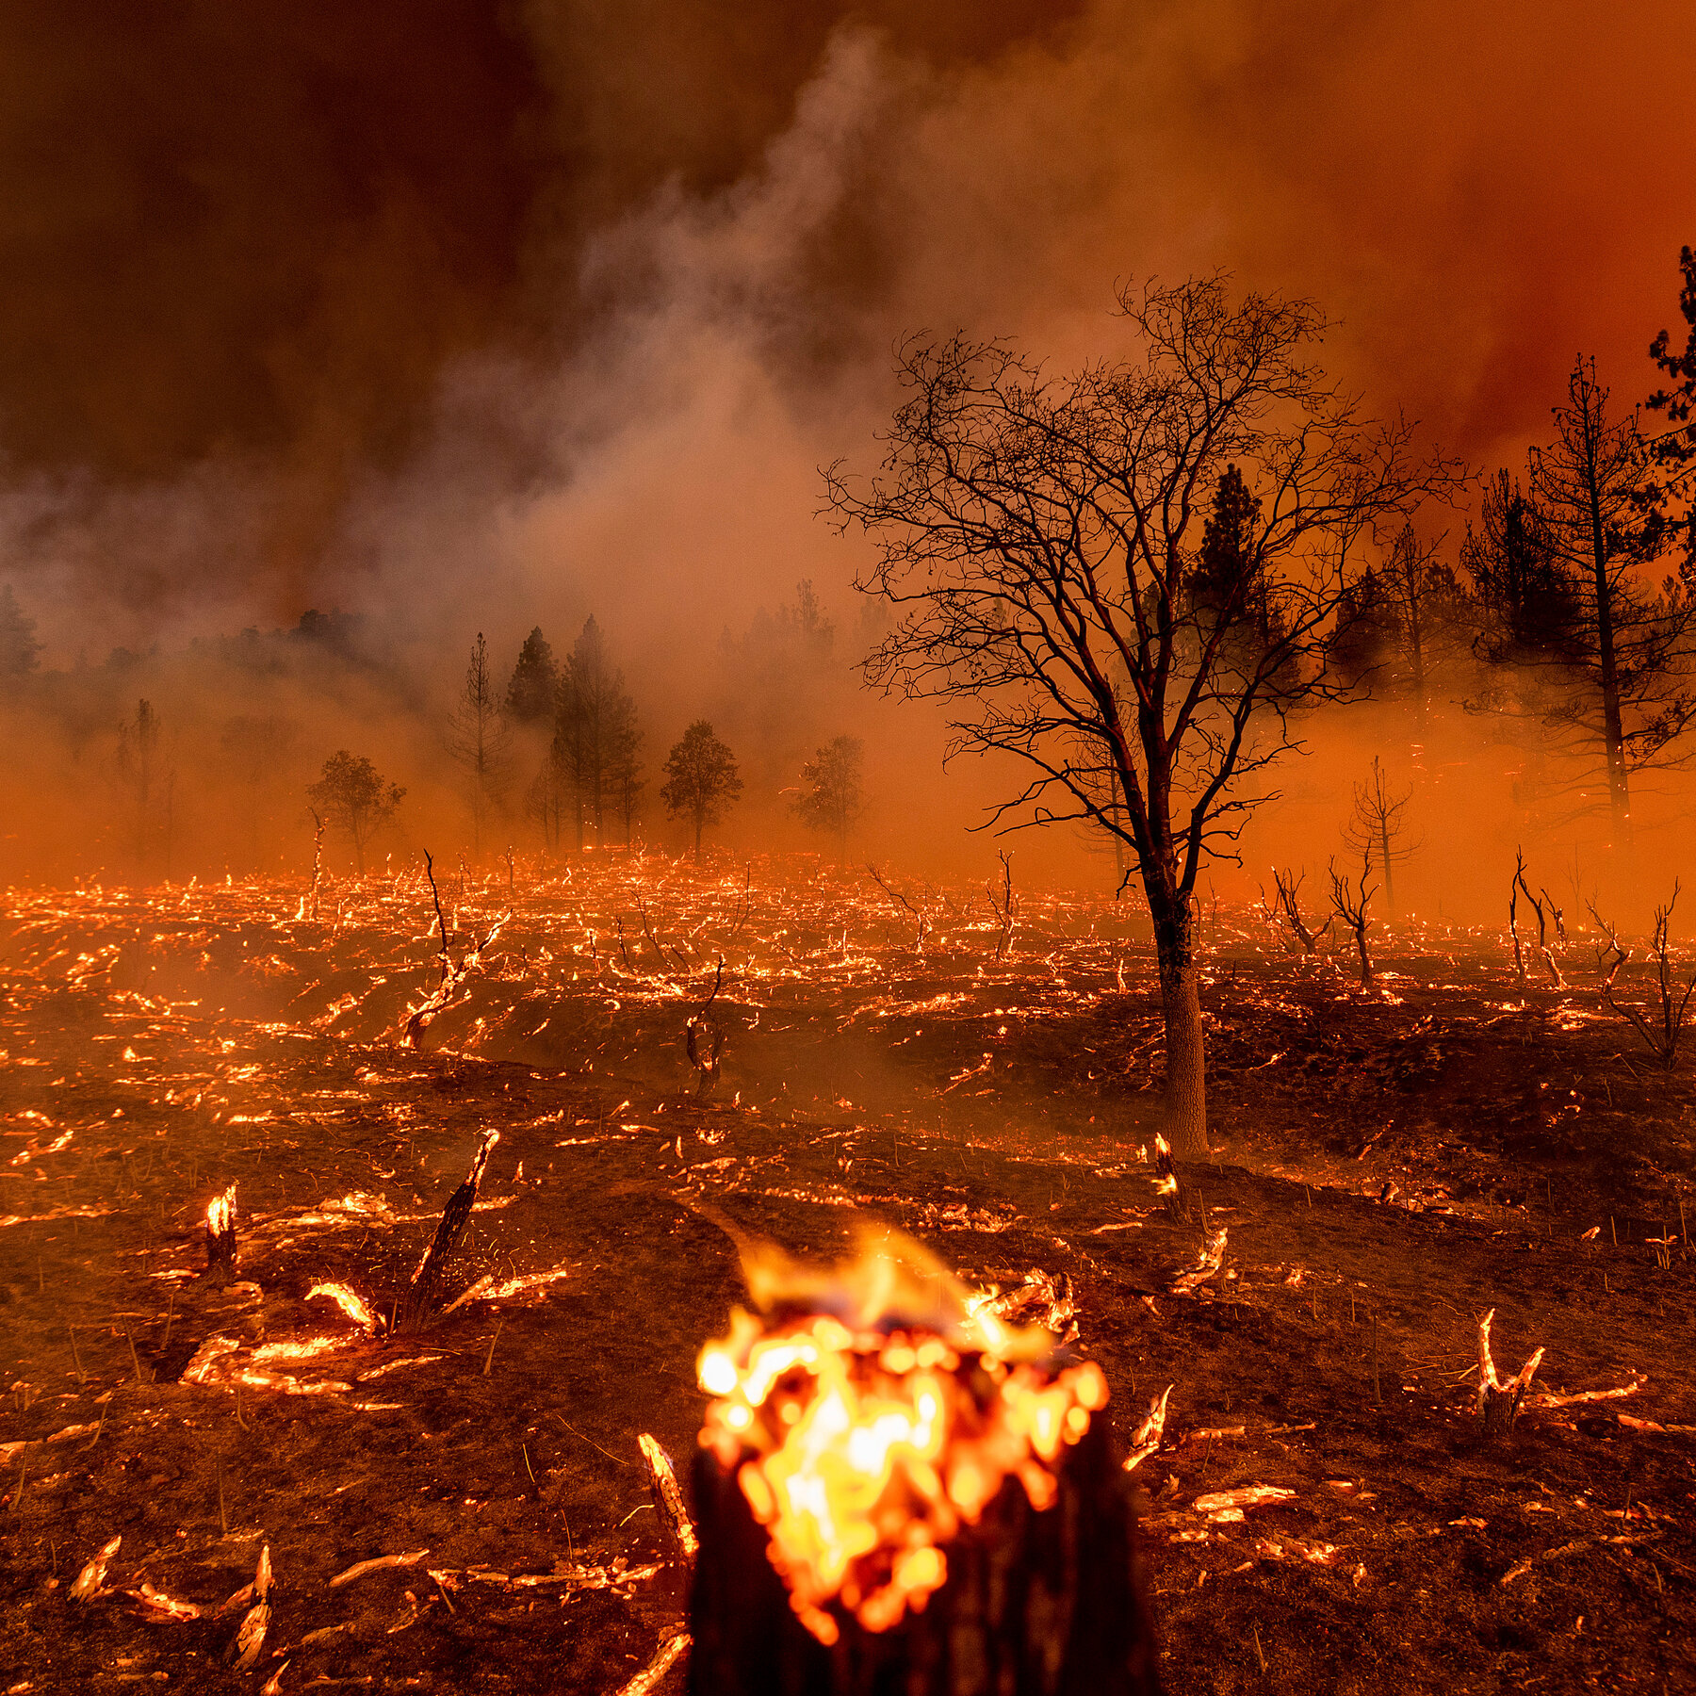
Problem Statement

Slide 4
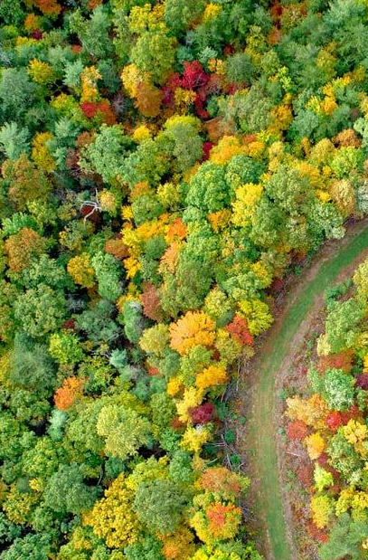
Use Case | How & What
How AI & ML could help?
What is Deforestation Estimator?

Slide 5
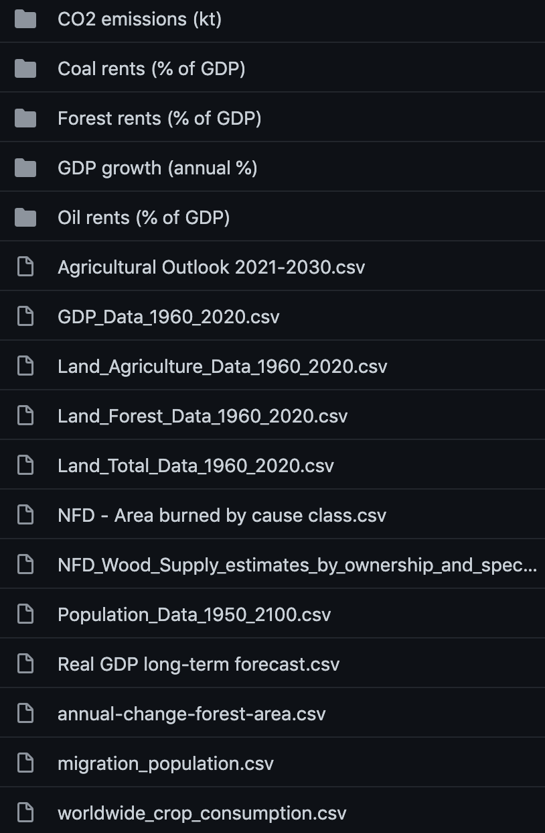
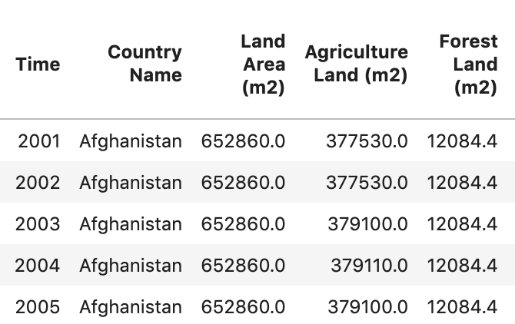

Step 1 – Data & Tools
Sources & Tools
Preparation
Challenges

Slide 6
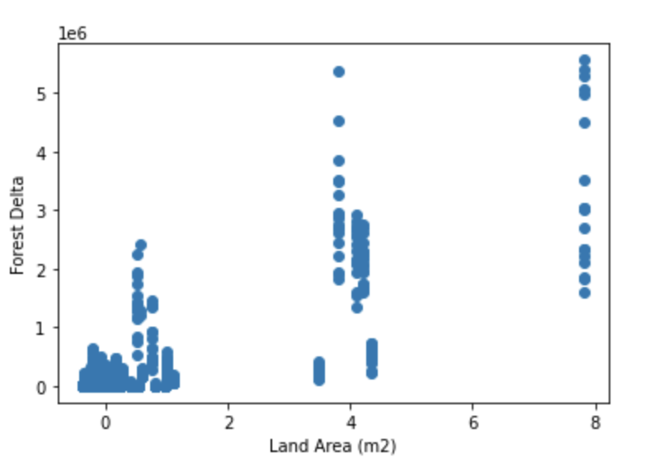
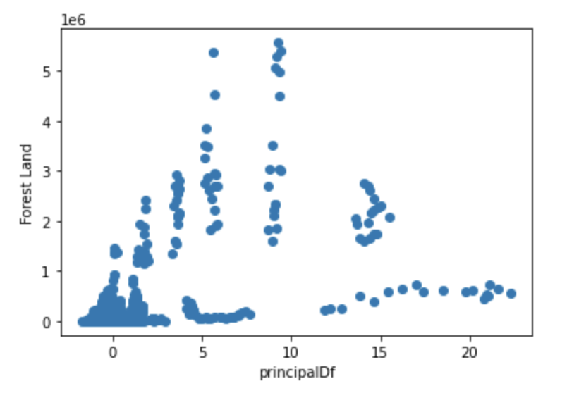
Step 2 – Model
Candidates
Selection & Strategies

Slide 7

Step 3 – Boosting & Polishing
Boosting
Polishing

Slide 8
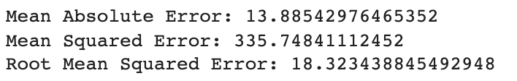
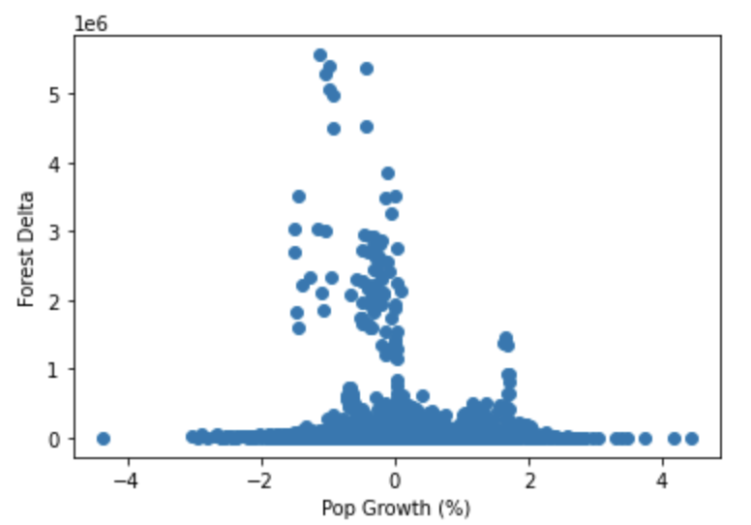
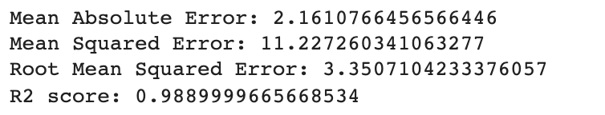
Barriers

Slide 9
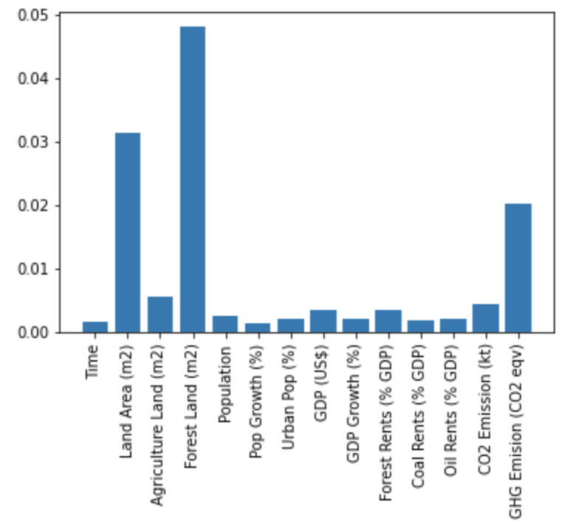
Insights

Slide 10

Recommendations & Future Steps

