Slide 1
A Comparison of GBDT Algorithms on High Cardinality Data
Nishant mohan

Slide 2




Contents
The Problem
GBDT Algorithms
Datasets
Methodology
Results
Discussion

Slide 3
The Problem
Real world datasets have categorical features, often with very high cardinality
There are many classification algorithms out there
Even Gradient Boosted Decision Tree algorithms have varying implementations
Is there a winning algorithm?

Slide 4

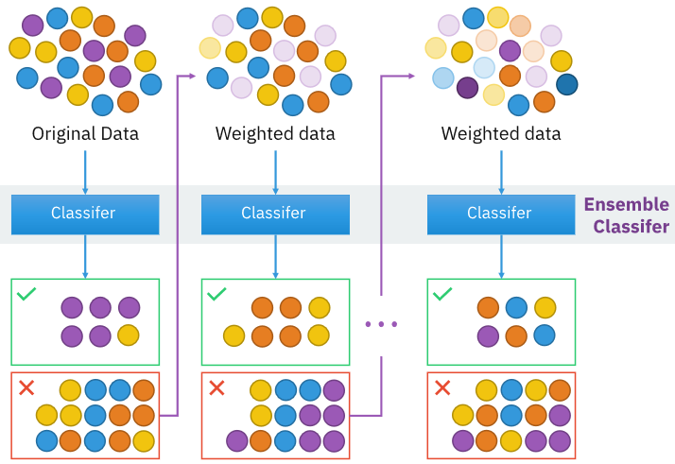
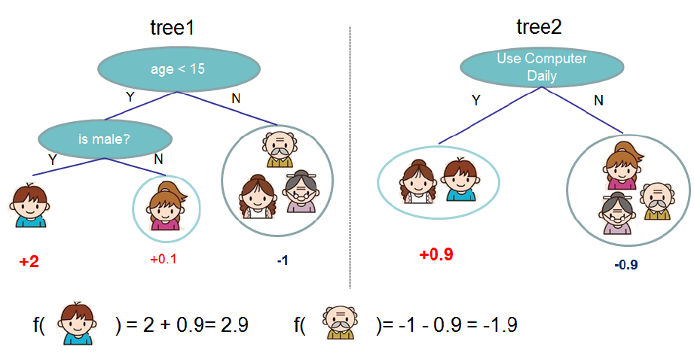
GBDT Algorithms
Boosting considered as an optimization problem on a suitable cost function
Iteratively learn from weak predictors and combine the results to form a strong learner
Incrementally assign adjusted weights to observations
Three state-of-the-art implementations
XGBoost
LightGBM
CatBoost
*BySirakorn-Ownwork,CCBY-SA4.0,https://commons.wikimedia.org/w/index.php?curid=85888769

Slide 5
XGBoost
LightGBM
CatBoost
Cache aware block structure helps to scale out-of-core
Exclusive Feature Bundling bundles mutually exclusive features together
Creates random permutations of the training samples
Residuals calculated with a model not trained on current observation
Focus on optimizing existing process
Uses histograms of features to select best possible split for the trees
Gives missing values a default direction
Values of target statistic only rely on the observed history
Gradient-based One-Side Sampling removes observations with small gradient
March 2014 Jan 2017 April 2017

Slide 6
Datasets
Name | Observations | Features | Categorical | Numerical | Highest Cardinality | Classes
Adult | 32,561 | 14 | 8 | 6 | 42 | 2
Amazon | 32,769 | 9 | 9 | - | 7,518 | 2
Bank Marketing | 41,188 | 20 | 10 | 10 | 12 | 2
Contraceptive | 1,473 | 9 | 4 | 5 | 34 | 3
Kick | 72,983 | 32 | 15 | 17 | 1,063 | 2
Land Prices | 3,458 | 5 | 4 | 1 | 60 | 10
Physician | 969,617 | 8 | 8 | - | 19,574 | 4
Poker Hand | 25,010 | 10 | 5 | 5 | 4 | 10

Slide 7
Methodology
Baseline
Train a Random Forest model for baseline
Train
Train each of the three GBDT algorithms on all the dataset
Evaluate
Measure performance of models across datasets
Analyze
Look for patterns based on the features of dataset

Slide 8
Results

Slide 9
How to measure performance?
Accuracy and F1 score
Accuracy gives a wrong picture for unbalanced datasets: an accuracy of 95% could be misleading if dataset has 95% 0’s and 5% 1s
F1 score penalizes incorrect predictions, but ignores the probabilistic nature of classification
Optimizes the certainty of a prediction
Log-loss is not a metric, but a loss function
Log-loss
Penalizes the predictions made with lesser certainty

Slide 10
How much Predictive power?
A model has some predictive power if the log-loss is less than a random guess log-loss
For all the 8 datasets, at least one model performed better than random guessing

Slide 12
Bank Marketing
Target Encoding with LightGBM performed best
Native Encoding performed worst for both LightGBM and CatBoost

Slide 13
Feature Importance

