Slide 1
A Comparison of GBDT Algorithms on High Cardinality Data
Nishant mohan

Slide 2




Contents
The Problem
GBDT Algorithm
Datasets
Methodology
Results and Discussion
Categorical Encoding

Slide 3
The Problem
Real world datasets have categorical features, often with very high cardinality
There are many classification algorithms out there
Even Gradient Boosted Decision Tree algorithms have varying implementations
Is there a winning algorithm?

Slide 4
Contents
The Problem
GBDT Algorithm
Datasets
Methodology
Results and Discussion
Categorical Encoding

Slide 5

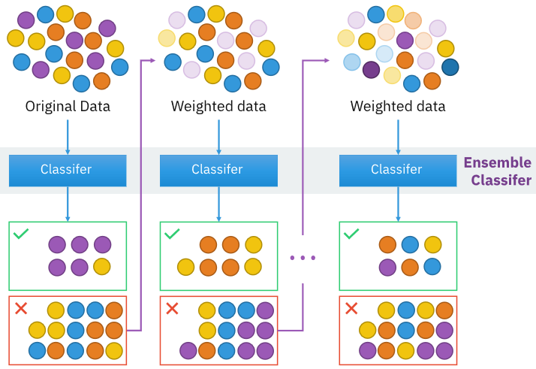
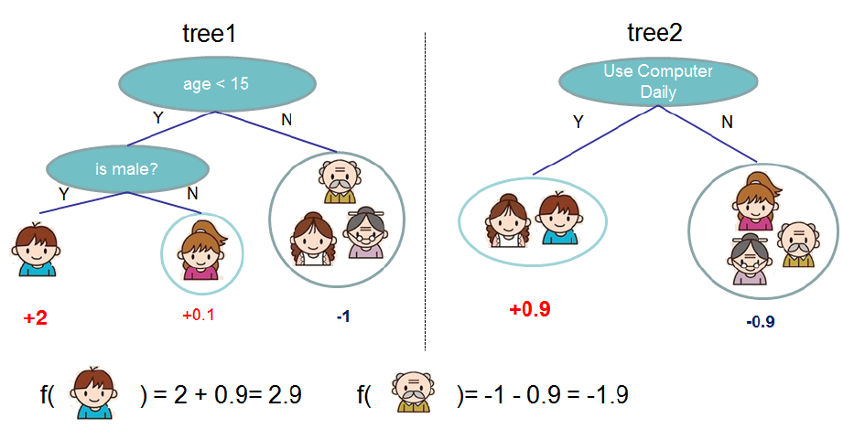
GBDT Algorithms
Boosting considered as an optimization problem on a suitable cost function
Iteratively learn from weak predictors and combine the results to form a strong learner
Incrementally assign adjusted weights to observations
Three state-of-the-art implementations
XGBoost
LightGBM
CatBoost
*BySirakorn-Ownwork,CCBY-SA4.0,https://commons.wikimedia.org/w/index.php?curid=85888769

Slide 6
Key Highlights
XGBoost
LightGBM
CatBoost
Cache aware block structure helps to scale out-of-core
Exclusive Feature Bundling bundles mutually exclusive features together
Creates random permutations of the training samples
Residuals calculated with a model not trained on current observation
Focus on optimizing existing process
Uses histograms of features to select best possible split for the trees
Gives missing values a default direction
Values of target statistic only rely on the observed history
Gradient-based One-Side Sampling removes observations with small gradient
March 2014 Jan 2017 April 2017

Slide 7
Contents
The Problem
GBDT Algorithm
Datasets
Methodology
Results and Discussion
Categorical Encoding

Slide 8
The curse of cardinality!
Features may have very high number of categories
Algorithms require the data to be numeric
Solution 1 - Drop categorical features : May suit some applications!
Solution 2 – Represent categories as numbers : But how? ☹

Slide 9
One Hot Encoding
Color
Red
Red
Yellow
Green
Yellow
Red | Yellow | Green
1 | 0 | 0
1 | 0 | 0
0 | 1 | 0
0 | 0 | 1
0 | 1 | 0
Probably the most popular approach
Represent each category as a binary column
But computationally expensive if very high number of categories

Slide 10
Target Encoding
Color | Target
Red | 1
Red | 0
Red | 1
Green | 1
Green | 0
Color | Target
0.67 | 1
0.67 | 0
0.67 | 1
0.50 | 1
0.50 | 1
Maps each instance of a category to the probability estimate of the target attribute
Smoothening of the means is also applied in order to avoid overfitting due to small number of observations of a category
Leads to target leakage!

Slide 11
Datasets
Name | Observations | Features | Categorical | Numerical | Highest Cardinality | Classes
Adult | 32,561 | 14 | 8 | 6 | 42 | 2
Amazon | 32,769 | 9 | 9 | - | 7,518 | 2
Bank Marketing | 41,188 | 20 | 10 | 10 | 12 | 2
Contraceptive | 1,473 | 9 | 4 | 5 | 34 | 3
Kick | 72,983 | 32 | 15 | 17 | 1,063 | 2
Land Prices | 3,458 | 5 | 4 | 1 | 60 | 10
Physician | 969,617 | 8 | 8 | - | 19,574 | 4
Poker Hand | 25,010 | 10 | 5 | 5 | 4 | 10

Slide 12
Contents
The Problem
GBDT Algorithm
Datasets
Methodology
Results and Discussion
Categorical Encoding

Slide 13
Methodology
Baseline
Get random guessing results for baseline
Train
Train each of the algorithms on all the dataset
Evaluate
Measure performance of models across datasets
Analyze
Look for patterns based on the features of dataset

Slide 14
How to measure performance?
Accuracy and F1 score
Accuracy gives a wrong picture for unbalanced datasets: an accuracy of 95% could be misleading if dataset has 95% 0’s and 5% 1s
F1 score penalizes incorrect predictions, but ignores the probabilistic nature of classification
Optimizes the certainty of a prediction
Log-loss is not a metric, but a loss function
Log-loss
Penalizes the predictions made with lesser certainty

Slide 15
Experimental Design
Four Algorithms
Random Forest
Four Encoding Techniques
OneHot
XGBoost
LightGBM
CatBoost
Target
Mixed
Native

Slide 16
Contents
The Problem
GBDT Algorithm
Datasets
Methodology
Results and Discussion
Categorical Encoding

Slide 17
Did we gain Predictive power?
A model has some predictive power if the log-loss is less than the random guess log-loss
For all the 8 datasets, at least one model performed better than random guessing

Slide 18
About Encodings
Onehot and Native encodings always perform better than baseline
Target and Native encodings are relatively unreliable, but perform better
Maybe they need tuning or smoothing?

Slide 19
About GBDTs
Random Forest performs reliably, but poorly
Performance of XGBoost seems highly unstable
CatBoost and LightGBM perform good, CatBoost trumps with higher margins

Slide 20
Adult Dataset
Native Encoding with CatBoost performed the best
Generally, target encoding performs better than one hot and mixed

Slide 21
Feature Importance

Slide 22
Bank Marketing
Target Encoding with LightGBM performed best
Native Encoding performed worst for both LightGBM and CatBoost

Slide 23
Feature Importance

Slide 25
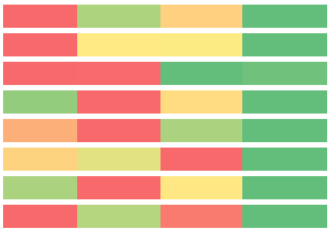
So, Who’s winning!?
Dataset | Random Forest | XGBoost | LightGBM | CatBoost
Adult | Target | Target | Target | Native
Amazon | Mixed | OneHot | Native | Native
Bank Marketing | Target | OneHot | Target | Mixed
Contraceptive | Target | OneHot | OneHot | Native
Kick | Target | OneHot | OneHot | Target
Land Prices | Mixed | Mixed | Mixed | Mixed
Physician | Target | OneHot | Target | Target
Poker Hand | Target | OneHot | Target | Target
CatBoost beats other algorithms in all datasets
But, need to experiment with encoding techniques
Target Encoding mostly performs better than other encoding techniques
XGBoost generally performs best with OneHot Encoding
On the contrary other algorithms do not!
Increasing Log Loss
A cross-tab showing best models. Text in each box shows best performing categorical encoding technique for that algorithm.
Color shows relative log-loss across algorithms for the dataset.

Slide 26
References
Tianqi Chen and Carlos Guestrin. 2016. XGBoost: A Scalable Tree Boosting System. In Proceedings of the 22nd ACM SIGKDD International Conference on Knowledge Discovery and Data Mining (KDD ’16). Association for Computing Machinery, New York, NY, USA, 785–794. DOI:https://doi.org/10.1145/2939672.2939785
LightGBM: Guolin Ke, Qi Meng, Thomas Finley, Taifeng Wang, Wei Chen, Weidong Ma, Qiwei Ye, and Tie-Yan Liu. 2017. LightGBM: a highly efficient gradient boosting decision tree. In Proceedings of the 31st International Conference on Neural Information Processing Systems (NIPS’17). Curran Associates Inc., Red Hook, NY, USA, 3149–3157.
Liudmila Prokhorenkova, Gleb Gusev, Aleksandr Vorobev, Anna Veronika Dorogush, and Andrey Gulin. 2018. CatBoost: unbiased boosting with categorical features. In Proceedings of the 32nd International Conference on Neural Information Processing Systems (NIPS’18). Curran Associates Inc., Red Hook, NY, USA, 6639–6649.
Micci-Barreca, D. (2001). A preprocessing scheme for high-cardinality categorical attributes in classification and prediction problems. ACM SIGKDD Explorations Newsletter, 3(1), 27.
Moeyersoms, J., & Martens, D. (2015). Including high-cardinality attributes in predictive models: A case study in churn prediction in the energy sector. Decision Support Systems, 72, 72–81
Cerda, P., & Varoquaux, G. (2020). Encoding high-cardinality string categorical variables. IEEE Transactions on Knowledge and Data Engineering, 1–1. doi:10.1109/tkde.2020.2992529
R Library Contrast Coding Systems For Categorical Variables, https://stats.idre.ucla.edu/r/library/r-library-contrast-coding-systems-for-categorical-variables/#HELMERT
Category Encoders, http://contrib.scikit-learn.org/category_encoders/index.html , last accessed: August 2nd, 2020
Smarter ways to encode Categorical Variables, https://towardsdatascience.com/smarter-ways-to-encode-categorical-data-for-machine-learning-part-1-of-3-6dca2f71b159 , last accessed: August 2nd, 2020

Slide 27

Feedback?

