Slide 1





DEPARTMENT OF COMPUTER SCIENCE & ENGINEERING
Convolutional Neural Networks and NLP for Handwritten Text Conversion
Guide :
Ms.Soja Rani,
Sr.Assistant Professor,
Dept. of CSE,
NHCE, Bangalore
By :
Mohan Krishna B(1NH14CS071)
Swathi Madhavan(1NH14CS732)
Prakash H (1NH14CS167)
Rahul N (1NH14CS098)

Slide 2
Contents
Abstract
Introduction
Existing system
Proposed system
Algorithm/Methodology
System requirements
Individual contribution
Conclusion

Slide 3
Abstract
This project seeks to classify individual sentences in a handwritten document page and then into handwritten word so that handwritten text can be translated to a digital form.
We used three main approaches to accomplish this task: classify individual sentences and classifying each words directly of that sentence and perform character segmentation.
For the former, we use Convolutional Neural Network (CNN) with various architectures to train a model that can accurately classify words and characters. We then pass the segmented characters to a Logistic Regression to output the probabilities of each character and then reconstruct each word according to the results of classification and segmentation. For the former ,we calculate the mean probability of the word and use Natural language Processing to categories words in a sentence to parts of speech and use brute force on each word with lower word occurrence probability.

Slide 4
Existing System:
The Existing System of Handwritten text conversion uses Machine learning, Logistic Regression where we convert to the character with highest probability. The efficiency was improved using convolutional neural networks.
Disadvantage:
Each character can never get the probability of 1.
Post processing of the output was not implement.

Slide 5
Proposed System:
The Goal of Project is to improve the efficiency of conversion of Handwritten text to digital form using RCNN(Recurrent Convolutional Neural Network) and Post processing using NLP(Natural Language Processing) to improve efficiency of conversion.
Advantages:
The word with mean probability of characters lower than the average is checked and corrected using NPL and brute forcing with dictionary.
NPL can also be used to identify proper noun and not make any correction those words.

Slide 6
Algorithm/methodology
Logistic Regression(Machine Learning)
Recurrent Convolutional Neural Network
Backpropagation
Logistic Regression
Natural Language Processing

Slide 7
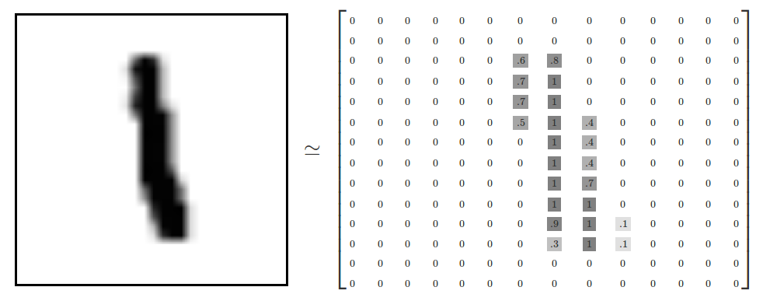
EMNIST Dataset

Slide 8
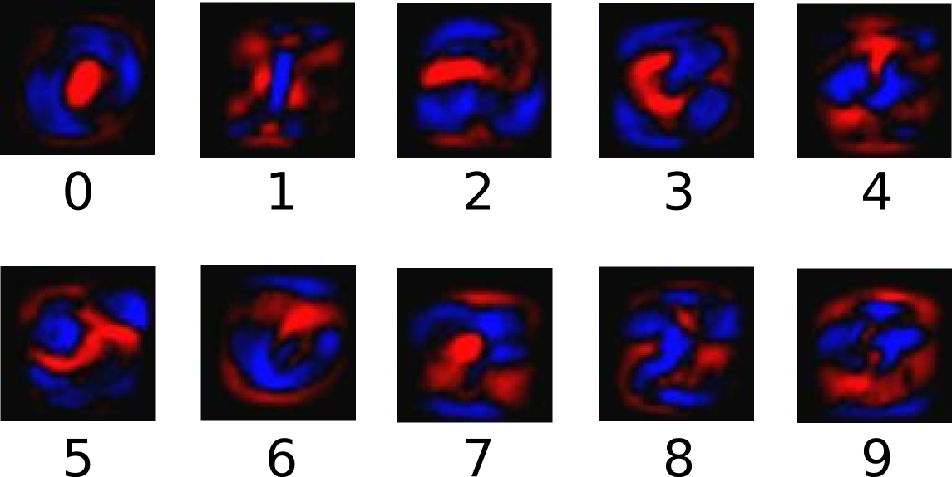
The following diagram shows the weights one model learned:

Slide 9

Deep Learning & Neural Networks

Slide 10
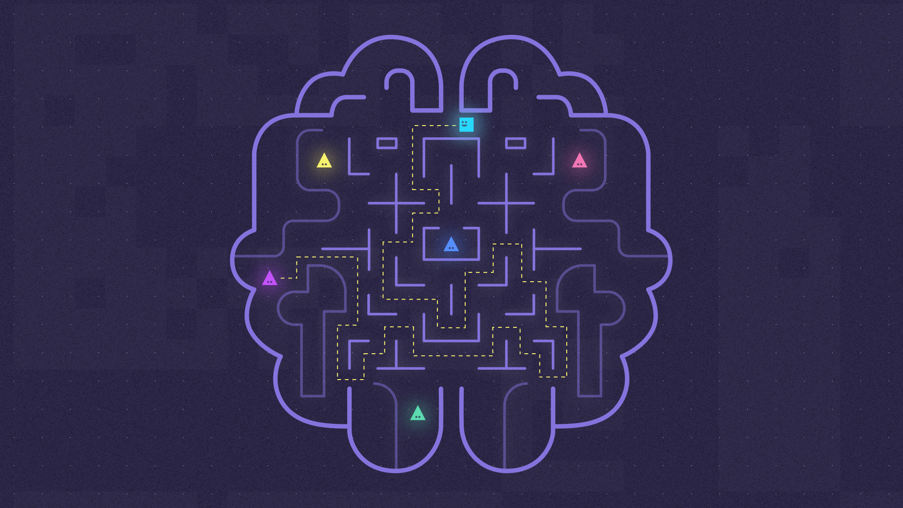
What’s Neural Networks?

Slide 11
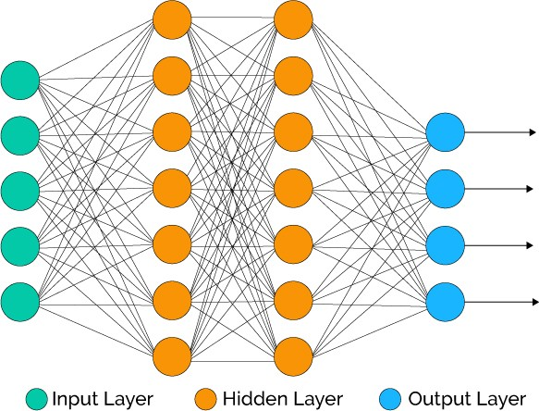
Convolutional Neural Network

Slide 12
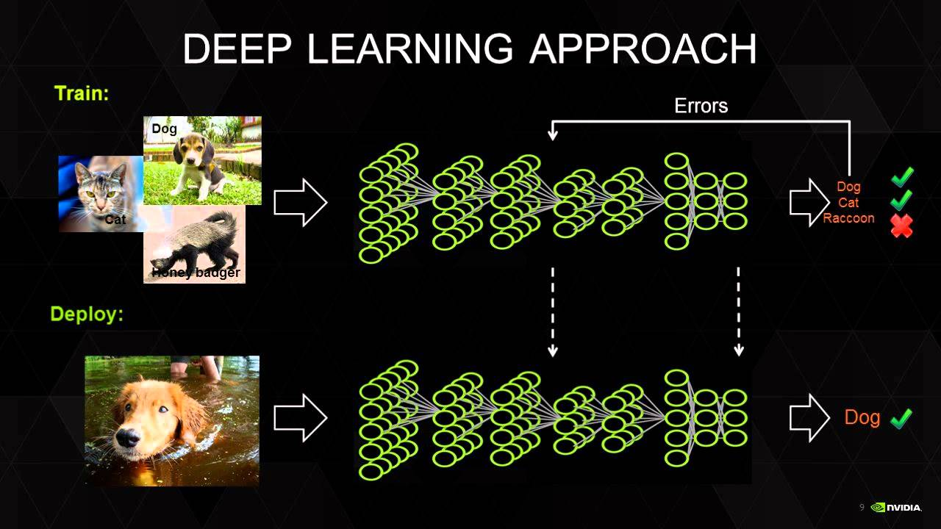
Image recognition how can it be achieved?

Slide 13
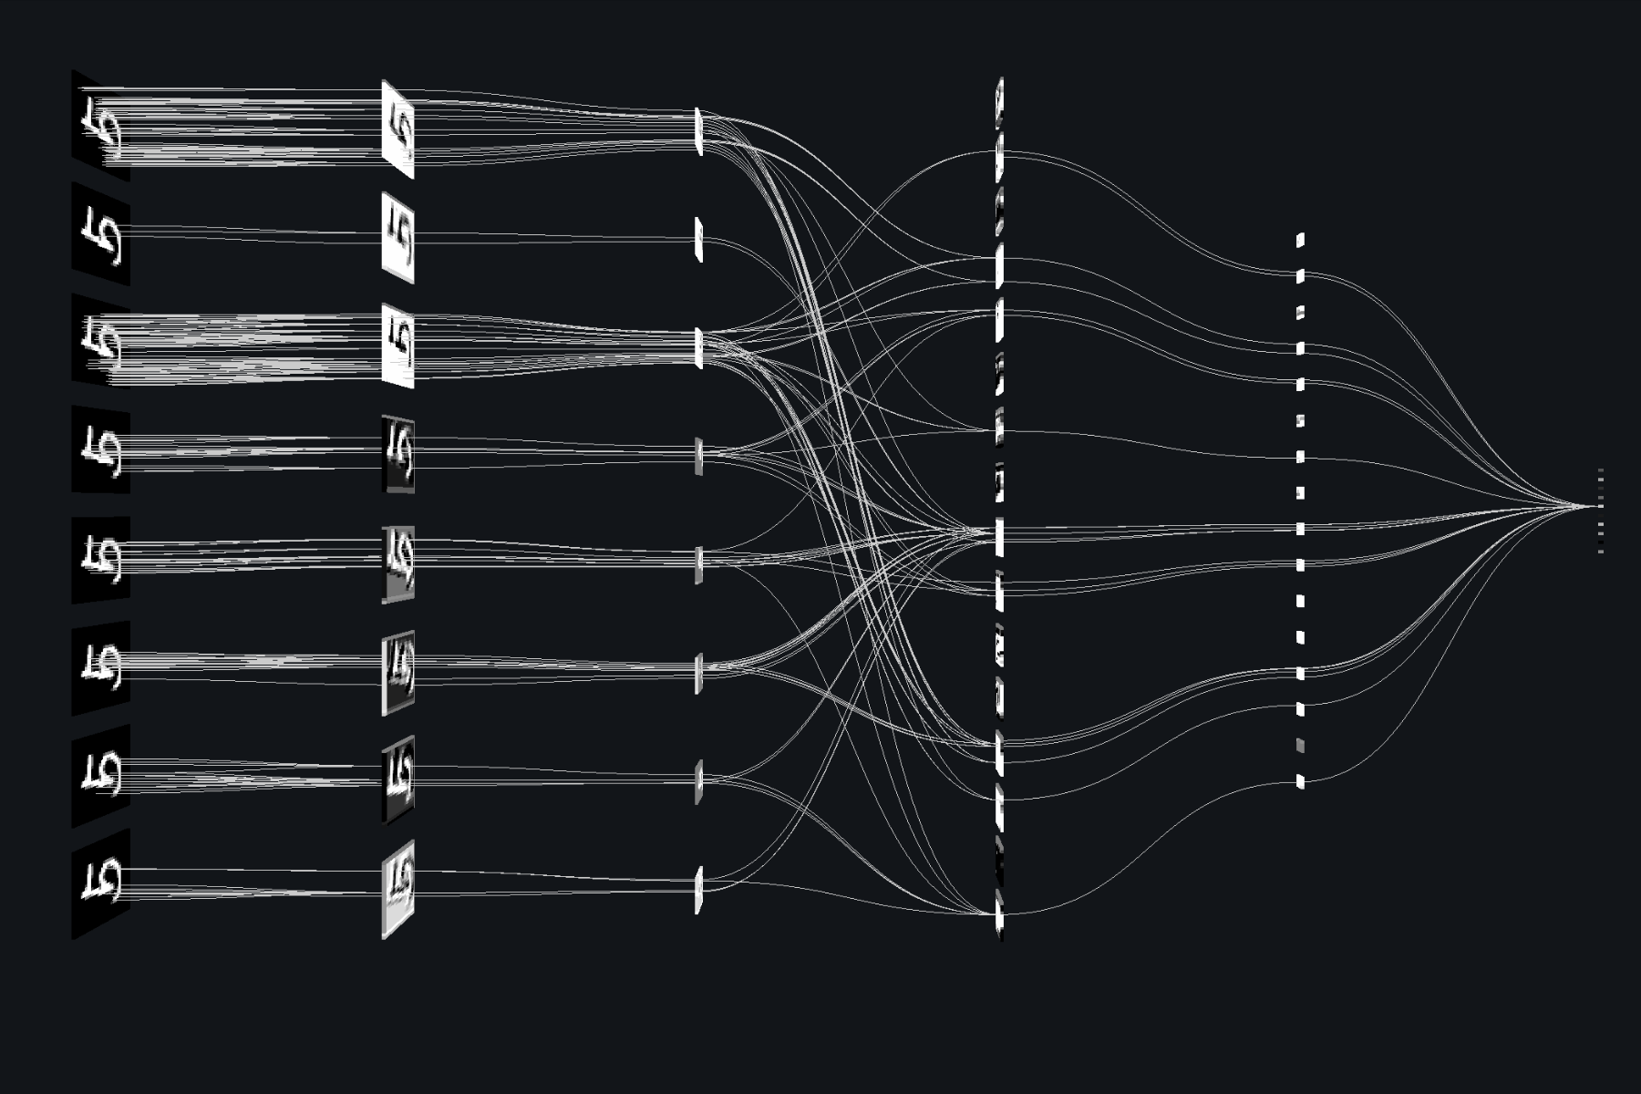
Implementation

Slide 14
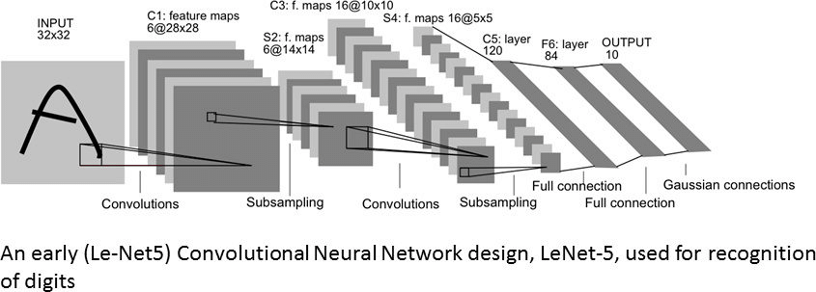

Slide 15
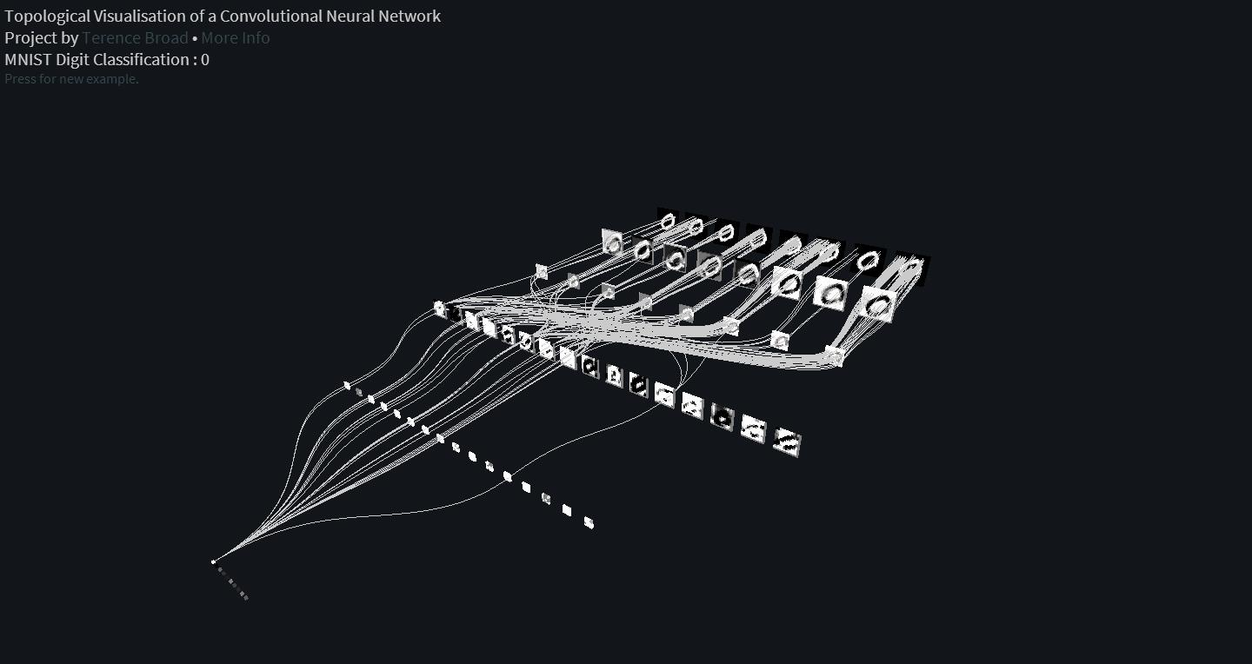

Slide 16
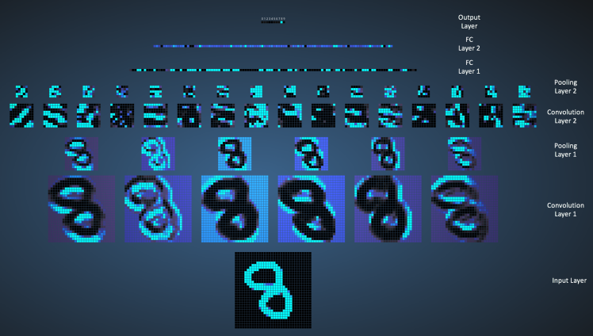

Slide 17
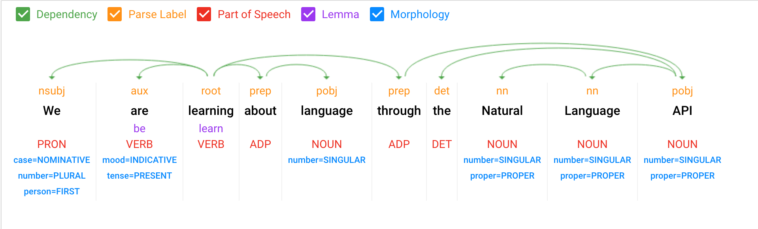
Natural Language Processing

Slide 18
SYSTEM REQUIREMENTS:
Operating System - Windows 10(preferred)
Processor - Intel i7
Speed - 3.0 GHz
RAM - 16 GB (min)
Hard Disk - 100 GB
Programming Language - Python
Graphic card NVidia with CUBA Support
Anaconda IDE
Tensor Flow
Nvidia cuDNN API
EMNIST Dataset

Slide 19
Individual Contribution
Name | Individual Programming Responsibility
Mohan Krishna B | Machine Learning and neural networks for creating the model
Swathi Madhavan | Natural Language processing for post processing the text conversion
Prakash H | Programming Script to input the document and classify the document into sentences, words and character segmentation.
Rahul N

Slide 20
Conclusion:
In this project we develop a Machine learning Neural Network model that can be used to convert the handwritten text document to digital document consisting of Unicode-8 characters.
The efficiency is further improved my post-processing the word into Natural Language processing model to make minor changes to the word and sentences.

Slide 21
NEW HORIZON COLLEGE OF ENGINEERING
(Accredited by NAAC with ‘A’ Grade, permanently affiliated to VTU)
Outer Ring Road, Panathur post, Kadubisanahalli,
BANGALORE-560103

