Slide 1
How To Use PowerPoint A Brief Introduction to Commonly Used Features

Slide 2
Introduction
PowerPoint is a very commonly used, fairly powerful presentation software from Microsoft. In your academic career (undergrad, graduate, or professional) there is a good chance that you have been or will be exposed to this tool. Furthermore, most of you will need to use it. This slide show is intended not only to be presented as a user guide to PowerPoint, but to be distributed as a way to practice what you learn as you learn it.

Slide 3
What Will be Demonstrated
Adding Slides to a Presentation
Using a Uniform Appearance/Motif
How to Vary Slide Layout and Text (font, size, color)
Using Graphics from ClipArt or a File
Using Animated Text (Timed and Manual)
Applying Slide Transitions
Adding Sound (From a File or the Gallery)
Using AutoShapes
Adding Videos and Animation
Placing Action Buttons for Nonlinear Slide Selection
Linking to Web Content or Email Addresses

Slide 4
Adding/Formatting Slides
Right-Click the Timeline to the left ← and go to “New Slide”
OR go to “Insert” and select “New Slide”
Open the “Layout” tab to the right → to change the format of a slide

Slide 5
Appearance/Motif
You can Apply a Motif by Opening the “Design” tab on the right →
Then Click on the Desired Motif to apply it to all slides
Click on the small drop down if you wish to apply the motif to only the current slide

Slide 6
Variation in Layout and Text
To Select a New Slide Layout, Open the “Layout” Tab to the right →
You can Use the Font Color drop down menu to change the text color
Use the Drop Down Font and Size menus above to vary the text

Slide 7


Clip Art Graphics
To Insert ClipArt, go to “Insert” and put your mouse on “Picture”
Another Menu will Open, select ClipArt
Once you Select your Image, You must Position and Resize it with the Mouse

Slide 8
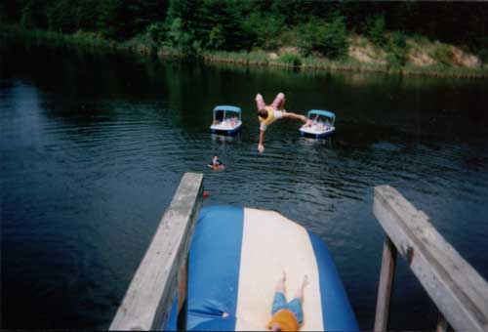

File Graphics
To Insert a File Image, go to “Insert” and put your mouse on “Picture”
Another Menu will Open, select “From File”
Once you Select your Image, You must Position and Resize it with the Mouse

