Slide 1



SMART INDIA HACKATHON 2026
TITLE PAGE
  Problem Statement ID –
  Problem Statement Title-
  Theme-
  PS Category- Software/Hardware
  Team ID-
  Team Name (Registered on portal)

Slide 2
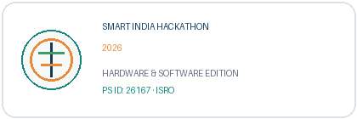
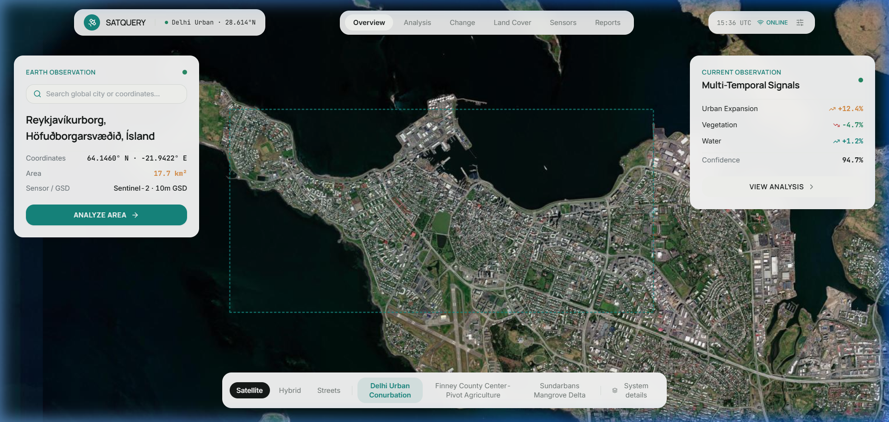




SMART INDIA HACKATHON 2026
ISRO · DEPARTMENT OF SPACE · THEME: SPACE TECHNOLOGY · SOFTWARE EDITION
SATQUERY AI
An Interactive Vision-Language Assistant for Multimodal Remote Sensing Image Analysis through Text Queries
NATURAL-LANGUAGE QUERY
MULTIMODAL ANALYSIS
AGENTIC AI ORCHESTRATION
Problem Statement ID: 26167
Problem Statement Title: SatQuery AI - An Interactive Vision-Language Assistant for Multimodal Remote Sensing Image Analysis through Text Queries
Organization: Indian Space Research Organisation (ISRO)
Department: Department of Space / Indian Space Research Organisation
Theme & Category: Space Technology · Software
Team Name & ID: Team SATQuery · SIH2026-26167
➔
➔
➔
SATELLITE
EARTH RASTER
MULTIMODAL AI
EVIDENCE
“From Satellite Data → Intelligent Evidence”
Verified Production System · SegFormer · BLIP-2 · CDVQA · Optical + SAR Fusion
SATQUERY AI • SIH 2026 • PS 26167 • ISRO • SPACE TECHNOLOGY

Slide 3

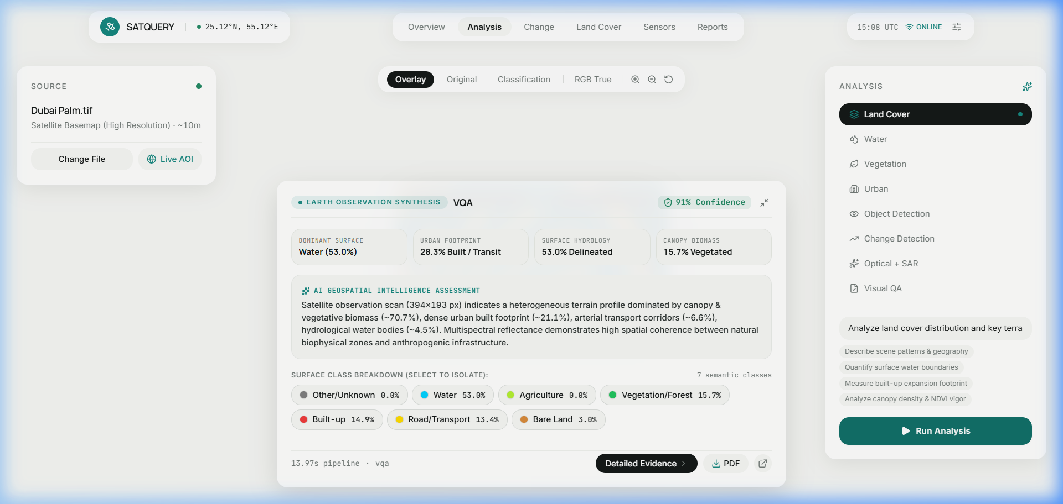
Team SATQuery
SATQUERY AI — FROM COMPLEX GIS TO NATURAL-LANGUAGE AI
FRAGMENTED TOOLS
Isolated specialist workflows
Land cover, change detection, VQA & SAR are siloed in disparate software.
EXPERT DEPENDENCY
High technical barrier
Requires manual parameter tuning: bands, radiometric calibration & CRS transforms.
MULTIMODAL COMPLEXITY
Data integration disconnect
Single optical images fail in clouds; optical, SAR & temporal passes remain uncoupled.
USER QUESTION
“What changed between
these two passes?”
AGENTIC CONTROLLER
Autonomous intent &
task classification
SPECIALIST AI
SegFormer · CDVQA
Optical + SAR Fusion
EVIDENCE OUTPUT
Pixel Masks · Hectares
Confidence & Audit Trace
➔
➔
➔
01
NATURAL LANGUAGE
Plain text query replacing GIS commands
02
AGENTIC ROUTING
Autonomous model and tool selection
03
OPTICAL + SAR FUSION
Multi-sensor day/night & cloud penetration
04
BI-TEMPORAL REASONING
Quantitative transition matrices & CDVQA
WHY SATQUERY? “One interface. Multiple specialist models. Evidence-grounded answers.”
SATQUERY AI • SIH 2026 • PS 26167 • ISRO • SPACE TECHNOLOGY
2

Slide 4




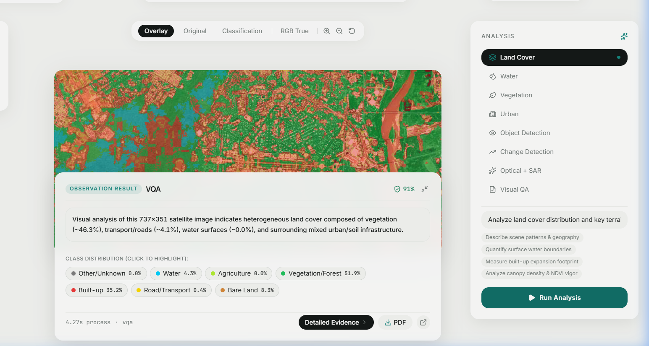

Team SATQuery
HOW SATQUERY AI WORKS
01
02
03
04
05
06
07
➔
➔
➔
➔
➔
➔
SATELLITE INPUT
GeoTIFF · Sentinel-1/2
Multi-Band Imagery
QUERY PARSING
Intent classification
Task identification
INPUT VALIDATION
CRS · Resolution
IoU Bounding Box
AGENTIC ROUTER
Specialist selection
Workflow planning
SPECIALIST AI
SegFormer · BLIP-2
CDVQA · Optical-SAR
EVIDENCE GEN
Pixel masks · NDVI
Confidence metric
ACTIONABLE OUTPUT
PDF / HTML Report
StepTracker audit
AGENTIC CONTROLLER & TASK ROUTING
SINGLE IMAGE
BI-TEMPORAL
OPTICAL + SAR
VQA · CAPTION · GROUNDING
CHANGE AI & TRANSITIONS
CROSS-MODAL FUSION
• RSVQA high-res adapter
• BLIP-2 scene captioner
• SegFormer-B0 land-cover
• CDVQA change VQA engine
• LEVIR-CD transition matrix
• Hectare / km² delta metrics
• Sentinel-1 SAR (VV/VH)
• Sentinel-2 MSI optical bands
• Cloud penetration consensus
① Natural Language Query
② Model Selection
③ Visual Evidence Overlay
④ Confidence Metric
⑤ Execution Trace
SATQUERY AI • SIH 2026 • PS 26167 • ISRO • SPACE TECHNOLOGY
3

Slide 5








Team SATQuery
FEASIBILITY & VIABILITY
TECHNICALLY FEASIBLE
POTENTIAL CHALLENGES
MITIGATION STRATEGIES
Open Geospatial Stack
Rasterio, GDAL, EPSG:3857/4326 affine coordinate transforms.
Optical Image Quality
Cloud occlusion, atmospheric haze, and night-time optical blindness.
Complementary SAR Fusion
SAR microwaves penetrate clouds and operate day/night unconditionally.
Open Satellite Datasets
Sentinel-1/2 (Copernicus), Landsat-8/9, LandCover.ai benchmarks.
Optical-SAR Alignment
Disparate sensor grids, spatial resolutions, and vantage angles.
Validate Spatial Compatibility
InputValidator verifies CRS & IoU bounding box overlap before inference.
Specialist AI Models
SegFormer-B0, CDVQA, BLIP-2 with remote-sensing domain adapters.
Large-Image Computation
Multi-gigabyte GeoTIFF rasters strain memory and inference latency.
Tiling & Patch Processing
Sub-region patch extraction (512x512) and pyramid tiling prevent OOM.
Web-Based Deployment
FastAPI async pipeline + React Leaflet hardware-accelerated viewer.
AI Reliability & Trust
Generic VLMs can hallucinate without spatial grounding verification.
Evidence-Grounded Output
Every response is tethered to pixel masks, spectral indices, & confidence.
BUILDABLE + SCALABLE + AUDITABLE: “Make complex multimodal satellite analysis accessible through one intelligent interface.”
SATQUERY AI • SIH 2026 • PS 26167 • ISRO • SPACE TECHNOLOGY
4

Slide 6





Team SATQuery
IMPACT & BENEFITS
SUPPORTED MODALITIES
SPECIALIST WORKFLOWS
EVIDENCE OUTPUT
REPORT GENERATION
SINGLE · BI-TEMPORAL
OPTICAL + SAR
21 REGISTERED TOOLS
PIXEL MASKS & STATS
AUDIT-READY DOSSIERS
Optical MSI, SAR Radar (VV/VH), Multi-Temporal
VQA, SegFormer, CDVQA, Grounding, Spectral Indices
Exact Hectares, km², NDVI, NDWI, NDBI & Confidence
Dynamic ReportLab PDF & HTML + StepTracker Trace
AGRICULTURE
Crop & Vegetation Monitoring
Quantify crop vigor, drought stress & irrigation dynamics.
• 10m Sentinel-2 MSI • NDVI/EVI vigor tracking • Field stress alerts
WATER RESOURCES
Hydrology & Catchment Basins
Delineate surface water bodies, reservoirs & river morphology.
• Automated NDWI thresholding • Temporal surface retention delta
URBAN PLANNING
Built-Up Footprint & Zoning
Track urban sprawl, impervious surfaces & infrastructure growth.
• SegFormer semantic extraction • NDBI built-up indices • Zoning audit
FOREST & ECOLOGY
Biomass & Conservation
Surveil dense forest cover, illegal clearing & coastal buffers.
• Multi-temporal change delta • Coastal CRZ protection monitoring
DISASTER RESPONSE
All-Weather Flood & Hazards
Rapid damage assessment during cyclones, floods & landslides.
• Sentinel-1 C-band SAR • Pierces cloud cover & night • Hour-zero triage
EARTH OBSERVATION
Sovereign Intelligence & Access
Democratize complex EO rasters for non-GIS domain specialists.
• 21 registered specialist tools • WGS84 & GeoTIFF spatial integrity
SATELLITE DATA (Optical / SAR / Pairs) ➔ AGENTIC AI ➔ VISUAL EVIDENCE ➔ ACTIONABLE INSIGHT ➔ DECISION SUPPORT
SATQUERY AI • SIH 2026 • PS 26167 • ISRO • SPACE TECHNOLOGY
5

Slide 7


Team SATQuery
RESEARCH, BENCHMARKS & TECHNICAL FOUNDATION
RESEARCH FOUNDATIONS & BENCHMARKS
HOW RESEARCH SUPPORTS SATQUERY
BigEarthNet — Remote-Sensing Representation Learning
Sumbul et al., IEEE IGARSS 2019 · Sentinel-2 multispectral band adaptation & land-cover taxonomy.
BigEarthNet ➔ Remote Sensing Adaptation Layer
RSVQA — Remote-Sensing Visual Question Answering
Lobry et al., IEEE TGRS 2020 · Foundational formulation for spatial counting, presence & relation VQA.
RSVQA ➔ Visual Question Answering (VQA) Module
VRSBench ➔ Region Grounding & Scene Captioning
VRSBench — Vision-Language Grounding & Captioning
Li et al., NeurIPS / IEEE 2024 · Evaluation benchmark for text-guided visual region reticles.
CDVQA ➔ Bi-Temporal Change Detection Engine
CDVQA — Bi-Temporal Change Detection VQA
Yuan et al., IEEE GRSL 2022 · Informs change reasoning and quantitative transition matrix extraction.
SEN1-2 ➔ Optical + SAR Cross-Modal Fusion
SegFormer — Semantic Transformer Segmentation
Xie et al., NeurIPS 2021 · Core neural backbone powering 6-class land cover segmentation on LandCover.ai.
Indian Space Policy 2023 ➔ Democratization of EO Data for Non-GIS Users
SEN1-2 — Optical-SAR Multimodal Learning
Schmitt et al., ISPRS Annals 2018 · Spatial co-registration & cross-spectral feature fusion standards.
🏛 ISRO Bhuvan & NRSC Compatibility: Adheres to OGC standards, WGS84 (EPSG:4326), Web Mercator (EPSG:3857) and GeoTIFF specifications for interoperable national infrastructure.
RESEARCH ➔ MODELS ➔ AGENTIC ORCHESTRATION ➔ EVIDENCE ➔ APPLICATION
SATQUERY AI • SIH 2026 • PS 26167 • ISRO • SPACE TECHNOLOGY
6

