Slide 1
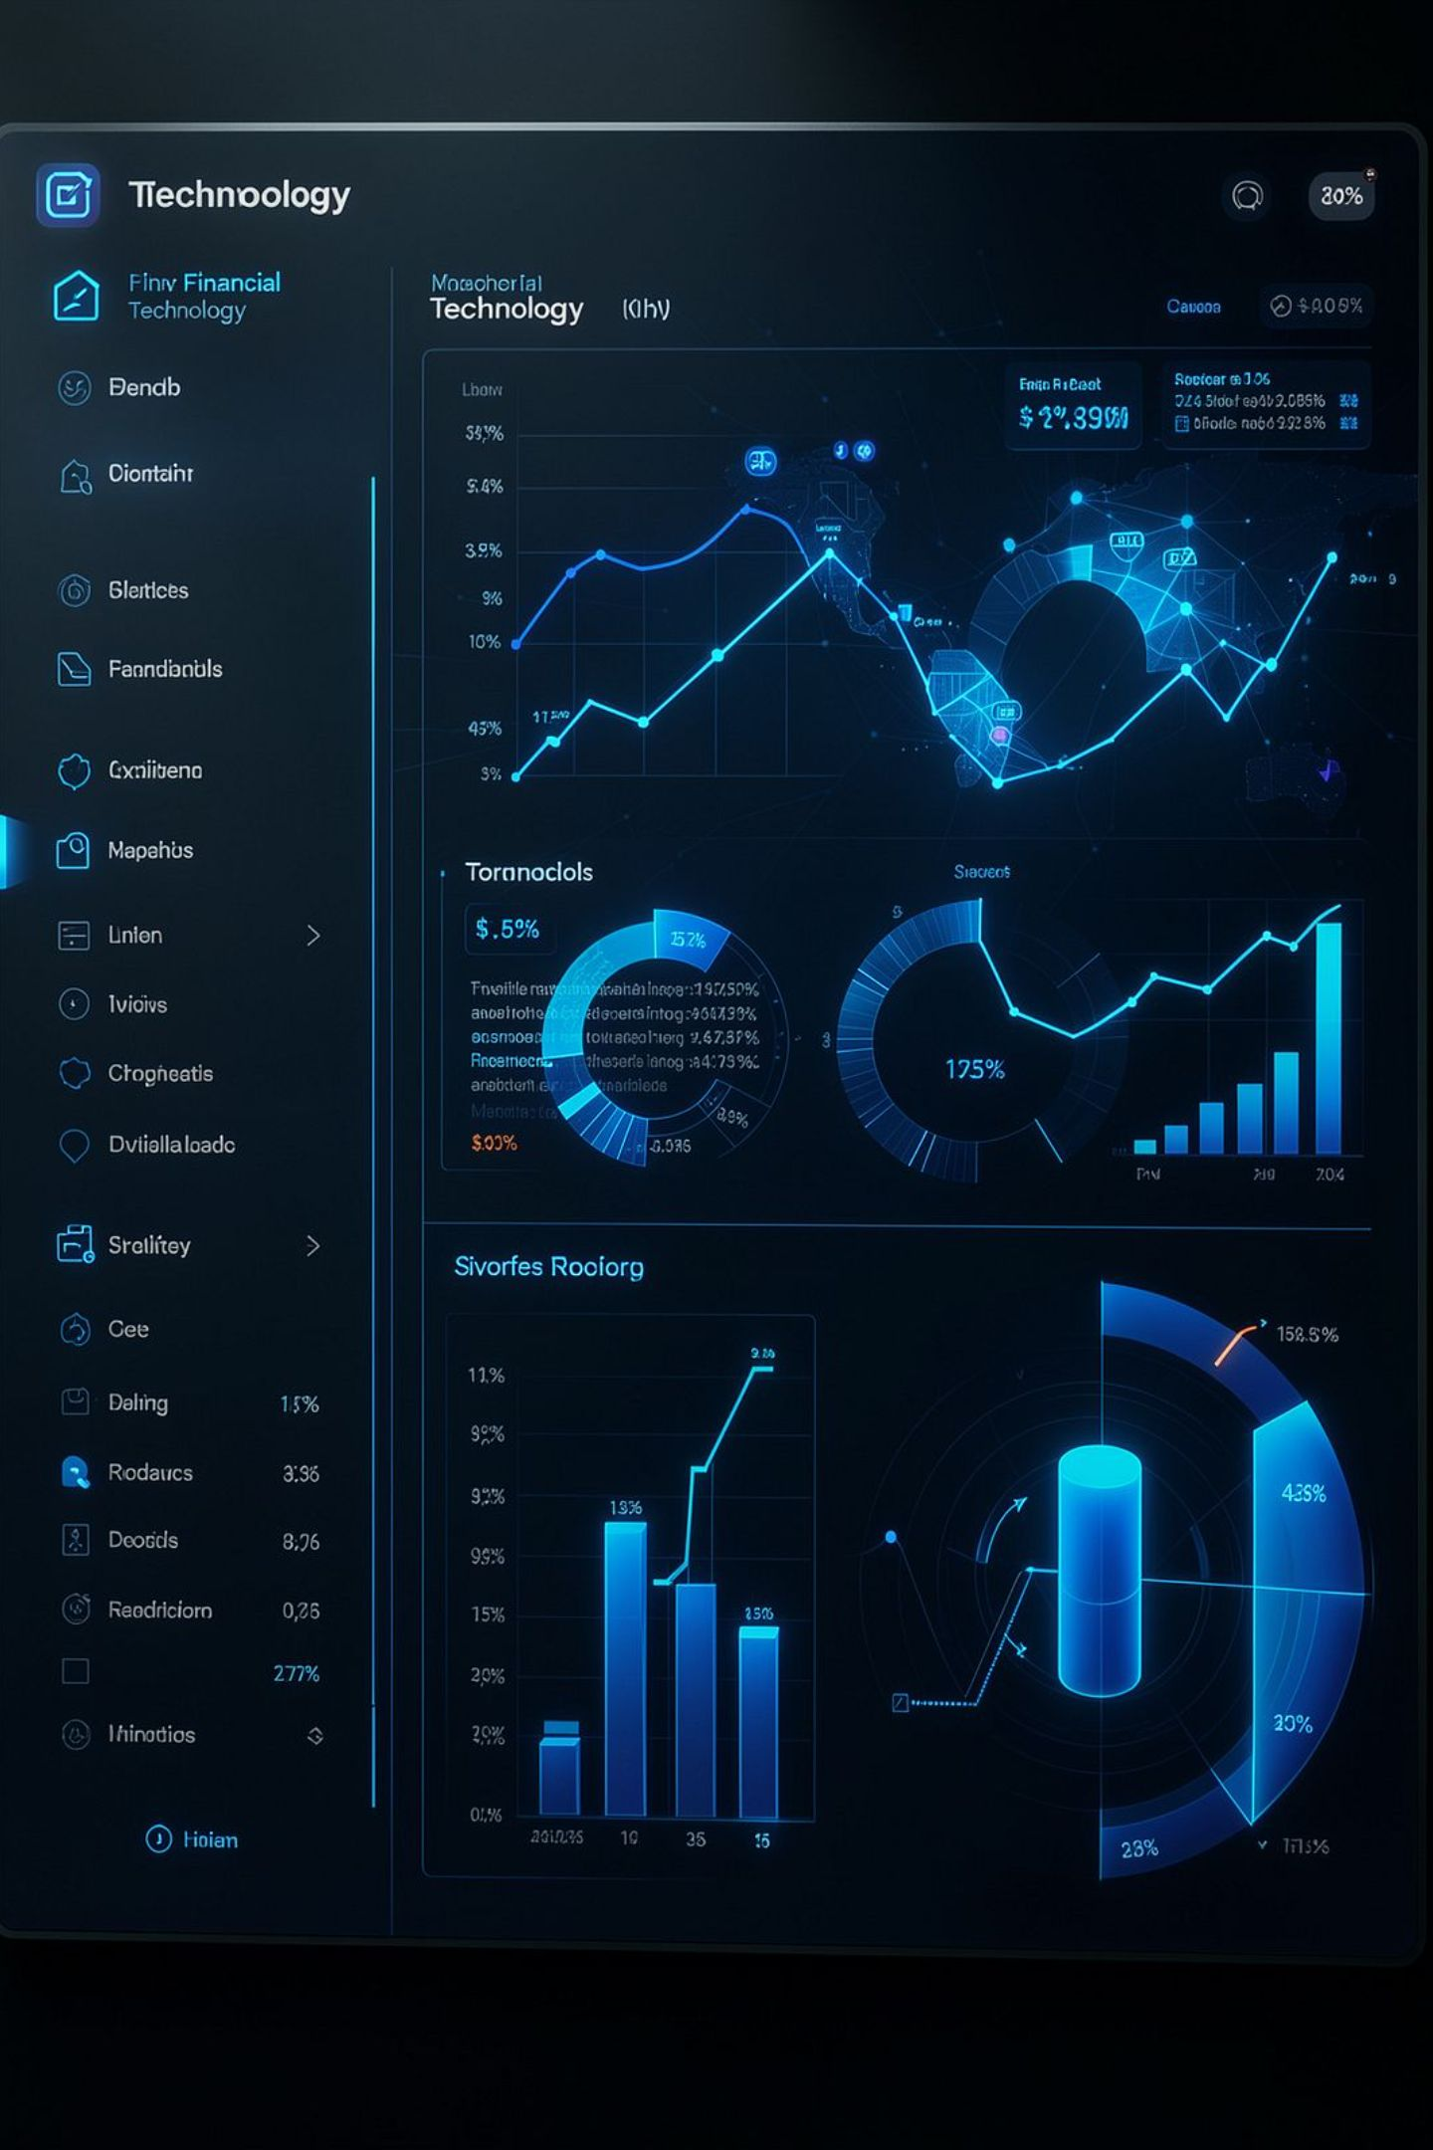
AI-Based Personalized Financial Planning System
B.E. COMPUTER SCIENCE ENGINEERING — ACADEMIC PROJECT REVIEW
Nagulan A
Mohanprasath P
Roll No: 240701344
Roll No: 240701328

Slide 2
ABSTRACT
AI-Based Personalized Financial Planning System
System Overview
A web-based financial planning platform powered by classical AI techniques. It is designed to be explainable, user-friendly, and practically actionable.
Core Capabilities
Tracks income, expenses, debts, assets, and goals
Uses expert systems, fuzzy logic, and health scoring
Optimizes portfolios with a genetic algorithm
Supports goal-oriented financial decisions

Slide 3
PROBLEM STATEMENT
Challenges in Personal Financial Planning
The Core Problem
Why Existing Tools Fall Short
Most individuals lack structured tools to evaluate their overall financial health holistically. Balancing income, expenses, debt, savings, and investments at the same time is difficult without intelligent decision support.
Most apps focus on tracking and reporting, not advising
Generic advice ignores personal goals and risk tolerance
Consumer tools rarely provide integrated, risk-aware reasoning

Slide 4
LITERATURE SURVEY
Existing Approaches in Financial Decision Support
Traditional Tools
Budgeting apps like Mint and YNAB focus on expense tracking
Dashboards summarize past activity but offer no forward-looking guidance
Spreadsheets require manual input and significant user expertise
Classical AI Methods
Rule-based systems encode financial heuristics for structured decisions
Fuzzy logic models uncertainty in risk tolerance
Genetic algorithms support portfolio optimization and asset allocation
Current Gap / Opportunity
Existing techniques work in isolation rather than as one integrated system
ML approaches often lack transparency and interpretability
A unified, explainable platform could combine profiling, scoring, risk analysis, and optimization

Slide 5

RESEARCH GAP
What Existing Solutions Miss
Tracking Over Advising
Siloed Data
Identified Research Need: One transparent platform for profile management, explainable reasoning, risk evaluation, and portfolio optimization.
Profiles, goals, risk, and optimization stay separate
Historical tracking, not forward-looking advice
This Project's Contribution
Integrated, explainable, personalized financial planning with classical AI.
No Transparency
Fragmented AI
Rules, fuzzy risk, and optimization are not unified
Recommendation logic is rarely explained

Slide 6
OBJECTIVES
Project Objectives
1
Intelligent Financial Assessment
2
Profile Management & Goal Tracking
AI-based assessment of income, expenses, debt, and assets.
Structured profiles with goal planning and progress monitoring.
3
Health Scoring & Risk Profiling
4
Personalized Investment Strategy
Quantified financial health scores using expert rules and fuzzy logic.
Tailored recommendations based on income, debt, expenses, and risk tolerance.
5
Genetic Algorithm Portfolio Optimization
6
Explainable Financial Reports
DEAP-based allocation optimization within financial constraints.
Clear reports with actionable insights and PDF export.

Slide 7
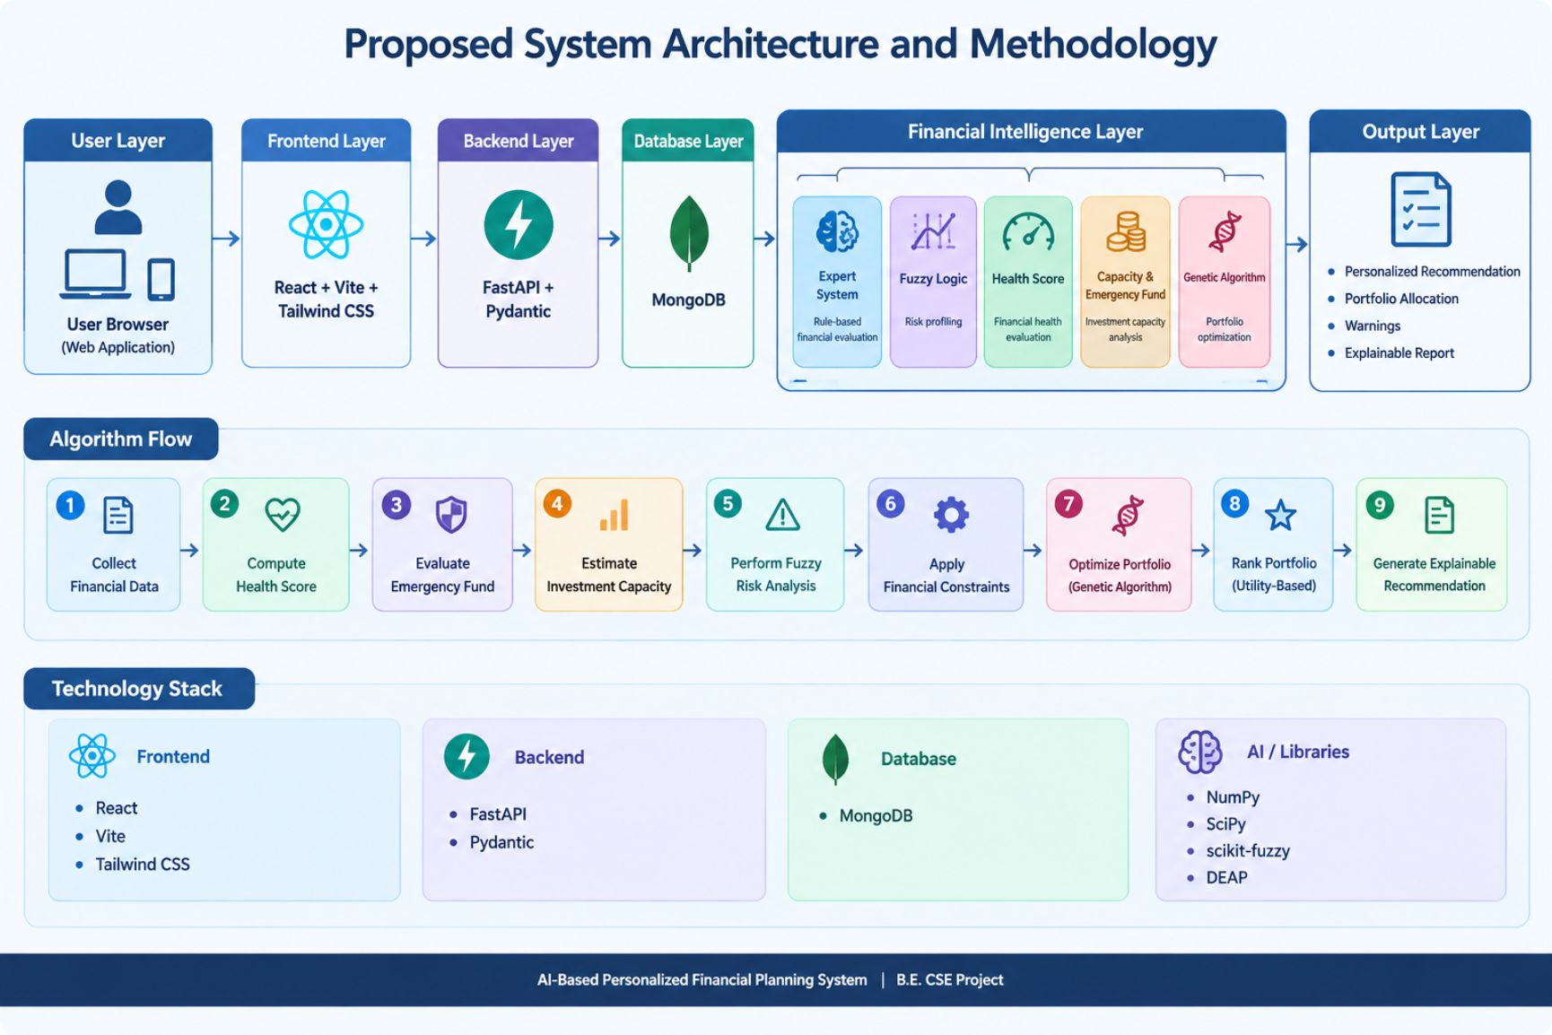
SYSTEM ARCHITECTURE & METHODOLOGY
Proposed System Architecture
Technology Stack
Frontend
React · Vite · Tailwind
Backend
FastAPI · Python
Database
MongoDB
AI Tools
NumPy · SciPy · scikit-fuzzy · DEAP
Core AI Modules
Expert System — Rule-based evaluation
Fuzzy Logic — Risk profiling
Health Scoring — Financial wellness score
Capacity Analysis — Savings and investment capacity
Genetic Algorithm — Portfolio optimization

Slide 8
IMPLEMENTATION
Software, System Requirements & Implementation
Core Implementation Features
Software Stack
Layer | Technology
Runtime | Python 3.10+, Node.js 18+
Frontend | React.js, Vite, Tailwind CSS
Backend API | FastAPI, Pydantic
Database | MongoDB 7+
AI Libraries | NumPy, SciPy, scikit-fuzzy, DEAP
Authentication & Security
Profile & Goal Management
JWT auth, authorization, and secure sessions.
Create financial profiles, set goals, and track progress.
AI Recommendation Engine
Scenario Simulation
What-if modeling to compare financial decisions.
Risk assessment, health scoring, and personalized recommendations.
System Requirements
RAM
Browser
Portfolio & Reporting
8 GB
Modern browser + internet
Optimized allocation, monthly reports, and PDF export.
IDE
VS Code or compatible

Slide 9
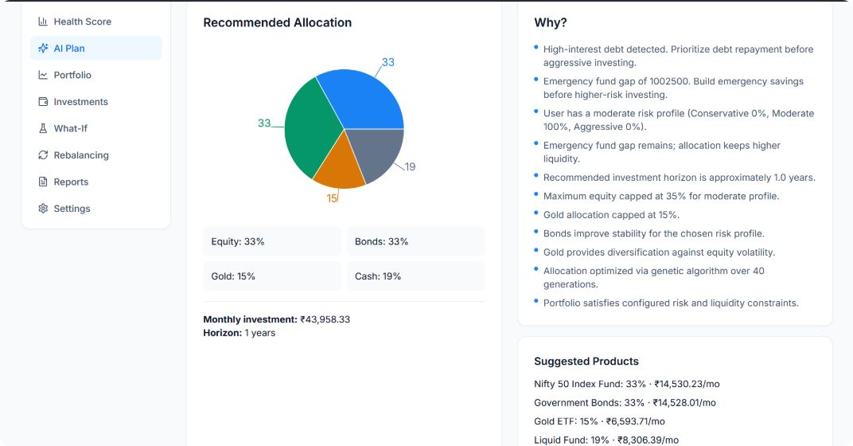
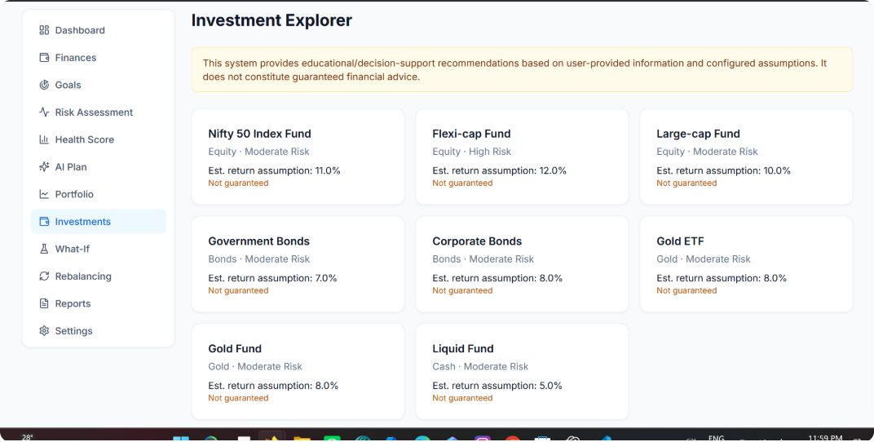
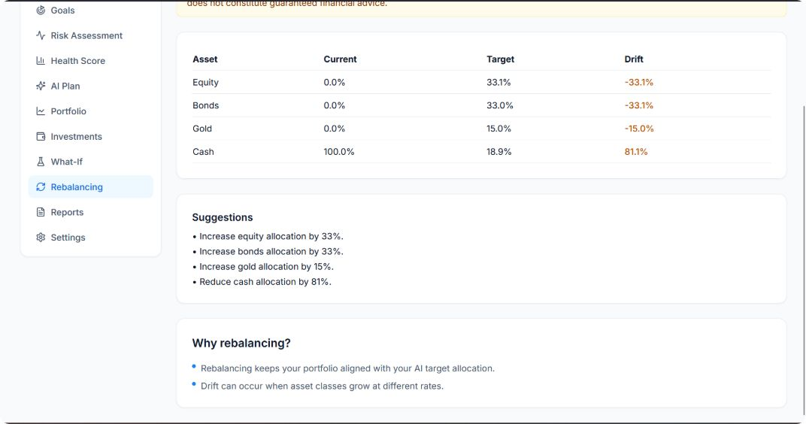
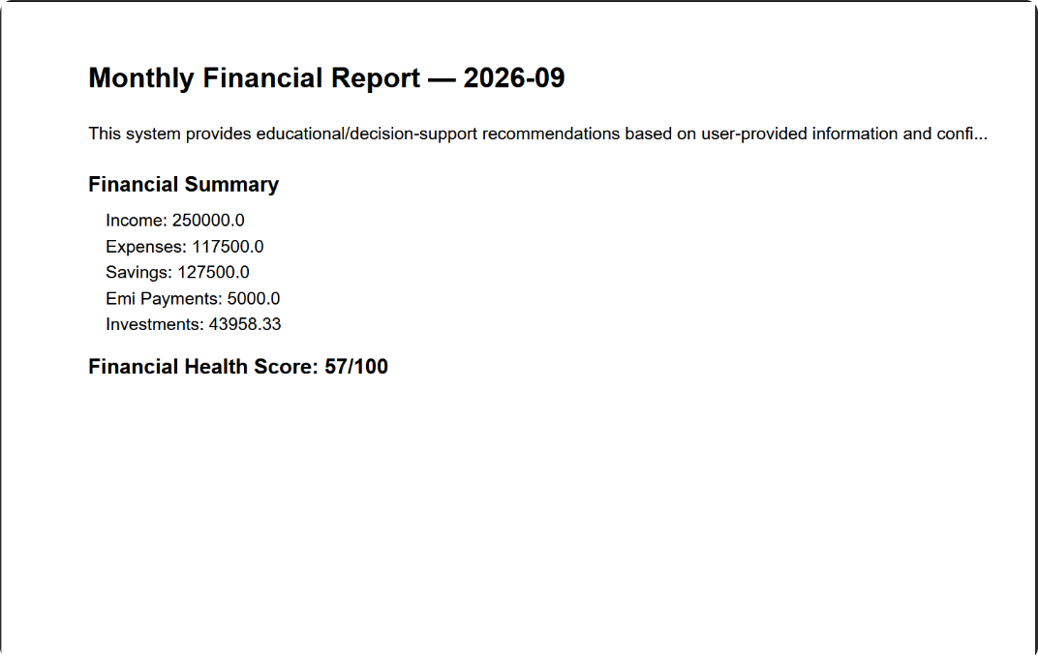
OUTPUT & RESULTS
System Output Demonstrations
Financial Health Dashboard — Personalized metrics, key indicators, and goal progress at a glance
Risk Profile & Health Score — Fuzzy logic-driven risk assessment with explainable scoring output
Portfolio Allocation & Recommendations — Genetic algorithm-optimized investment breakdown with reasoning
Monthly Report & PDF Export — Actionable insights with scenario simulation and offline-accessible reports

