Slide 1


Slide 2
Agenda :
-Introduction
-Problems
-SMART
-OAuth
-Two Methods of Launching SMART-on-FHIR Apps
-Scopes(Permissions)

Slide 3
Introduction
-2009 : Mandl & Kohane recognized the Inflexible Architecture of EHR systems
-Inspired by well defined morden API Standard.
- EHR systems as a platform.
-2010 : Joshua Mandel & team started developing SMART in Boston Children’s Hospital and Harvard Medical School
-ONC funded $15m

Slide 4
Problem
- no security standard for connecting 3rd party apps with EHR
- patients and clinicians should use the apps provided by the EHR system they have.
- apps created for one EHR system can't use for different EHR system.
- Any application development that using EHR data could only be done by the application vendor, reducing the possibility of developing specialized and innovative applications.

Slide 5
SMART-Substitutable Medical Applications Reusable Technologies
-Goal : to enable any developer to create a healthcare application that would work at any healthcare organization, regardless of EHR.
Challenge : standard for sharing granular clinical data
-SMART + FHIR = SMART-on-FHIR
-SMART on FHIR defined a way for health apps to connect to EHR systems with appropriate security guarantees.
-Connect 3rd party apps to EHR Data.
-User : App Choice (Substitutable).
-app launch : From Inside or Outside of EHR System.

Slide 6
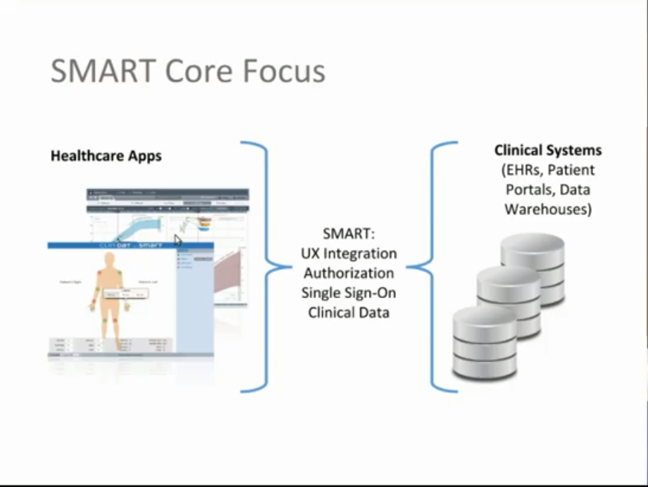

Slide 7
OAuth(Open Authorization)
OAuth doesn't share password data but instead uses authorization tokens to prove an identity between consumers and service providers. OAuth is an authentication protocol that allows you to approve one application interacting with another on your behalf without giving away your password.

Slide 8
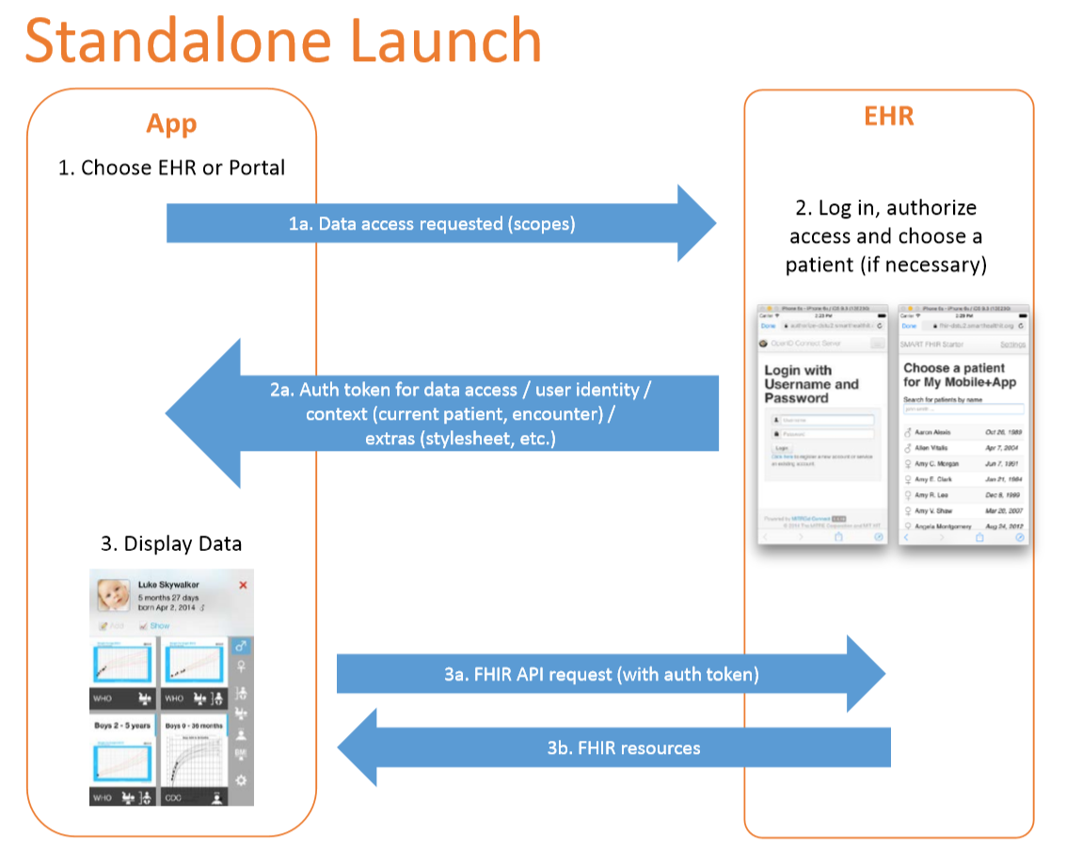

Slide 9
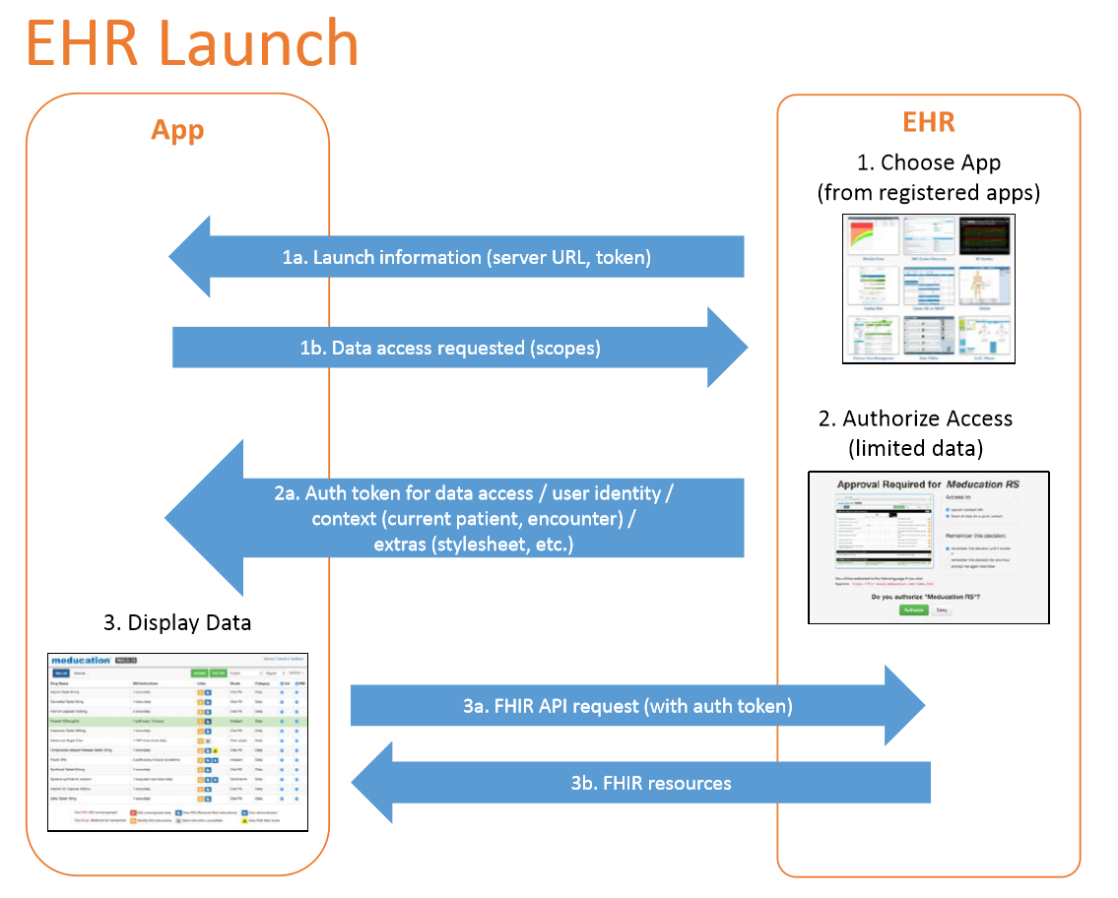

Slide 10
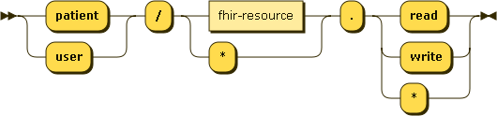
Scopes for requesting clinical data
-Scopes tell the what are all the Permissions the app need
Patient/Patient.read
Access type FHIR Resource Permission
- read and write permissions for patient-specific and user-level access.
-wildcard (*) for both.

Slide 11
cont...
-Patient/Medication.read , Patient/Observation.*
-Patient/*.read(All Resources)
-Patient/Medication.write
-User/*.read
Note : Observation can contain sensitive data.

Slide 12
-Bilirubin App : uses time of birth and serum bilirubin levels to monitor and flag risk for kernicterus.
-Meducation App :. uses a medication list to produce patient-friendly instructions in 12 languages.
-CARDIAC CONSULTANT App : https://asymmetrik.com/solutions/healthcare/health-risk-assessment/
- App Gallery : https://apps.smarthealthit.org/
-Library : https://github.com/smart-on-fhir/client-js
-for testing apps : https://launch.smarthealthit.org/
-Youtube : https://www.youtube.com/watch?v=N0PXAxBA-J8&t=1876s (by Josh Mandel)

