Slide 1
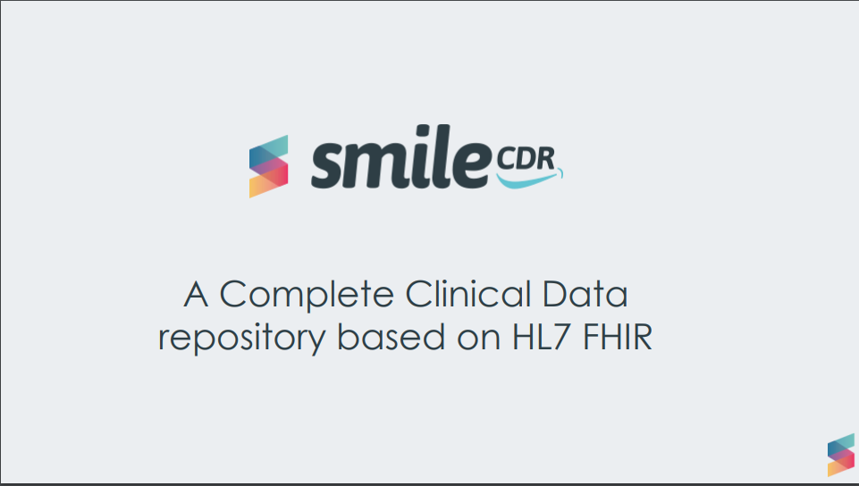

Slide 2
Complete FHIR Support
Powered by HAPI FHIR
Support for all published versions of FHIR
This includes stable long term support for published versions and immediate bleeding edge support for upcoming versions

Slide 3
Deployment models
Smile CDR supports several configurations:
• Cloud deployment,
• Local deployment
Configurable options:
• Multiple database options; Oracle, MariaDB, PostgreSQL, MySQL, Derby

Slide 4
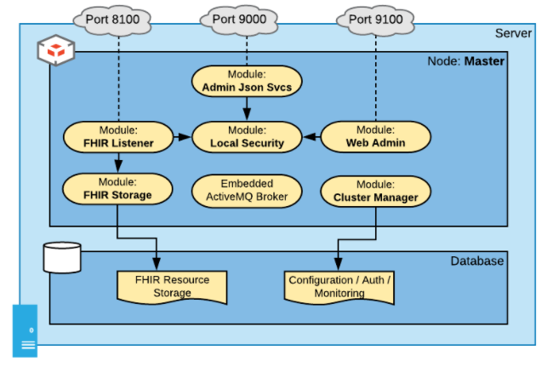
Basic Configuration
The following diagram shows the modules in a default installation of Smile CDR.

Slide 5
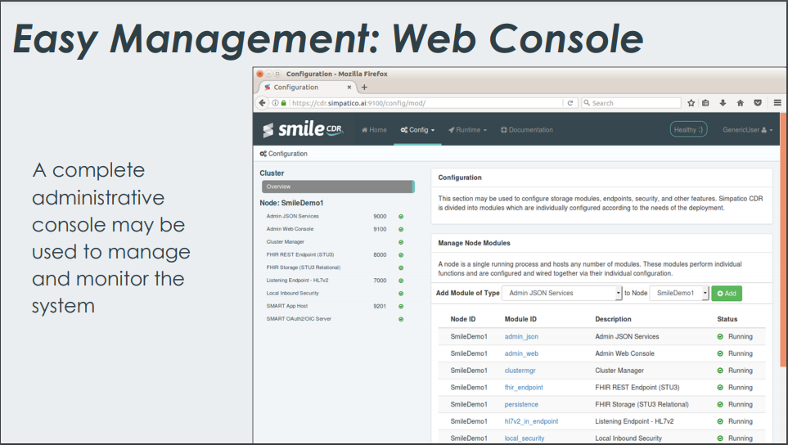

Slide 6
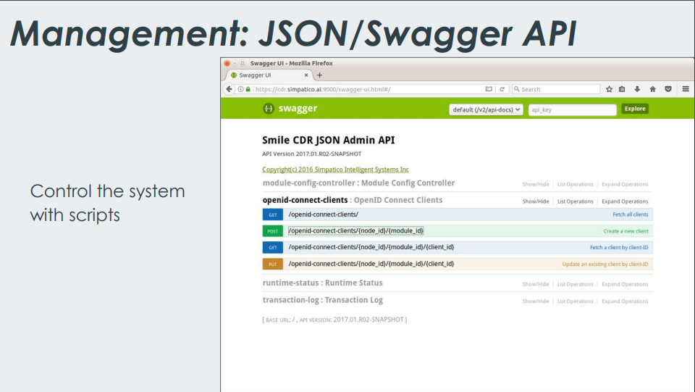

Slide 7
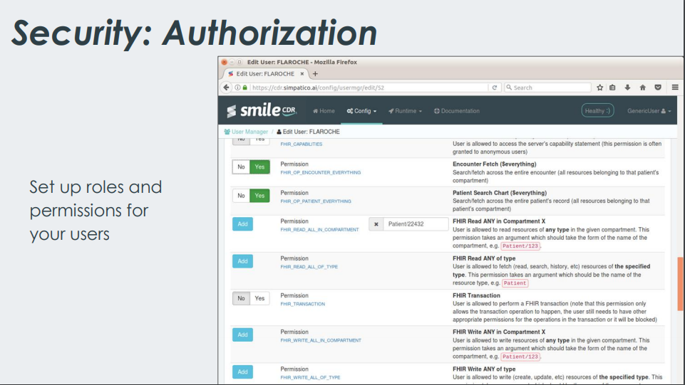

Slide 8
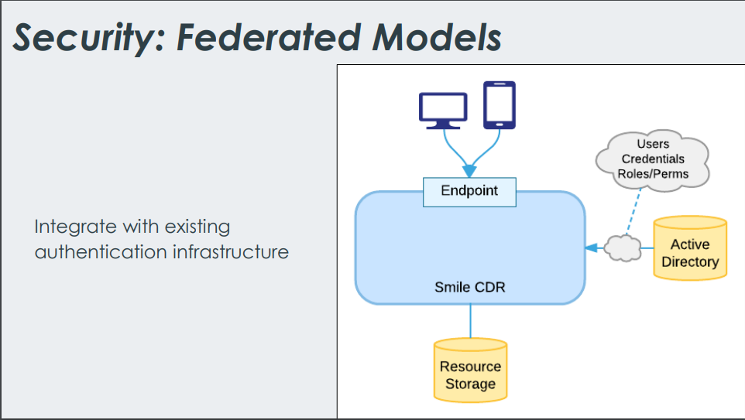

Slide 9
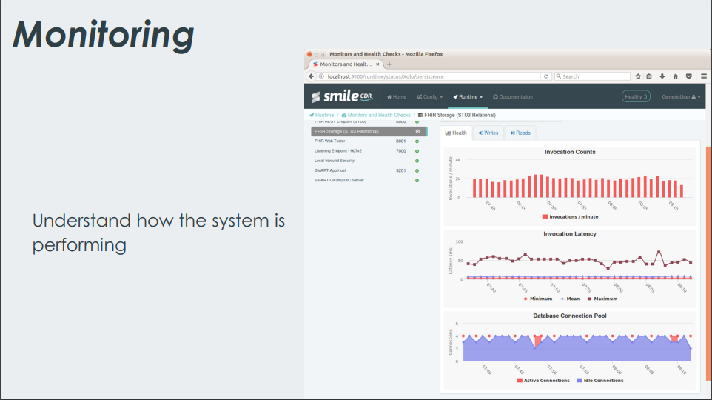

Slide 10
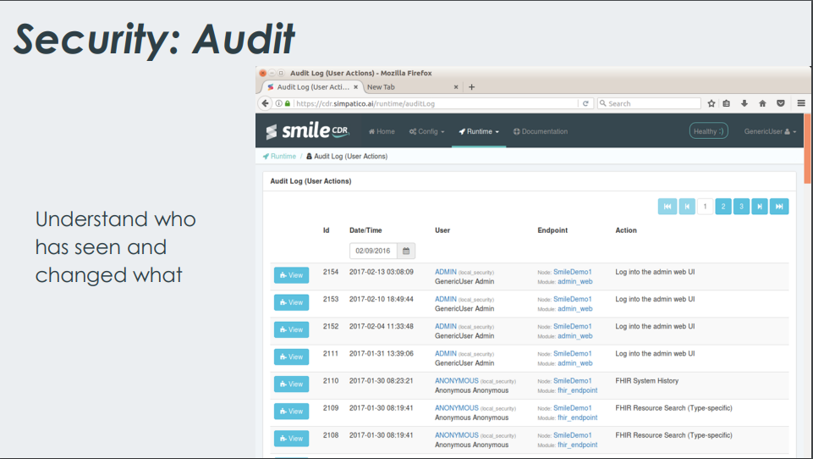

Slide 11
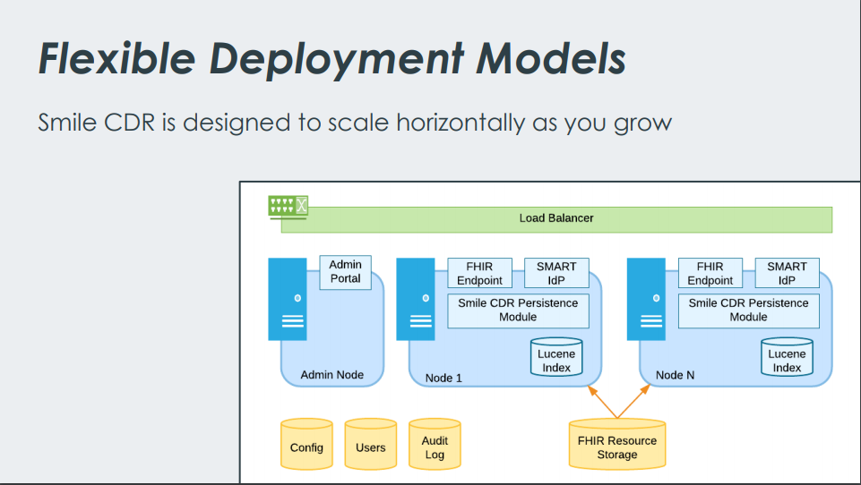

Slide 12
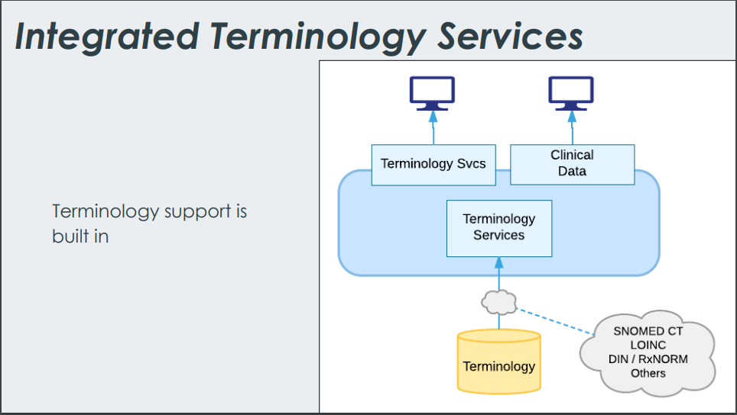

Slide 13
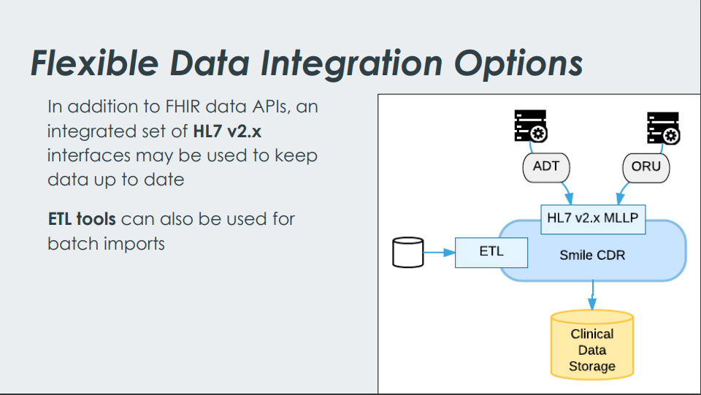

Slide 14
FHIR Endpoint Module
The FHIR Endpoint module is an HTTP Server (i.e. a web server) that allows external clients to interact with the FHIR Storage module.
FHIR Storage Module
The FHIR Storage module is responsible for resource storage and retrieval. It stores data in two places:
A relational database is used as the primary storage mechanism. All resources are stored in the database and indexes are created to help in finding them.
A Lucene file system is used to provide full text searching capability, as well as to support some terminology service functions.
Custom Search Parameters

Slide 15
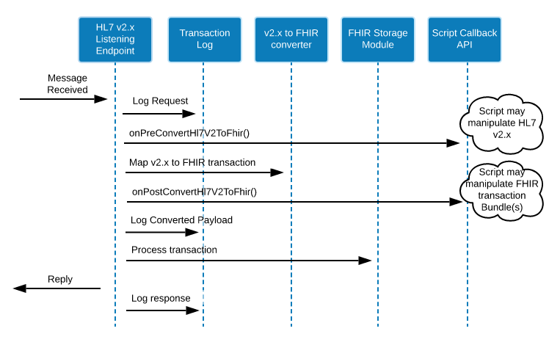
CDA Module
Smile CDR includes a CDA document generation tool capable of transforming a Bundle of Fhir resources into a CDA XML document.
Monitoring Endpoints
Each Module has an EndPoints for Monitor the availability
HL7 V2 - FHIR
Callback Scripts

Slide 16
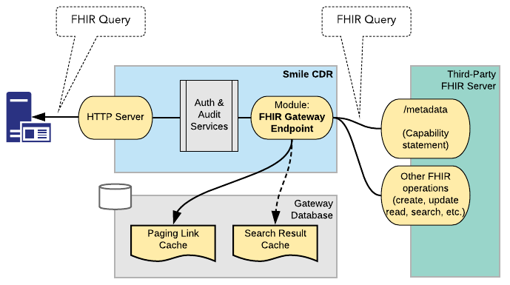
FHIR Gateway Endpoint

Slide 17
Narrative Generator
Automatically generating narratives based on your resources.may include a human-readable narrative that contains a summary of the resource and may be used to represent the content of the resource to a human.
Subscription
The subscription resource is used to define a push-based subscription from a server to another system. Once a subscription is registered with the server, the server checks every resource that is created or updated, and if the resource matches the given criteria, it sends a message on the defined "channel" so that another system can take an appropriate action.

Slide 18
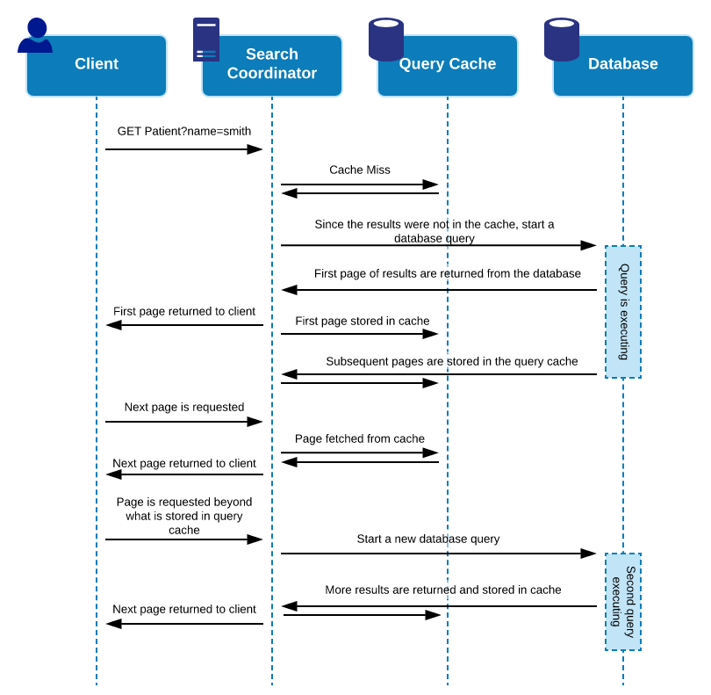
FHIR Performance and Caching
Smile CDR uses an internal mechanism called the Search Coordinator, which executes database search queries in a background thread in order to minimize the amount of time that a client waits for search results to become available.
LiveBundle
create a Watchlist of group of Patients so LiveBundle will start tracking data for this patient based on some rules.

Slide 19
SECURITY
Inbound Security Module
LDAP Inbound Security Module
Scripted Inbound Security Module
SMART Outbound Security Module
SMART Inbound Security Module
OpenID Connect -OpenID Connect Clients
-OpenID Connect Servers

Slide 20
Enterprise Master Person Index (EMPI)
An Enterprise Master Patient Index (EMPI) allows for links to be created and maintained between different Patient and/or Practitioner resources. These links are used to indicate the fact that different Patient/Practitioner resources are known or believed to refer to the same actual (real world) person.
EMPI watches for incoming Patient resources and automatically links them to Person resources based on the rules.
Hybrid Providers
Use SmileCDR as a facade for your internal systems.

Slide 21
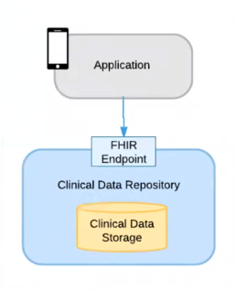
Some Use cases:
-Archival storage of clinical records
-Rapid development for health applications
-CDR for Hospitals
-Centralized CDR for Government/Research

Slide 22
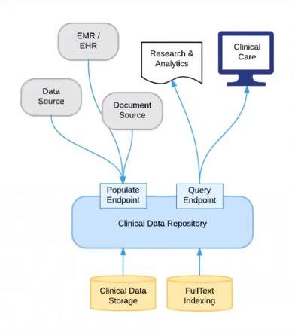
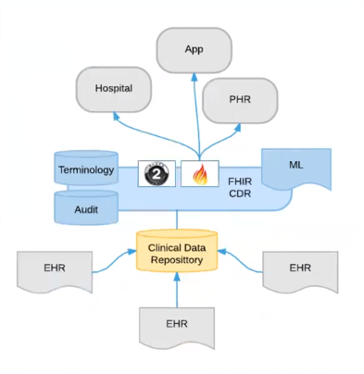

Slide 23
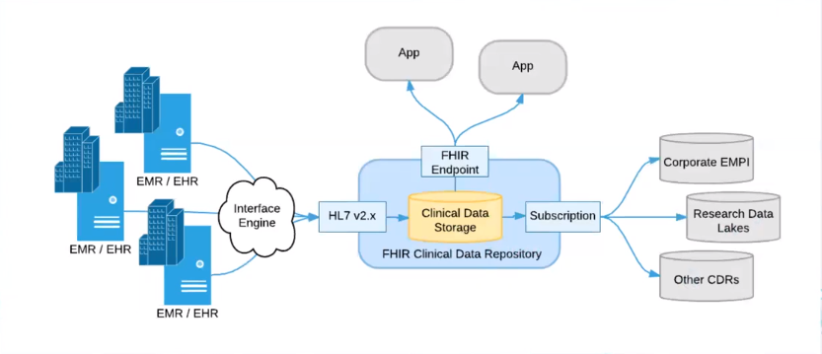
Case study:

Slide 24
Case study:
A Leading Diagnostics Company Uses Smile CDR to Accelerate SMART on FHIR Integration with Apple Health.

Slide 25
Thank you

