Slide 1
Apigee

Slide 2
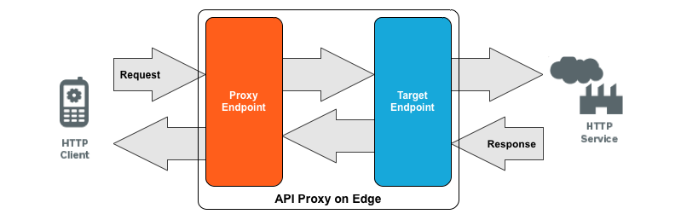
apigee
Apigee Edge is a platform for developing and managing APIs with a proxy layer. Cloud based management tool.

Slide 3
-Security
-Client benefits
-Monetize
-Analize

Slide 4
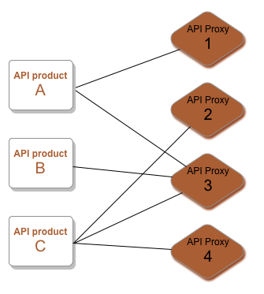
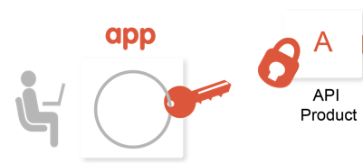
API Product:
An API product is a bundle of API proxies combined with a service plan.
That service plan can set access limits on API proxies, provide security, allow monitoring and analytics.

Slide 5
Portal :
We can add multiple Api Products based on customer requirements into a portal and provide portal url to consumers.
Out-of-the-box, the developer portal enables your portal users to create a developer account, sign in, and manage the apps that will consume your APIs.
Policies:
There are 30+ Policies are available in Apigee edge for security, Traffic management and mediation.
Some of the policies are
-ResponseCache policy
-Quota policy
-Access control
-SpikeArrest policy
-JSONtoXML policy
-XMLtoJSON policy
-OAuth v2 policies
-VerifyAPIKey policy
Extension: JavaScript,Python, java Callout

