Slide 1
CDS-Hooks

Slide 2
Problem with smart apps:
How the user know , the app is available?
That app is relevant or not?
Where to find?
CDS-hooks
Vender agnostic remote decision support.
Started by SMART Team
Open source and Project under HL7

Slide 3
CDS Service
Invoked by EHR via a hook(external from EHR),
Run own logic using FHIR data,
info/suggestion/APP link as a Card
Example Hooks
Patient-view
Medication-prescribe

Slide 4
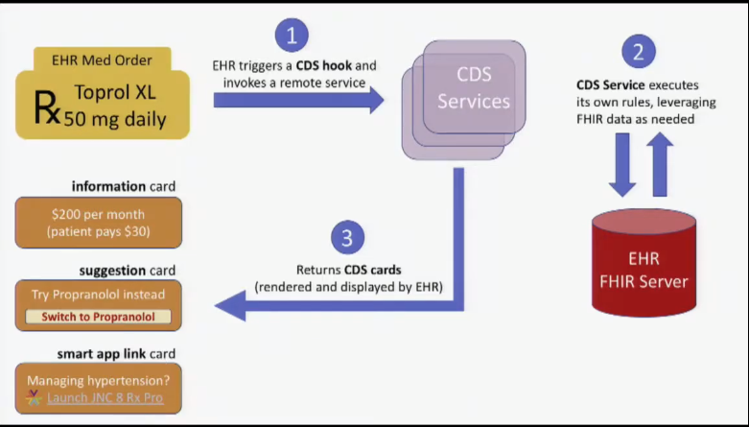

Slide 5
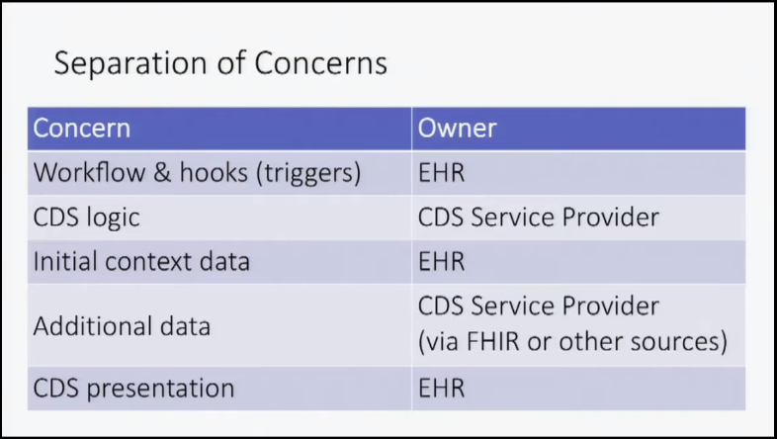

Slide 6
Cards :
CDS service can return any number of cards
Each card must have:
A concise summary
An indicator noting the importance of the card
Information on the organization or data set that is the source of the card’s data

Slide 7
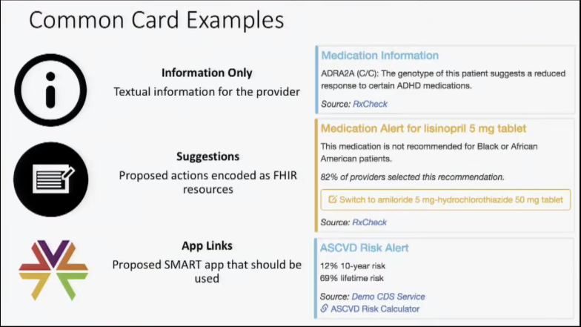

Slide 8
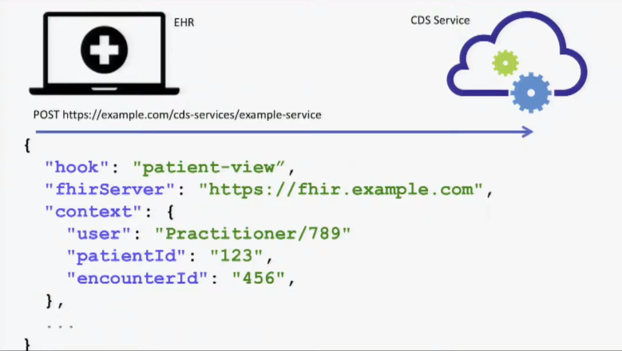
Request:

Slide 9
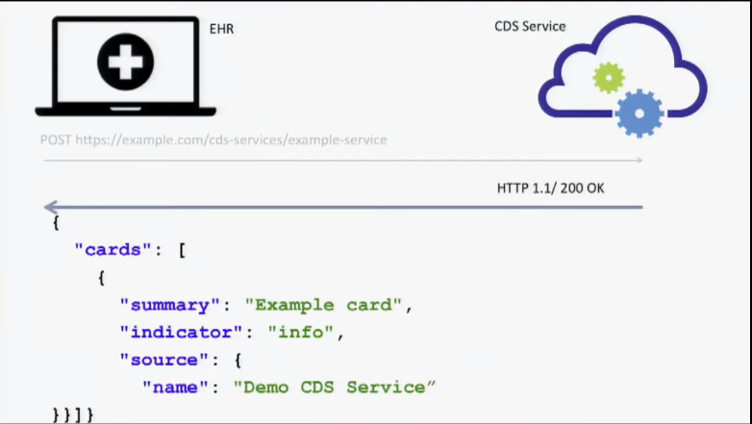
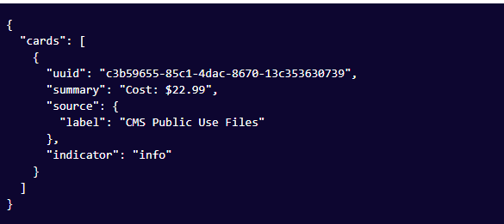
CDS service Response JSON

Slide 10
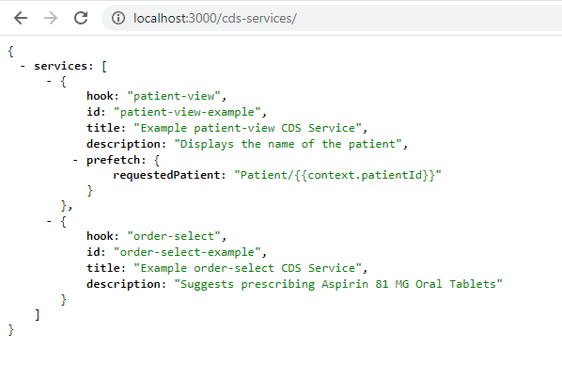
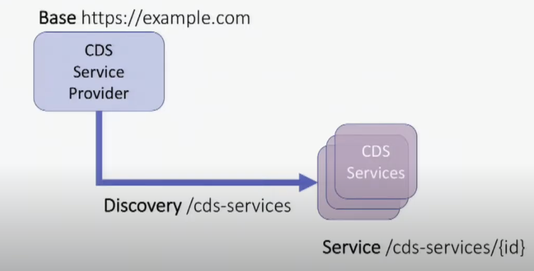
Indicators:
Informational Warning Critical
Discovery point URL:

Slide 11
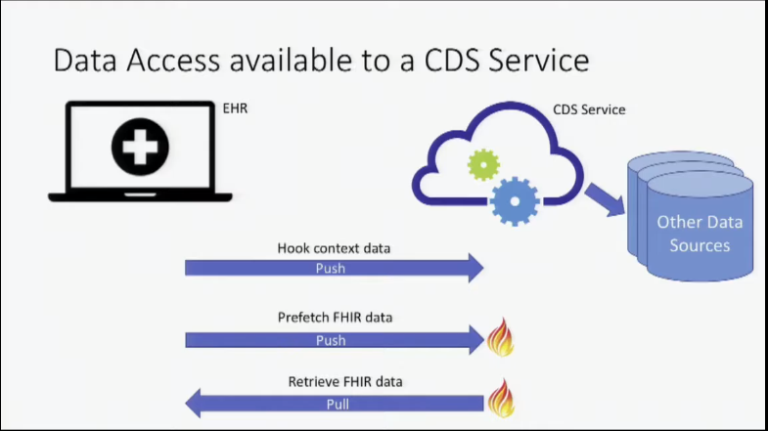

Slide 12
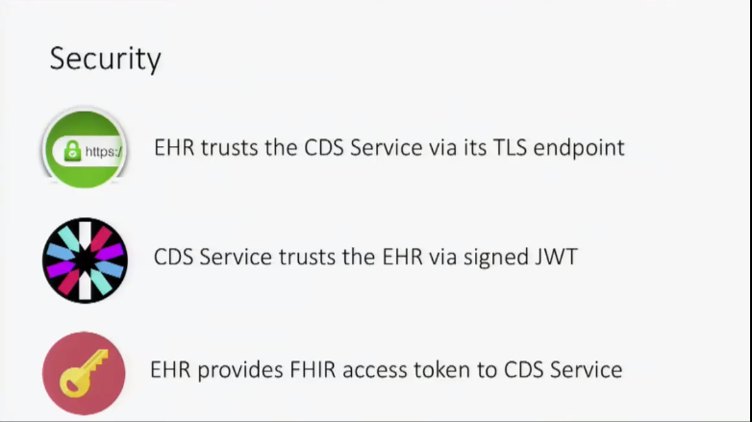

Slide 13
Current Version 1.0(STU)
Hooks available and Maturity
patient-view 4
appointment-book 1
encounter-discharge 1
encounter-start 1
order-select 1
order-sign 1
Maturity level | Maturity Title
0 | Draft
1 | Submitted
2 | tested
3 | Considered
4 | Documented
5 | Matre
6 | Normative

Slide 14
Thank You

