Slide 1
KEYLOGGER IN SECURITY
NAAN MUDHALVAN
Presented by
G.MOHAN RAJ
III BE CSE
SURYA ENGINEERING COLLEGE
ERODE

Slide 2
OVERVIEW
Problem Statement
Proposed System
System Development Approach
Algorithm
Deployment
Result
Conclusion
Future Scope
References

Slide 3
PROBLEM STATEMENT
In today's digital age, where cybersecurity threats loom large, one of the significant concerns is the proliferation of keyloggers, stealthy software tools designed to monitor and record keystrokes on a user's computer without their knowledge. Keyloggers pose a severe threat to individuals and organizations as they can capture sensitive information such as passwords, credit card details, and other personal data, leading to identity theft, financial loss, and privacy breaches.

Slide 4
PROPOSED SYSTEM
1. User Access Controls: Enforce strict access controls to limit employees' permissions based on their roles and responsibilities.
2. Activity Monitoring: Implement continuous monitoring of employee actions using security tools and logging mechanisms.
3. Regular Audits: Conduct periodic audits of system logs and user activities to identify suspicious behavior and unauthorized software installations.
4. Incident Response Plan: Develop a comprehensive incident response plan to address insider attacks promptly and minimize their impact on operations.
5. Cybersecurity Awareness Training: Provide ongoing training to employees to raise awareness about insider threats and educate them on best practices for maintaining data integrity and security.

Slide 5
SYSTEM DEVELOPMENT APPROACH
1. Operating System:
- Windows, macOS, or Linux.
2. Hardware:
- Standard computer hardware.
3. Programming Language:
- Python is commonly used.
4. Libraries:
- PyHook or pyxhook for Windows/Linux, pynput for cross-platform support, pywin32 for Windows, Xlib for Linux, ctypes for macOS, pyinstaller for packaging.
5. Tools:
- IDE like PyCharm, version control with Git, virtual environment setup with virtualenv or Anaconda, documentation with Sphinx or MkDocs.

Slide 6
ALGORITHM
1. Capture Keystrokes:
- Continuously monitor keyboard input to capture keystrokes.
- Record each key pressed along with any modifiers and special keys.
2. Log Keystrokes:
- Save the captured keystrokes in a log file with timestamps.
3. Handle Special Cases:
- Manage special cases like system keys or unintended actions.
4. Run Stealthily (Optional):
- Hide the keylogger to run without detection.

Slide 7
DEPLOYMENT
Development:
DEvelop the keylogger using chosen programming language and libraries.
Testing:
Ensure accurate and reliable keystroke capturing without system interference.
Packaging:
Package the keylogger into an executable file.
Deployment:
Distribute responsibly, following ethical guidelines and legal regulations.
Monitoring and Maintenance:
REgularly monitor and update the keylogger as needed.

Slide 8
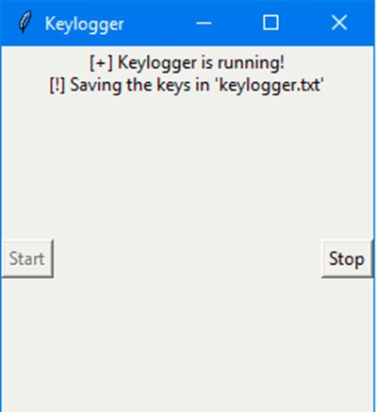
RESULT
The keylogger project successfully captures and logs keystrokes, providing insight into user activity on the system. By recording keystrokes, the project helps identify potential security breaches and unauthorized access to sensitive information. Additionally, the keylogger can serve as a valuable tool for forensic analysis and monitoring user behavior, aiding in the prevention and detection of data leakage incidents within the organization.

Slide 9
CONCLUSIONS
To safeguard sensitive information and maintain data integrity, implementing robust security measures and comprehensive employee training programs is paramount in mitigating the risk of data leakage. By proactively addressing potential vulnerabilities and educating employees on best practices, organizations can effectively mitigate the threat of unauthorized access and minimize the potential for severe financial and reputational damage resulting from data breaches.

Slide 10
FEATURE SCOPE
1. Keystroke Logging:
Capture and record all keystrokes entered by the user.
2. Timestamping:
Include timestamps for each keystroke to track when it was entered.
3. Special Key Handling:
Handle special keys and combinations (e.g., Enter, Ctrl) appropriately.
4. Stealth Mode (Optional):
Ability to run the keylogger stealthily without detection.

Slide 11
REFRENCES
S. Li, L., Z. M. Fauzee, N. Zamin, N. Kamarudin, N. A.Sabri, and N. S.Nik Ab Aziz. "An Encrypted Log File Keylogger System for Parental Control." International Journal of Engineering & Technology 7, no. 2.28 (May 16, 2018): 193. http://dx.doi.org/10.14419/ijet.v7i2.28.12910.
Singh, Arjun, Pushpa Choudhary, Akhilesh kumar singh, and Dheerendra kumar tyagi. "Keylogger Detection and Prevention." Journal of Physics: Conference Series 2007, no. 1 (August 1, 2021): 012005. http://dx.doi.org/10.1088/1742-6596/2007/1/012005.
Guryanov, Konstantin V. "THE PROJECT "GUNMAN": FIRST KEYLOGGER." Basis, no. 2 (2020): 79–91. http://dx.doi.org/10.51962/2587-8042_2020_8_79.
Aron, Jacob. "Touchscreen keylogger captures details from your taps." New Scientist 211, no. 2825 (August 2011): 21. http://dx.doi.org/10.1016/s0262-4079(11)61950-7.

Slide 12
Thank you

