Slide 1
Luxury Housing Sales Analysis – BLR
Mohan raj
Sr Component Engineer

Slide 2
PROJECT OBJECTIVE
Design and implement a comprehensive real estate analytics solution that mirrors a production-grade data pipeline used in enterprise environments.
The project will leverage a large-scale housing dataset containing over 100,000 records to demonstrate robust data engineering, advanced analytics, and interactive reporting.

Slide 3
SCOPE OF WORK
Advanced Data Cleaning & Preprocessing (Exploratory Data Analysis (EDA)
Utilize Python and pandas to perform rigorous data preparation, including
  Missing value imputation
  Outlier detection and treatment
  Feature engineering and normalization
  Validation of data integrity and consistency
  Modularize the workflow for scalability and reproducibility.

Slide 4
TOOLS & TECHNOLOGIES
Programming & Data Processing
  Python – Core programming language for data analysis and modeling.
  pandas – Data manipulation, cleaning, and transformation.
  scikit-learn – Machine learning, imputation (KNNImputer), and predictive modelling.
Data Visualization & Reporting
  Matplotlib & Seaborn – For exploratory data analysis and static visualizations.
  Power BI – For creating interactive dashboards, reports, and real-time insights visualization.
Data Storage & Management
  SQL – For scalable data querying and integration.
Deployment
  Power BI Service – To publish and share interactive dashboards.

Slide 5
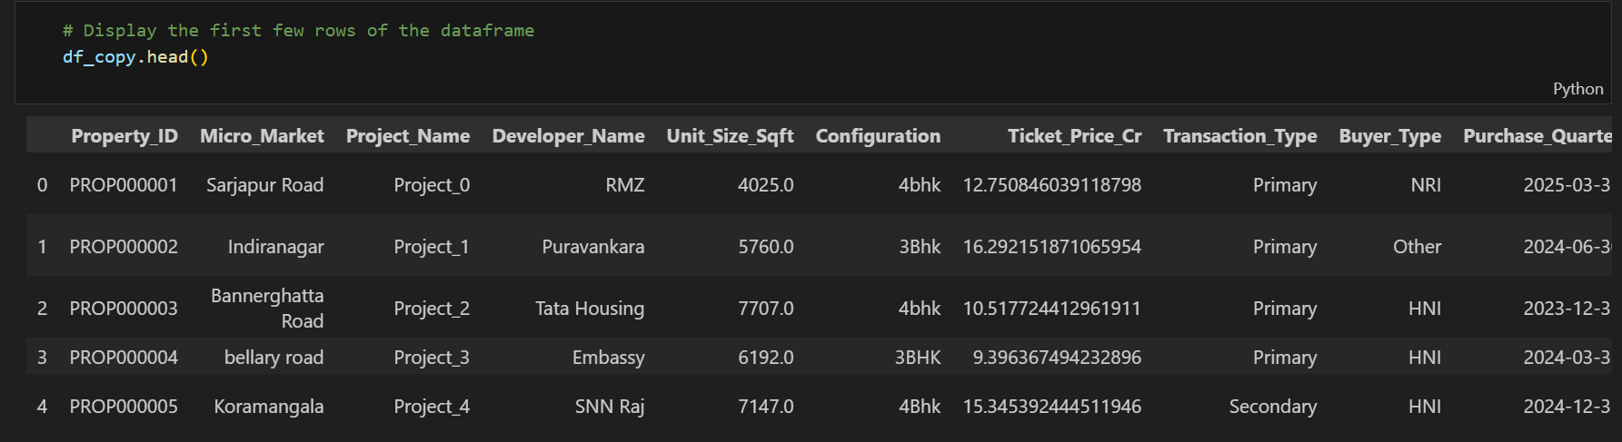
DATA EXTRACTION AND DATAFRAME CREATION
Data extraction is done locally by read comment for the CSV. File
Extracted data is validated for there “dtype “,” non-null count”,” column”
If duplicate are found same is removed from the DF
Then the cleaned data is stored to the ‘MY SQL”

Slide 6
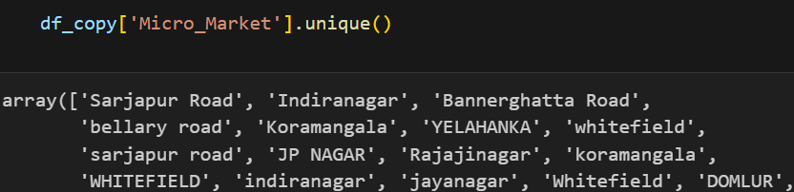
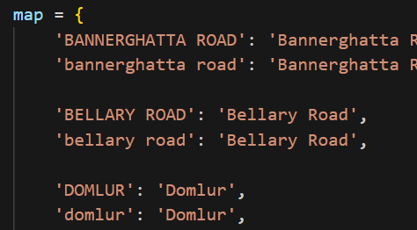
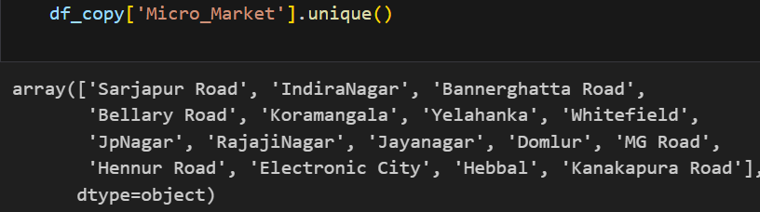
EXPLORATORY DATA ANALYSIS (EDA)
Micro_Markit column has multiple discrepancies for the same area name. Used mapping method for standardization
Unit_Size_Sqft-Data has right skewed and also able to find some outliners
    Removed the outliners manually
    Applied KNN imputation for null values – however observed unexpected spikes( n_neighbors 5 and 10)

Slide 7
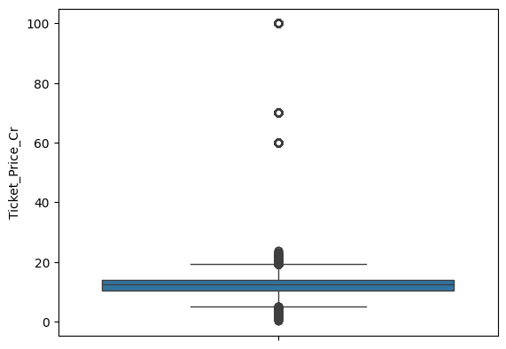
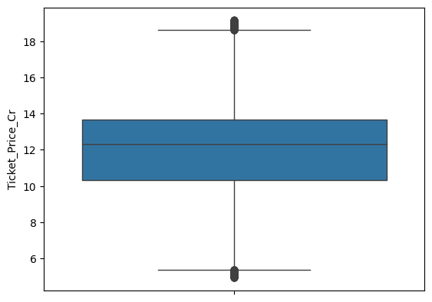
EXPLORATORY DATA ANALYSIS (EDA)
Ticket_Price_Cr- Data has outliers and missing values
  IQR method is used for handline the missing values
  Applied KNN imputation for null values – however observed unexpected spikes( n_neighbors 5 and 10)

Slide 8
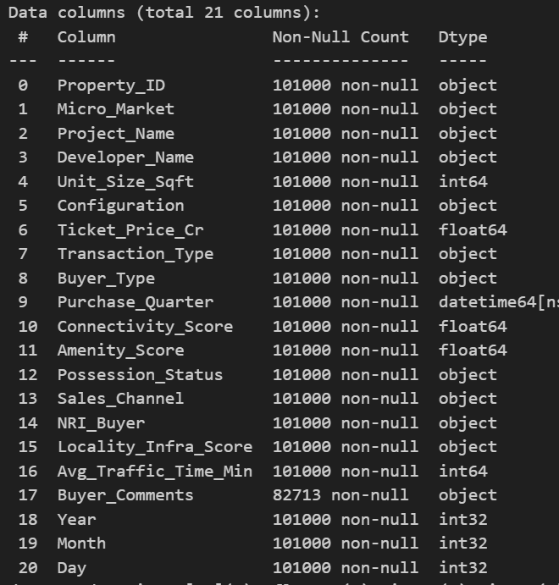
EXPLORATORY DATA ANALYSIS (EDA)
Multiple columns have null values and outliners which got processed and fill the missing values
Data Type was changed accordingly
Future Enginereing-Purchase_Quarter is split into “year”,”Month”&”Day”(Month is mapped for Quarter based analysis)
Buyers Comments-Which don’t have signified impact on the projection hence left as it is
Numerical values are standardized

Slide 9
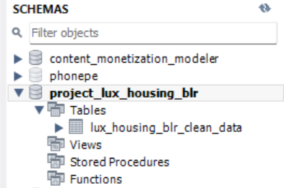
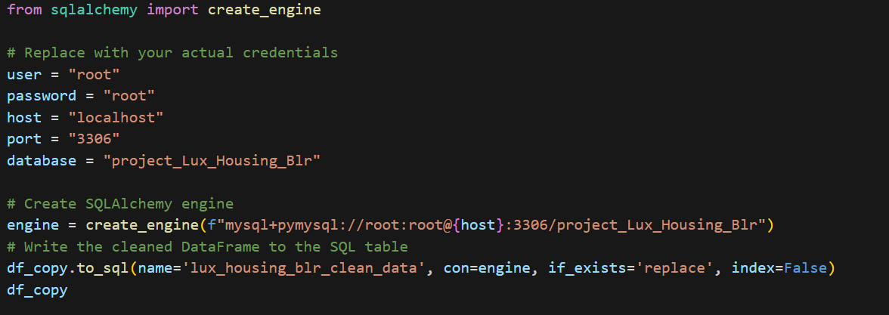
SQL DATABASE AND TABLE CREATION
Set up a connection between your cleaned DataFrame and MySQL database using ‘sqlalchemy’s ‘
Define MySQL credentials
Creates A connection engine that lets pandas or sqlalchemy's talk to your MySQL database.
Create a database in my SQL with the name “project_lux_housing_blr ”
Finally moved the created DataFrame to ‘My SQL’ under the database “lux_housing_blr_clean_data”

Slide 10
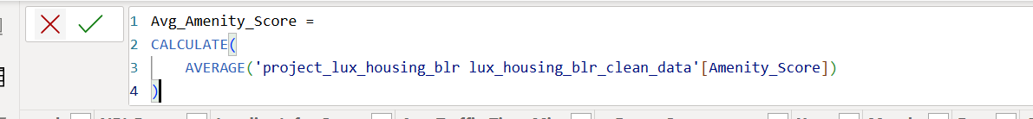
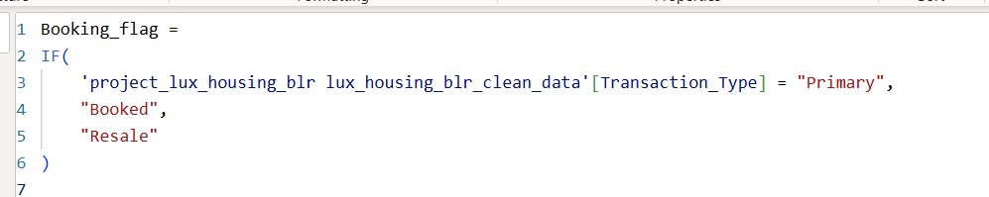
Power BI VISUALIZATION
Connected Power BI to SQL DB
Using “New Measure” created below measure which will used for Visualization and its metrics
  Avg_Amenity_Score
  AVG_Ticket_Price
  Booking_Conversion_Rate
  Booking_Count …etc
Using “New Column” created “Booking_flag”

Slide 11
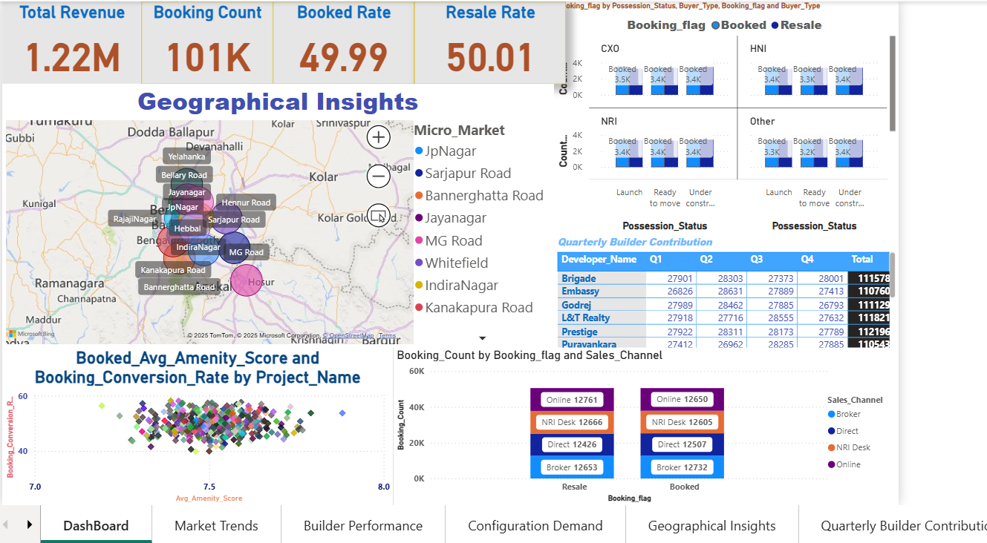
Power BI -Dashboard

Slide 12
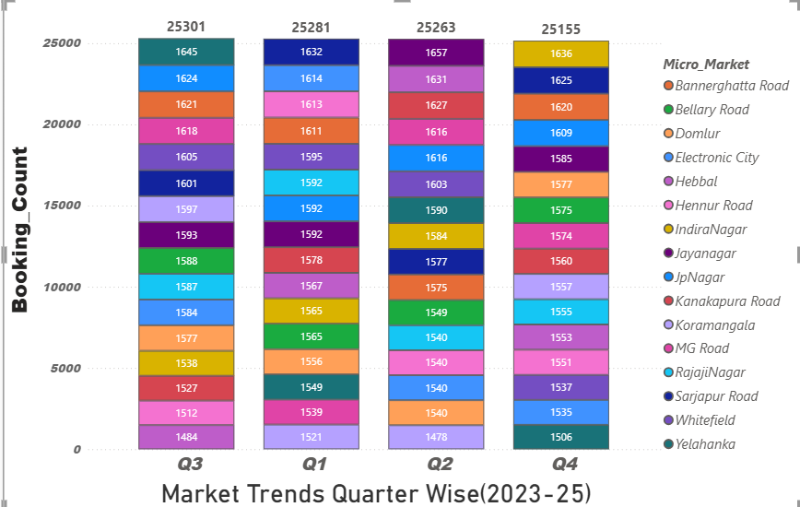
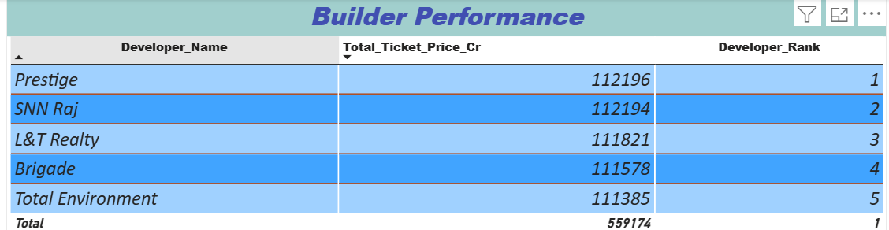
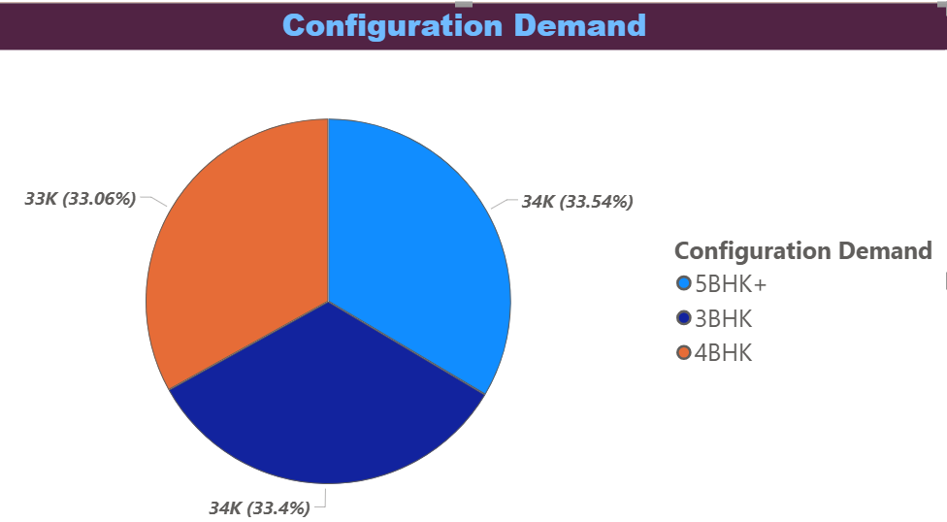
Power BI VISUALIZATION

Slide 13
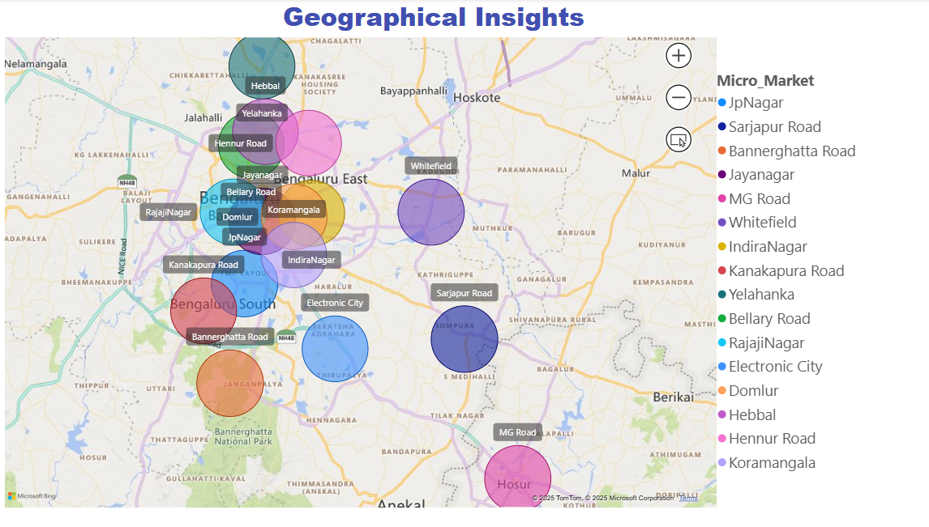
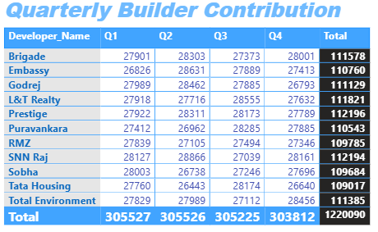
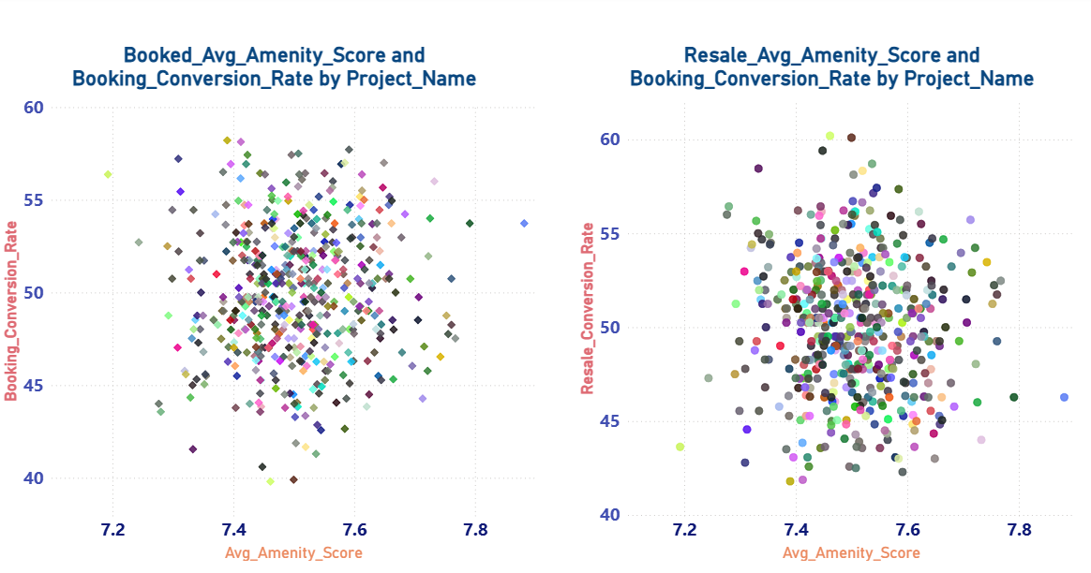
Power BI VISUALIZATION

Slide 14
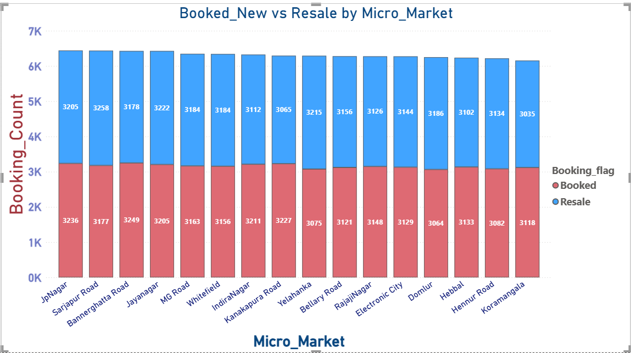
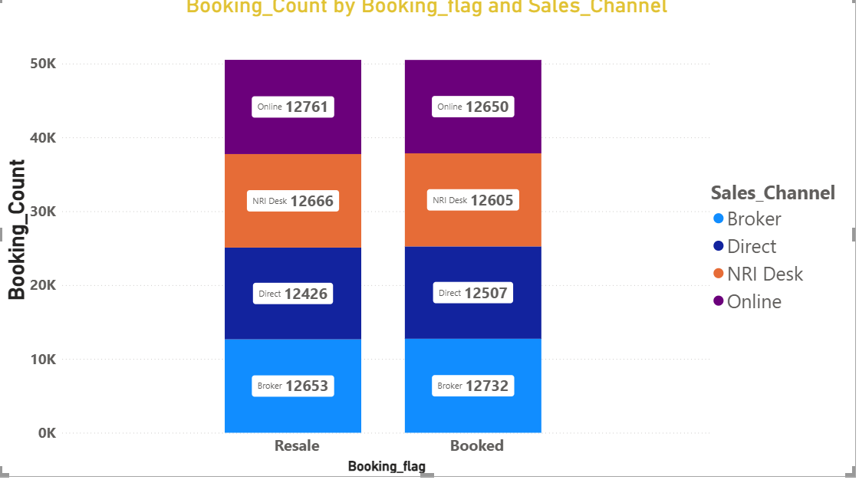
Power BI VISUALIZATION

Slide 15
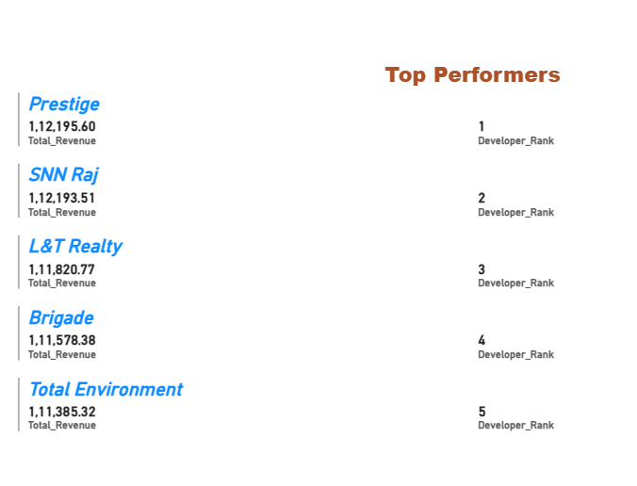
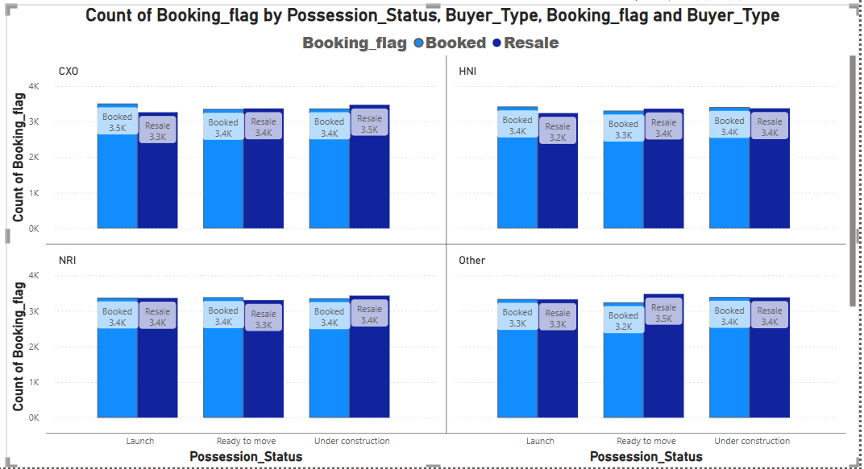
Power BI VISUALIZATION

Slide 16
CONCLUSIONS
Builder Performance:
  Top developer in terms of total house sale price and revenue is “prestige”
  If customer rating is available then we can rank builders for reliability
Configuration Demand:
  Demand remains almost same. Meaning house configuration are equally spread across buyers groups
Geographical Insights:
  Most of the projects are planned well within central BLR area
  West BLR has very limited market saturation –we can explore more options
  East and South BLR have higher market due to IT core hub
  Some spread on the north BLR due to BLR airport and some IT Hub has been opened recently – we can push market in these upcoming areas

Slide 17
CONCLUSIONS
Amenity Impact(Booked_New):
  Based on the average amenity Score most of the buyer segment looking for good amenity with average between 7.4 to 7.6 (Tight Scatter)
Amenity Impact(Resale):
  Based on the average amenity Score most of the buyer segment looking for good amenity with average between 7.4 to 7.6 (Tight Scatter)
  Some buyers looking for average between 7.6 to 7.8 for the resale – That’s!
Booking Conversion:
  Conversion rate seems to equal across the micro market – demand is available in both the sectors
Sales Channel Efficiency:
  Equal demand across sales Channel(Broker, Direct, NRI and online) for both New and resale

Slide 18
Thank you

