Slide 1
BIG DATA
HADOOP
© Amit Mishra

Slide 2
HADOOP : INTRODUCTION
2012
Digital Universe = 20 Zettabytes
2014
31% of enterprises managing more than 1 Petabyte
85% of growth from new types of data with Machine generated data increasing 15x
Geo-location
Data
Sensor
Data
Machine
Generated
Social
Networks
2020
Digital Universe will
increase by 40 Zettabytes
Web Logs
Click Streams
Documents
Emails
Unstructured Data
ERP , CRM
System Data
© Amit Mishra

Slide 3
HADOOP : INTRODUCTION
Over decades , there has been a humongous explosion in data. From each sector its
increasing per day.
Structured
Semi Structured
Machine Data
Unstructured
Unstructured
ERP , CRM
System Data
Documents
Emails, XML Data
Sensor Data,
GeoLocation Data
CSV Data, Social Media(Audio, Video)
JSON Data, Weblogs
BIG DATA
© Amit Mishra

Slide 4
HADOOP FRAMEWORK
HADOOP is an open-source software framework developed on Distributed File System (DFS) for storing data and running applications on clusters of commodity hardware.
HDFS is highly fault tolerant and designed using low-cost hardware.
It provides massive storage for any kind of data, enormous processing power and the ability to handle virtually limitless concurrent tasks or jobs.
Apache Hadoop is to break up unstructured data and distribute it into many parts for concurrent data analysis.
© Amit Mishra

Slide 5


DISTRIBUTED FILE SYSTEM
1 Machine
4 I/O operational channels
Processing speed : 100MB/s
5 Machine
4 I/O operational channels
Processing speed : 100MB/s
© Amit Mishra

Slide 6



HADOOP CLUSTER
© Amit Mishra

Slide 7
HADOOP CONFIGURATION
Modes of Hadoop Configuration
Standalone
Mode
Pseudo-distributed mode
Fully Distributed mode
All Hadoop services runs in a single JVM on a single machine
Each Hadoop runs on its own JVM, but on a single machine
Hadoop services runs on individual JVM , but these reside in separate commodity machine in single cluster
© Amit Mishra

Slide 8
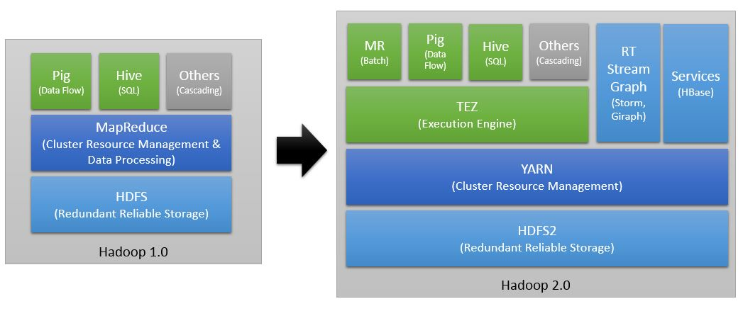
HADOOP 1.0 VS HADOOP 2.0
© Amit Mishra

Slide 9
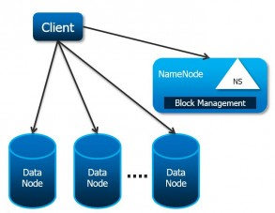
HADOOP 1.0 VS HADOOP 2.0
HDFS Federation
Hadoop Cluster can scale up to hundreds of DataNodes, and the NameNode keeps all its metadata in memory (RAM). This results in the limitation on maximum number of files a Hadoop Cluster can store (typically 50-100M files). As your data size and cluster size grow this becomes a bottleneck as size of your cluster is limited by the NameNode memory.
Hadoop 2.0 feature HDFS Federation which allows horizontal scaling for Hadoop distributed file system (HDFS). HDFS Federation supports Multiple NameNodes and manages Namespaces. The DataNodes are used as common storage for blocks by all the Namenodes. DataNodes send periodic heartbeats and block reports and handle commands from its associated NameNodes.
© Amit Mishra

Slide 10
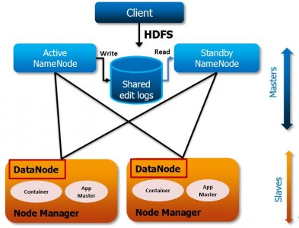
HADOOP 1.0 VS HADOOP 2.0
NameNode High Availability
In Hadoop 1.x, NameNode was single point of failure. NameNode failure makes the Hadoop Cluster inaccessible. Usually, this is a rare occurrence because of sever failure.
In case of NameNode failure, Hadoop Administrators need to manually recover the NameNode using Secondary NameNode.
Hadoop 2.0 Architecture supports multiple NameNodes to remove this bottleneck. Hadoop 2.0, NameNode High Availability feature comes with support for a Passive Standby NameNode. These Active-Passive NameNodes are configured for automatic failover.
© Amit Mishra

Slide 11
HADOOP 1.0 VS HADOOP 2.0
YARN
In Hadoop 1.0 JobTracker is responsible for both managing the cluster's resources and driving the execution of the MapReduce job.
YARN splits up the two major functionalities of overburdened Jobtracker (resource management and job scheduling/monitoring) into two separate daemons:
  A Global Resource Manager and
  Application Master.
A Resource Manager (RM) focuses on managing the cluster resources
An Application Master (AM) one-per-running-application, manages each running application & is responsible for containers, monitoring their resource usage (cpu, memory, disk, network) and reporting the same to the ResourceManager/Scheduler.
YARN provides central resource manager. With YARN, you can now run multiple applications in Hadoop, all sharing a common resource.
© Amit Mishra

Slide 12
HADOOP 1.0 VS HADOOP 2.0
YARN
RESOURCE MANAGER
It is a cluster level (one for each cluster) component and runs on the master machine
It has two components: Scheduler & Applications Manager
The Scheduler is responsible for allocating resources to the various running applications subject to familiar constraints of capacities, queues etc. The Scheduler is pure scheduler in the sense that it performs no monitoring or tracking of status for the application.
The Applications Manager is responsible for accepting job-submissions, negotiating the first container for executing the application specific Applications Master and provides the service for restarting the Applications Master container on failure.
It keeps a track of the heartbeats from the Node Manager
© Amit Mishra

Slide 13
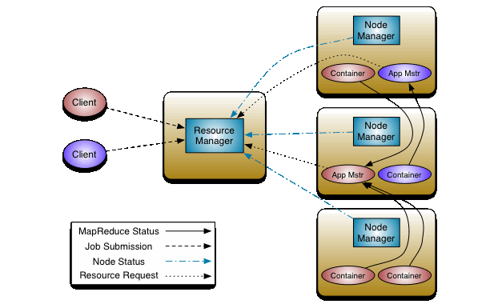
HADOOP 1.0 VS HADOOP 2.0
YARN (Yet Another Resource Negotiator)
© Amit Mishra

Slide 14
HADOOP 1.0 VS HADOOP 2.0
HDFS SNAPSHOT
Hadoop 2 adds support for file system snapshots. A snapshot is a point-in-time image of the entire file system or a sub tree of a file system.
A snapshot has many uses:
Protection against user errors: An admin can set up a process to take snapshots periodically. If a user accidentally deletes files, these can be restored from the snapshot that contains the files.
Backup: If an admin wants to back up the entire file system or a subtree in the file system, the admin takes a snapshot and uses it as the starting point of a full backup.
Disaster recovery: Snapshots can be used for copying consistent point-in-time images over to a remote site for disaster recovery.
© Amit Mishra

Slide 15

HADOOP 2.x Core Components
YARN
Resource
Manager
Node
manager
Node
manager
Node
manager
Node
manager
Name Node
Admin
Data
node
Data
node
Data
node
Data
node
HDFS Cluster
© Amit Mishra

Slide 16
HADOOP COMPONENTS
HADOOP COMMON
HDFS
MAPREDUCE
YARN
Apache Foundation has pre-defined set of utilities and libraries that can be used by other modules within the Hadoop ecosystem.
HDFS is the “Secret Sauce” of Hadoop components as users can dump huge datasets into HDFS and the data will sit there until the user wants to leverage it for analysis.
MapReduce is a Java-based system which injects data from the HDFS gets processed efficiently. MapReduce is responsible for the analyzing large datasets in parallel before reducing it to find the results.
YARN forms an integral part of Hadoop 2.0. It is great enabler for dynamic resource utilization on Hadoop as users can run various Hadoop applications without having to bother about increasing workloads.
HADOOP
© Amit Mishra

Slide 17
HADOOP ECOSYSTEM
Apache Oozie
(Workflow and Job Scheduling)
(Querying)
HIVE
(Scripting)
PIG Latin
Apache Mahout
(NoSQL Data Base)
Apache HBase
Zookeeper
(Coordination)
Map-Reduce Framework (Distributed Processing)
YARN
Cluster Resource Management
Hadoop Distributed File System (HDFS)
FLUME
SQOOP
Semi-structured data
Structured data

Slide 18
BIG DATA
HADOOP HDFS
© Amit Mishra

Slide 19
HADOOP HDFS
Secondary NameNode
Ram: 32GB
Hard Disk: 1TB
Processor: Xenon with 4 cores
Ethernet: 3 x 10 GB/s
OS : 64-bit CentOS
Power: Redundant power supply
Active NameNode
Ram: 64GB
Hard Disk: 1TB
Processor: Xenon with 4 cores
Ethernet: 3 x 10 GB/s
OS : 64-bit CentOS
Power: Redundant power supply
StandBy NameNode
Ram: 64GB
Hard Disk: 1TB
Processor: Xenon with 4 cores
Ethernet: 3 x 10 GB/s
OS : 64-bit CentOS
Power: Redundant power supply
DataNode
Ram: 16GB
Hard Disk: 6 x 2TB
Processor: Xenon with 4 cores
Ethernet: 3 x 10 GB/s
OS : 64-bit CentOS
DataNode
Ram: 16GB
Hard Disk: 6 x 2TB
Processor: Xenon with 4 cores
Ethernet: 3 x 10 GB/s
OS : 64-bit CentOS
© Amit Mishra

Slide 20
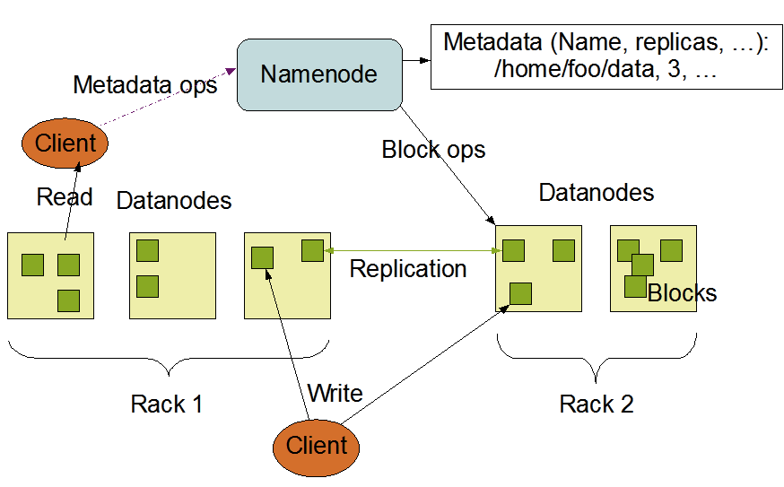
HDFS ARCHITECHTURE
© Amit Mishra

Slide 21
HDFS RACK AWARENESS
In a large cluster of Hadoop, in order to improve the network traffic while reading/writing HDFS file, namenode chooses the datanode which is closer to the same rack or nearby rack to Read/Write request. Namenode achieves rack information by maintaining the rack id’s of each datanode. This concept that chooses closer datanodes based on the rack information is called Rack Awareness in Hadoop.
Rack awareness is having the knowledge of Cluster topology or more specifically how the different data nodes are distributed across the racks of a Hadoop cluster. Default Hadoop installation assumes that all data nodes belong to the same rack.
© Amit Mishra

Slide 22
HDFS RACK AWARENESS
To improve data high availability and reliability.
Improve the performance of the cluster.
To improve network bandwidth.
Avoid losing data if entire rack fails though the chance of the rack failure is far less than that of node failure.
To keep bulk data in the rack when possible.
An assumption that in-rack id’s higher bandwidth, lower latency.
© Amit Mishra

Slide 23
HAPPY LEARNING
© Amit Mishra

