Slide 1


Predict Rain tomorrow in Australia
Mithun Mohanraj

Slide 2
Data-set
Rain in Australia(Kaggle) - contains daily weather observations from numerous Australian weather stations.
Includes 142193 observations of 24 variables in major Australian cities like Brisbane, Canberra, Melbourne, Hobart etc.
Features include various measurements of weather information like Minimum temperature, Maximum temperature, sunshine, evaporation, wind direction, wind gust speed, clouds, location, Date etc.

Slide 3
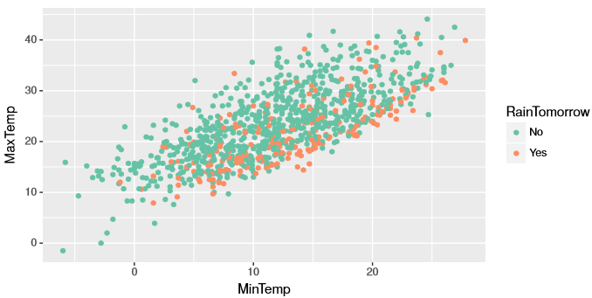
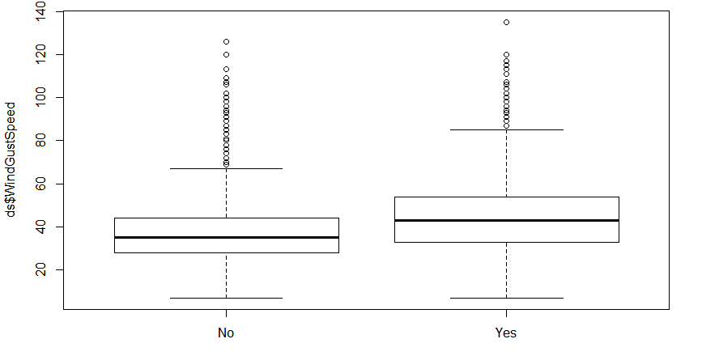
Problem Definition
Predict whether or not it will rain tomorrow by training a binary classification model on target Rain-Tomorrow
The target Rain-Tomorrow means: Did it rain the next day? Yes or No.
Highly Non-linear : Upper right scatter plot of Max-temp vs min-temp shows that the data is highly non-linear.
Outliers : Box-plot of wind-gust speed against target variable shows that the number of outliers for both the classes are very high

Slide 4
Data Pre-Processing
Data omission : There are lot of observations with missing values along different measurements. Omitting the rows that has missing values reduced the data to 56420 observations.
Creating dummies for categorical variables: There are seven categorical variables which had to be converted into factors.
Standardizing Quantitative variables: There are 17 numerical predictors which had to be standardized by subtracting the column means and dividing it by its standard deviation
Separating the data into training and validation set: Data is separated into 60% for training and 40% for validation.

Slide 5
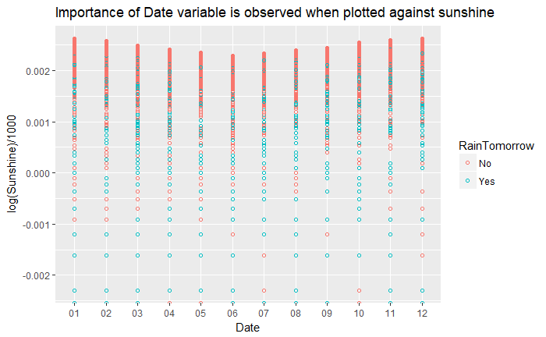
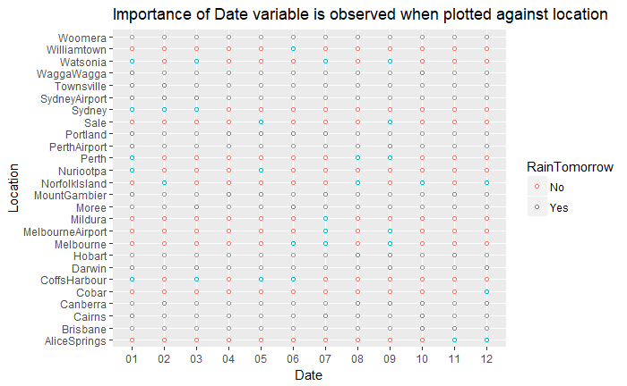
Is the Date variable important?
Yes ,It is important. Date variable is important because it gives us important information on year ,month ,day of the recorded observations.
Especially, For rain prediction we can extract the seasonal information from the date by grouping the observations on the month it is recorded.

Slide 6
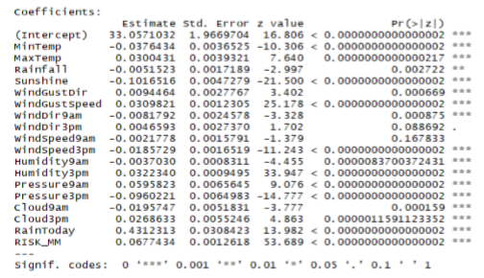
Variable Selection using step-wise AIC
Step-wise AIC does both forward and backward selection of predictors and finally yields a model fitted based on importance of predictors.
The importance is based on if p-value < 0.05(Significance level) , The variable is considered as statistically significant.
The number of asterisks near the p-value for each variable signifies the importance of the variable.
Based on results, statistically important variables are used for fitting the models

Slide 7
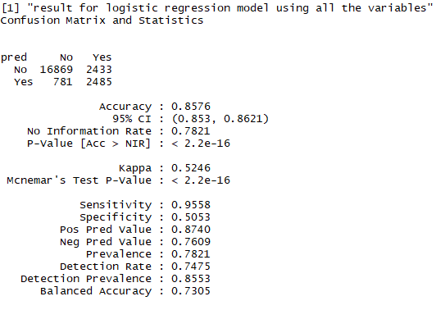
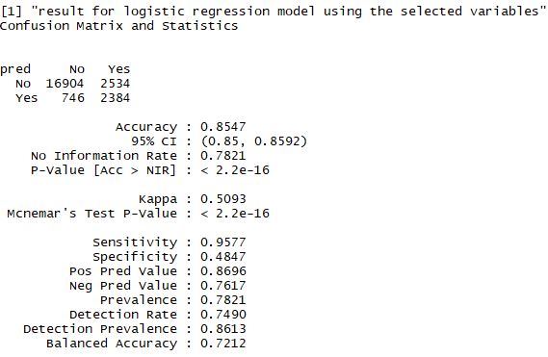
Logistic Regression Model
Logistic regression models are fitted based on inclusion of variables.
The first model includes all the variables and the results obtained are displayed in upper right figure.
The second model is fitted only on the important variables and the result obtained is almost same to that of including all the variables.

Slide 8
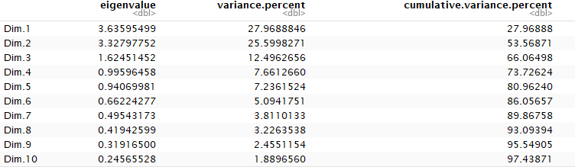
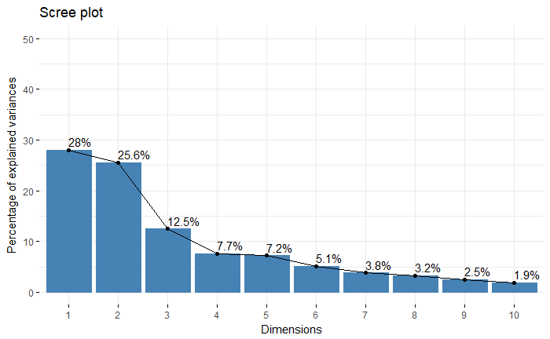
Principal component analysis on Quantitative variables
Principal component Analysis is basically done for dimensionality reduction and obtaining uncorrelated features(PC’s).
PCA is performed on 13 numerical predictors(statistically significant).
The numerical predictors are standardized before performing PCA.
Figure at upper right of the slide shows the percentage of variance explained by each PC and first five PC’s almost explain 80% of the data.
Scree plot shows the percentage of variance explained by each dimension.

Slide 9
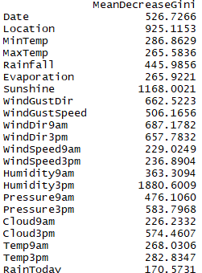
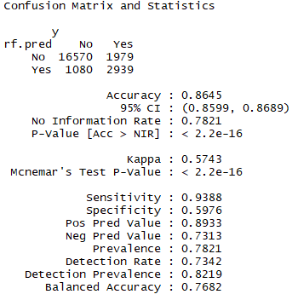
Random Forest Model
Random forest is the ensemble tree method which grows number of trees on the boot-strapped samples and uses subset of features for each split to reduce the correlation between the trees.
Fit the Random forest model using selected variables and the mean decrease in Gini index for each variable as obtained is shown in the upper right figure.
Performance of Random forest model is displayed at bottom right of the slide.
Random forest model slightly outperforms the logistic regression model in terms of accuracy rate.

Slide 10
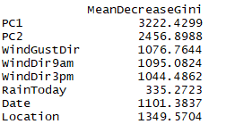
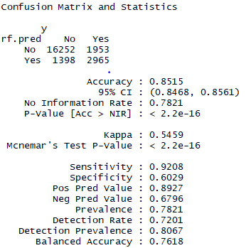
Effect of PCA on Random Forest
Random forest model is fitted on including First two principal component and all the important categorical variables.
Interestingly , The decrease in Gini while using PC1 and PC2 is very high compared to other variables. This shows that PC’s are the important features while fitting the model
Also ,observe that the accuracy rate of random forest model using PC’s remains almost same to that of using all the numerical predictors. Importance of using PCA for dimensionality reduction is evident here.

Slide 11
Inference & Conclusion
From variable selection , we can infer that statistical significance of the variables is the important thing to be considered before fitting any model on the data.
Including statistically insignificant data in the model induces the additional complexity for the algorithm and does not provide any important information.
PCA is a powerful method for dimensionality reduction ,it also produces uncorrelated features explaining most of information in few dimensions.
Logistic regression is the powerful tool for analyzing the importance of variables and its effect on the response variable.
Random forest performs very well on the data containing both numerical and categorical variables.

