Slide 1
Enquiry Management System
User Operation Manual
Generated by AntiGravity

Slide 2
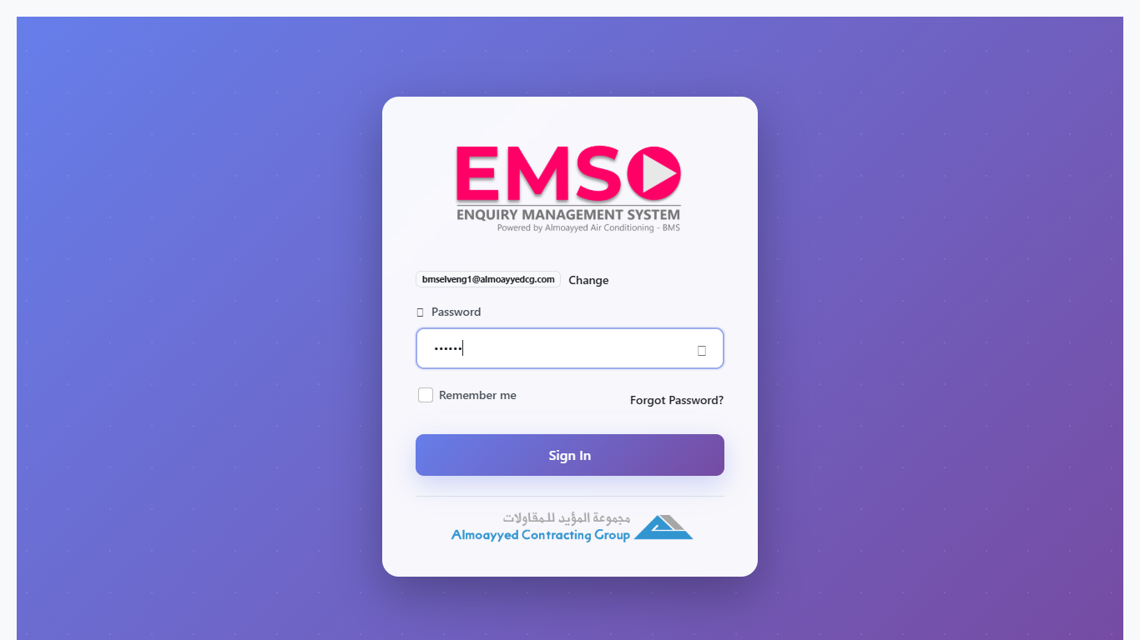
1. Login Screen
Enter your Email ID and Password to access the system.

Slide 3
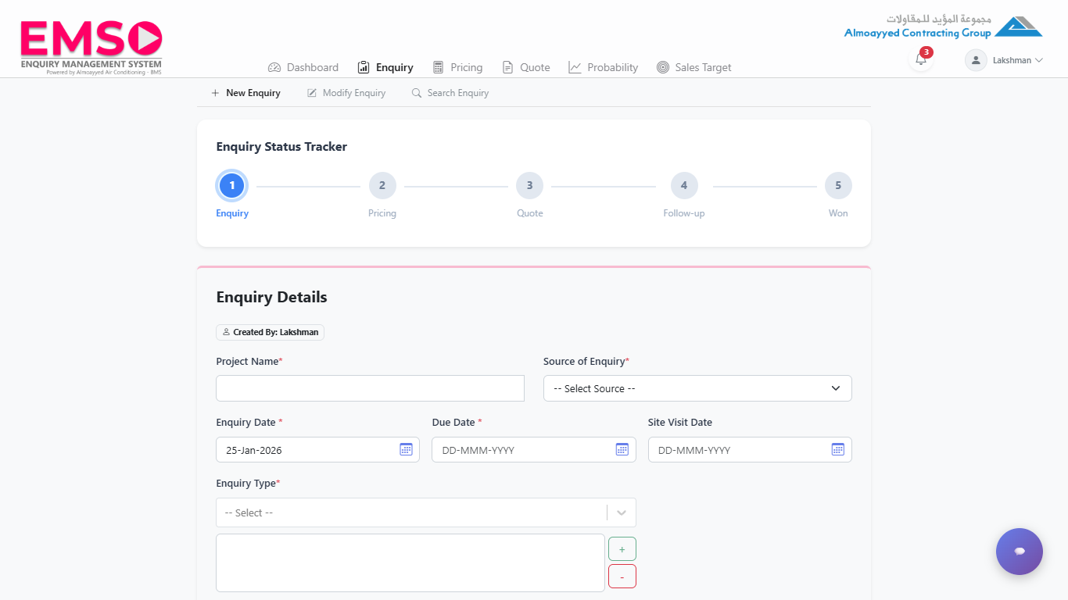
2. Dashboard
The dashboard provides an overview of open enquiries, pending quotes, and recent activity.

Slide 4
3. Enquiry Module
Manage all incoming enquiries. Use "New Enquiry" to add, or Search to find existing records.

Slide 5
4. Pricing Module
Perform detailed cost estimations for labor, materials, and overheads.

Slide 6
5. Quote Generation
Generate professional quotations for customers based on approved pricing.

