Slide 1

Edge AI-Based Smart Patient Monitoring and Assistance System
Team Name
CREATIVE CREW
Team Members
NASHRIN FATHIMA K
MOHAN RAJ S

Slide 2
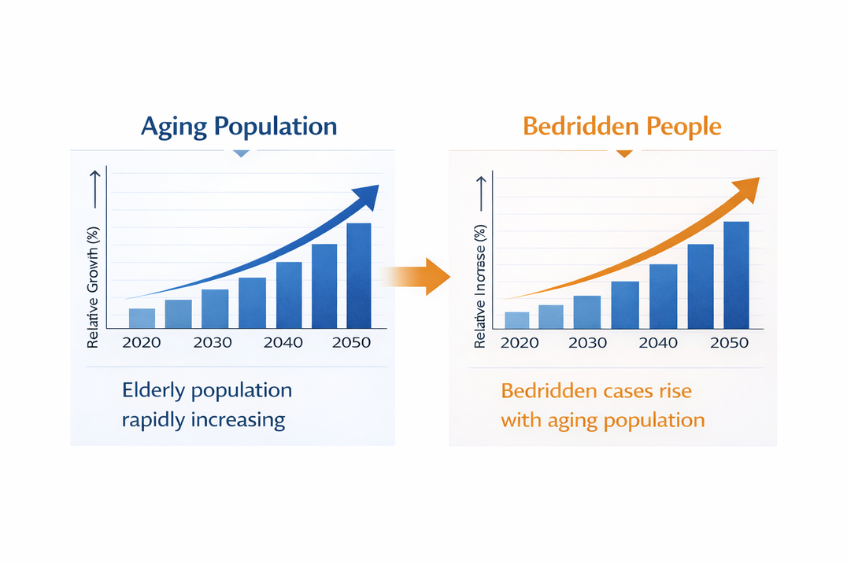
PROBLEM STATEMENT
In home and healthcare environments, elderly individuals, post-operative patients, and people with limited mobility often require assistance for basic daily needs.Existing systems typically use a single alert mechanism (like a buzzer), which does not clearly indicate the user's specific requirement.
This leads to:
Delayed response
Miscommunication
Increased dependency on caregivers
There is an urgent need for a solution that is:
Enables elderly and disabled users to express
specific needs easily
Ensures reliable and accurate communication
Is affordable and scalable for all environments
3

Slide 3
PROPOSED SOLUTION
Intuitive Patient Interaction:
Touch (button) and voice input enable easy and clear communication
of patient needs.
Edge AI Processing:
On-device feature extraction and TinyML classification ensure fast and accurate request recognition.
On-Device TinyML:
Local processing provides low latency, high reliability, and eliminates cloud dependency.
Caregiver Alerts:
Real-time notifications via audio output (speaker) clearly indicate the patient’s specific need.
2

Slide 4
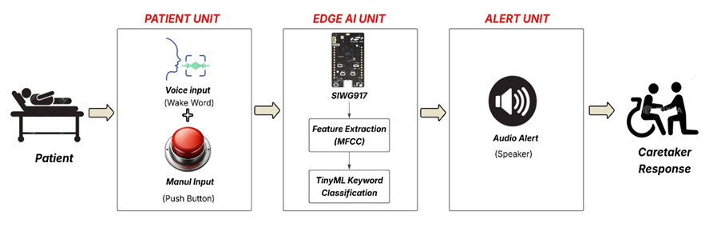
BLOCK DIAGRAM
4

Slide 5

SYSTEM OVERVIEW
Hardware
Edge AI
Model: TinyML Keyword Classifier
On-Device Processing (Edge AI)
Detects:
Food
Water
Restroom
Emergency
Pain
SIWG917 (Edge AI MCU)
Input Microphone (Voice Input)
Push Button (Manual Input)
DF Mini MP3 Player
Speaker (Audio Output)
Power Supply
5

Slide 6
ML DETAILS
Model Type: TinyML Keyword Classification
Input Shape: 1 × 98 × 1 × 104
Output Shape: 1 × 8 (Food, Water, Restroom, Emergency, Pain, noise, unknown, silence)
Input Data Type: int8
Flash Size: 175.2 KB
On-Device Inference (Edge AI)
Low Latency (Real-Time Response)
Memory Efficient for Embedded Systems
2

Slide 7
FUTURE ENHANCEMENT
Wi-Fi integration for mobile app connectivity and real-time caregiver alerts
Advanced ML models for higher accuracy and intelligent decision-making
Predictive AI: Anticipate falls or health risks before they occur
Expanded Sensors: Add ECG, SpO₂, and respiratory monitoring for better health insights
Personalized AI: TinyML adapts to individual patient behavior for improved detection
6

Slide 8
THANK YOU

