Slide 1
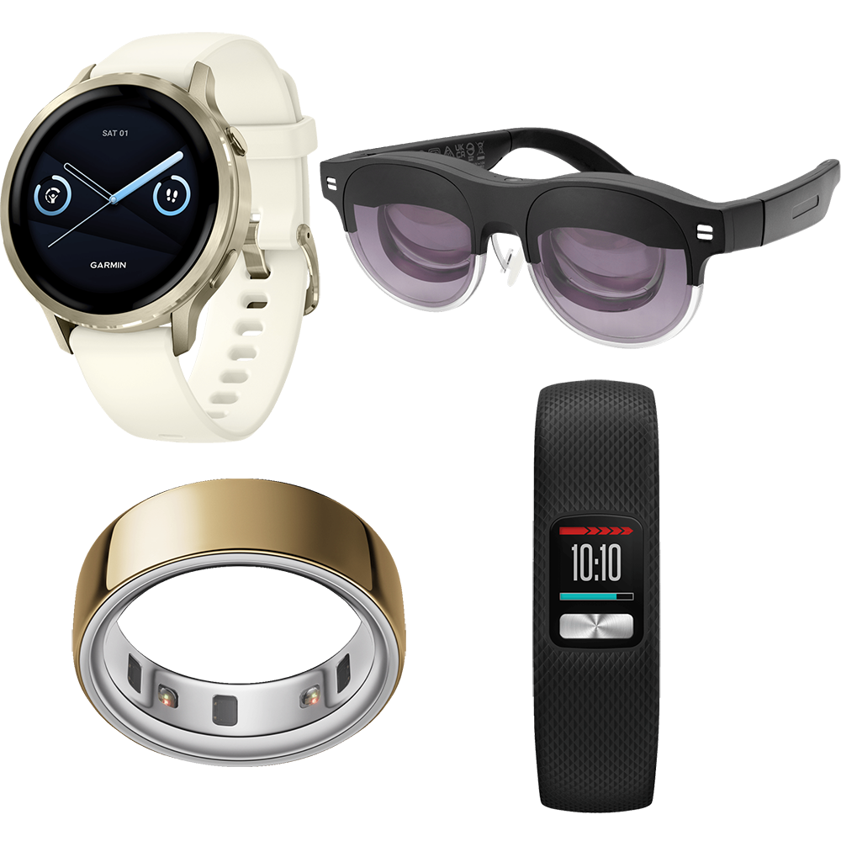
Wearable Computing & Smart Wearable Devices
Seminar Presentation
Emerging Technology • IoT • Sensors • AI

Slide 2
1. Introduction to the Emerging Technology
Wearable computing means integrating computing, sensors and communication into devices worn on the body.
Smart wearables collect data from the user and environment, process it, and provide useful feedback.
Examples include smartwatches, fitness bands, smart glasses, smart rings and connected medical devices.
They combine IoT, wireless communication, mobile apps, cloud computing and increasingly AI.
Image source: Wearable device showcase
2

Slide 3
2. Need and Motivation
Continuous Monitoring
Instant Feedback
Track activity, location and selected body signals without interrupting daily life.
Give alerts, reminders, navigation and notifications directly to the user.
Personalization
Connected Living
Use collected data to provide recommendations and adaptive experiences.
Connect people, smartphones, cloud services and smart environments.
3

Slide 4
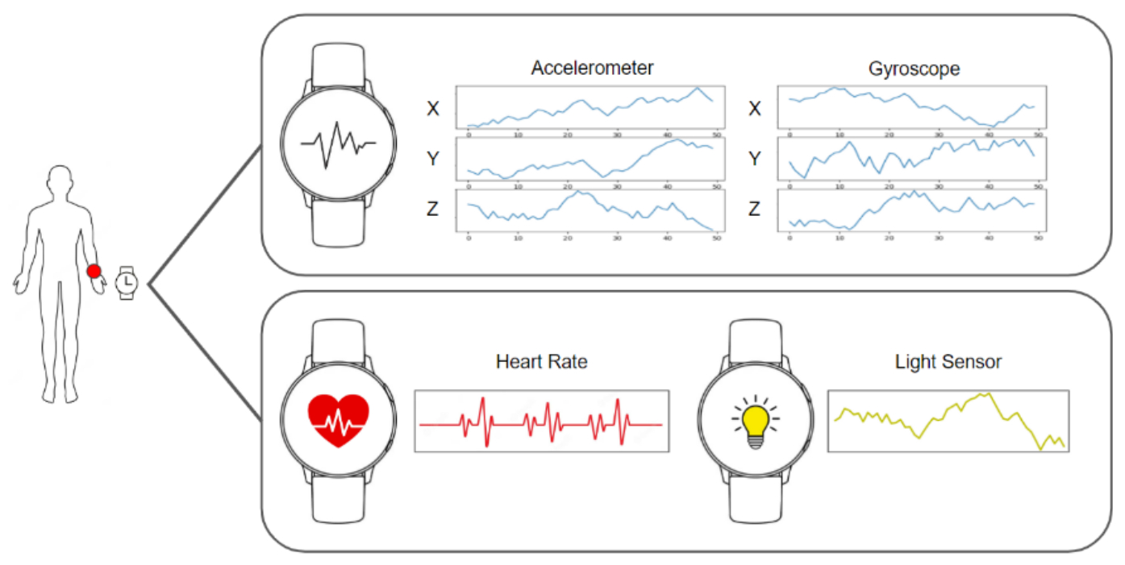
3. Working Principle / Architecture
Sensors
Wearable Processor
Wireless Link
Phone / Cloud
User Output
Capture motion, heart rate, location, temperature, etc.
Filters and analyzes sensor readings.
Bluetooth / Wi-Fi / NFC transfers information.
Stores data and runs advanced analytics.
App dashboard, vibration, sound or visual alert.
Basic flow: Sense → Process → Communicate → Analyze → Respond
Image source: JoVE smartwatch sensor-data illustration
4

Slide 5
4. Key Components and Technologies
Sensors
Processing
Connectivity
Accelerometer, gyroscope, optical sensors, GPS, temperature and other sensors.
Microcontrollers, low-power processors and edge computing.
Bluetooth Low Energy, Wi-Fi, NFC, cellular and other wireless technologies.
Software
AI & Analytics
Power
Mobile apps, cloud platforms, dashboards and device operating systems.
Pattern recognition, prediction, personalization and anomaly detection.
Rechargeable batteries and power-efficient hardware/software design.
Image source: Smartwatch internal-design diagram
5

Slide 6
5. Applications / Real-World Use Cases
Healthcare: remote monitoring, medication reminders, activity tracking and emergency alerts.
Fitness & Sports: workout tracking, heart-rate monitoring, performance analysis and coaching.
Safety: location sharing, fall detection, SOS alerts and worker safety monitoring.
Navigation & Smart Glasses: hands-free directions, visual information and assisted tasks.
Workplace & Industry: equipment support, hands-free instructions and condition monitoring.
Everyday Life: payments, notifications, sleep/activity tracking and smart-home interaction.
6

Slide 7
6. Advantages and Limitations
Advantages
Limitations
• Continuous and convenient monitoring • Hands-free access to information • Faster alerts and notifications • Personalized user experiences • Supports health, fitness and safety • Enables new human–computer interactions
• Battery life and charging requirements • Privacy and data-security concerns • Sensor accuracy can vary • Device cost and maintenance • Comfort, size and usability issues • Dependence on connectivity for some features
7

Slide 8
8. Challenges and Future Scope
Major Challenges
Future Scope
• Protecting personal and biometric data • Improving battery life • Maintaining sensor accuracy • Reducing device size and weight • Ensuring interoperability • Building trust in AI-generated insights
• More natural human–computer interaction • Flexible and skin-friendly electronics • Better on-device AI • Wider healthcare and workplace adoption • Smarter context-aware assistants • Integration with smart homes, vehicles and cities
9

Slide 9
9. Case Study / Example: Smartwatch Ecosystem
A smartwatch combines sensors, a processor, wireless connectivity, display and battery in a wearable form.
Step 1 — Sensors collect movement and selected physiological/environmental data.
Step 2 — The device processes readings and detects useful events or patterns.
Step 3 — Bluetooth/Wi-Fi can synchronize information with a smartphone or cloud service.
Step 4 — The user receives dashboards, reminders, notifications or alerts.
Key lesson: a wearable becomes 'smart' when sensing, processing, connectivity and useful feedback work together.
10

Slide 10
10. Conclusion
Wearable computing is transforming computers from devices we hold into systems we can wear and interact with naturally.
Smart wearables combine sensors, embedded computing, wireless communication, apps, cloud services and AI.
They are useful across healthcare, fitness, safety, industry, navigation and everyday life.
The next generation will focus on smaller devices, better batteries, stronger privacy, smarter AI and more natural interaction.
Thank You
11

Slide 11
References
1. IEEE — Resources on wearable computing, sensors and Internet of Things.
2. NIST — Guidance and research related to cybersecurity and privacy in connected devices.
3. World Health Organization — Digital health and wearable technology resources.
4. Bluetooth SIG — Bluetooth Low Energy technology documentation.
5. Standard textbooks and academic research papers on Internet of Things, embedded systems and human–computer interaction.
Image sources used:
JoVE — smartwatch accelerometer, gyroscope, heart-rate and light-sensor illustration.
Gigantti — wearable device showcase image.
ResearchGate — smartwatch internal design diagram.
12

