Slide 1






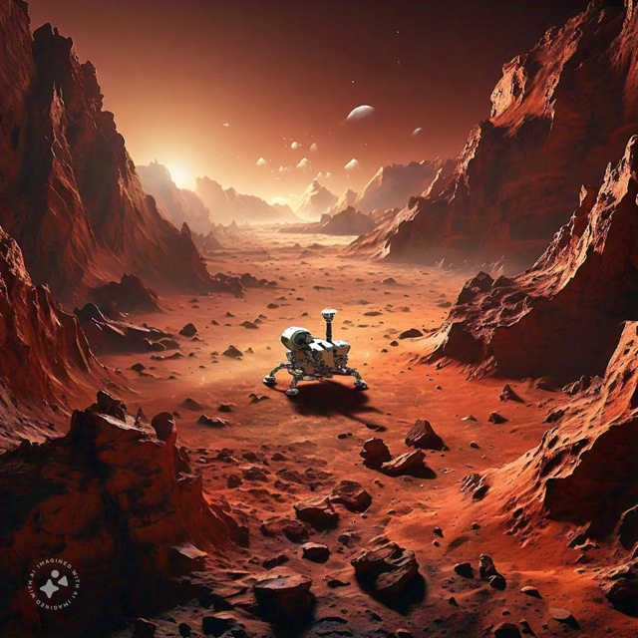


PROBLEM DETAILS
Problem statement ID:1602
Problem statement title: Student Innovation (How to go Mars)
Theme: Space Technology
PS category: Software
Team ID: 25600
Team Name:Soft Developers

Slide 2
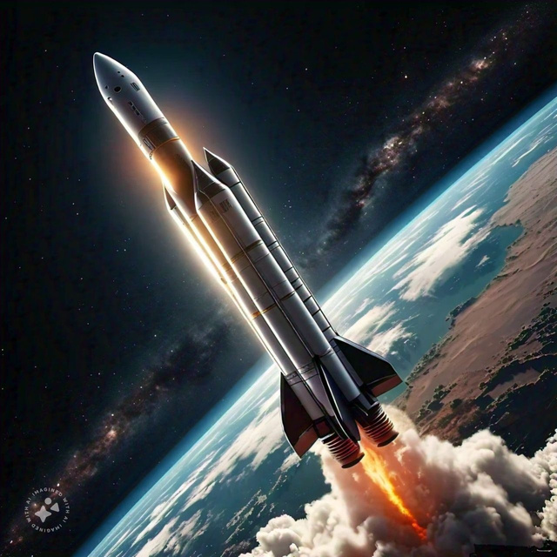
HOW TO GO MARS
# Distance between earth and mars
# Travelling time and reduce the time
Project's main goal
# Choose the best type of Fuel
Ex : H2O
#Nano Technology
#Safe landing

Slide 3
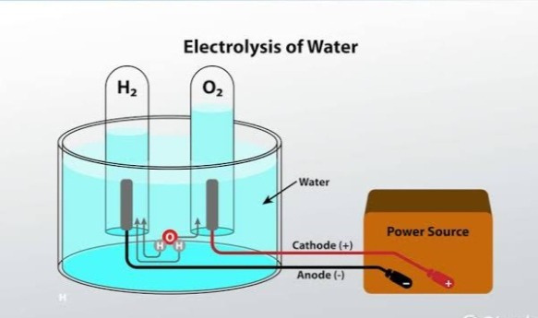
PROJECT GOAL
#The distance of mars, approximately 225 million kms .
#Travel time 6 to 9 months approximately .
# Fuel is H2O
*** In Electrolysis***
#The bond breakdown ,
liquid hydrogen is used of
Fuel.

Slide 4
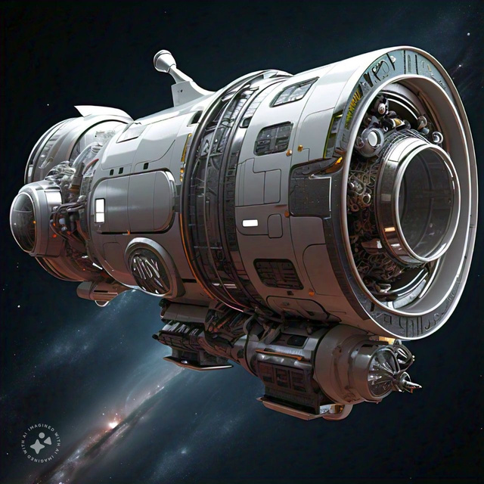
NANO TECHNOLOGY
Nano technology in spacecraft and rocket
Reduce the weight in 100 times
Hybrid spacecraft in nano technology
Safe Landing
Using Nano navigation ,nano protection
Using air bags etc...

Slide 5
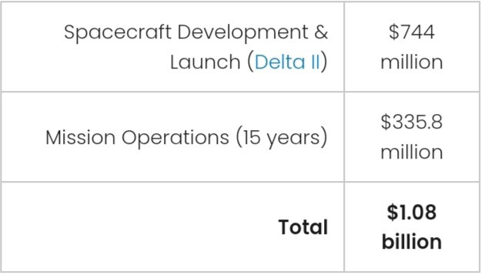
ANALYSIS
#Reduce the time.
#Reduce unwanted weight .
# Communication.
Laser communication
systems in infrared laser etc ..
#Cryo sleep or hibernation
technology (To reduce amount of food and
save energy sleep during long term journey)
#Cost of project

Slide 6
#The future will be have many technology .
#2030 may be create the colonynation in mars
Reference and research
ISRO, NASA and spaceX
Description of problem statement:
For use of travel or activities beyond earth's atmosphere, for purposes such as spaceflight or space exploration.
Thank you
Presented by
Soft Developers

