Slide 1
Functional Programming in JavaScript
Mohan Ram

Slide 2
Functional Programming
Functional programming is the process of building software by composing pure functions, avoiding shared state, mutable data, and side-effects.
Functional programming is declarative rather than imperative, which means programming is done with expressions or declarations instead of statements.

Slide 3
Declarative vs Imperative Programming
With imperative programming, you tell the compiler what you want to happen, step by step.
With declarative programming, on the other hand, you write code that describes what you want, but not necessarily how to get it (declare your desired results, but not the step-by-step):
Example: http://plnkr.co/edit/TjqSpd2D8URHdF0uXA4n?p=info
http://plnkr.co/edit/JDLzOjyqY7KXoBl4HQFj?p=info

Slide 4
Avoid Side Effects
Use pure functions

Slide 5
Side effects
Side effect is anything that a function might do that isn’t computing its output from its input.
Examples for the side effects
Accessing the global variables
Printing outputs or DOM accessibility
Updating back end data (or any asynchronous action
Example – Pure vs Impure functions http://plnkr.co/edit/AoDc4haMj5YVa80tfJKg

Slide 6
Use higher-order functions
Functions can be inputs/outputs
http://plnkr.co/edit/rpqASgHTwh8YEuKBTlnm?p=preview

Slide 7
Don’t Iterate
Use map, reduce, filters

Slide 8
Don’t Iterate
Instead of using for/while to iterate over each item to do some manipulation on them.
Use higher order functions like map, reduce, filters

Slide 9
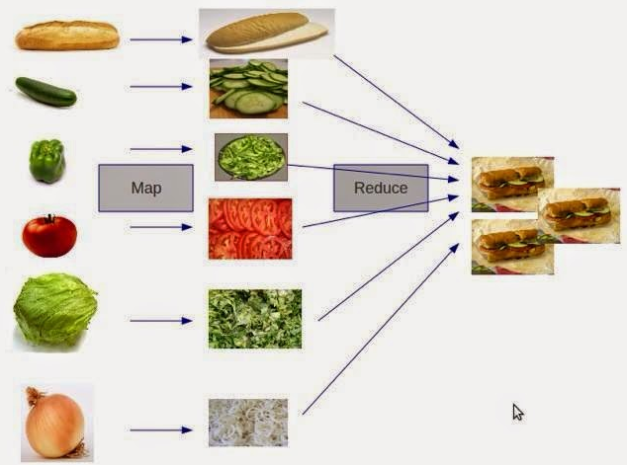
Source: http://www.datasciencecentral.com/forum/topics/what-is-map-reduce

Slide 10
Avoid mutability
Use immutable data
http://plnkr.co/edit/1WCYQ2SXe3OvhaytpIuj?p=preview

Slide 11
Drawback with Immutable
Whenever we need to change our data we do create a new copy of data.
To replace one room we need to create a whole new array (copying the rooms even we didn’t change ).
Being simple array its fine but once our object or array grows more complex this methodology gives efficiency problem.

Slide 12
Persistent data structures for efficient immutability
Mori, Immutable JS, Undeep

Slide 13
Persistent data structures - History
This idea was theoretically introduced by Phil Bagwell in his paper called “Ideal Hash Trees”.
Then Rich Hickey who invented Clojure implemented data structures using P Bagwell idea to make clojure really efficient for handling immutable data structures and functional operations.
Example - http://plnkr.co/edit/VOSVbpHKPyBv6REQnCA2?p=preview

Slide 14
Functional Libraries for JS
Mori - http://swannodette.github.io/mori/
ImmutableJS - https://facebook.github.io/immutable-js/
Underscore JS - http://underscorejs.org/
Lodash - https://lodash.com/
Ramda - http://ramdajs.com/

Slide 15
Recap
Declarative Programming
Avoid Side Effects – use pure functions
Use Higher-order functions
Don’t Iterate
Avoid Mutability
Persistent data structures for efficiency.

Slide 16
Thank you
Questions?

