Slide 1
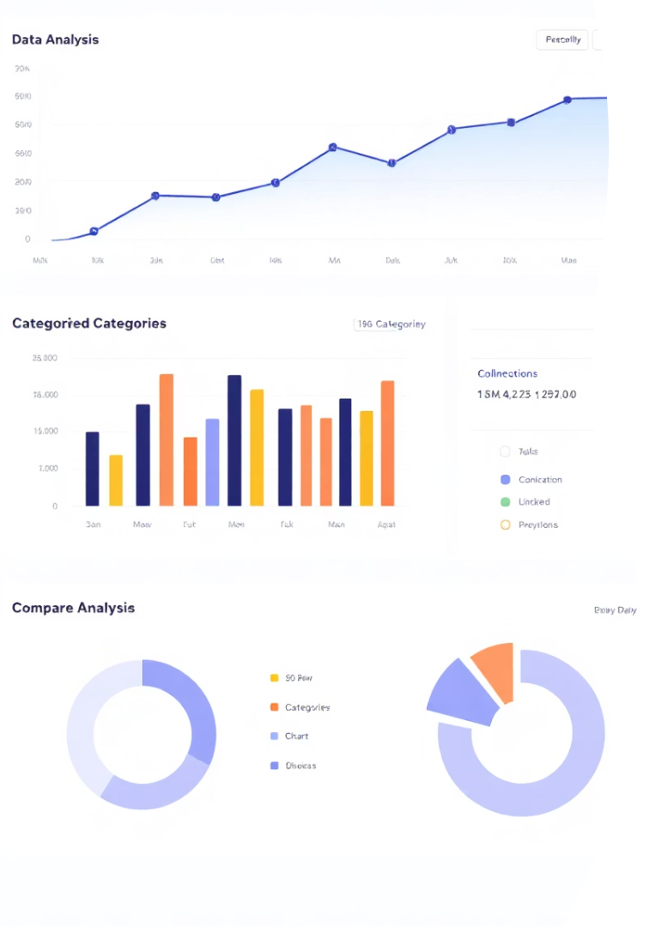
Customer Churn Analysis Overview
This presentation explores customer churn using a dataset of 7,043 records with 21 attributes. The data includes customer demographics, service details, and churn status. Our goal is to understand factors influencing churn and derive actionable insights.
We begin by examining data structure, cleaning missing values, and then proceed to univariate and numerical analyses. Visualizations help reveal patterns in churn behavior across different customer segments and services.

Slide 2
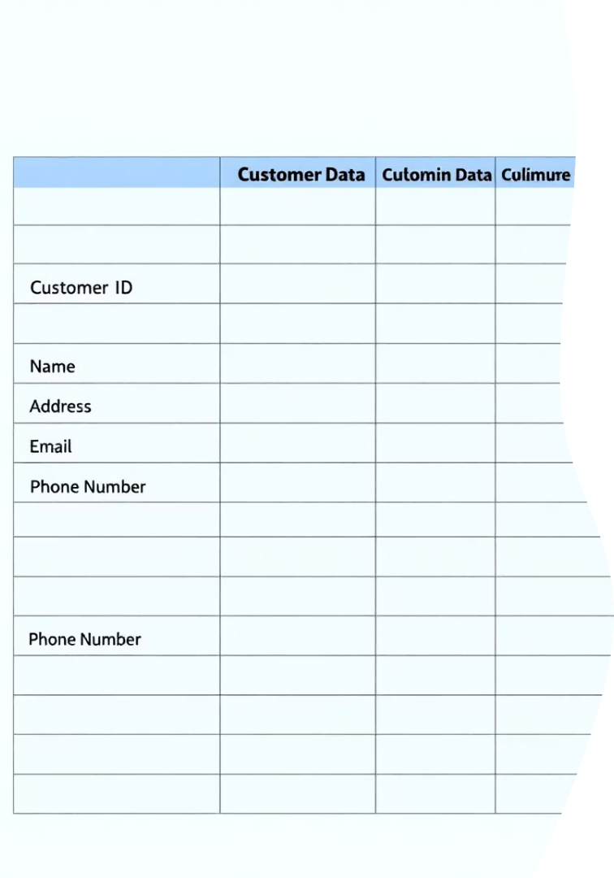
Dataset Structure and Initial Insights
Dataset Size
Data Types
7,043 rows and 21 columns covering customer info, services, and churn.
Mix of categorical and numerical data; TotalCharges initially as object, converted to numeric.
Missing Values
Only 11 missing values in TotalCharges, representing 0.15% of data, safely removed.

Slide 3

Data Cleaning and Preparation
Handling Missing Data
Feature Engineering
Created tenure groups in 12-month bins to categorize customer tenure.
Converted TotalCharges to numeric and dropped rows with missing values.
Column Reduction
Dropped customerID and raw tenure columns to focus on relevant features.

Slide 4
Univariate Analysis of Churn Factors
Churn Distribution
Service Impact
Demographics
Churn rate is 26.6%, with 73.4% customers retained.
Customers without online security or tech support have higher churn.
Non-senior citizens churn more frequently than seniors.
Month-to-month contracts show higher churn compared to long-term contracts.
Fiber optic users tend to churn more than DSL or no internet users.
Gender and phone service availability have minimal impact on churn.

Slide 5
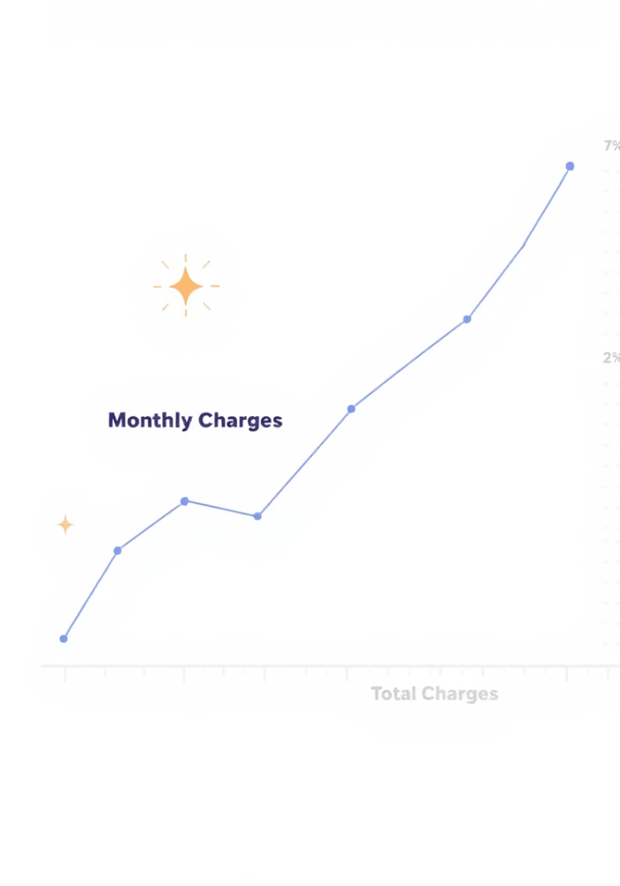



Numerical Analysis: Charges and Churn
Monthly Charges
Higher monthly charges correlate with increased churn probability.
Total Charges
Surprisingly, churn is higher at lower total charges, indicating shorter tenure.
Combined Effect
High monthly charges with low tenure and total charges link strongly to churn.

Slide 6
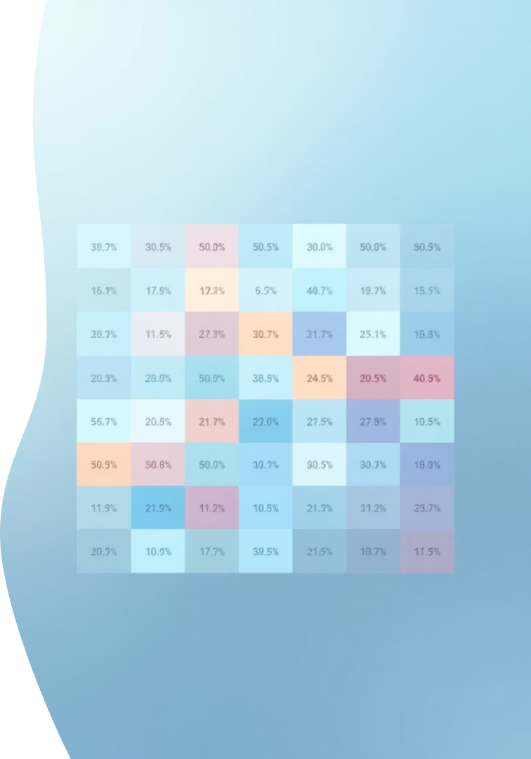
Correlation and Heatmap Insights
Strong Positive Correlations
Strong Negative Correlations
Month-to-month contracts, no online security, no tech support, and fiber optic internet associate with high churn.
Long-term contracts and customers with 5+ years tenure show low churn.
Minimal Impact Factors
Gender, phone service, and multiple lines have little influence on churn.

Slide 7
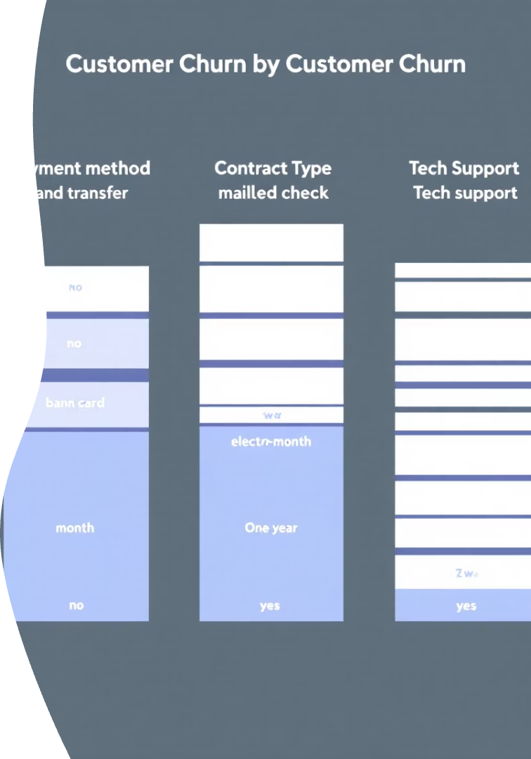

Churn Distribution by Key Features
Payment Method
Electronic check users have the highest churn rate compared to other payment types.
Contract Type
Month-to-month contracts show significantly higher churn than one or two-year contracts.
Tech Support
Customers without tech support are more likely to churn.

Slide 8

Conclusion and Key Takeaways
Highest Churn Drivers
Electronic check payment, month-to-month contracts, no online security, and no tech support.
Customer Profile
Non-senior citizens and customers with shorter tenure are more prone to churn.
Next Steps
Further analysis to uncover additional insights and develop targeted retention strategies.

