Slide 1
R Introduction
Li Xiaoli

Slide 2
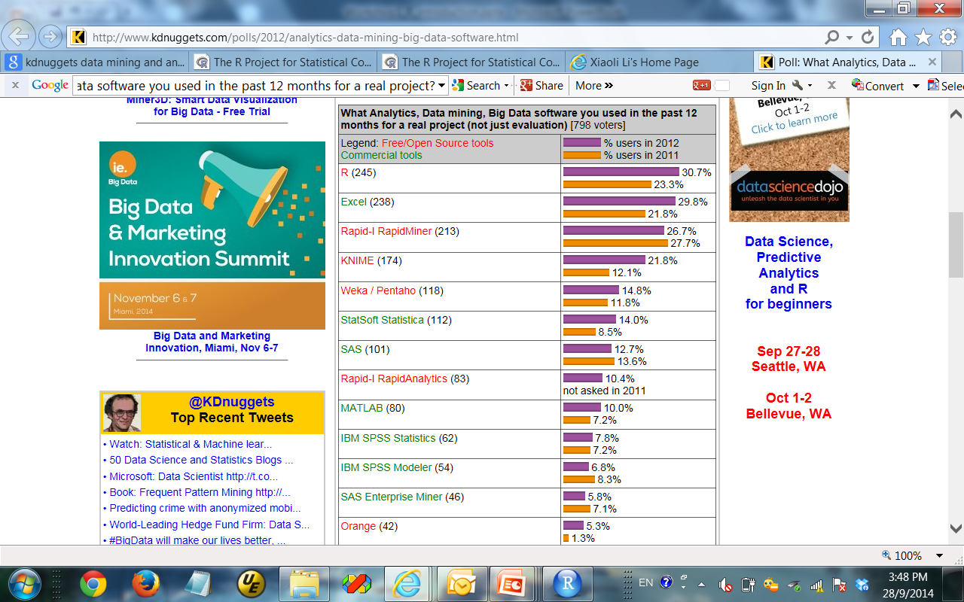
http://www.kdnuggets.com/polls/2012/analytics-data-mining-big-data-software.html

Slide 3
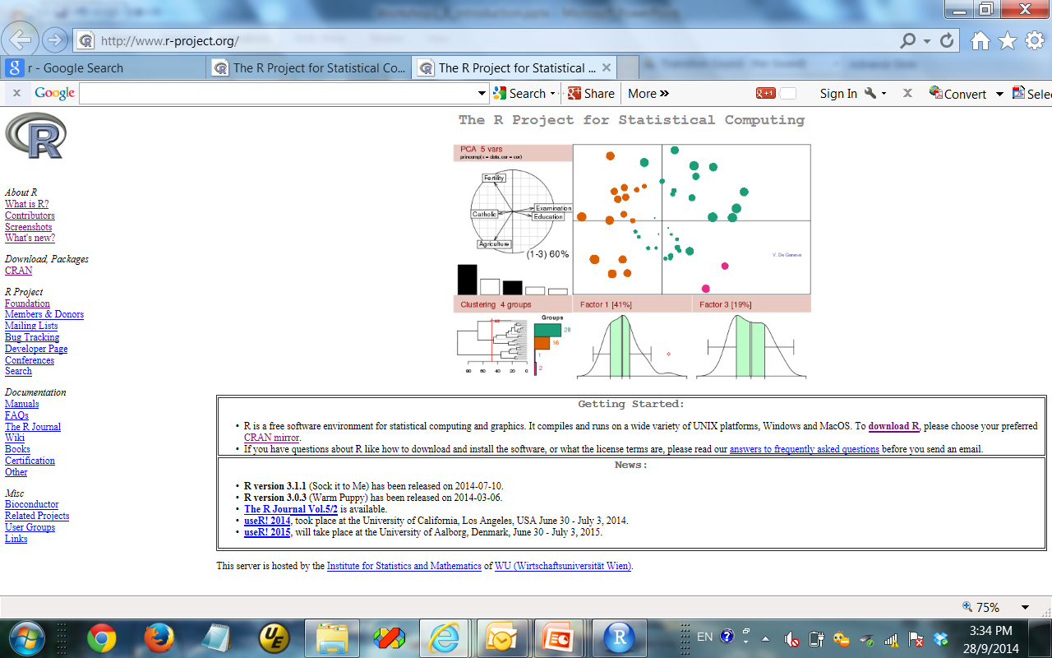
What is R and why do we use it?
Open source, most widely used for statistical analysis and graphics
Extensible via dynamically loadable add-on packages
> 5,887 packages on CRAN
http://cran.r-project.org/web/packages/
What are the packages on Network Analysis?
Relatively easy to use
> v = rnorm(256)
> A = as.matrix (v,16,16)
> summary(A)
> library (fields)
> image.plot (A)
Notes:
Go to CRAN web-site and show the libraries

Slide 4
Why R?
Open source – It’s free!
Statistical functions – R is designed for statistical computing
Data Mining – R is also widely used by data scientists
Econometrics
Genetics
…..
Excellent graphing engine – plot nice graphs with built-in functions and external packages like ggplot2 and heatmap.2
Easy to Use – do more with less so you can spend more time thinking about the problem you are trying to solve
Notes:
Open source statistical programming language
Thousand of packages for:
Statistics
Machine Learning
Econometrics
Genetics
… and much more!

Slide 5
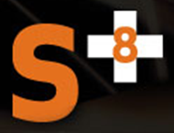

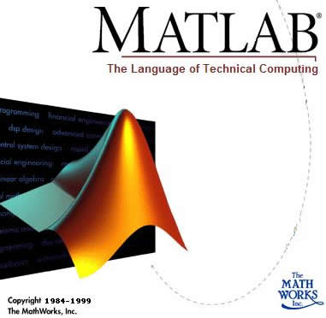


Why R?
Statistics & Data Mining
Commercial
Technical computing
Matrix and vector formulations
Statistical computing and graphics
http://www.r-project.org
Data Visualization and analysis platform
Image processing, vector computing
Developed by R. Gentleman & R. Ihaka
Expanded by community as open source
Statistically rich
Notes:
5
Do the head count of who uses each tool routinely or more preferentially.
There are other commercial software: S-PLUS, SAS
Much limited data mining tools: Weka, DAP, gretl
Matlab – for matrices
IDL – for visualization
R – for statistics, and open, extensible, large community
------------------------------------------
Other Open Source Projects:
Dap, gretl, Weka
Other Proprietary Projects:
IDL, Matlab, Mathematica
Dap: a small statistics and graphics package based on C. Anyone familiar with the basic syntax of C programs can learn to use the C-style features of Dap quickly and easily; advanced features of C are not necessary, although they are available.
Gretl: Gnu Regression, Econometrics and Time-series Library. for econometric analysis
Weka: a collection of machine learning algorithms for data mining tasks.

Slide 6
The Programmer’s Dilemma
What programming language to use & why?
Productivity
Performance
High-
Scripting
(R, MATLAB, IDL)
Level
Languages
Object Oriented
(C++, Java)
Functional languages
(C, Fortran)
Low-Level Languages
Assembly
Notes:
Low level languages can yield good performance, but often the productivity suffers. In contrast, high-level languages can offer good productivity, at the expense of performance.
Since many scientists use scripting environments, such as R, MATLAB and IDL, pR strives to bring the performance of low-level languages into high-level languages, specifically R, by enabling third-party compiled routines to execute transparently within R.
Examples of parallel third-party libraries: ScaLAPACK, PETSc
6

Slide 7

Features of R
R is an integrated suite of software for data manipulation, calculation, and graphical display
Effective data handling
Various operators for calculations on arrays/matrices
Graphical facilities for data analysis
Well-developed language including conditionals, loops, recursive functions and I/O capabilities.

Slide 8
R Installation
Download R from
http://www.r-project.org
Rstudio R IDE software at
http://www.rstudio.com
RStudio IDE is a powerful and productive user interface for R.
Video: Simple Introduction of Rstudio IDE
http://www.rstudio.com/products/RStudio/
Notes:
Integrated Development Environment

Slide 9
Getting help
From R GUI
help(function_name)
help(prcomp)
? function_name
?prcomp
help.search(“topic”)
??topic
Search CRAN
http://www.r-project.org
CRAN Task Views (for individual packages)
http://cran.cnr.berkeley.edu/web/views/
Notes:
Principal Components Analysis

Slide 10
R Basics: Basic functions
# list installed packages
library()
# install a package
install.packages("ggplot2")
# load a library
library(ggplot2)
# search help files (free text search from all the help in the menu)
??mean
# help for a function (if you know what function you are looking for)
?mean

Slide 11
Variables and assignment
Use variables to store values
Three ways to assign variables
a = 6
a <- 6
6 -> a
Update variables by using the current value in an assignment
x = x + 1
Notes:
_

Slide 12
Basic usage: arithmetic in R
You can use R as a calculator
Typed expressions will be evaluated and printed out
Main operations: +, -, *, /, ^
Obeys order of operations
Use parentheses to group expressions
More complex operations appear as functions
sqrt(2)
sin(pi/4), cos(pi/4), tan(pi/4), asin(1), acos(1), atan(1)
exp(1), log(2), log10(10)

Slide 13
Data Types in R
http://www.statmethods.net/input/datatypes.html
Vectors (numerical, character, logical),
Matrices: all columns in a matrix must have the same mode(numeric, character, etc.) and the same length.
Arrays: Arrays are similar to matrices but can have more than two dimensions.
Data frames: more general than a matrix, in that different columns can have different modes (numeric, character,).
Lists: An ordered collection of objects (components). A list allows you to gather a variety of (possibly unrelated) objects under one name.
Factors: Tell R that a variable is nominal by making it a factor. The factor stores the nominal values as a vector of integers in the range [ 1... k ] (where k is the number of unique values in the nominal variable), and an internal vector of character strings (the original values) mapped to these integers.

Slide 14
Vectors and vector operations
To create a vector:
To access vector elements:
# c() command to create vector x
x=c(12,32,54,33,21,65)
# c() to add elements to vector x
x=c(x,55,32)
# 2nd element of x
x[2]
# first five elements of x
x[1:5]
# all but the 3rd element of x
x[-3]
# values of x that are < 40
x[x<40]
# values of y such that x is < 40
y[x<40]
# seq() command to create sequence of number
years=seq(1990,2003)
# to contain in steps of .5
a=seq(3,5,.5)
# can use : to step by 1
years=1990:2003;
To perform operations:
# rep() command to create data that follow a regular pattern
b=rep(1,5)
c=rep(1:2,4)
# mathematical operations on vectors
y=c(3,2,4,3,7,6,1,1)
x+y; 2*y; x*y; x/y; y^2
Notes:
Take examples from R tutorial(s)

Slide 15
R Basics : Variable / Object assignment
# variable assignment
a = 1; b = 2; c = 3
# arrays (have the same type)
a = c(1,2,3) c(...)This produces a vector of whatever is passed as an argument to c().
b = c("x", "y", "z")
c = 1:5
seq(1,2,by=.2) #This produces a sequence of numbers by a given increment
rep(1:5,3) #This produces a vector of repetitions of x by a given number of times.
a <- c(1,2,5.3,6,-2,4) # numeric vector b <- c("one","two","three") # character vector c <- c(TRUE,TRUE,TRUE,FALSE,TRUE,FALSE) #logical vector
Notes:
Different data type, factor, date, another array,
If you want to have some sequence: c = 1:5
You can have a vector of character

Slide 16
Matrices & matrix operations
To create a matrix:
# matrix() command to create matrix A with rows and cols
A=matrix(c(54,49,49,41,26,43,49,50,58,71),nrow=5,ncol=2)
B=matrix(1,nrow=4,ncol=4)
To access matrix elements:
Statistical operations:
# matrix_name[row_no, col_no]
A[2,1] # 2nd row, 1st column element
A[3,] # 3rd row
A[,2] # 2nd column of the matrix
A[2:4,c(2,1)] # submatrix of 2nd-4th elements of the 3rd and 1st columns
A["KC",] # access row by name, "KC"
rowSums(A)
colSums(A)
rowMeans(A)
colMeans(A)
# max of each columns
apply(A,2,max)
# min of each row
apply(A,1,min)
Element by element ops:
Matrix/vector multiplication:
2*A+3; A+B; A*B; A/B;
A %*% B;
Notes:
Take examples from R tutorial(s)

Slide 17
Useful functions for vectors and matrices
Find # of elements or dimensions
length(v), length(A), dim(A)
Transpose
t(v), t(A)
Matrix inverse
solve(A)
Sort vector values
sort(v)
Statistics
min(), max(), mean(), median(), sum(), sd(), quantile()
Treat matrices as a single vector (same with sort())

Slide 18
R Basics: data frames
codes = data.frame(id.x=1:4, code=c("B","B","A","D"))
colors = data.frame(id.y=1:4, color=c("red","red",NA,"white"))
d = merge( codes, colors, by.x="id.x", by.y="id.y")
You can have multiple columns, and every column could have different data types, which is very useful in real life.
Notes:
Different data type, factor, date, another array,
If you want to have some sequence: c = 1:5
You can have a matrix of characters, numbers, dates,
Different data types
R has a wide variety of data types including scalars, vectors (numerical, character, logical), matrices, data frames, and lists.
NA represent sth is missing
SQL, join, here we use merge
by.x="id.x", by.y="id.y“ which is the first key I want to use
If they have the same name, we just use by

Slide 19
R Basics: Assessing data in dataframes
# dataframes by column names
d$code
d$color
d[c("code", "color")]

Slide 20
R Basics: Object properties
str(d) # structure of the data
summary(d)
is.na(d): which cell/location in your variable has missing value
length(c): how long is your variable (if it is a matrix, it gives you nothing)
dim(d): row by column
nrow(d): # of rows
ncol(d): # of columns
Notes:
Factors are represented as the numbers, internally.
Just more efficient representation for the operation related to factors
Summary
Numeric: give you quantiles
Factors tell you the mapping

Slide 21
R Basics: Simple statistics
mean(1:9)
max(4:8)
range(c)
sum(c)
quantile(c,0.95)
rank(c)
var(c)
sd(c)
cor(c,rnorm(5))
table(d$color)
table(d$code,d$color)

Slide 22
R Basics: Simulation and Sampling Data
# Simulate data
rnorm(1000): randomly generate data with normal ditribution
rpois(10,4): simulate the poisson distribution
# Sampling data
sample(1:10): generate the random 10 data
sample(1:10, size = 5): sample 5 from my data
sample(1:10, size = 15, replace = TRUE)
set.seed(26011973)
sample(1:10, size = 15, replace = TRUE)

Slide 23
R Basics: Defining and calling functions
power<-function(x,y) x**y #power is the function name
power(2,3)
graphnormal<-function(n=1000) {
d = rnorm(n)
histogram(d)
}
graphnormal(10000)

Slide 24
R Basics: Memory Management
# save object to file
save(d,file="d.RData")
# memory management (house keeping things)
objects()
ls()
rm(list=ls())
# load object from file
load("d.RData")
Notes:
Unless you want to save and load it again (for big variable)

Slide 25
Graphical display and plotting
Most common plotting function is plot()
plot(x,y) plots y vs x
plot(x) plots x vs 1: length(x)
plot() has many options for labels, colors, symbol, size, etc.
Check help with ?plot
Use points(), lines(), or text() to add to an existing plot
Use x11() to start a new output window
Save plots with png(), jpeg(), tiff(), or bmp()

Slide 26
R Basics: Graphical display and plotting
x=c(1,2,3, 4, 5)
y=c(1,4,9, 16, 25)
plot(x,y)
x11()
plot(x,y)
plot(x,y, main="My first Figure Using R", sub="what is subtitle?")
plot(x,y, main="My first Figure Using R", col="red", sub="what is subtitle?", xlab="X-axis label", ylab="y-axix label", xlim=c(0, 6), ylim=c(0, 26))

Slide 27
Reading data from files
Large data sets are better loaded through the file input interface in R
Reading a table of data can be done using the read.table() command:
a <- read.table(“a.txt”)
The values are read into R as an object of type data frame. Various options can specify reading or discarding of headers and other metadata.
A more primitive but universal file-reading function exists, called scan()
b = scan(“input.dat”);
scan() returns a vector of the data read

Slide 28
Programming in R
The following slides assume a basic understanding of programming concepts
For more information, please see chapters 9 and 10 of the R manual:
http://cran.r-project.org/doc/manuals/R-intro.html
Additional resources
Beginning R: An Introduction to Statistical Programming by Larry Pace
Introduction to R webpage on APSnet:
http://www.apsnet.org/edcenter/advanced/topics/ecologyandepidemiologyinr/introductiontor/Pages/default.aspx
The R Inferno:
http://www.burns-stat.com/pages/Tutor/R_inferno.pdf

Slide 29
Conditional statements
Perform different commands in different situations
if (condition) command_if_true
Can add else command_if_false to end
Group multiple commands together with braces {}
if (cond1) {cmd1; cmd2;} else if (cond2) {cmd3; cmd4;}
Conditions use relational operators
==, !=, <, >, <=, >=
Do not confuse = (assignment) with == (equality)
= is a command, == is a question
Combine conditions with and (&&) and or (||)
Use & and | for vectors of length > 1 (element-wise)

Slide 30
Loops
Most common type of loop is the for loop
for (x in v) { loop_commands; }
v is a vector, commands repeat for each value in v
Variable x becomes each value in v, in order
Example: adding the numbers 1-10
total = 0; for (x in 1:10) total = total + x;
Other type of loop is the while loop
while (condition) { loop_commands; }
Condition is identical to if statement
Commands are repeated until condition is false
Might execute commands 0 times if already false
while loops are useful when you don’t know number of iterations

Slide 31
Lists
Objects containing an ordered collection of objects
Components do not have to be of same type
Use list() to create a list:
a <- list(“hello”,c(4,2,1),“class”);
Components can be named:
a <- list(string1=“hello”,num=c(4,2,1),string2=“class”)
Use [[position]] to access list elements
E.g., a[[2]]
Running the length() command on a list gives the number of higher-level objects

Slide 32
Writing your own functions
Writing functions in R is defined by an assignment like:
a <- function(arg1,arg2) { function_commands; }
Functions are R objects of type “function”
Functions can be written in C/FORTRAN and called via .C() or .Fortran()
Arguments may have default values
Example: my.pow <- function(base, pow = 2) {return base^pow;}
Arguments with default values become optional, should usually appear at end of argument list (though not required)
Arguments are untyped
Allows multipurpose functions that depend on argument type
Use class(), is.numeric(), is.matrix(), etc. to determine type

Slide 33
Useful R links
R Home: http://www.r-project.org/
R’s CRAN package distribution: http://cran.cnr.berkeley.edu/
Introduction to R manual: http://cran.cnr.berkeley.edu/doc/manuals/R-intro.pdf
Writing R extensions: http://cran.cnr.berkeley.edu/doc/manuals/R-exts.pdf
Other R documentation: http://cran.cnr.berkeley.edu/manuals.html

Slide 34
References
Nagiza F. Samatova, William Hendrix, John Jenkins, Kanchana Padmanabhan, Arpan Chakraborty, Practical Graph Mining With R

