Slide 1
Morphology (CS 626-449)
By Mugdha Bapat
Under the guidance of
Prof. Pushpak Bhattacharyya

Slide 2
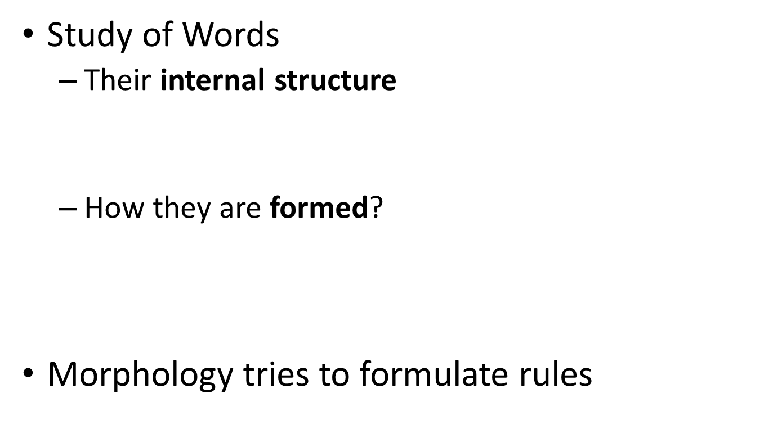
What is Morphology?
washing
wash
-ing
bat
bats
rat
rats
write
writer
browse
browser

Slide 3
Morphology for NLP
Machine Translation
Information Retrieval
  goose and geese are two words referring to the same root goose
Analyze
    पुस्तक, Noun, Direct Case, Plural
Generate
Transfer
    किताबें: किताब, Noun,
    Direct Case, Plural
    पुस्तके

Slide 4
Need of MA and MG
Why not list all the forms of a word along with their features?
  Drink:
    drink, V, 1st person
    drink, V, 2nd person
    drink, V, 3rd person, plural
  Drinks: drink, V, 3rd person, singular
  Drank: …
  Drunk: …
  Drinking: …

Slide 5
Need of MA and MG
Reasons:
  Productivity: going, drinking, running, playing
    Storing every form leads to inefficiency
  Addition of new words
    Verb: To fax. Forms: fax, faxes, faxed, faxing
  Morphological complex languages: Marathi
    दारासमोरच्यांनी – दार(SG)+समोर+चा(PL)+नी
    Meaning: दरवाजे के सामने वालों ने
    Polymorphemic
    Possible to store all the forms?

Slide 6
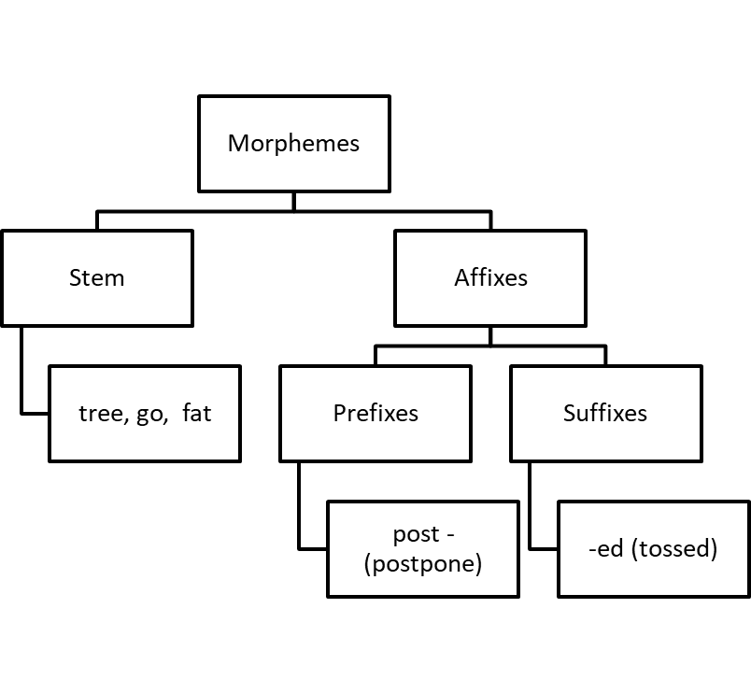
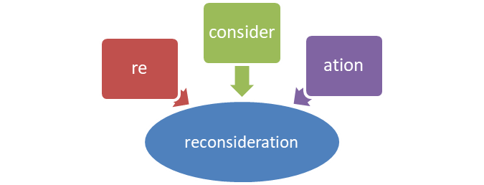
Morphemes
Smallest meaning bearing units constituting a word
Stem
Prefix
Suffix
Affixes in Hindi?

Slide 7
Classes of Morphology
Inflection
Derivation

Slide 8
Inflection
Indicates some grammatical function like
Results in a word of the same class
Productivity
Case | लड़का (D) | लड़के (O)
Number | लड़का (Sg) | लड़के (Pl)
Person | जाऊँगा (1st) | जाओगे (2nd)
Gender | जाऊँगा(Masc) | जाऊँगी (Fem)
Tense | गया(Pas) | जाऊँगी (Fem)

Slide 9
Derivation
Usually, results in a word of a different class
  -able when attached to a verb gives an adjective
  read (V) + -able = readable (Adj)
Often meaning of the derived word is difficult to predict exactly
  writer :: writer (one who writes)
  paint :: painter (one who paints)
  cut :: cutter? (an instrument used to cut)
Less productive
  eatable :: readable :: runnable?

Slide 10
Problems in MA
Productivity
False Analysis
Bound Base Morphemes

Slide 11


Productivity
Property of a morphological process to give rise to new formations on a systematic basis
Exceptions
Peaceable | Actionable | Companionable
Saleable | Marriageable | Reasonable
Impressionable | Fashionable | knowledgeable

Slide 12
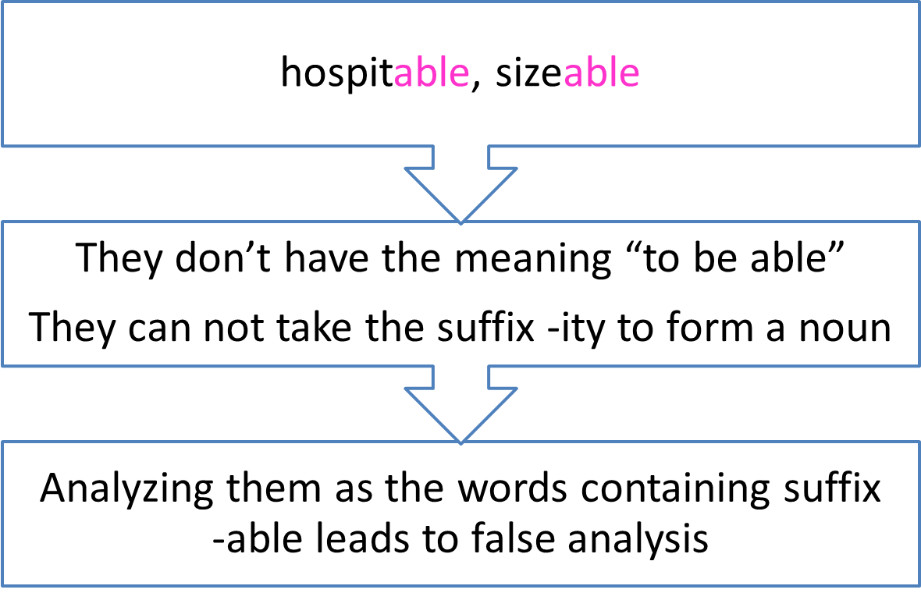
False analysis

Slide 13
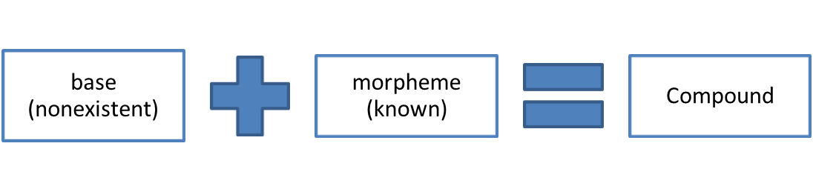
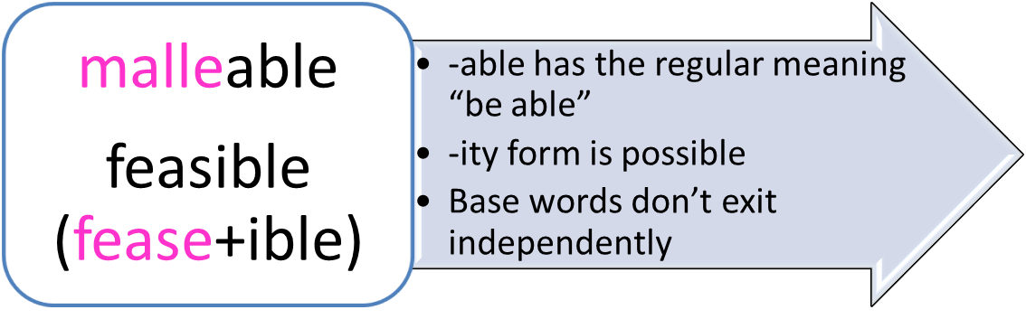
Bound Base Morphemes
Occur only in a particular complex word
Do not have independent existence

Slide 14
More on Inflection
Noun inflectional suffixes | Plural marker -s Possessive marker ‘s
Verb inflectional suffixes | Third person present singular marker -s Past tense marker -ed Progressive marker -ing Past participle markers -en or –ed
Adjective inflectional suffixes | Comparative marker -er Superlative marker -est
Inflectional Suffixes in English

Slide 15
Spelling Rules
Generally words are pluralized by adding –s to the end
Words ending in –s, -z, -sh and sometimes –x require –es
  buses, quizzes, dishes, boxes
Nouns ending in –y preceded by a consonant change the –y to -i
  babies, floppies

Slide 16
Verbal Inflection
Morphological Form Classes | Regularly Inflected Verbs |  |  |  | Irregularly Inflected Verbs
Stem | Jump | Parse | Fry | Sob | Eat | Bring | Cut
-s form | Jumps | Parses | Fries | Sobs | Eats | Brings | Cuts
-ing participle | Jumping | Parsing | Frying | Sobbing | Eating | Bringing | Cutting
Past form | Jumped | Parsed | Fried | Sobbed | Ate | Brought | Cut
–ed participle | Jumped | Parsed | Fried | Sobbed | Eaten | Brought | Cut
Forms governed by spelling rules
Idiosyncratic forms

Slide 17
Morphological Parsing
Finding
  Constituent morphemes
  Features
Input | Morphological Parsed Output
cats | cat +N +PL
geese | goose +N +PL
goose | (goose +N +SG) or (goose +V)
gooses | goose +V +3G
caught | (catch +V +PAST-PART) or (catch +V +PAST)

Slide 18
Resources
Lexicon | List of stems and suffixes along with basic information about them
Morphotactics | A model of morpheme ordering that explains which classes of morphemes can follow other classes of morphemes
Orthographic Rules | Spelling rules used to model the changes that occur in the work usually when two morphemes combine

Slide 19
Morphological Recognition
reg-noun | irregular-sg-noun | irregular-pl-noun | plural
flower | goose | geese | -s
cat | sheep | sheep
dog | mouse | mice
Lexicon

Slide 20
Morphological Recognition: Nouns
reg-noun | irregular-sg-noun | irregular-pl-noun | plural
flower | goose | geese | -s
cat | sheep | sheep
dog | mouse | mice
Lexicon
reg-noun
plural (-s)
q0
q1
q2
FSA
Note: Here, we are ignoring the nouns which take the suffix –es for pluralization
irreg-pl-noun
irreg-sg-noun

Slide 21
Adjectives
Type | Properties | Examples
adj-root1 | Occur with un- and -ly | happy, real
Adj-root2 | Can’t occur with un- and -ly | big, red

Slide 22
Adjectives
Type | Properties | Examples
adj-root1 | Occur with un- and -ly | happy, real
Adj-root2 | Can’t occur with un- and -ly | big, red
adj-root1
-er
-ly
-est
q1
q2
un-
q0
q5
adj-root1
ε
q3
q4
-er
-est
adj-root2

Slide 23
References
“Linguistics, An Introduction to Language and Communication” by Adrian Akmajian, Richard A. Demers, Ann K. Farmer and Robert M. Harnish (5th Edition)
SPEECH and LANGUAGE PROCESSING, An Introduction to Natural Language Processing,
Computational Linguistics, and Speech Recognition by Daniel Jurafsky and James H. Martin (Second Edition)

