Slide 1
Presentation On Industrial Summer Training
Presented By:
Mohan Kumar Sah
B.Tech (CSE dept. , 7th Sem.)
Roll No: CSB16071
Tezpur Central University, Tezpur, Assam

Slide 2
Contents
About the Company “TechTrunk Venture Private Limited”
Description of Internship
Datasets and Objectives
Methodology of Implementing ML algorithms on different datasets
Talking Chatbot and Chatbot Corpus
Implementation of Talking Chatbot
Conclusion
Bibliography

Slide 3
TechTrunk Venture Private Limited
TechTrunk Venture Private Limited is a company which provides online courses on Artificial Intelligence, Machine Learning, Deep Learning and Internet Of Thing.
It also provides online classes through live LED classes and regular class rooms by working professionals and consultants from renowned organizations processing over a decade of experiences.
It also provides workshops on University level and delivers workshops across the country.
It also organize summer and winter training on Artificial Intelligence, Machine Learning, Deep Learning and Internet Of Thing during summer and winter vacation respectively.
It also enables it trainers to work on different IT projects ensuring they gain real time industry experience that helps it to deliver the high quality training.

Slide 4
Internship Description
Post: Artificial Intelligence and Machine Learning Intern Guide: Sobin Sunny
Job Assigned:
Asked to explore about the concepts like Feature Engineering, Feature Selection, and Exploratory Data Analysis.
Asked to analyze 10 different data sets using the mentioned concepts and create machine learning model on these data sets.
Asked to assign one of the above data set for analysis and model creation to students who came for training in the company and guide them in their work.
Asked to build a Talking Chat bot using corpus data set.
Software Required:
Anaconda, Jupyter Notebooks
Language & Libraries Required:
Python programming language.
Libraries: numpy, pandas, sklearn, matplotlib, seaborn, speech_recognition, chatterbot, pyttsx3, PyAudio

Slide 5
Datasets with Objectives
1. Chicago Crime Dataset
Objective: Explore the data, and provide insights and forecasts about crimes in Chicago.
2. Sales-Win-Loss Dataset
Objective: Explore, analyze data and build a predictive model to tell us which sales campaign will result in a loss and which will result in a win.
3. Marketing Campaign Dataset
Objective: Analyze test market campaigns based on responses, revenue and other key metrics. Predict who will respond to which campaign by which channel and why.
4. Accounts Receivable Dataset
Objective: Understand the factors of successful collection efforts. You can Predict which customers will pay fastest and recover more money and improve collections efficiency.

Slide 6
5. Tips Dataset
Objective: Explore the dataset, and extract useful information from the dataset.
6. Automobile Dataset
Objective: Explore dataset, do feature selection process and predict price of vehicle or car.
7. Pima Indians diabetes Dataset
Objective: Explore dataset and diagnostically predict whether or not a patient has diabetes,
based on certain diagnostic measurements included in the dataset.
8. Rain in Australia Dataset
Objective: Explore data, extract information and Predict whether or not it will rain
tomorrow by training a binary classification model on target RainTomorrow.
9. Financial Dataset
Objective: Explore data, extract information and do fraud detection in finance.
10. IPL Dataset
Objective: Analyze the IPL data and Predict the winner of the next matches of IPL based on
past data, Visualizations, Perspectives, etc.

Slide 7
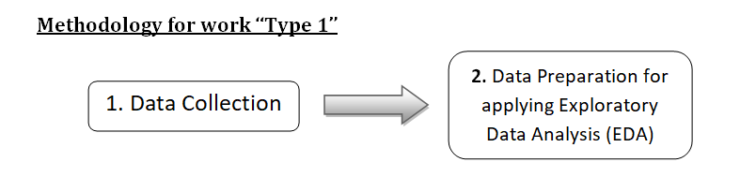
Methodology for Implementing ML algorithms on different datasets
The company assigned me two types of work:
Type 1: I have to apply Exploratory Data Analysis (EDA) on some datasets.
Type 2: I have to explore, analyze and build Machine Learning models on some datasets.

Slide 8
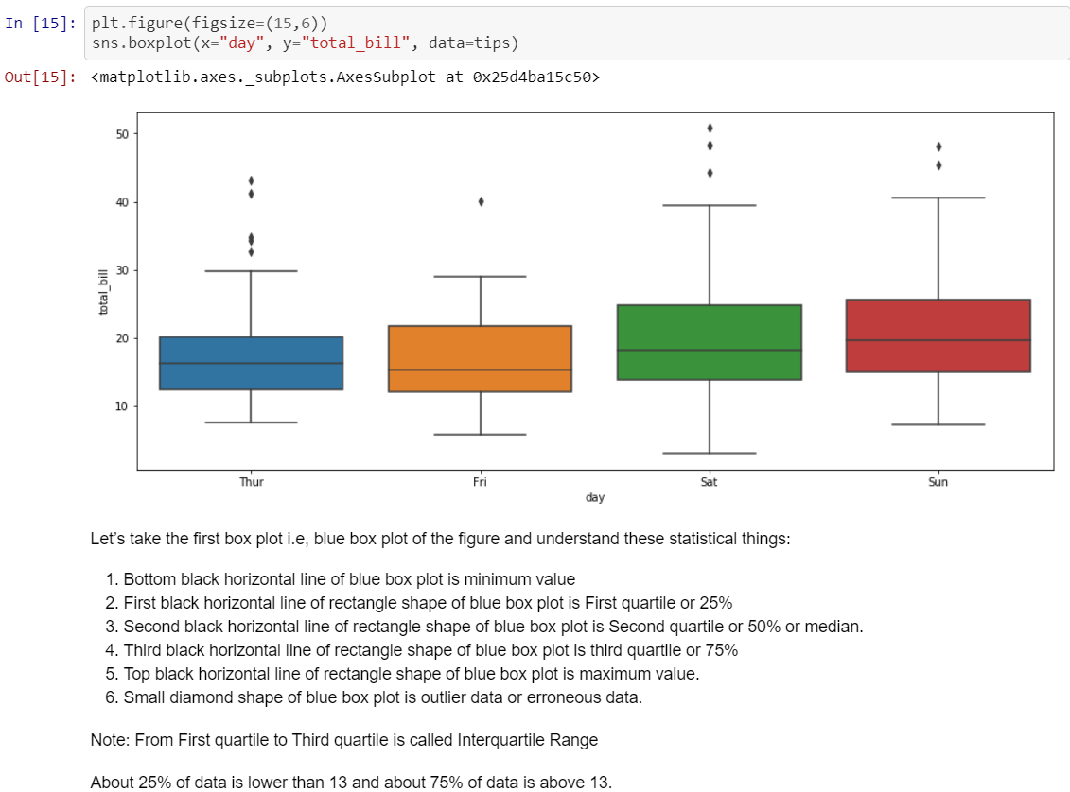
Box Plot

Slide 9
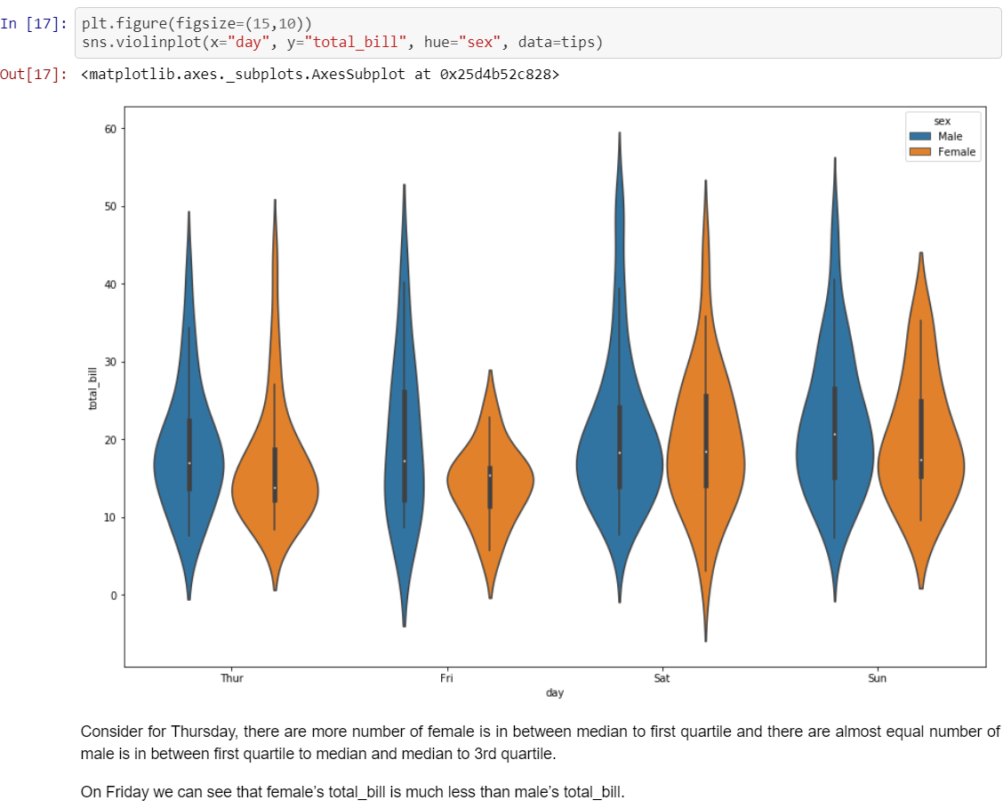
Violin Plot

Slide 10
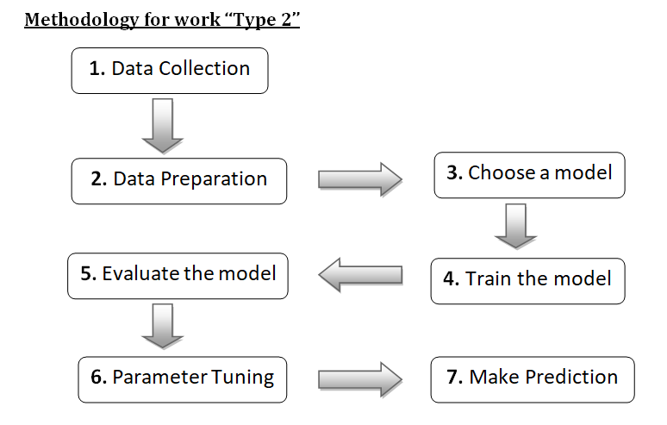

Slide 11
Results
SI NO. | Dataset | AIM | Algorithm | Accuracy
1. | Chicago Crime | Exploratory Data Analysis | X | X
2. | Sales-Win-Loss | Model Creation | K-Nearest Neighbors | 84.40 %
3. | Marketing Campaign | Exploratory Data Analysis | X | X
4. | Accounts Receivable | Exploratory Data Analysis | X | X
5. | Tips | Exploratory Data Analysis | X | X
6. | Automobile | Model Creation | Linear Regression | 81.39 %
7. | Pima Indian Diabetes | Model Creation | Logistic Regression | 81.17 %
8. | Rain in Australia | Model Creation | Logistic Regression | 84.34 %
9. | Financial | Model Creation | Logistic Regression | 90.92 %
10. | IPL | Exploratory Data Analysis | X | X

Slide 12
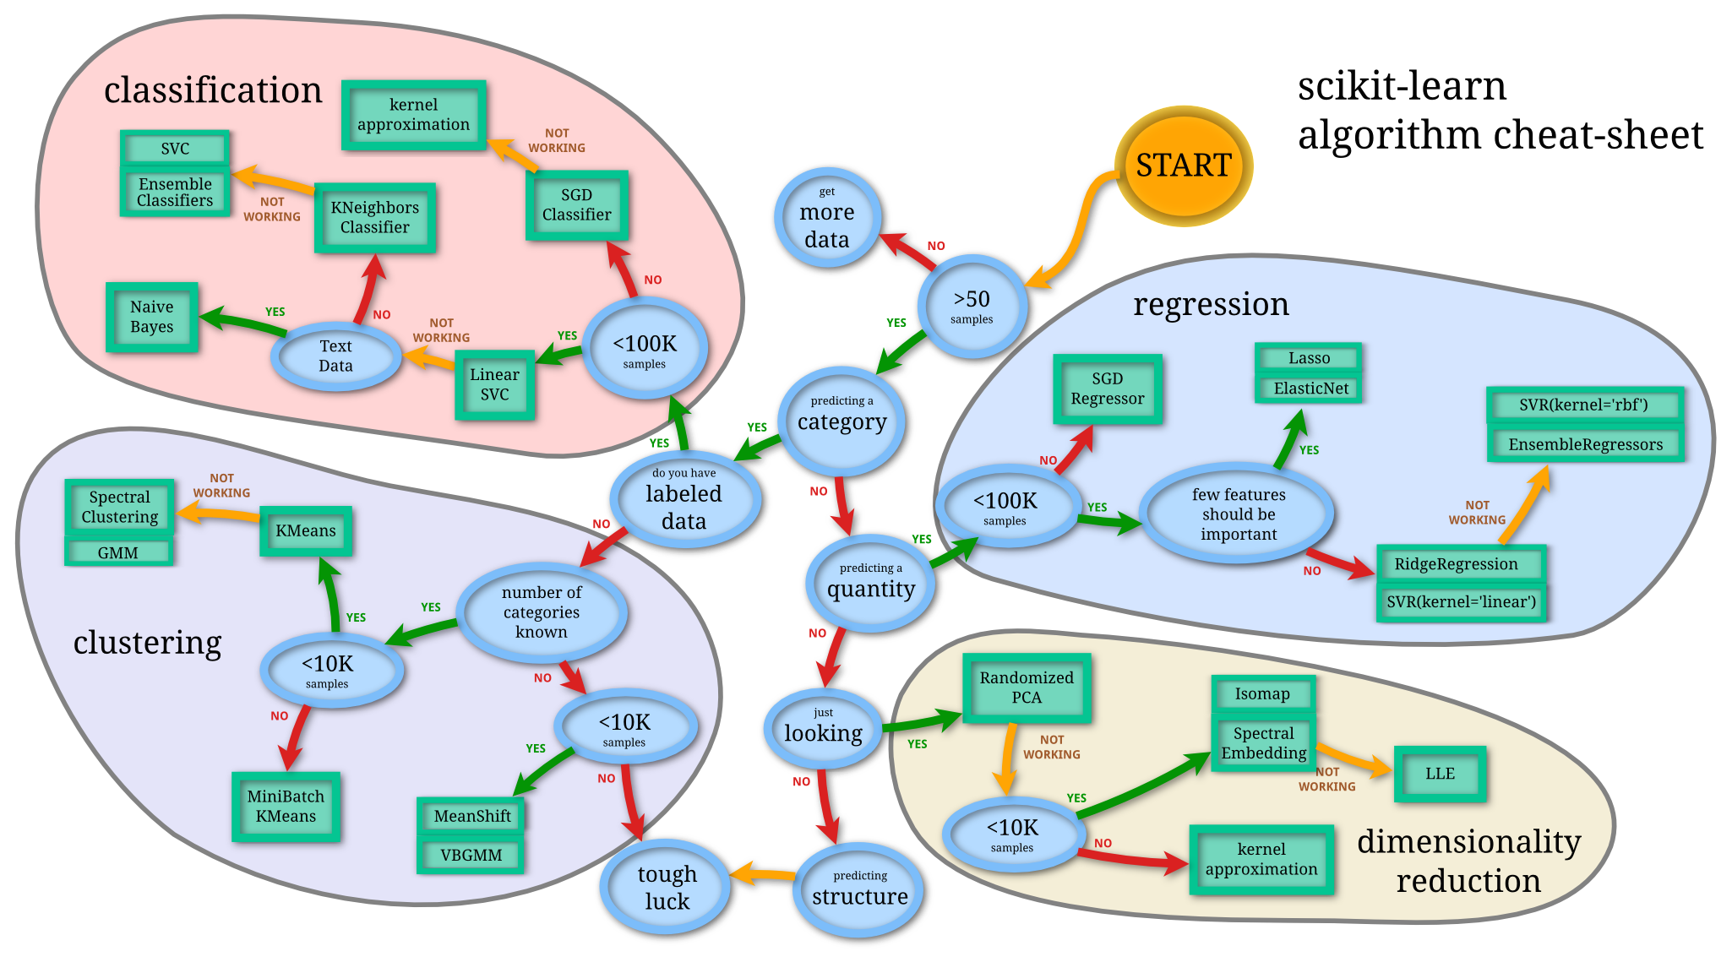
Different algorithms are for different tasks, how to choose right one

Slide 13
Talking Chatbot and Chatbot Corpus
Chatbot: A chatbot is artificial intelligence (AI) software that can simulate a conversation
(or a chat) with a user in natural language through messaging applications, websites, and
mobile apps or through the telephone.
Talking chatbot: It is similar to the chatbot only difference is that it takes voice as input
and also gives voice as output.
Chatbot Corpus: It is a corpus of dialog data that is included in the chatterbot module.

Slide 14
Implementation of Talking Chatbot
Logic used to build the Talking Chatbot:
I developed my own logic to build the Talking Chatbot which mainly consist of three steps :
First we have to develop a chatbot which can take a text and reply with a text (Used in step 2).
1. Converting the speech (user voice) into text
Here first we recognize the voice of the user which is the input of the Talking Chatbot
and after we convert the voice into string (text) for the next step.
2. Feed the text to chatbot which will give a reply to that text
3. Converting the reply into speech (chatbot voice)
Here we convert the text again to voice which is the output of the Talking Chatbot.
In python code I put these three steps in a infinite while loop and set a condition that if user
say “bye” then loop breaks and program terminates.

Slide 15
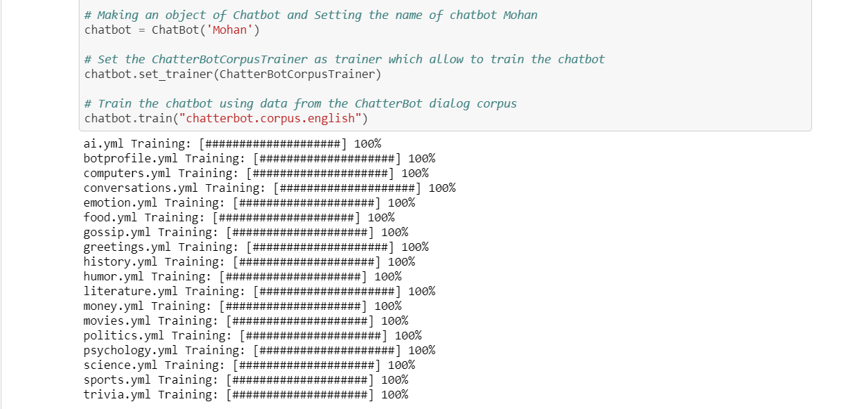
Importing necessary packages
Chatbot which can take the text and reply with text

Slide 16
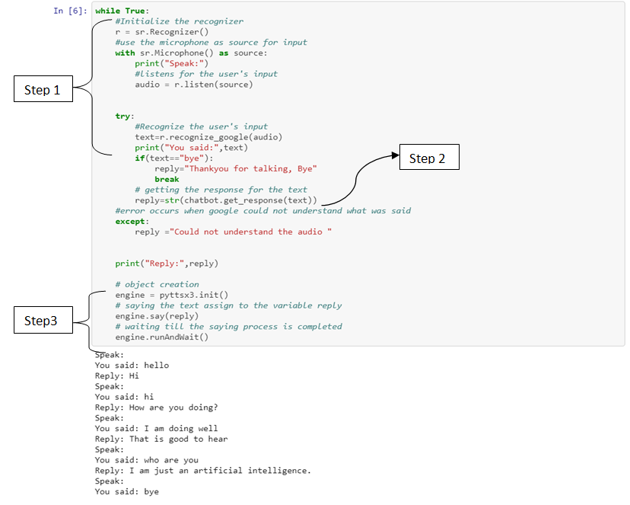
Talking Chatbot

Slide 17
Conclusion
During the internship period of two months (01st June, 2019 to 01st Aug, 2019), I learned a lot in the field of Machine Learning, Deep Learning and Data Science. I learned something which I never learned before.
Apart from knowledge, I earned good industrial experiences. I learned how to deal with pressure that we are normally facing in office. I learned how to deal with clients and how to talk with clients on any projects.
Since I was asked to guide and help some students in their projects, I also gained mentoring experiences. By talking to students or clearing doubts of students, I learned how to teach or guide someone or help someone in their projects. I also developed my communication skills.
At last I would like to inform you that I was successfully delivering my work whether it was about working on projects or mentoring the students. I successfully completed all the work assigned by company on time.
On last day of Internship, Director of the company provided me the Certificate and Recommendation Letter for my work and said I did well and he was happy with my work.

Slide 18
Bibliography
https://botpress.io/learn/what-and-why
https://expertsystem.com/chatbot/
https://chatterbot.readthedocs.io/en/stable/
https://towardsdatascience.com/understanding-feature-engineering-part-2-categorical-data-f54324193e63
https://blog.myyellowroad.com/using-categorical-data-in-machine-learning-with-python-from-dummy-variables-to-deep-category-66041f734512
https://www.analyticsvidhya.com/blog/2016/12/introduction-to-feature-selection-methods-with-an-example-or-how-to-select-the-right-variables/
http://www.statgraphics.com/exploratory-data-analysis
https://medium.com/datadriveninvestor/build-your-first-chatbot-in-10-lines-of-code-88c4f15e39c9
https://chatterbot.readthedocs.io/en/stable/corpus.html
https://www.geeksforgeeks.org/ml-linear-regression/
https://towardsdatascience.com/introduction-to-machine-learning-algorithms-linear-regression-14c4e325882a
https://towardsdatascience.com/introduction-to-logistic-regression-66248243c148
https://www.geeksforgeeks.org/k-nearest-neighbours/
https://www.kdnuggets.com/2018/05/general-approaches-machine-learning-process.html

Slide 19
Thank You

