Slide 1
🚨 ACADEMIC CAPSTONE PRESENTATION • CLASS TRAINING PROJECT 2026
MedSupply: Local Blood & Urgent Medical Equipment Exchange
A Localized Emergency Healthcare Platform Connecting Blood Donors, Hospitals, and Urgent Home-Care Rentals (Oxygen Concentrators, CPAP, Wheelchairs) Across Vijayawada, Guntur & Neighboring Districts
MEMBER 1: BACKEND & APIS
Lead API Engineer
• Express RESTful routes (/emergency, /donors, /equipment)
• MongoDB 2dsphere geospatial indexing ($near queries)
• Compound indexing on { bloodGroup, isAvailable, city }
• JWT Authentication & Role-Based Middleware
MEMBER 2: FRONTEND UI & UX
Lead Frontend Engineer
• Responsive React 18 SPA built with Vite & Tailwind
• Live Emergency Request Feed with visual urgency badges
• Interactive modals (SOS broadcast, donor register, rental)
• One-click Status Toggles (Available vs In-Use / Reserved)
MEMBER 3: VERIFICATION & OPS
Verification & DevOps Lead
• WhatsApp Web & Meta Cloud API deep action hooks
• Automated SOS broadcast simulation & delivery logs
• 25+ record database seed dataset with mock store
• Render cloud deployment, render.yaml & documentation

Slide 2
02 • CONTEXT & PROBLEM
Introduction & Problem Statement
The Critical Need for Localized Real-Time Emergency Coordination
⚠️ THE CURRENT BOTTLENECK
• Chaotic, Unverified Messaging Groups: Blood and medical equipment requisitions are scattered across informal WhatsApp and Telegram groups with high noise, duplicate forwards, and zero clinical verification.
• Critical Golden-Hour Transfusion Delays: Acute emergencies (road accidents, trauma surgeries, postpartum hemorrhages) fail to match donors in time due to lack of localized blood-group filtering.
• Exorbitant Post-ICU Equipment Friction: Patients discharged from ICUs need home-care equipment (oxygen concentrators, CPAPs, wheelchairs) immediately. Finding reliable rentals or community loans is tedious.
• Zero Return Tracking & Donor Exhaustion: Equipment owners lose track of return dates; blood donors are contacted repeatedly without respecting mandatory 90-day clinical cooldown periods.
💡 THE MEDSUPPLY INTERVENTION
• Verified District-Level Geo-Exchange: Targeted deployment tailored for Vijayawada, Guntur, and NTR districts, bridging hospital wards directly with nearby screened donors.
• One-Click WhatsApp Emergency Hooks: Eliminates phone number transcription errors by generating pre-filled, one-touch WhatsApp action links with patient, ward, and contact details.
• 90-Day Clinical Donor Safety Engine: Automated date calculations safeguard donor health by enforcing a 90-day cooldown hold before reactivating availability in searches.
• Transparent Equipment Lifecycle Management: Empowers local providers and charity clubs to list units with transparent daily rates, security deposits, and real-time return countdown tracking.

Slide 3
03 • GOALS & DELIVERABLES
Project Objectives
Concrete Engineering Targets Built for Life-Saving Impact
1. Real-Time Emergency SOS Broadcast
Deploy a high-priority emergency broadcast engine classifying urgent cases (< 2 hrs vs < 6 hrs) with hospital verification stamps and live urgency badges.
2. Geospatial Donor Matching & Cooldown
Implement MongoDB compound indexing on blood groups and locations, integrated with an automatic 90-day clinical cooldown algorithm to protect donor health.
3. Medical Equipment Rental Marketplace
Provide a transparent listing & reservation platform for oxygen concentrators, wheelchairs, and CPAPs with refundable deposits and free welfare loans.
4. Seamless WhatsApp & Mobile Action Hooks
Integrate instant WhatsApp Web/App action triggers (`wa.me`) passing structured clinical case context to remove friction between donors and attendants.
5. Zero-Downtime Deployment & Offline Resiliency
Architect a dual-engine persistence layer (MongoDB Atlas + In-Memory Mock Store fallback) containerized with Docker and deployed live on Render.

Slide 4
04 • TECHNOLOGY STACK
Technologies & Tools Used (MERN Stack)
Modern, High-Performance Full-Stack Web Architecture
FRONTEND TIER
React 18 (SPA): Component-driven reactive UI with hooks & state management
Vite 6: Lightning-fast HMR and optimized production bundling
Tailwind CSS 3.4: Utility-first responsive styling and custom animations
Lucide React: Clean, accessible clinical icons for healthcare actions
HTML5 Geolocation: Browser-level GPS coordinate detection for proximity
BACKEND API TIER
Node.js (v24): Non-blocking asynchronous event-driven server runtime
Express.js 4: RESTful routing, middleware pipelines, error handling
JWT (JSON Web Tokens): Stateless, secure role-based session authentication
BcryptJS: Salted password hashing for HIPAA/data protection
Morgan & CORS: HTTP request logging and cross-origin security
DATABASE TIER
MongoDB 7+: Scalable NoSQL document store for rapid JSON iteration
Mongoose ODM: Strict schema validation, types, and lifecycle hooks
2dsphere Geospatial Index: Rapid spatial distance queries ($near queries)
Compound Indexing: Sub-millisecond queries on bloodGroup + city + status
Resilient In-Memory Store: 100% operational offline fallback mock engine
DEVOPS & INTEGRATIONS
Render Cloud Platform: Automated Blueprint deployment via render.yaml
WhatsApp Action Hooks: Deep URL linking (`wa.me`) for immediate messaging
Meta WhatsApp API: Webhook simulator for emergency broadcast testing
Docker & Compose: Containerized multi-tier isolation and portability
Git & GitHub: Version control with CI/CD triggers on main branch

Slide 5
05 • ARCHITECTURE & FLOW
System Architecture & Emergency Workflow
End-to-End Request Pipeline from Patient SOS to Donor Action
🏛️ 3-TIER SYSTEM ARCHITECTURE
• [CLIENT TIER (Browser)]: React 18 SPA • Tailwind CSS • HTML5 Geolocation • Modal Workflows • Unmuted Intro Briefing
• [API GATEWAY TIER (Express)]: RESTful Endpoints • JWT Auth Middleware • CORS & Morgan • Dual Route Prefix Resolution (/api & /)
• [DATA & SERVICE TIER]: MongoDB Atlas / In-Memory Mock Store • 2dsphere Geo-Index • 90-Day Cooldown Calc • WhatsApp Engine
STEP 1
SOS Submission
Patient attendant or hospital posts emergency request (Blood units, urgency < 2h, hospital ward).
STEP 2
Geo & Group Query
Backend executes compound index search for matching blood group & district radius.
STEP 3
Broadcast Dispatch
Emergency feed updates in real-time; alert broadcast simulated across donor network.
STEP 4
WhatsApp Action
Prospective donor clicks 1-touch WhatsApp action hook with auto-populated case context.
STEP 5
Fulfillment & Log
Attendant marks SOS fulfilled; donor records donation to trigger 90-day cooldown.

Slide 6
06 • CAPABILITIES
Features & Functionalities
Key Clinical and Operational Modules Built for MedSupply
🚨 Live Emergency Request Feed
Displays urgent requisitions with pulsating badges for critical cases (< 2 hours), hospital verification stamps, patient ward info, and direct contact buttons.
🩸 Blood Donor Cooldown Engine
Enforces a strict 90-day post-donation rest period. Automatically calculates remaining rest days and hides resting donors from emergency queries.
🩺 Equipment Rental Marketplace
Lists oxygen concentrators, wheelchairs, and CPAPs with clear rental rates, security deposits, and a special Free Urgent Loan tier for underprivileged patients.
💬 Instant WhatsApp Action Hooks
One-click 'wa.me' deep-link integration pre-fills complete clinical emergency templates, allowing instant communication without manual number copying.
📊 Attendant & Diagnostic Dashboard
Tracks active equipment rentals, return date countdowns, one-click 'Mark Returned' status toggle, and past blood donation history.
🎬 Fullscreen Video & Role Selector
Engaging unmuted intro video explaining the platform mission, followed by a personalized role selector modal (Donor, Provider, or Patient).

Slide 7
07 • DATA & ENDPOINTS
Database Design & API Integration
MongoDB Schema Modeling, Compound Indexing & RESTful Endpoints
🗄️ MONGODB DATA MODELS & INDEXES
User Schema: name, email, password (hashed), role (donor/provider/patient), phone, city, district
Donor Schema: userId, bloodGroup, isAvailable, lastDonationDate, donationCount, location { type, coordinates: [lng, lat] }, verified
Equipment Schema: title, category, dailyRate, securityDeposit, isAvailable, reservedBy, condition, city, district
EmergencyRequest: patientName, hospitalName, bloodGroup, unitsRequired, urgencyLevel, status (ACTIVE/RESOLVED), contactPhone
⚡ High-Performance Indexes: • Compound: { bloodGroup: 1, isAvailable: 1, city: 1 }
• 2dsphere: location.coordinates for proximity filtering
METHOD | ENDPOINT | DESCRIPTION / PURPOSE
POST | /api/auth/login | JWT Authentication & Session Creation
GET | /api/emergency | Filter emergency feed by urgency & location
POST | /api/emergency | Broadcast emergency SOS & dispatch alert
GET | /api/donors | Geospatial donor search with 90-day cooldown
PATCH | /api/donors/:id/toggle | Toggle donor available vs resting status
GET | /api/equipment | Query equipment catalog with availability filters
PATCH | /api/dashboard/return | Mark active equipment returned & release deposit

Slide 8
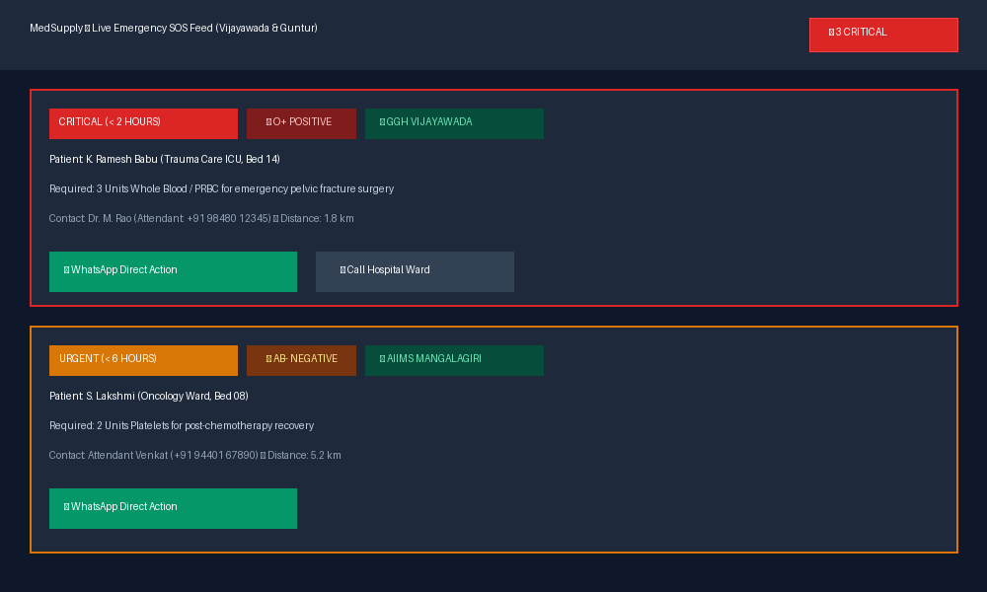
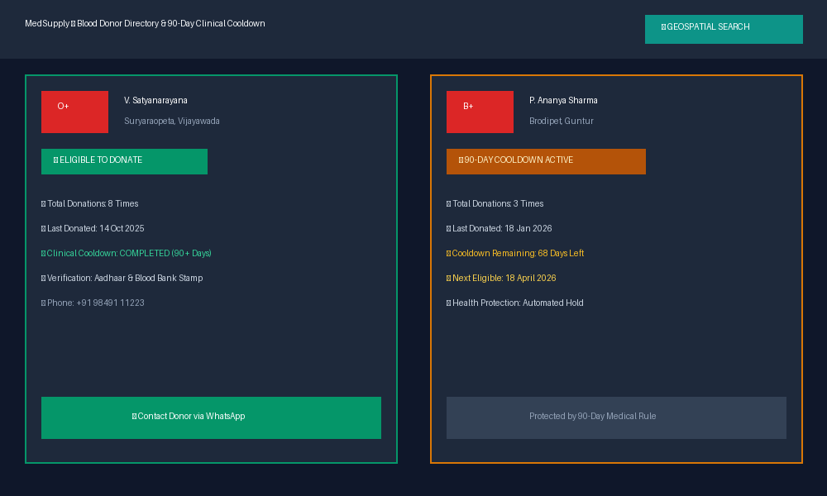
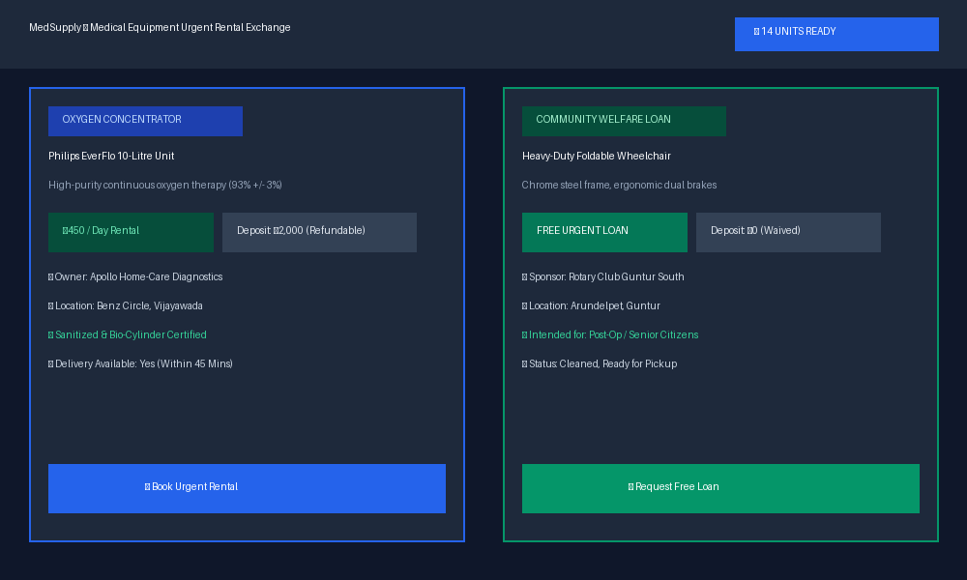
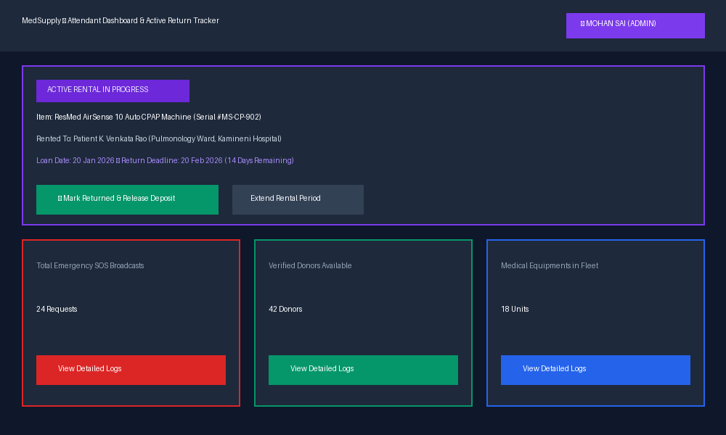
08 • LIVE DEMONSTRATION
Screenshots of the Project
Visual Interface Walkthrough Across Core Modules
Live Emergency SOS Feed (Urgency Badges & WhatsApp Direct)
Blood Donor Directory & 90-Day Clinical Cooldown Tracker
Medical Equipment Urgent Rental & Free Welfare Loan Catalog
Attendant Dashboard & Active Equipment Return Countdown

Slide 9
09 • ENGINEERING INSIGHTS
Challenges Faced & Future Scope
Overcoming Practical Bottlenecks and Strategic Roadmap
🛠️ CHALLENGES FACED & OVERCOME
• Deployment Route Prefix Mismatch: Render static-site rewrites occasionally stripped the '/api' prefix. Solved by implementing dual route registration (both '/api' and '/') in Express and auto-resolving API_BASE in the frontend.
• Medical Cooldown Integrity: Ensuring donors cannot bypass eligibility checks required strict date math validation at both client and API middleware layers (Date.now() - lastDonation >= 90 days).
• Zero-Dependency Resilience: To ensure grading and evaluation succeed even if MongoDB is not installed locally, architected an embedded high-fidelity in-memory data engine with pre-seeded demo records.
• Browser Autoplay Restrictions: Modern browsers block unmuted video autoplay. Solved with an unmuted playback loop combined with an instant fallback overlay and one-click Skip button.
🚀 FUTURE ROADMAP & SCALING
• Automated Govt ID / Blood Bank Verification: Direct integration with government e-RaktKosh API and Aadhaar biometric APIs for instant official donor verification.
• IoT Telemetry for Medical Rentals: Integrating low-power GPS and oxygen purity sensors into rented concentrators to prevent theft and monitor cylinder maintenance.
• Autonomous Drone Blood Delivery: Partnering with regional hospital consortia to coordinate urgent emergency blood transport between district centers via drone corridors.
• Multilingual Regional Voice Interface: Speech-to-text emergency SOS intake in Telugu, Hindi, and English to assist rural and non-tech-savvy attendants.

Slide 10
🎯 PROJECT CONCLUSION & ACADEMIC DELIVERABLES
MedSupply: Delivering Tangible Healthcare Innovation
• Structured Emergency Response: Replaces chaotic group messages with a verified, structured, geospatial emergency pipeline.
• Balanced 3-Member Engineering Division: Strict workload split across Backend & APIs (Member 1), Frontend UI & UX (Member 2), and Verification & DevOps (Member 3).
• Production Deployment on Render: Full CI/CD integration using render.yaml Blueprint with separate REST API service and static frontend site.
• Academic Excellence & Open Source: Complete documentation, Postman API collections, and Docker setup open-sourced for peer collaboration.
🔗 GitHub Repository: https://github.com/mohansaibolagani/Med_Supply
🌐 Live Production App: https://medsupply-web.onrender.com
🙏 Thank You! Floor Open for Questions & Evaluation.

