Slide 1
Prediction Of Product Rating
CMPE 255 – Data Mining
Submitted to :
Professor David Anastasiu
Presented By:
Saloni Mohan
Sahitya Mullapudi
Nishchay Madan

Slide 2
Motivation
Emergence in the usage of E-commerce website
Most trusted source for information on product performance – Online Customer Reviews
The analysis of Online Customer Reviews generate useful information

Slide 3
Objective
Prediction of user rating on the basis of reviews using regression techniques
Generate two models and compare and analyze results for both
Model1 – Individual reviews
Model2 – Aggregation on the basis of product ID and rating

Slide 4
Algorithms Used
Linear Regression
Ridge regression
Logistic Regression
KNN Regression

Slide 5
Tools And Technologies
Jupyter Notebook
Python data science libraries – Pandas,Numpy and Scipy
Sklearn for dimensionality reduction and regression algorithms
Matplotlib for plotting graph

Slide 6


Measure for Accuracy
We have Mean Squared Error for the accuracy measure
Mean Squared Error - mean squared error (MSE) or mean squared deviation (MSD) of an estimator (of a procedure for estimating an unobserved quantity) measures the average of the squares of the errors or deviations—that is, the difference between the estimator and what is estimated

Slide 7
Comparison between both the models
MSE for both the models for different algorithms
 | Individual | Aggregate
Ridge | 0.68 | 0.70
Logistic | 0.5 | 0.857
Linear | 0.9 | 1.87
KNN | 0.60 | 1.50

Slide 8
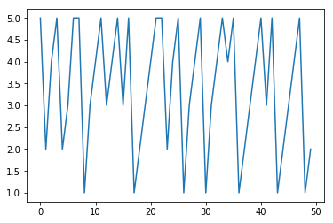
Graph for Test Rating

Slide 9
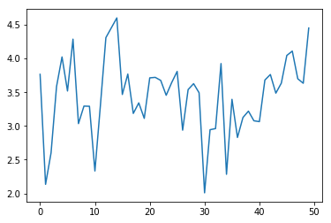
Graph for KNN Regression

Slide 10
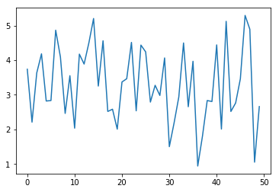
Graph for Ridge Regression

Slide 11
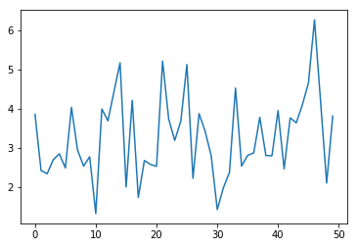
Graph for Linear Regression

Slide 12
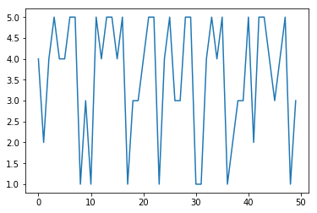
Graph for Logistic Regression

Slide 13
Thank You

