Slide 1
I Assistant Development Project Multi-Function Intelligent Chatbot
Presented by: [MOHAN SANTHI CHINTHALA]
Course: Prompt Engineering
Date: [28-06-2025]
Project ID: Major Project - AI Assistant Development

Slide 2
Multi-Function Intelligent Chatbot
Objective
Design and implement a comprehensive AI Assistant capable of performing multiple tasks through effective prompt engineering
Key Goals
✅ Create a user-friendly web-based interface
✅ Implement three distinct AI functions
✅ Design effective prompts for each function
✅ Include user feedback mechanisms
✅ Demonstrate prompt engineering skills

Slide 3
Technical Requirements Met
Three Core Functions:
Question Answering System
Text Summarization Engine
Creative Content Generation
Prompt Engineering:
3 different prompt styles per function (9 total)
Varying complexity, tone, and context
User-selectable prompt templates
User Interface:
Modern web-based interface
Intuitive function selection
Real-time chat experience

Slide 4
System Architecture
Technology Stack
Frontend: HTML5, CSS3, JavaScript (ES6+)
Styling: Custom CSS with modern design principles
Functionality: Vanilla JavaScript for maximum compatibility
Storage: In-memory data handling (no external dependencies)
Architecture Benefits
✅ Responsive Design: Works on desktop and mobile
✅ No Dependencies: Runs entirely in browser
✅ Modular Structure: Easy to extend and maintain
✅ Performance Optimized: Fast loading and smooth interactions

Slide 5
Core Functions Deep Dive
1. Question Answering System 🤔
Purpose: Provide factual information and explanations
Prompt Variations:
Direct Factual: "Please provide a clear and factual answer to: {input}"
Detailed Explanation: "Please provide a detailed explanation about: {input}.
Include relevant context and examples."
Simple & Concise: "In simple terms, {input}"
Use Cases: Educational queries, fact-checking, general knowledge

Slide 6
e
2. Text Summarization Engine
Purpose: Extract key points and create concise summaries
Prompt Variations:
Brief Summary: "Please provide a brief summary of the following text: {input}"
Key Points: "Extract the main points from this text and list them clearly: {input}"
Comprehensive Overview: "Provide a comprehensive overview and analysis of: {input}"
Use Cases: Document analysis, research
assistance, content review

Slide 7
Core Functions Deep Dive (Continued)
3. Creative Content Generation ✨
Purpose: Generate stories, poems, and creative writing
Prompt Variations:
Creative Story: "Write a creative and engaging story about: {input}"
Poetic Style: "Create a beautiful poem inspired by: {input}"
Creative Ideas: "Generate creative and innovative ideas for: {input}"
Use Cases: Creative writing, brainstorming, content inspiration

Slide 8
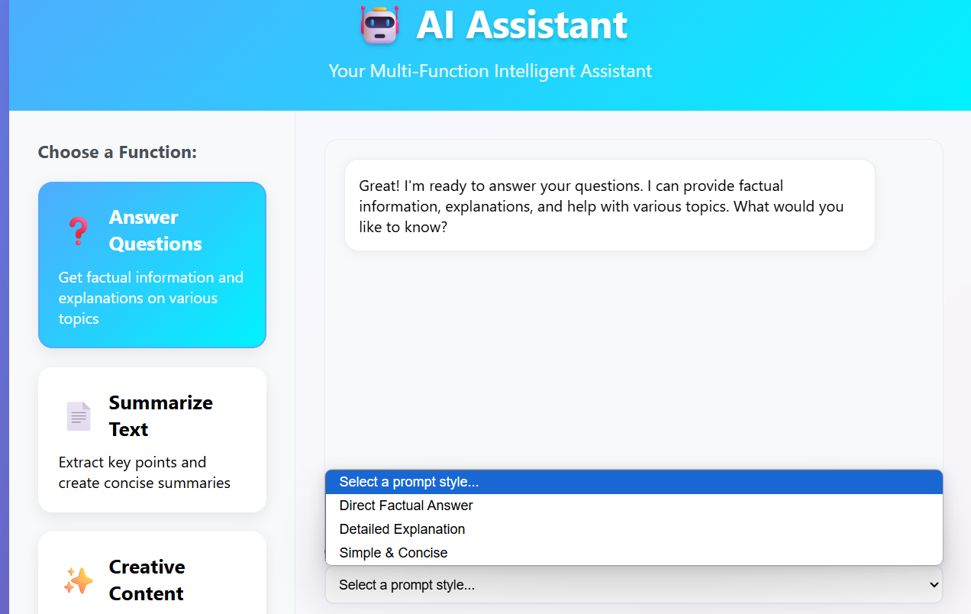
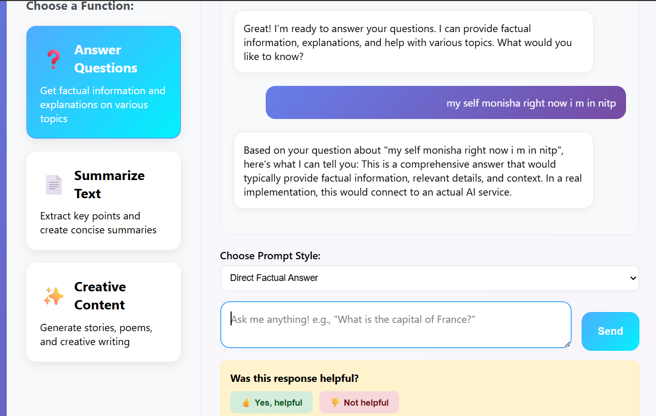
Questions Answering System

Slide 9
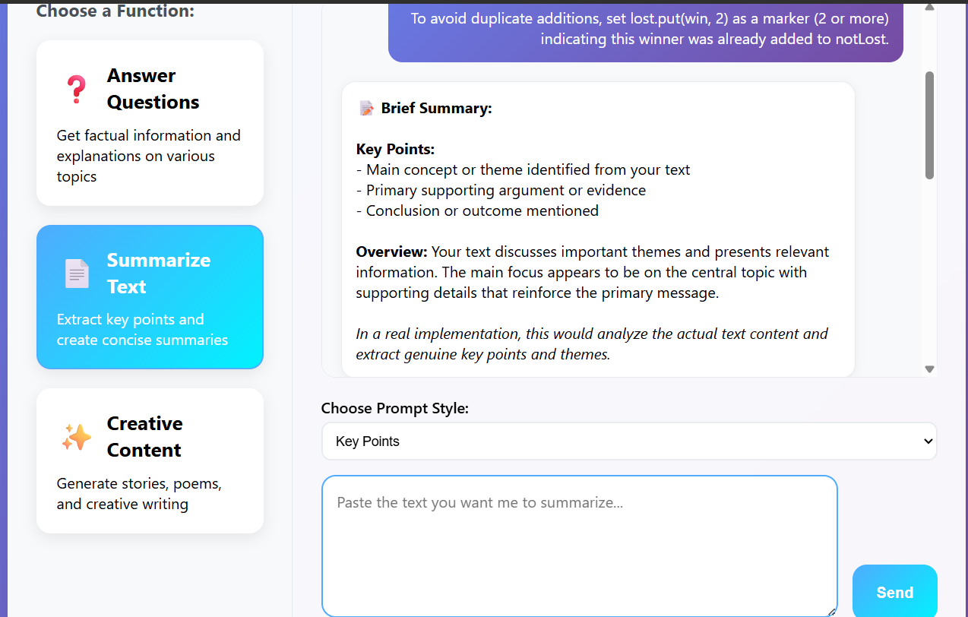
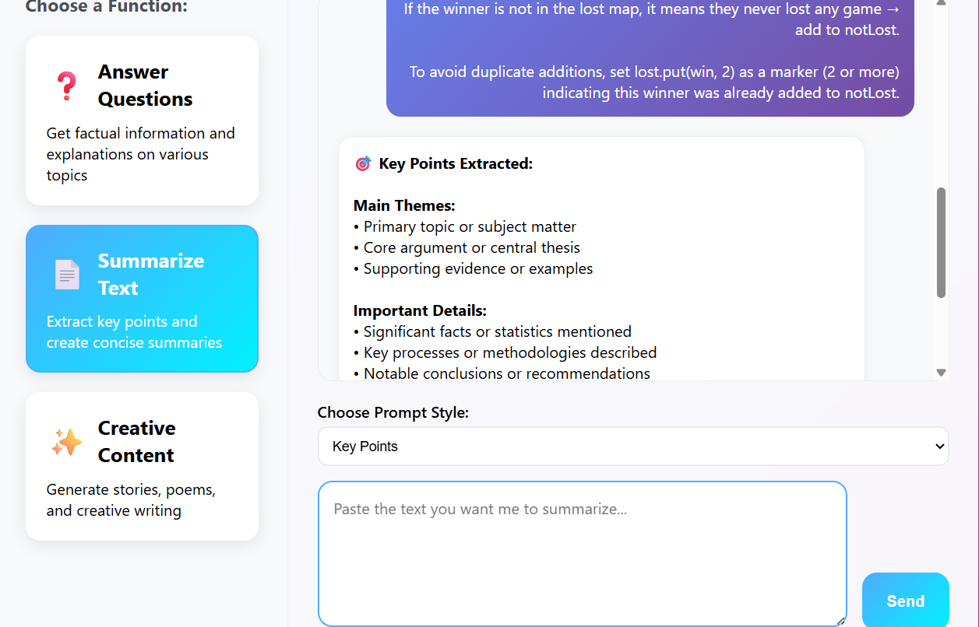
Text Summarization Enginee

Slide 10
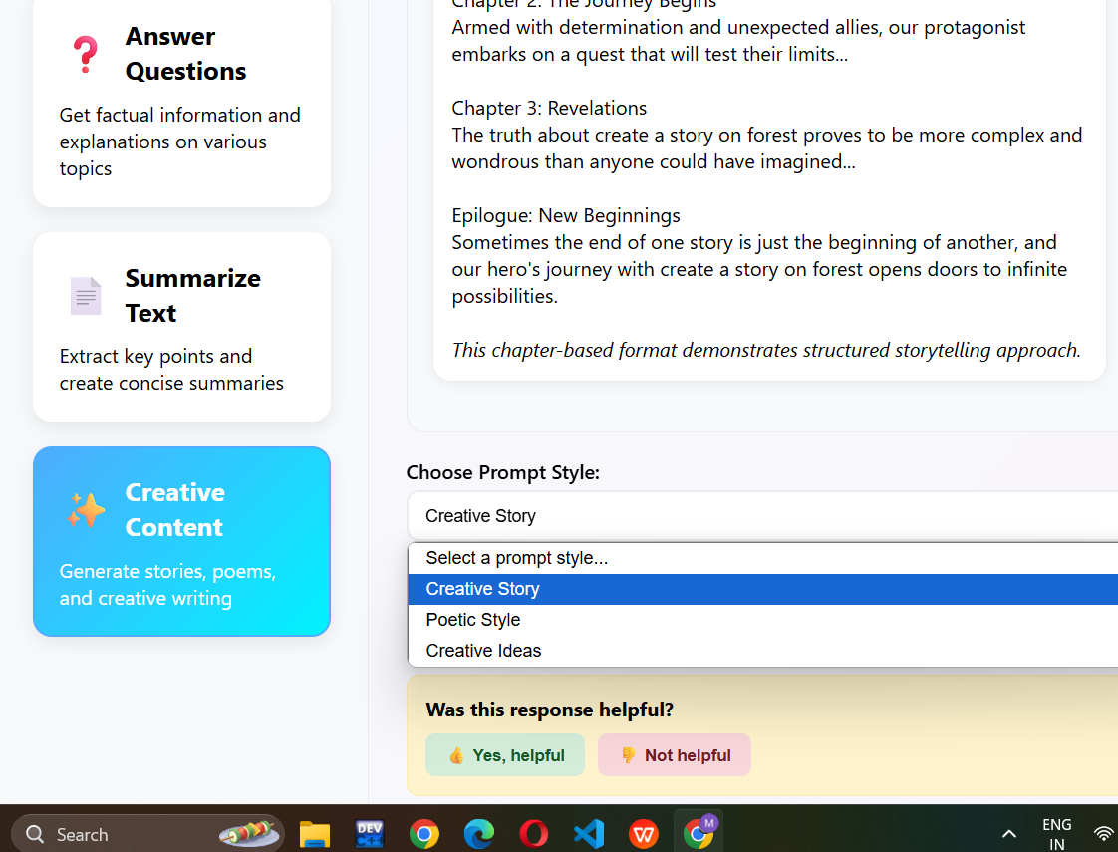
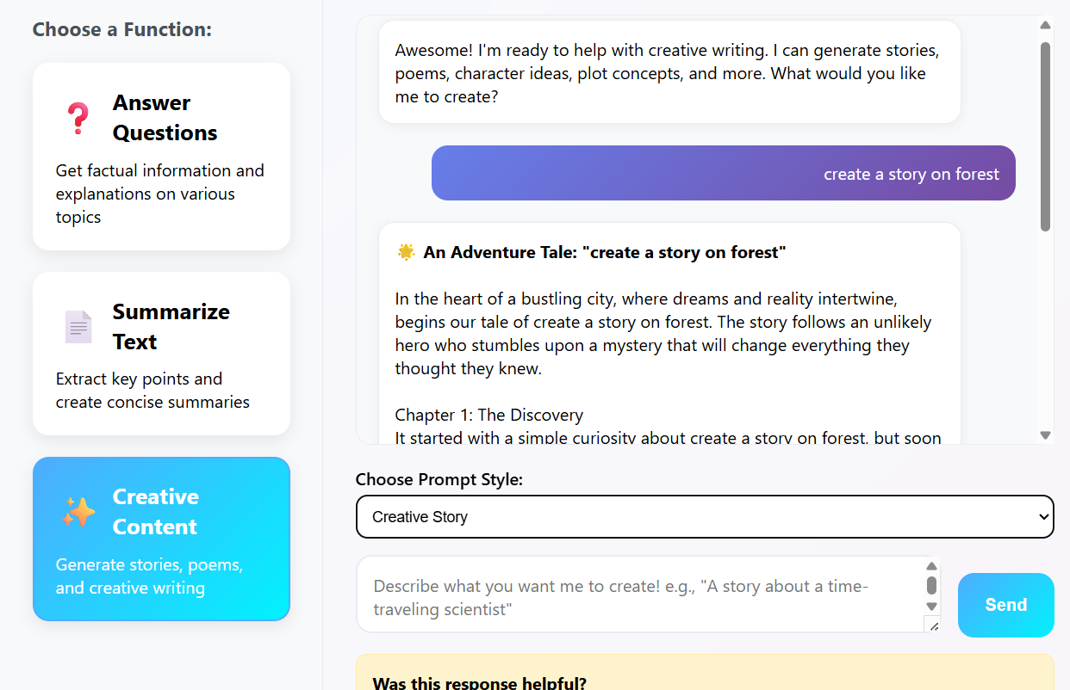
For creative content

Slide 11
Prompt Engineering Strategy
Prompt Design Philosophy
Clarity: Clear, unambiguous instructions
Context: Appropriate background information
Flexibility: Adaptable to various inputs
Consistency: Reliable output format
Prompt Optimization Techniques
Template Variables: {input} placeholder system
Style Modifiers: Tone and complexity variations
Output Formatting: Structured response guidelines
Error Handling: Graceful degradation for edge cases

Slide 12
User Experience Features
Interactive Elements
Function Selection: Visual cards with hover animations
Prompt Style Chooser: Dropdown for different approaches
Real-time Chat: Instant message display with animations
Typing Indicators: Shows AI "thinking" process
Feedback System
Binary Feedback: Helpful/Not Helpful buttons
Data Collection: Timestamp, function type, feedback type
User Acknowledgment: Thank you messages
**Analytic

Slide 13
Thank you

