Slide 1
Fine-tuning an LLM, step by step
Manual config → LoRA → QLoRA → training data → Trainer → TRL trainers

Slide 2
Our journey
Six steps, each one adds something to the one before
1 Manual config
2 LoRA
3 QLoRA
Freeze layers by hand, train the rest
Keep the model frozen, train tiny adapters
LoRA on a 4-bit compressed base model
basics_of_fine_tuning.py
basics_of_fine_tuning_with_PEFT.py
basics_of_fine_tuning_with_QLORA.py
4 Training data
5 Trainer
6 TRL trainers
Policy facts as question and answer text
Runs the training loop for you
SFT, DPO, Reward, GRPO
create_training_data.py
lora_finetune.py, qlora_finetune.py
sft_lora_qlora.py and 3 more

Slide 3
What fine-tuning is
Take an open model that is already trained, and train it a little more on your data
Types of fine-tuning
Fine-tuning vs RAG
Full: every weight changes
Partial: layer freezing (BERT)
PEFT: only small add-ons train
PEFT includes LoRA, QLoRA, adapters, prompt tuning
Fine-tuning changes the model's weights, once, before deployment
RAG leaves the model alone and adds retrieved text to each question
Fine-tune for behaviour, style and format
Use RAG for facts that change, like policy documents

Slide 4
Step 1: manual config (layer freezing)
BERT classification: freeze everything, then unfreeze only what should learn
basics_of_fine_tuning.py
What this does
model = AutoModelForSequenceClassification
.from_pretrained("bert-base-uncased", num_labels=2)
# freeze all parameters
for param in model.parameters():
param.requires_grad = False
# unfreeze the classifier head
for param in model.classifier.parameters():
param.requires_grad = True
# unfreeze the last 2 encoder layers
for layer in model.bert.encoder.layer[-2:]:
for param in layer.parameters():
param.requires_grad = True
The classifier head is a new, randomly started layer; it must be trained
Last 2 of 12 layers also train
About 12.9% of BERT-base's 109.5M weights are trainable
The original weights in those layers do change

Slide 5
Step 1b: the manual training loop
Eight sentences, one batch, 15 steps. No trainer needed.
basics_of_fine_tuning_part2.py
The 4 steps
optimizer = torch.optim.AdamW(
filter(lambda p: p.requires_grad,
model.parameters()), lr=2e-5)
model.train()
for epoch in range(15):
outputs = model(**inputs, labels=labels)
loss = outputs.loss
loss.backward()
optimizer.step()
optimizer.zero_grad()
forward pass: model guesses, loss measures the error
backward(): works out how to change each weight
step(): changes the unfrozen weights
zero_grad(): clears for the next round

Slide 6
Step 2: LoRA
Leave the model frozen. Train two small matrices next to each layer.
basics_of_fine_tuning_with_PEFT.py
Why it matters
config = LoraConfig(
r=8, # adapter size
lora_alpha=16,
target_modules=["q_proj", "v_proj"],
lora_dropout=0.05,
task_type="CAUSAL_LM",
)
model = get_peft_model(model, config)
r sets the adapter size: bigger r, more capacity
target_modules picks which layers get adapters
For Qwen2.5-0.5B with r=8 on q and v, about 0.1% of weights train
Original model stays untouched; the adapter is a few MB
W + ΔW
W: original weights, frozen. ΔW = B × A: tiny, trained.

Slide 7
Which layers should LoRA train?
Your target_modules choice decides what the model can learn
Attention: tokens talk to each other
MLP: each token thinks alone
q_proj, k_proj, v_proj, o_proj
Changes how the model focuses
gate_proj, up_proj, down_proj
Holds much of the model's knowledge
Setup | target_modules | Good for
Minimal | ["q_proj", "v_proj"] | Style and tone, small data, low memory
Attention only | q, k, v, o | Better task focus
Attention + MLP | "all-linear" | New domain knowledge, best quality (usual for QLoRA)

Slide 8
Step 3: QLoRA
The same LoRA, but the frozen base model is loaded in 4-bit
basics_of_fine_tuning_with_QLORA.py
What changes
bnb_config = BitsAndBytesConfig(
load_in_4bit=True,
bnb_4bit_quant_type="nf4",
bnb_4bit_compute_dtype=torch.float16,
bnb_4bit_use_double_quant=True,
)
model = AutoModelForCausalLM.from_pretrained(
"Qwen/Qwen2.5-0.5B",
quantization_config=bnb_config,
device_map="auto",
)
model = prepare_model_for_kbit_training(model)
# LoraConfig + get_peft_model: unchanged
Two additions: 4-bit loading and prepare_model_for_kbit_training
Adapters still train at normal precision
Same trainable share as LoRA; smaller memory for the base
Needs an NVIDIA GPU (bitsandbytes). Use Colab on a Mac

Slide 9
Manual vs LoRA vs QLoRA
 | Manual (layer freezing) | LoRA | QLoRA
What trains | Chosen original layers | Small adapters | Small adapters
Original weights | Changed (those layers) | Frozen | Frozen and 4-bit
Trainable share | About 13% (BERT, last 2 layers) | Well under 1% | Same as LoRA
Memory | Moderate | Lower | Lowest
Hardware | Any | GPU recommended | NVIDIA GPU only
Our file | basics_of_fine_tuning_part2.py | lora_finetune.py | qlora_finetune.py

Slide 10
How we train on our input data
Policy facts reshaped from search chunks into question and answer text
One training example (the text column)
Points to remember
### Question:
How many days of annual leave
do employees get?
### Answer:
All full-time employees receive 20 days
of annual leave per calendar year.<EOS>
RAG: split the PDF into chunks and search them at question time
Fine-tuning: turn the same facts into question and answer pairs and train on them
The end marker (EOS) teaches the model when to stop
Nine examples is only a demo; real runs need far more
create_training_data.py turns 9 policy facts into a .jsonl file. The sft_lora_qlora.py script builds the same text inline.

Slide 11
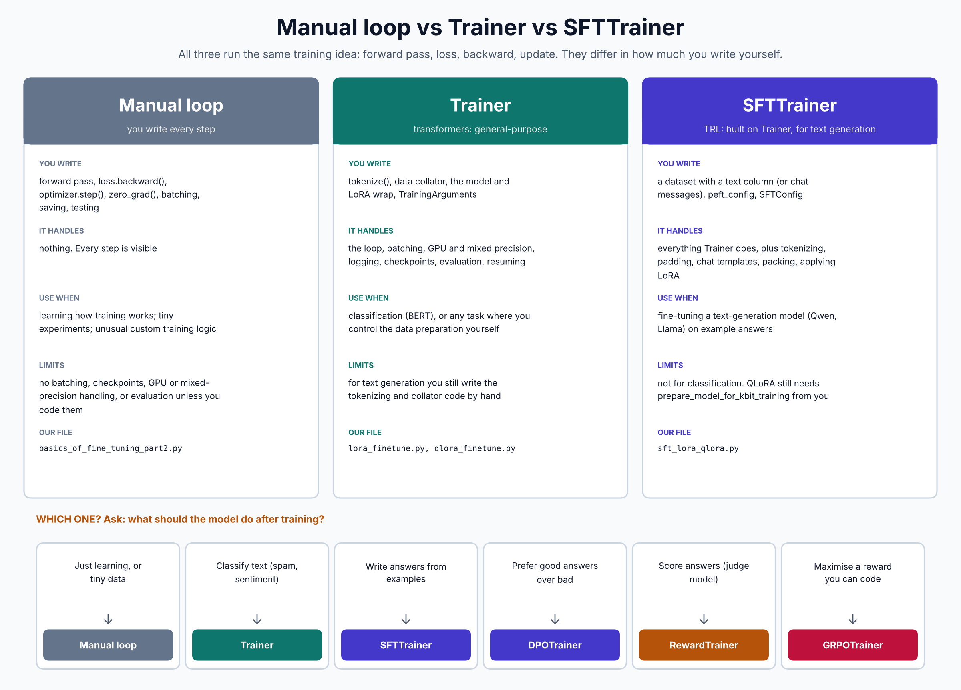
Why use a trainer?

Slide 12
Step 4: Trainer (transformers)
It runs the loop; you still prepare the data
lora_finetune.py (the Trainer part)
What it saves you
def tokenize(example):
return tokenizer(example["text"], truncation=True,
padding="max_length", max_length=128)
tokenized = dataset.map(tokenize, remove_columns=["text"])
collator = DataCollatorForLanguageModeling(
tokenizer=tokenizer, mlm=False)
trainer = Trainer(model=model, args=training_args,
train_dataset=tokenized,
data_collator=collator)
trainer.train()
The loop, batching, GPU and precision
Logging, checkpoints, evaluation, resuming
You still write tokenize(), the collator and the LoRA wrap
Right choice for classification such as BERT

Slide 13
Step 5: SFTTrainer (TRL)
Built on Trainer, for fine-tuning text generation on example answers
sft_lora_qlora.py
What it saves you
trainer = SFTTrainer(
model=model,
args=SFTConfig(
output_dir="out",
num_train_epochs=10,
learning_rate=2e-4,
dataset_text_field="text",
max_length=256,
),
train_dataset=dataset,
processing_class=tokenizer,
peft_config=lora_config, # LoRA applied for you
)
trainer.train()
No tokenize() or collator
Pass peft_config; it wraps the model with LoRA
Handles padding, chat formats, packing
QLoRA: you still call prepare_model_for_kbit_training first

Slide 14
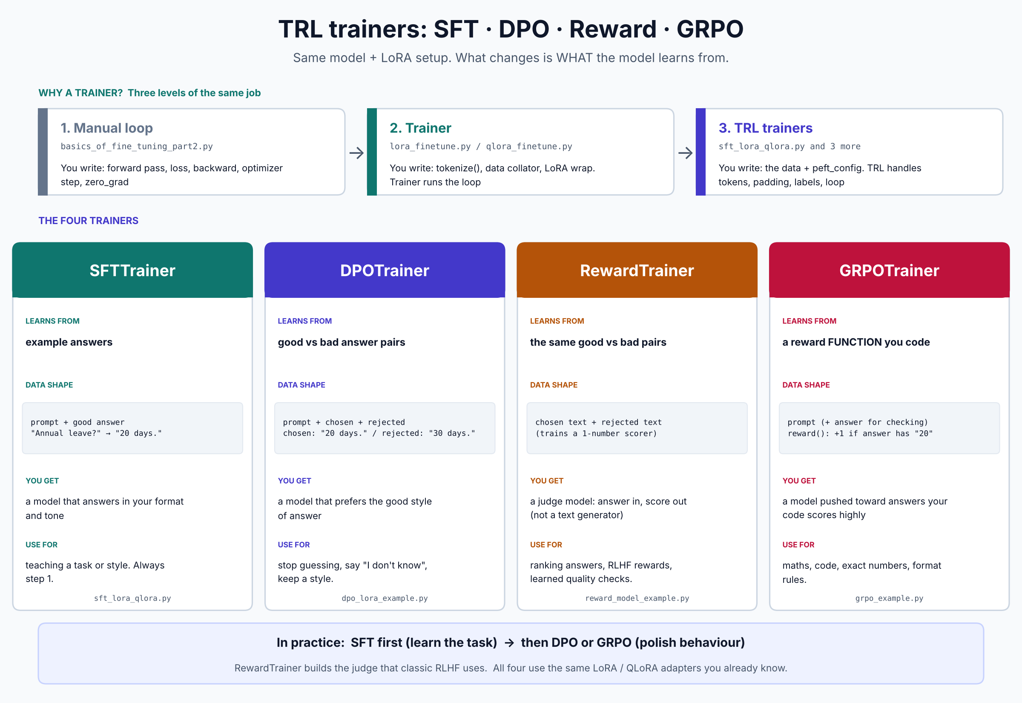
The four TRL trainers

Slide 15
Is it reinforcement learning?
Only part of TRL is
Trainer | Reinforcement learning? | Why
SFTTrainer | No | Supervised: the model imitates example answers
DPOTrainer | Not strictly, but from the RL family | Same goal as RLHF, trained directly on good and bad pairs with no generate and score loop
RewardTrainer | A building block for RL | Trains the judge; the RL step comes afterwards (PPO in classic RLHF)
GRPOTrainer | Yes | Generates answers, your function scores them, better ones are reinforced
In practice: SFT first to learn the task, then DPO or GRPO to polish behaviour.

Slide 16
Optional speed-up: Unsloth
Same LoRA and QLoRA, faster and lighter on GPU memory
Plain Hugging Face | Unsloth
BitsAndBytesConfig + from_pretrained | FastLanguageModel.from_pretrained(load_in_4bit=True)
prepare_model_for_kbit_training | handled inside
LoraConfig + get_peft_model | FastLanguageModel.get_peft_model(...)
SFTTrainer | still SFTTrainer, faster underneath
Good to know
Built on transformers, peft and TRL; it does not replace them
Mainly for NVIDIA GPUs; use Colab
Import unsloth before the other libraries
Not a new method, just a faster way to run it

Slide 17
Which one to use
Ask: what should the model do after training?
Learning, or tiny experiment
Manual loop
Classify text (spam, sentiment)
Trainer
Write answers from examples
SFTTrainer
Prefer good answers over bad
DPOTrainer
Score answers (judge model)
RewardTrainer
Maximise a reward you can code
GRPOTrainer

Slide 18
Files and setup
Our files
Setup
basics_of_fine_tuning(.py, _part2.py)
basics_of_fine_tuning_with_PEFT / QLORA / UNSLOTH.py
create_training_data.py
lora_finetune.py, qlora_finetune.py
sft_lora_qlora.py
dpo_lora_example.py, reward_model_example.py, grpo_example.py
pip install torch transformers peft datasets accelerate trl
pip install bitsandbytes (QLoRA only)
Fine-tuning needs a GPU: use a free Colab T4
QLoRA and Unsloth need NVIDIA; they will not run on a Mac

Slide 19
Remember this
Manual
you write every step
LoRA / QLoRA
what you train: small adapters (QLoRA: on a 4-bit base)
Trainer
runs the loop for any task
SFTTrainer
text generation from example answers
DPO / Reward / GRPO
preferences, judges and rewards

