Slide 1
LangChain · LangGraph · LangSmith
Three layers of one stack: parts, flow, visibility
LangChain
LangGraph
LangSmith

Slide 2
The one-line answer
They are not rivals. Each solves a different problem.
LangChain = the parts
LangGraph = the flow
LangSmith = the visibility
Connects the model to tools, data and prompts
Analogy: a toolbox
Answers: what can my app use?
Controls the order: loops, branches, pauses
Analogy: a flowchart
Answers: in what order, and what if it fails?
Records, tests and monitors every run
Analogy: CCTV plus exam marks
Answers: what happened, and is it any good?

Slide 3
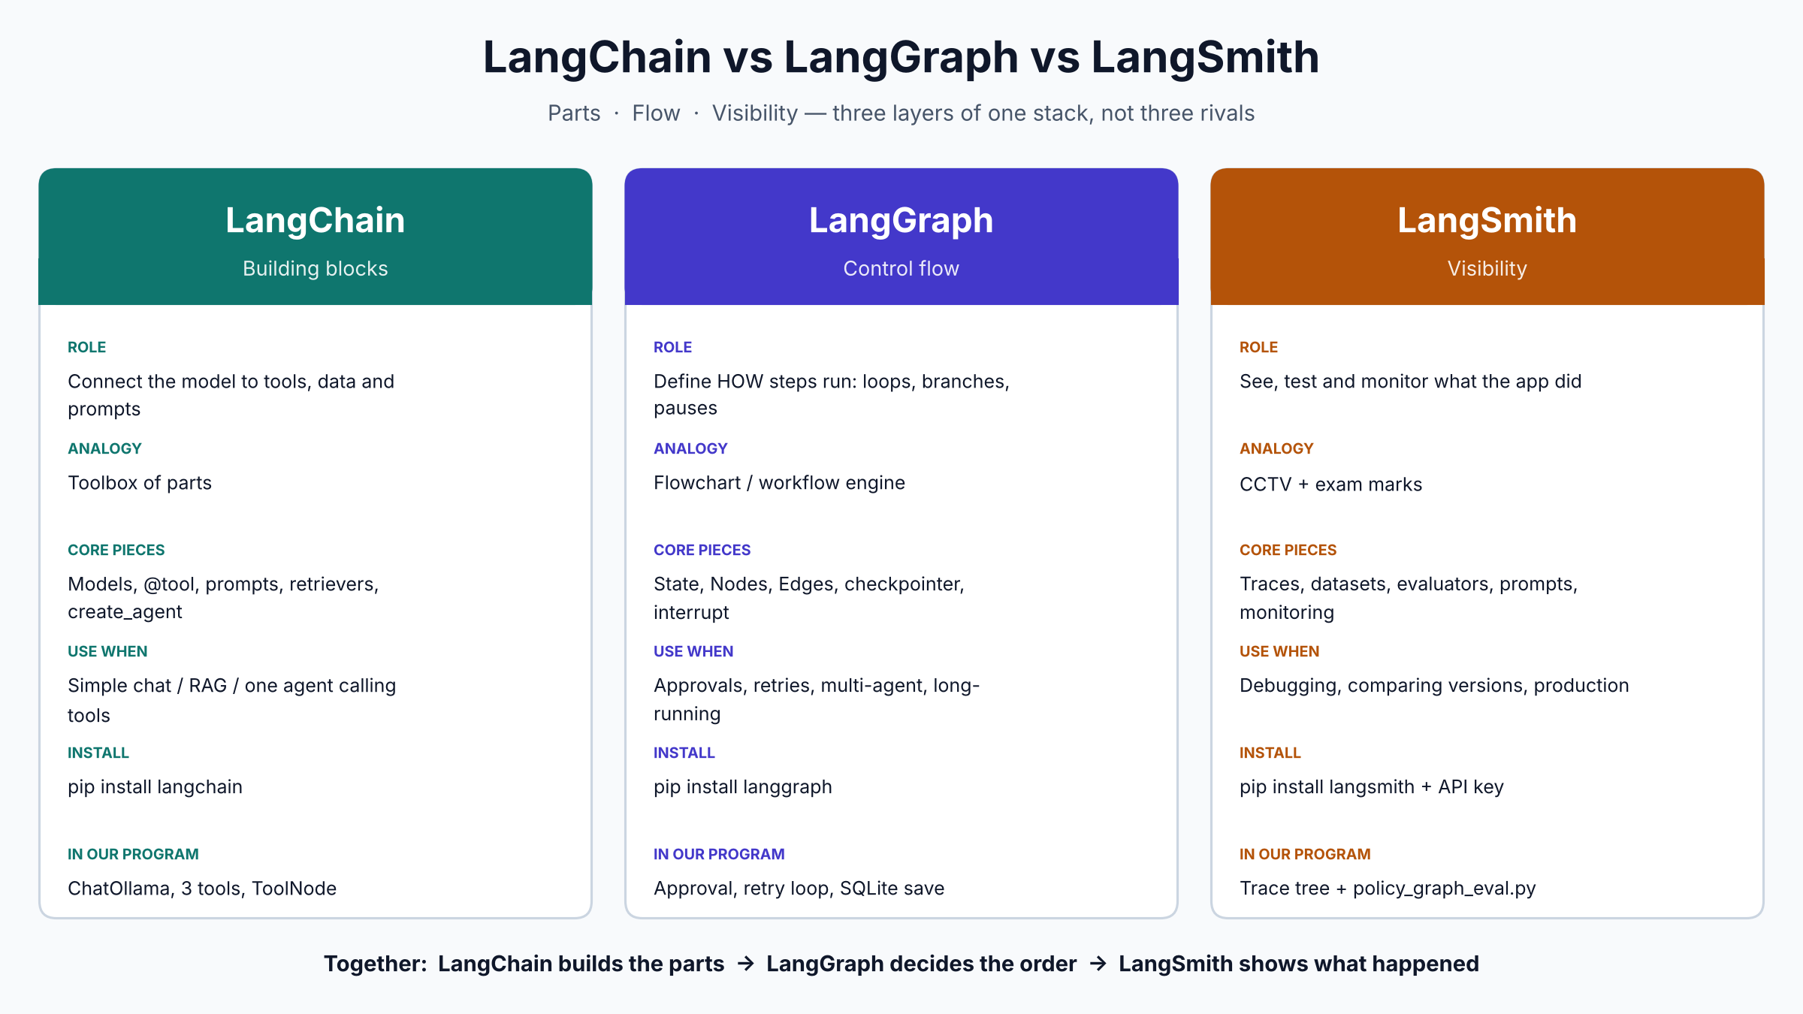
Side-by-side comparison

Slide 4
LangChain: the building blocks
What it gives you
Core pieces
In our course code
Chat models (ChatOllama, ChatOpenAI)
@tool functions the model can call
Prompts and messages
Retrievers, vector stores, embeddings, loaders
create_agent: a ready-made tool-calling loop
rag_engine.py: FAISS, re-ranker, 3 tools
ChatOllama(model='llama3.1')
ToolNode runs the tool calls
Good alone for: simple chat, RAG, one agent with tools

Slide 5
LangGraph: the control flow
Use it when a straight line is not enough
Core pieces
In our program
State: shared notebook all steps read and write
Nodes: functions (agent, tools, checks)
Edges: the paths, including conditional ones
Checkpointer: saves progress to SQLite
interrupt(): pause for a human, resume later
Approval step before raise_hr_ticket
Groundedness check, then one retry if it fails
Conversation survives a restart (--thread)
Also the right tool for multi-agent supervisors

Slide 6
LangSmith: the visibility
It does not run your app. It watches and tests it.
Core pieces
In our program
Tracing: every model call, tool call and node
Datasets: saved test questions
Evaluators: automatic scoring of answers
Prompt management and version history
Monitoring: cost, latency, errors in production
Set LANGSMITH_API_KEY and tracing turns on
Groundedness check logged as its own step
policy_graph_eval.py: 3 evaluators over a dataset
Compare experiments after changing model or chunker

Slide 7
How they fit in policy_graph_app.py
One request, three layers working together
User question
agent
(LangChain model)
tools
(LangChain tools)
approval
(LangGraph pause)
groundedness
check
Answer
→
→
→
→
→
LangSmith watches the whole row above and records every step as one trace tree.
LangChain supplies the model and tools.
LangGraph decides: pause for approval, loop back, retry once, then stop.
Remove LangSmith and the app still works. You just cannot see inside it.

Slide 8
When to use what
Start simple. Add layers only when you feel the pain.
Simple chatbot or RAG
LangChain only
Needs approval, retries, loops or branches
Add LangGraph
Several agents with a supervisor
LangGraph
Need to debug a bad answer
Add LangSmith tracing
Need to prove a change made things better
LangSmith evaluation
Going to production
All three; LangSmith monitoring

Slide 9
Setup cheat sheet
Install
Turn on LangSmith (optional)
pip install langchain langchain-ollama
pip install langgraph langgraph-checkpoint-sqlite
pip install langsmith
ollama pull llama3.1
python create_holiday_db.py
uvicorn holiday_api:app --port 8000
Free key at smith.langchain.com
export LANGSMITH_API_KEY=lsv2_...
export LANGSMITH_PROJECT=policy-assistant
Tracing starts automatically
Run: python policy_graph_app.py
Eval: python policy_graph_eval.py

Slide 10
Remember this
LangChain
builds the parts
LangGraph
decides the order
LangSmith
shows what happened

