Slide 1
Design a Gray Code
to Binary Converter
DIGITAL LOGIC · DESIGN PROJECT
A four-bit combinational circuit built from cumulative XOR logic, then verified in Logisim.
2620040114—Mohan Siva Siddhartha
2620040088– Varshitha K V N Deva
2620040056 – Gelli Janani
2620040116 – Peela Joshmitha

Slide 2

Gray code prevents multi-bit transition errors
WHY GRAY CODE?
Gray code is a unit-distance code: adjacent values differ in exactly one bit.
DESIGN OBJECTIVE
Convert an n-bit Gray input
This single-bit change reduces ambiguity when a changing position or count is sampled between transitions.
Produce the equivalent binary output with a combinational circuit.

Slide 3
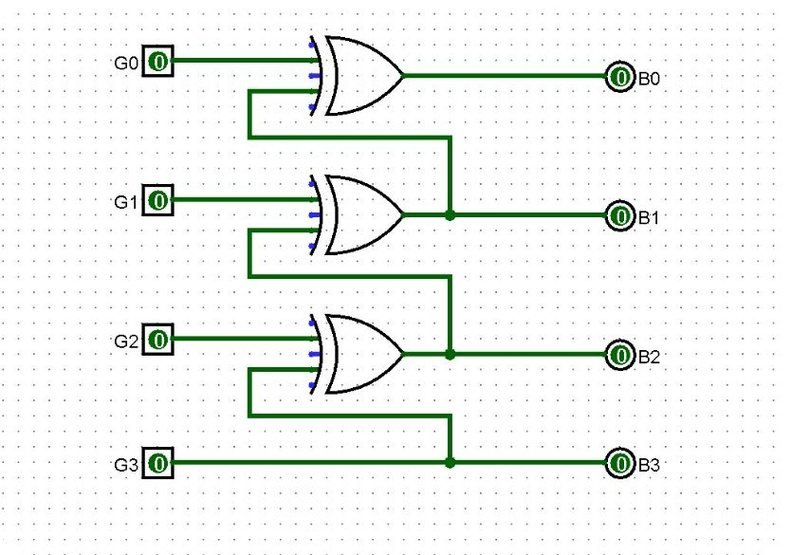
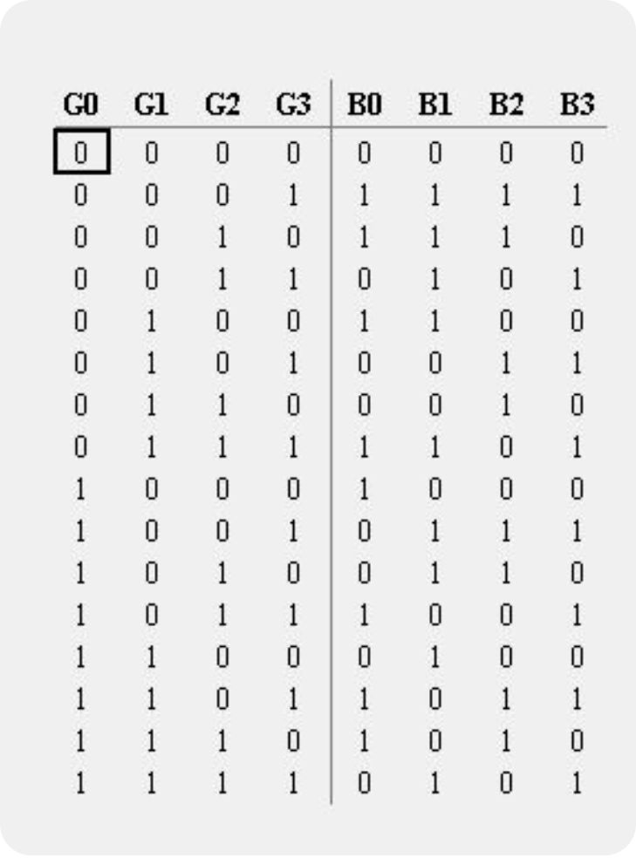
Conversion is a running XOR from MSB to LSB
THE CORE RULE
Copy the most-significant bit, then recover each following binary bit from the current Gray bit and the binary bit already decoded.
SCALING LAW
n − 1
b3 = g3
b1 = g1 ⊕ b2
XOR gates for an n-bit converter
b2 = g2 ⊕ b3
b0 = g0 ⊕ b1
The basic chain needs no AND or OR gates. Each stage reuses the binary result immediately above it.

Slide 4
The 4-bit logic circuit is a three-stage XOR chain
4-BIT IMPLEMENTATION
G3 passes directly to B3. For G2–G0, each XOR combines the Gray bit with the preceding binary output.
G3
B3
READ THE CHAIN
B3 passes through unchanged. The three XOR stages recover B2, B1, and B0 in order.
g2 ⊕ b3
G2
⊕
B2
g1 ⊕ b2
G1
⊕
B1
g0 ⊕ b1
G0
⊕
B0

Slide 5
Logisim turns the equations into a testable circuit
FROM EQUATION TO TEST
Place the pins
Wire the chain
Probe the behavior
Place four input pins and four output pins; label them G3–G0 and B3–B0.
Wire G3 directly to B3, then add XOR gates for B2, B1, and B0.
Set input pins with switches, observe LEDs or probes, and verify each output against the expected binary value.

Slide 6
Verify every tested code word
VERIFICATION RECORD
Use the editable verification table; add the final Logisim screenshot beside it before submission.
Gray input | Expected binary | Observed binary | Status
0000 | 0000 | [enter] | [pass/fail]
0001 | 0001 | [enter] | [pass/fail]
0011 | 0010 | [enter] | [pass/fail]
0010 | 0011 | [enter] | [pass/fail]
0110 | 0100 | [enter] | [pass/fail]
0111 | 0101 | [enter] | [pass/fail]
0101 | 0110 | [enter] | [pass/fail]
0100 | 0111 | [enter] | [pass/fail]

Slide 7



One XOR chain supports several practical systems
Position encoders
Communication
Rotary and position encoders reduce readout errors when adjacent positions change.
Digital communication and data conversion limit ambiguity during transitions.
Logic organization
Karnaugh maps and sequencing organize adjacent combinations so only one bit changes.

Slide 8

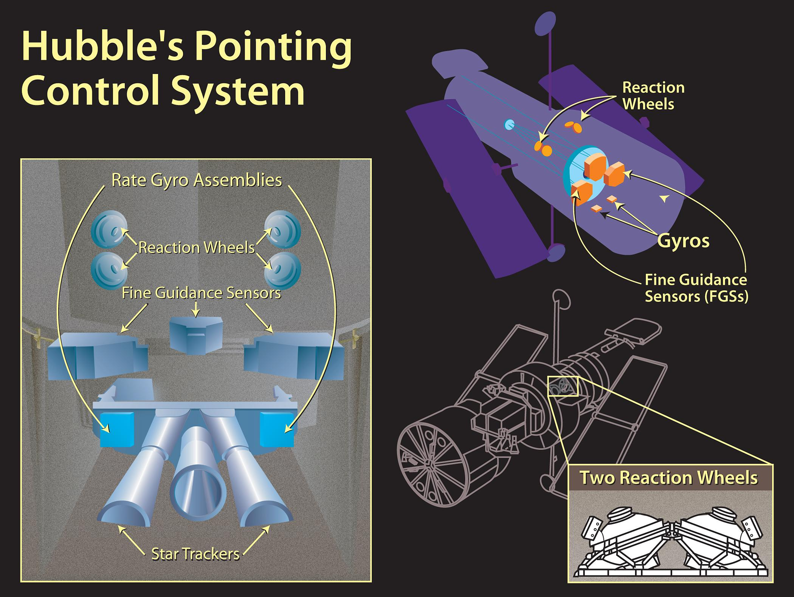


Slide 9
What if one wrong bit changed a spacecraft’s decision?
THE CORE IDEA
One safe transition.
One usable value.
A position sensor must tell a machine exactly where it is.
Gray code changes only one bit between neighboring positions. A Gray-to-binary converter translates that reading into a format digital systems can use.
A rover’s robotic arm needs accurate joint-angle measurements.
A telescope must point precisely toward a target.
A temporarily incorrect reading can confuse a control system.
Gray code reduces transition ambiguity. It does not shield electronics from every radiation or system fault.

