Slide 1
SOIL MOISTURE INDICATOR
Shri Shankaracharya Institute of Professional Management & Technology, Raipur
Minor Project Report on
CSE 6th Semester
Department of Computer Science and Engineering,
Batch 2019-2023
Session Jan – June 2022
Presentation Date:
Project Group Members:
Vaibhav Gupta , 303302219115
Nitish Kumar Verma , 303302219072
Abdul Mazid Memon , 30330222302
Project Guide :
Dr. Chaitali Bisawas Dutta
(CSE DEPARTMENT)

Slide 2
Project Overview
This sensor can be used to test the moisture of soil, when the soil is having water shortage.
As the name says, soil moisture indicator will indicate the levelof moisture in the soil.
It will be quite useful for gardeners & farmers as it will show the moisture content present in the soil, so they can avoid over irrigation or under irrigation.
A relay control can be added to this device that will self irrigate the land when moisture level becomes low.

Slide 3
Problem Identification
During irrigation a farmer faces many problems like:-
Wastage of too much water.
Water Shortage.
Decrease in crop yield.
Increase in cost of energy.
Increase in fertilizer cost.

Slide 4
Applications Area :-
The applications of soil moisture indicator in some of the following areas :-
Soil moisture indicator
Agriculture
Landscape irrigation
Research

Slide 5
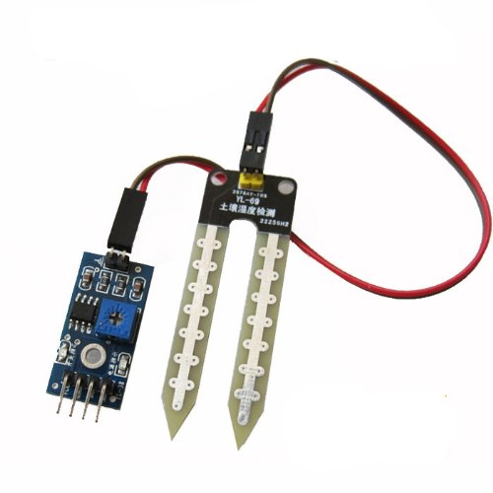
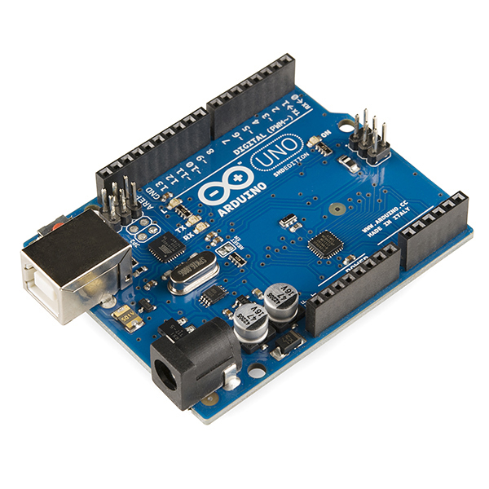
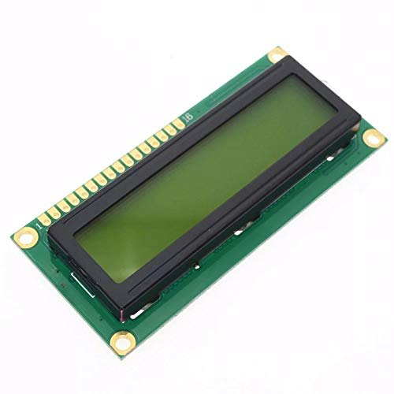
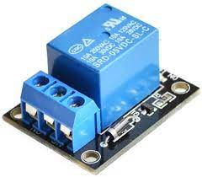
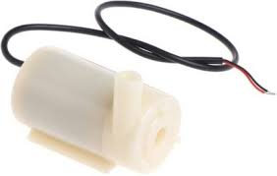
Project Requirements (Developer)
Soil Moisture sensor
Arduino Uno
LCD Display Module
5v DC Pump
Relay Module

Slide 6
Project Requirements (End User)
Soil moisture Indicator measures the water content in soil.
It is used measure the rise and fall of the amount (or percentage) of water in the soil.
This is an ideal and Low cost agricultural tool for Farmers to keep plants/farms grow healthier.
By using this device the farmer could save considerable amount of precious water.

Slide 7
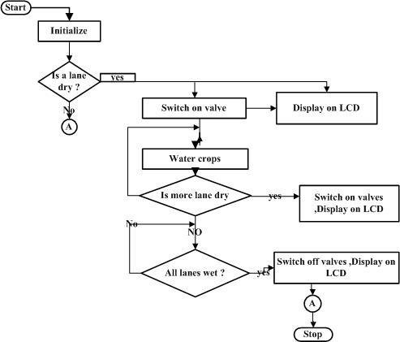
Data Flow Diagram

Slide 8
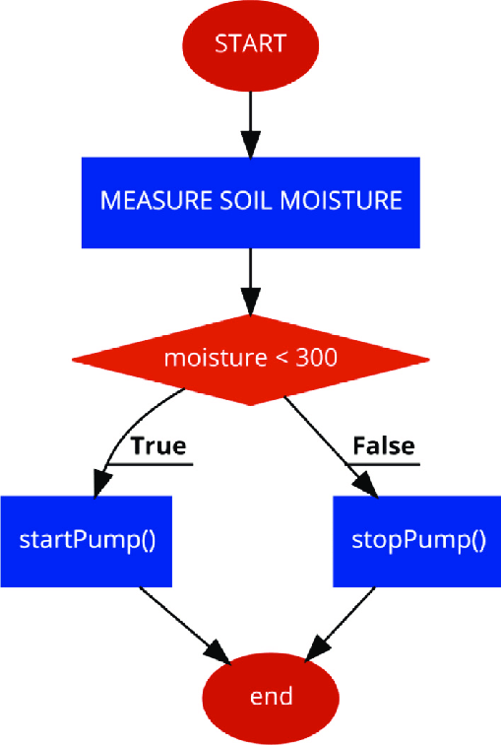
Project Work Flow Diagram

Slide 9
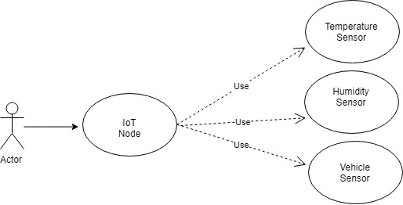
USE CASE Diagram

Slide 10
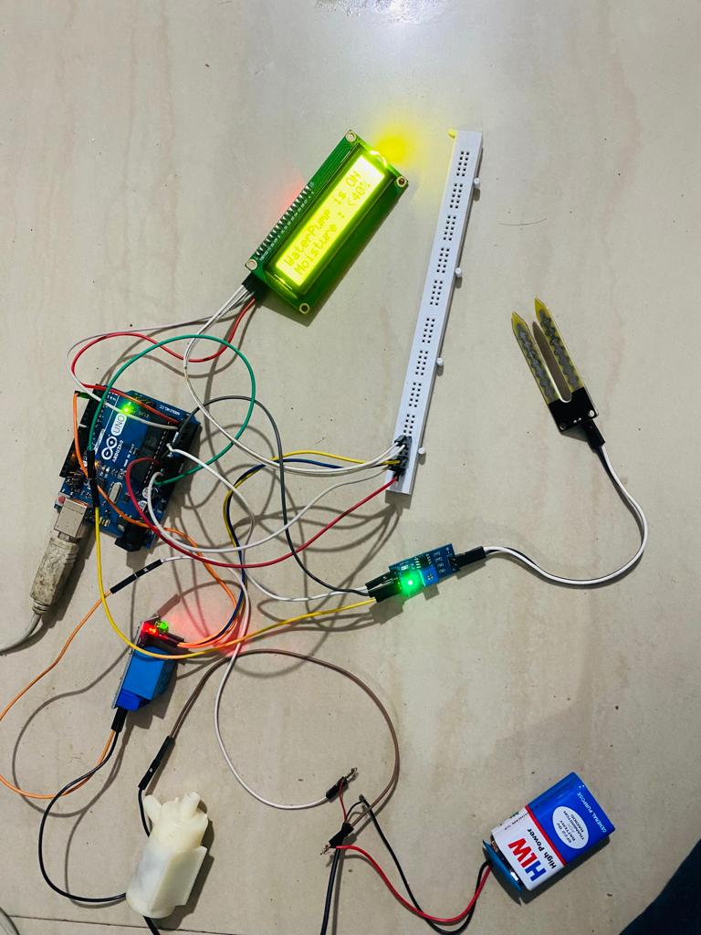
Snapshots with description
#include <LiquidCrystal_I2C.h>LiquidCrystal_I2C lcd(0x27, 16, 2); void setup() { Serial.begin(115200); lcd.init(); lcd.backlight(); lcd.clear(); pinMode(2, OUTPUT); digitalWrite(2, HIGH); delay(1000); lcd.setCursor(0, 0); lcd.print("IRRIGATION"); lcd.setCursor(0, 1); lcd.print("SYSTEM IS ON "); lcd.print(""); delay(3000); lcd.clear();} void loop() { int value = analogRead(A0); Serial.println(value); if (value > 350) { digitalWrite(2, LOW); lcd.setCursor(0, 0); lcd.print("WaterPump is ON "); } else { digitalWrite(2, HIGH); lcd.setCursor(0, 0); lcd.print("WaterPump is OFF"); } if (value < 300) { lcd.setCursor(0, 1); lcd.print("Moisture: >70%"); } else if (value > 300 && value < 350) { lcd.setCursor(0, 1); lcd.print("Moisture:60%"); } else if (value > 350) { lcd.setCursor(0, 1); lcd.print("Moisture : <40%"); }}

Slide 11
Result & Conclusion
1. Soil moister indicator is easy to use, gives instant result
2. It also build an awareness and knowledge of eash irrigated field.

Slide 12
References
Text Book
Toby Velte, Anthony Vote and Robert Elsenpeter, “Cloud Computing: A Practical Approach”, McGraw Hill, 2002
Web Resources
https://iotportfolio.home.blog/portfolio-1-3/
https://www.researchgate.net/figure/Flow-chart-diagram-of-microcontroller_fig2_319130612

