Slide 1
ENTERING TO BASICS
CURATED BY
PRIYANKA MALLIK

Slide 2
RULES
Pounce to answer
Don’t say answer until QM asked you.
Don’t hesistate to answer if it’s wrong.
If needed, hint will provided.

Slide 3


Slide 4
1.X introduced its model which is initiative through three distinct concepts. The original 2009 Frankfurt concept was an R8-based supercar utilizing four electric motors for all-wheel drive. This was followed by the 2010 Detroit concept, a smaller, rear-wheel-drive performance coupe powered by two motors. Finally, the Y served as a front-wheel-drive hybrid, uniquely featuring a Wankel rotary engine as a range-extender. Together, these models demonstrated X's intent to apply electric technology to everything from high-performance sports cars to efficient city vehicles. Identify company X and model Y.

Slide 5


Slide 6
ANSWER
X- Audi
Y-A1 e-tron

Slide 7
2. X transformed the Y from a traditional folk and ceremonial instrument into a respected Hindustani classical powerhouse. His virtuosity single-handedly elevated it to the global concert stage, forever linking his name to the instrument. X was commemorated on his 102nd birth anniversary by Search Engine Google which showed a special doodle on its Indian home page for him on 21 March 2018.The Government of Bihar has proposed setting up of a museum, a town hall-cum-library and installation of a life-size statue at his birthplace in Dumraon. Imtiaz Ali's Rockstar character Ustad Jameel Khan played by Shammi Kapoor was slightly inspired by Khan.
Identify X and instrument Y.

Slide 9
ANSWER
X-Bismillah Khan
Y-Shehnai

Slide 10
3.X is a statue of the 11th-century Indian philosopher Ramanuja, located on the premises of the Chinna Jeeyar Trust at Muchintal, Ranga Reddy district in the outskirts of Hyderabad.
The project of building the statue was conceptualized by the trust to commemorate the 1,000th birth anniversary of Ramanuja. The statue was built at an estimated cost of ₹1,000 crore (US$120 million), which is majorly collected from donations by the devotees.The base building hosts the vedic digital library, research centre, ancient Indian texts, theatre and a gallery. Ramanuja's works are presented in the gallery. The statue has a concrete core which is surrounded by a panchaloha sheet with a thickness varying between 10 mm and 20 mm. Identify X and also what the based building known as?

Slide 12
Answer
X-Statue of Equality
Bhadravedi

Slide 13
4. X is an Indian woman cricketer, who represents the India women’s national team as a middle-order batter, had earlier represented her state team in field hockey before taking up professional cricket, became only the second Indian woman after Smriti Mandhana to score a double century in a 50-over cricket match, accumulated 245 runs across four innings to finish as India’s second-highest run-scorer in the tri-nation Women’s One Day International series held in Sri Lanka in May 2025, and was honoured with the Jagmohan Dalmiya Award for the Best Domestic Junior Women’s Cricketer by the Board of Control for Cricket in India in 2018.
Identify X.

Slide 15
ANSWER
X-Jemmimah Rodrigues

Slide 16
5. X is a G7 power and constitutional monarchy leading in robotics, automotive, and electronics. Despite a world-class military, it renounces war constitutionally. While facing population decline, this country maintains a massive global footprint through its high life expectancy and iconic popular culture. Its contemporary culture is a global "cultural superpower," blending Asian traditions with Western influences. It preserves ancient arts like calligraphy, tea ceremonies, and kabuki through a robust "National Treasure" system. Boasting eighteen cultural UNESCO sites,X seamlessly integrates historic crafts and martial arts into a modern, globally influential society.
Identify X.

Slide 18
ANSWER
X-Japan

Slide 19
6. In New Delhi, There is a temple designed by Iranian architect Fariborz Sahba, was dedicated in 1986. Funded largely by Ardishír Rustampúr’s life savings, the structure features a unique floral design realized by Flint and Neill and Larsen & Toubro. Since opening in 1987, it has become a global landmark for Baháʼí worship. Inspired by the national flower, the temple features 27 marble-clad petals arranged in nine sides. This design symbolizes purity and spirituality across various faiths. Built with Greek Penteli marble, the 34.3-meter-tall hall accommodates up to 2,500 people and is surrounded by nine ponds and 26 acres of gardens. The permanent delegation of India to UNESCO stated that the Lotus Temple had received over 100 million visitors by April 2014. Identify the temple.

Slide 21
ANSWER
Lotus Temple

Slide 22




7.Connect the flags
says about the dependencies

Slide 24
ANSWER
Flags of European Dependencies

Slide 25
8. This Polynesian variation is played worldwide, especially within diaspora communities in Australia and New Zealand, featuring unique cultural adaptations and rules.There is no limit to team size, and teams are made up of whoever turns up regardless of gender or age. Tourist accounts mention that strangers are often welcomed. Players are typically all-rounders.It is more than a sport; it’s a massive community festival featuring singing, dancing, and feasts. The rules of the sport are flexible. Indeed, the majority of reports written in the game simply say that the rules can only be known by those playing and it is the traditional sport played in Tuvalu. Identify the sport.

Slide 27
ANSWER
Kilikiti

Slide 28

9.A new NASA study suggests that the amount of X element and strength of the which field have been correlated for more than half a billion years.
What is X and Y?

Slide 30
ANSWER
The solar wind flows around Earth's magnetic field. A new NASA study suggests that the amount of oxygen in the atmosphere and strength of the magnetic field have been correlated for more than half a billion years.

Slide 31
10. Born on 19 August 1950,X is an Indian educator, author, and philanthropist, and the Founder-Chairperson of the Infosys Foundation. She is known for her extensive social work in education, healthcare, rural development, and orphan care, and for her contributions to literature in Kannada and English. The Global Indian Award,[which is worth $50, 000, is given each year to a prominent Indian who has made a major mark in his or her chosen field also Her husband too got the same award in 2014, so they became first couple conferred with this award. She donated the sum to the Field Institute. A novel originally authored by her in Kannada and later translated into English, was adapted as a televised dramatic series by Zee TV in 2001.Identify X and novel name.

Slide 33
ANSWER
X- Sudha Murty
Novel-Dollar Bahu

Slide 34
11.According to the Avanti Khanda of the Skanda Purana, which powerful deity is revered in Ujjain and uniquely receives liquor as part of ritual offerings? This deity is traditionally regarded as the guardian deity of Ujjain and is honored as the city’s Senapati (Commander-in-Chief or Chief General). The deity’s image is not a conventional idol but a rock face smeared with kumkuma (vermilion), crowned with a silver head and adorned with a distinctive Maratha-style pagri, a custom believed to date back to the era of Mahadaji Shinde.
Identify the deity.

Slide 36
ANSWER
Kaal Bhairab

Slide 37
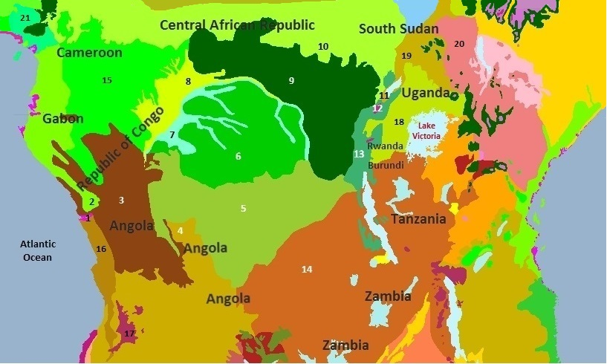
12. In 2021, deforestation of the rainforest increased by 5%.
The rainforests have 1,000 native species of birds like the grey parrot, brown nightjar and the bat hawk, and 700 species of fish like the Nile tilapia, Nile perch and the giraffe catfish. In this region (shown in figure),there is a rainforest situated which having 6 ecoregions.
Identify the rainforest.

Slide 39
ANSWER
Congo Rainforest

Slide 40
13. X is a Eco-sensitive Zone from both a ecological and environmental point of view and to prohibit industries or class of industries and their operations and processes in the said Eco-sensitive zone. Bounded by the Hirakud reservoir on the east and north, the sanctuary supports both terrestrial and aquatic biodiversity, attracts migratory waterfowl in winter, and is home to 250+ plant species, many with ethno-botanical and medicinal value.It is rich in biodiversity, hosting over 40 mammal species, 200 birds, along with reptiles, amphibians, fishes, butterflies, odonates, and spiders. It is home to animals such as cheetal, sambar, wild boar, gaur, chowsingha, peacock, langur, sloth bear, leopard, and Indian wild dog.
Identify X.

Slide 42
ANSWER
Debrigarh Wildlife Sanctuary

Slide 43
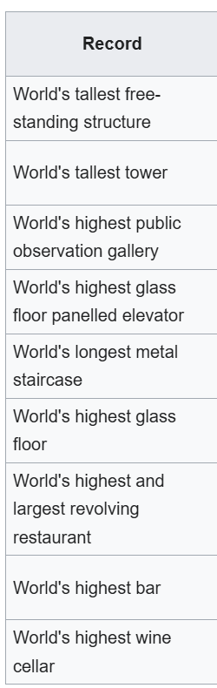
14.Name the building which it have this much record in
its achievement.

Slide 45
ANSWER
CN Tower

Slide 46
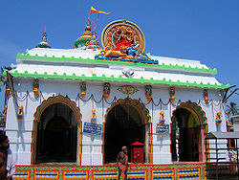
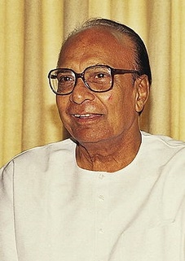

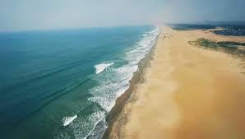
15. Connect the image

Slide 48
ANSWER
Jagatsinghpur

Slide 49
THANK YOU

