Slide 1
QUIZ ME BABY💦

Slide 2


Slide 3
QUESTION-1 In 2007, Two people initiated an e-commerce venture X in Bengaluru, India named after the process of exploring a catalog. Their first sale of the venture involved a book titled “Leaving Microsoft to change the World” It is the first Indian Company app to cross 50 million downloads on playstore and is one of the most preferred and visited websites in India, receiving over 13 million visitors per day Id X.

Slide 4


Slide 5

ANSWER Flipkart

Slide 6
QUESTION-2 It was renamed X after a type of coffee, because the team working on it were drinking a lot of it. It was designed for interactive television. However, the technology was not ready for it at the time, so X was instead used for web development. The creator of X, was working at Sun Labs, who was working on Set-up box by cleaning C++ and ended up with X, leading the origin. Id X.

Slide 7


Slide 8

ANSWER JAVA

Slide 9
QUESTION 3 Dennis Fong, better known by his online alias Thresh, is an American businessman and retired professional player of the first-person shooter video games Quake and Doom. Known informally as the first professional gamer, Fong noticed a minor inconvenience for which he came up with a solution that is used by even the non serious gamers, while playing games like Fire Temple. Most people need to use the right hand for the mouse for operating a gun or view, so the left hand is used for controlling the avatar's movement. Right hand is the more dexterous hand for most people, and operating the mouse needs more dexterity. This gave rise to a slight problem which was solved by Thresh. What was the inconvenience and the solution coughed up for it?

Slide 10


Slide 11
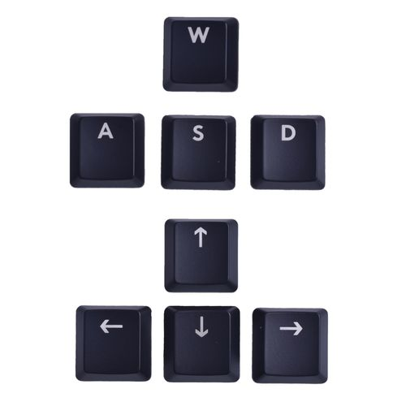
ANSWERS Using WASD as substitute for arrow keys for movements

Slide 12
Identify the phone from the specifications QUESTION-4 Release Date- September 2013 Display - 5″ IPS LCD, Full HD (1920 × 1080), ~441 ppi Operating System- Android 4.2.1 (Jelly Bean) Processor- 1.5 GHz Quad-Core MediaTek MT6589T RAM- 1 GB Internal Storage- 16 GB Expandable Storage- Up to 64 GB via microSD Rear Camera- 13 MP Autofocus with LED flash Front Camera- 5 MP Battery- 3,150 mAh Removable Li-ion Connectivity- Dual SIM (GSM/3G), Wi‑Fi, Bluetooth 4.0, GPS, micro-USB 2.0 Sensors- G-sensor, Light, Proximity, Magnetic Dimensions- 142 × 71 × 9.8 mm Identify the phone from the specifications ! Hint- Ask for Hint LoL

Slide 13
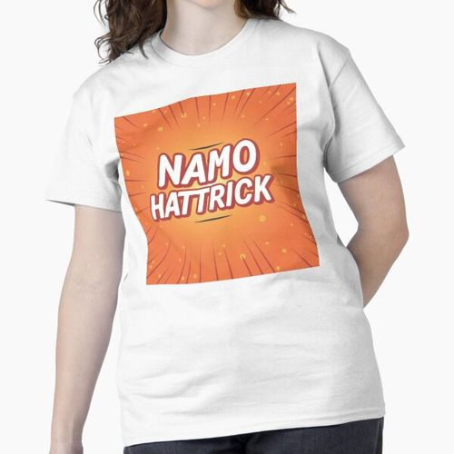

Slide 14
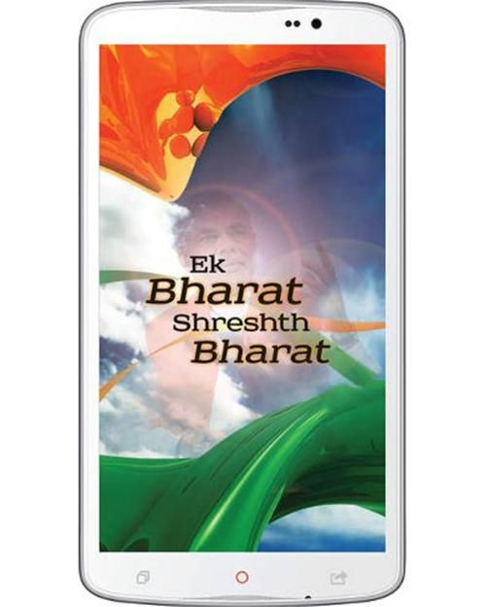
ANSWER NaMo phone (Narendra Modi Phone)

Slide 15
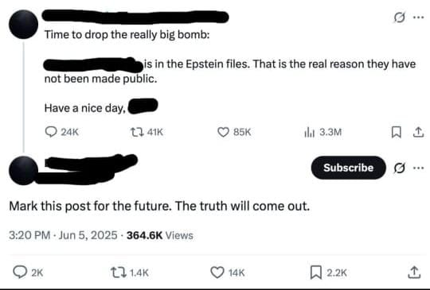
QUESTION-5 X and Y are notably the best friends everyone knew. Well now in recent times, X is accusing Y of him being on the Epstein list. Id X and Y.

Slide 16
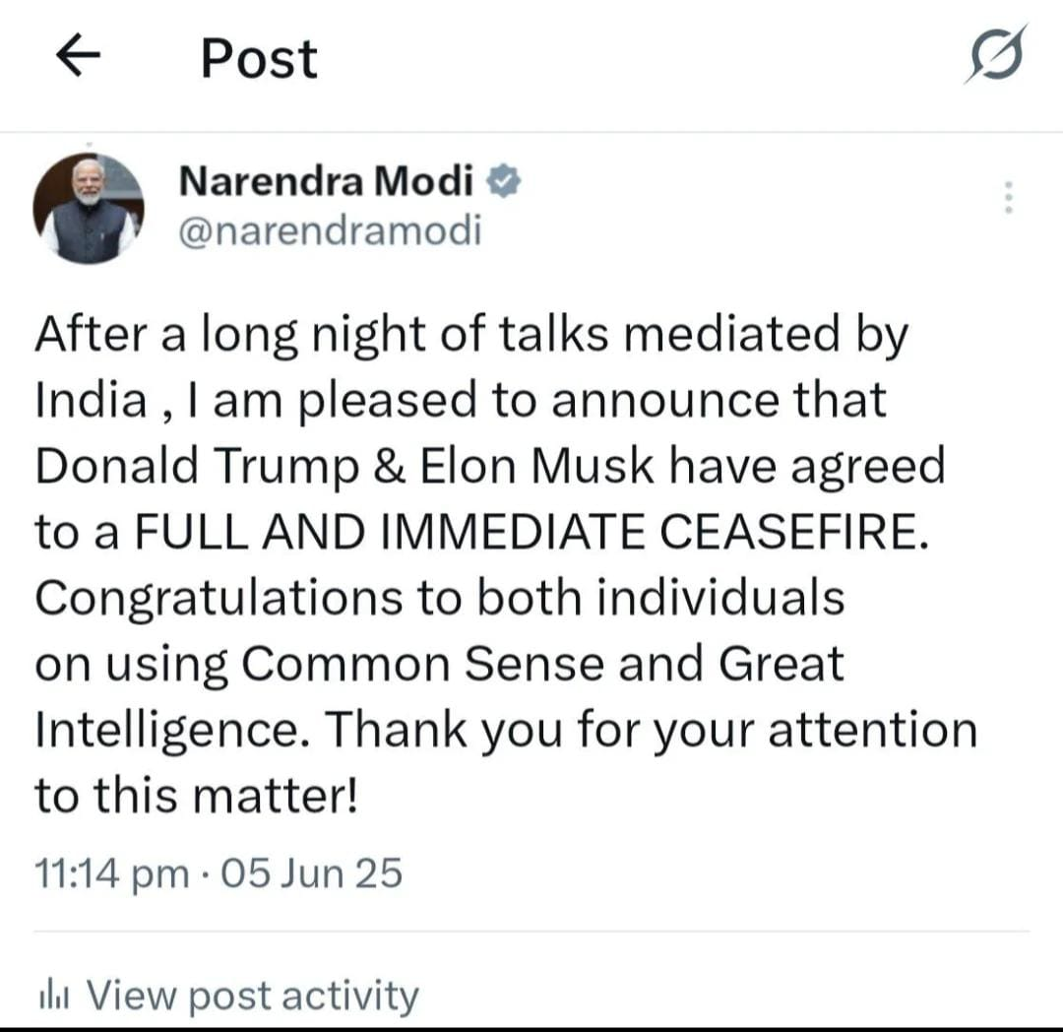

Slide 17

ANSWER X- Elon Musk Y- Donald Trump

Slide 18
QUESTION-6 La Tomatina in Spain is a festival celebrated on the last Wednesday of August where the people play with tomatoes. In 2010, 16 tons of tomatoes worth Rs 1 crore were flown in from Portugal but not on the occasion of the festival. The entire town was shut down and residents of Bunol, for their extreme cooperation with the event got a chance to celebrate Tomatina twice in the year 2010, once for Spain and once for India. What Incident X provided the opportunity for the residents of Bunol in Spain to celebrate Tomatina twice in 2010?

Slide 19
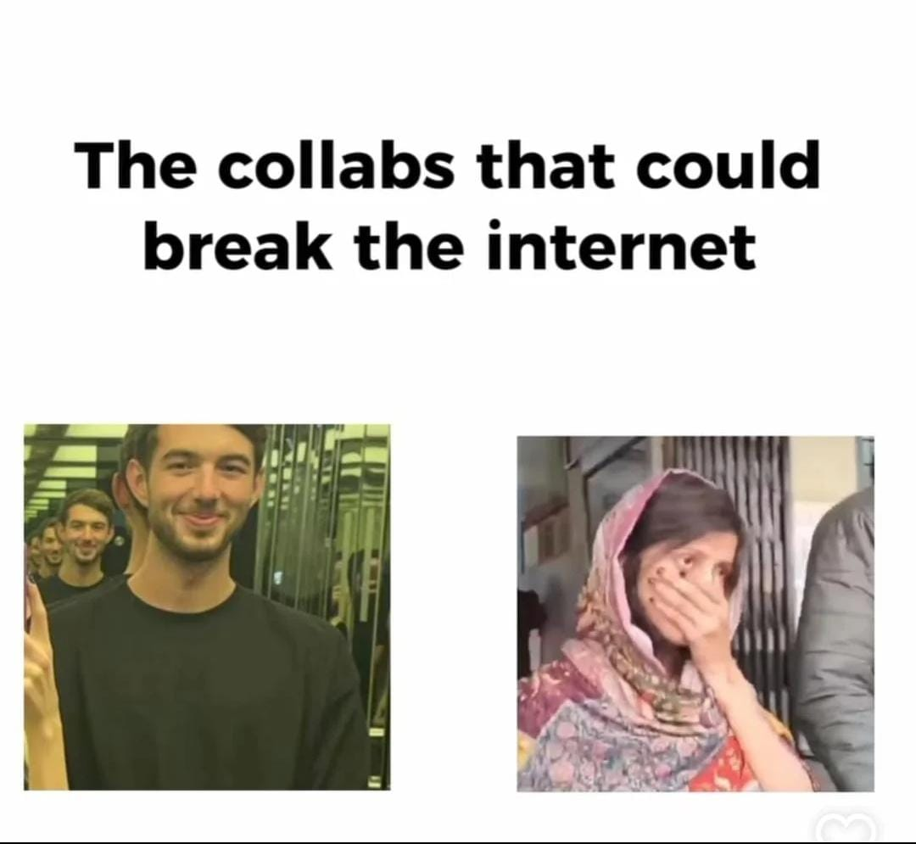

Slide 20
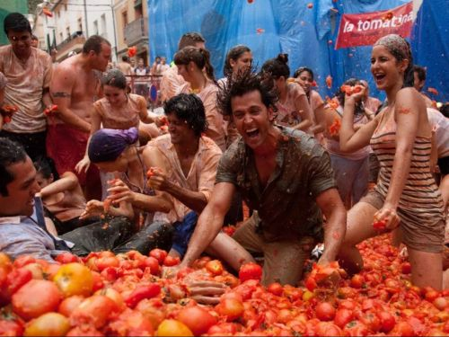
ANSWER The filming of Zindagi na milegi Dobara

Slide 21
QUESTION-7 In 1959 a horn antenna was built as part of NASA's Project Echo. In 1964, two scientists working on calibrating this antenna to remove interference were unable to identify a source of random noise.The device's design was intended to eliminate noise from the surroundings, but a noise persisted and interference from urban areas, nuclear tests or pigeons living in the antenna were all ruled out.After they figured out what the mysterious hum was, they went on to for the discovery, which confirmed a theory X. they went on to win the Nobel prize for the discovery. Identify the theory X.

Slide 22
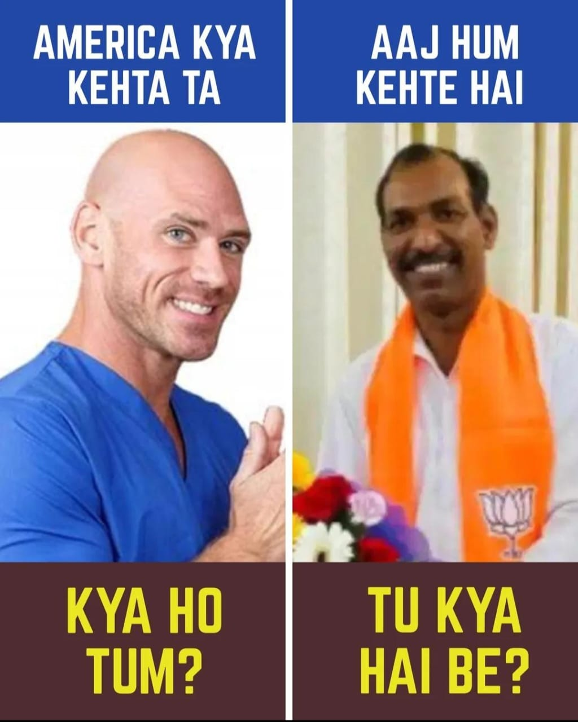

Slide 23

ANSWER X- Big Bang Theory

Slide 24
QUESTION-8 Song X from the movie Y was banned from playing in theatres and OTT. This is because of copyright infringement filed by a popular Kerala-based band Thaikkudam Bridge. The band alleged that there are unavoidable similarities between X and their song titled Navrasam. Navrasam was a tribute to Kerala's popular art form Kathakali.Though, X is not affiliated with the song Navrasam, yet both have the same theme of culture representation and their music almost resembles each other.ID the song X.

Slide 25


Slide 26
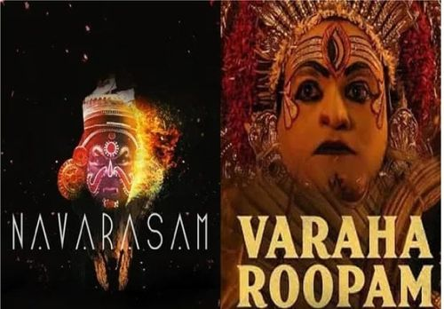
ANSWER X- Varaha Roopam Y- Kantara

Slide 27
QUESTION-9 In medieval life in Europe, People used measuring units which had very quirky name. X was the unit for measuring wine. X is derived from word ‘botte’ a medieval French and Italian word for boot. In Italy, botte is still used to refer to wine cask. Apart from X as measuring unit, word 'X wine' is used for cheap wine. Also, getting 'wine X ' means getting partner for sexual activity just because partner being excessively drunk. ID X.

Slide 28


Slide 29
ANSWER X- Butt

Slide 30
QUESTION-10 Following the previous question, in medieval era, people used weight of man for measurement of weights. Names of of such units varied from place to place. Some regions used name 'man' while some used Y. Measurement of Y varied from place to place but for modern world people, it is always equal to justice in fictional City. ID Y.

Slide 31


Slide 32

ANSWER Y-Batman

Slide 33
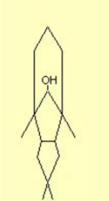
Question- 11 Here is the flat structure of a chemical molecule, synthesised in the late 1960s, and named X after the structure's look, and a famous event happening in the world and beyond. Another very apt connection is the specific number of carbon on which the -OH group is present. What is X ? Also, which numbered carbon atom is the -OH present on?

Slide 34
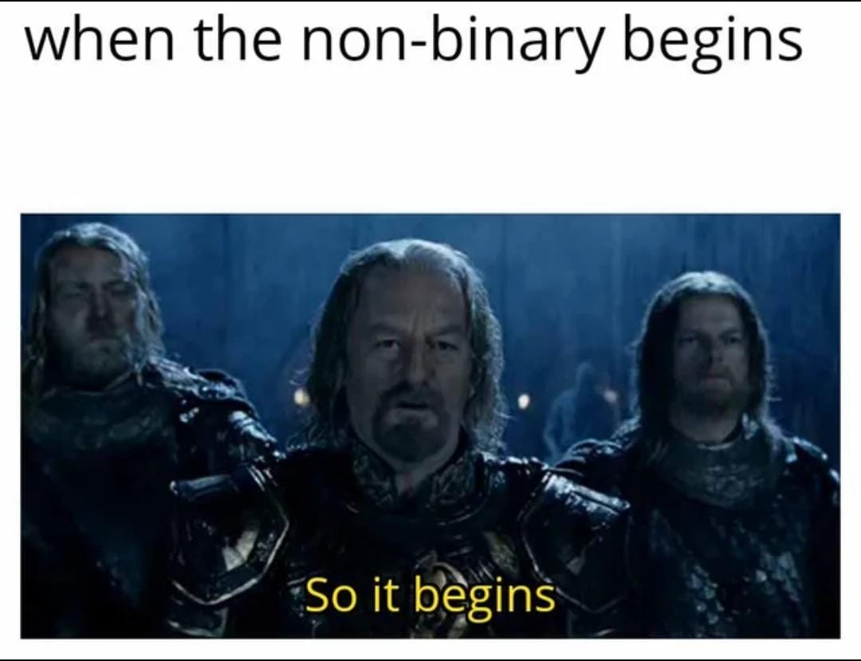

Slide 35
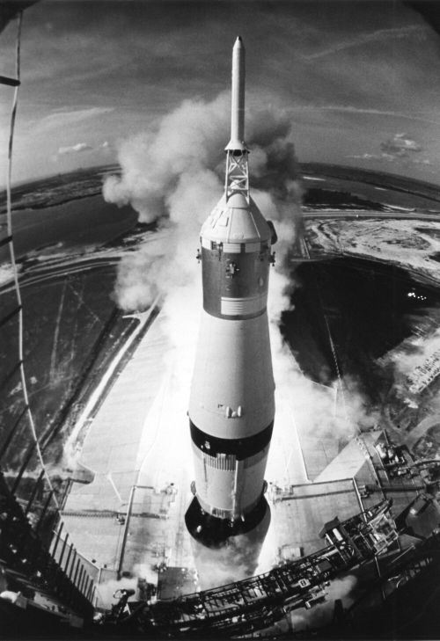
ANSWER Apolloane, named after resemblance to rockets and Apollo moon landings The –OH group is placed on carbon 11 to get apolloane-11-ol, referring to Apollo 11

Slide 36
QUESTION-12 The song has given the artist their first Brit award, the equivalent of a Grammy. It has been used in a few television series, of which in the series X, the song has been used to represent the emotional struggles of a character. The artist of the song is said to be selective about giving permission for her songs, but she is a fan of the series, thus the permission. The song's original name had to be changed because it has to be played in religious countries. The artist thought that this idea of changing the title seemed ridiculous as it was a big part of the song's identity. Identify the song and series X.

Slide 37


Slide 38
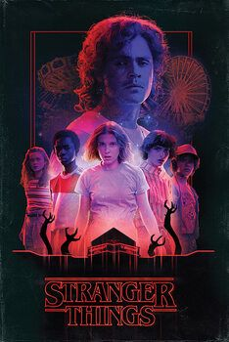
ANSWER Song- Running up that hill (A deal with god) X- Stranger things

Slide 39
QUESTION-13 This 24 crore ‘item’ X that played an important role during the 2010 commonwealth games, was first offered to DRDO after the end of the games, the DRDO rejected the gift stating that it had no use of it. At last, it was bought by the Goa government for the Lusofonia Games in November that saw participation of 12 Portuguese-speaking countries. It was sold at a token amount of rs.1 as the Ministry of Youth Affairs and Sports cannot charge anything from a government agency. Identify X.

Slide 40


Slide 41
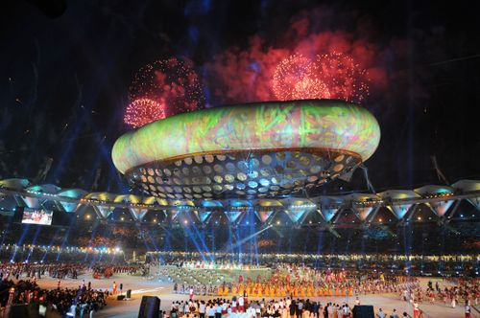
ANSWER The Aerostat used in opening and closing ceremony

Slide 42
QUESTION-14 Tilda van der Meer is a major character and the final antagonist in Horizon Forbidden West. As an easter egg, when the gameplay enters her mansion, one could find a X if they are observant and one of the characters in that is spotted wearing a black dress. The name of X can also be derived from the fact that, this black dress wearing individual is connected to a fictional organisation from a 21st century primetime TV show Y. Owing to her nationality and entertainment connect, identify X and Y.

Slide 43
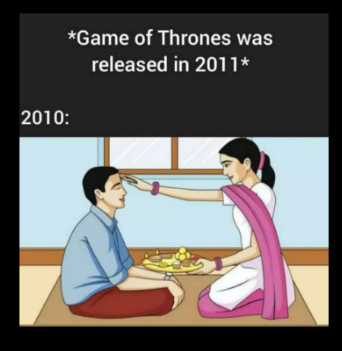

Slide 44
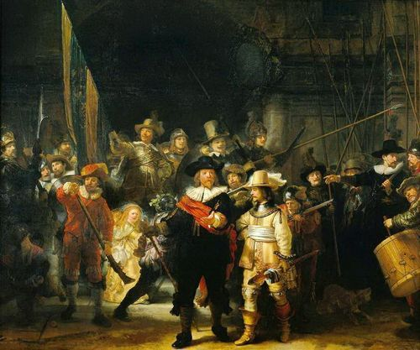
ANSWER X- The Night’s Watch Y- Game of Thrones

Slide 45
QUESTION-15 Long connect

Slide 46
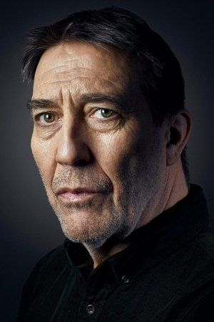

Slide 47


Slide 48
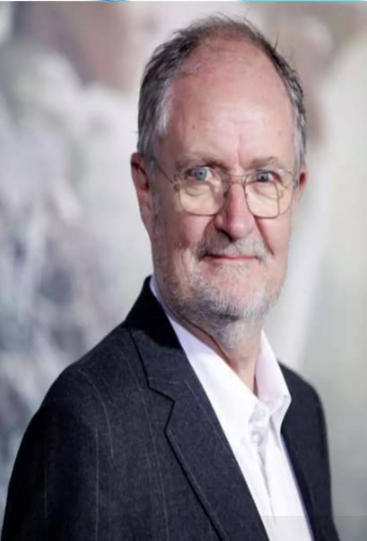

Slide 49
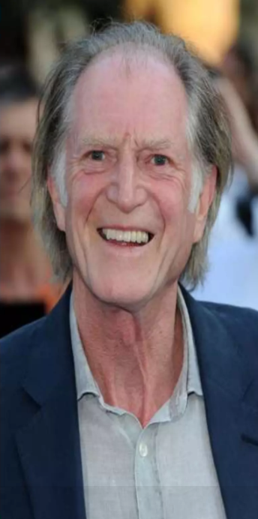

Slide 50


Slide 51


Slide 52
ANSWER All of them were cast in both Game of thrones and Harry Potter

Slide 53
Thank You Everyone !

