Slide 1
Websphere Application Server
Introduction:
WebSphere application server is a software framework which hosts the java based web applications.
It is a run time environment for j2ee applications.
Various platforms are supported by was such as linux, windows, Aix,ios,IBM etc.
It works with various web services like apache http server, Microsoft Internet Information Services.

Slide 2
Various WAS packages And Installation
WAS network deployment
WAS Express
WAS Base
Installation:
WAS can be installed only through IBM installation manager
For installation we need to the follow the below steps:
Install IBM installation manager
Install WAS ND through IBM IM
Based on the credentials we need to install the IBM IM through GUI mode
if the user is admin then we need to run the install utility
if the user is non admin the we need to run the userinst utility
if it is a group user then we need to run groupinst
Once installed the profiles location of the was would be as below:
C:\Users\manihaaraishwarya\IBM\WebSphere\AppServer\profiles

Slide 3
websphere terminologies:
Application server
The application server is the platform on which java based applications run
It is an environment where you host banking applications
Node
A node is a logical group of one or more application servers on a physical computer
It is an administrative grouping of application servers for configuration and operational management within one operating system instance
Application servers that run on a specific host is grouped as a logical unit for ease of administration and enabling other WAS features.
Cell:
A cell is a logical group of nodes that enables common administrative activities in a WAS distributed environment
The below illustrates the components of the application server environment. The number of nodes and servers present in application server environment varies based on the topology.
Deployment manager
Application servers can be managed centrally through deployment manager
It is a central administration point of a cell that consists of two or more nodes (stand-alone application server) and node groups in a distributed server configuration
Node agent
While adding a stand-alone application server to deployment manager cell, an operating system process will be created in the machine wherein the stand-alone application server resides. This is called node agent

Slide 4
WAS topologies
Standalone Environment
It is used for testing the applications where clustered environment is not supported.
Distributed server environment
Multiple servers are managed from a single deployment manager cell.
Administrative agent environment
An administrative agent can manage single server remotely without any additional connection to the physical machine
Job manager environment
Job manager manages multiples topologies through a single entry point

Slide 5
Usage of WebSphere tools:
Profile management tool(PMT) :
PMT is used to create application servers on which you host banking application
Application server's run time environment is called as profile
Below are the profile types in which various profiles are created :
Cell (Deployment manager and a federated application server)
Application server (Stand-alone application server profile)
Management (Deployment manager, job manager and administrative agent profile)
Managed (Federated node to DMGR without server)
Secure Proxy (Secures the WAS topology).

Slide 6
Creation of an application server in linux environment:
It can be created through manageprofiles.sh or through gui mode by selecting the typical profile creation by running the profile management tool(pmt.sh)
Select the typical profile creation option
Provide the WAS credentials
By then it can be created with the values as below:
Name of the server: server1 (auto-generated name)
Profile Name: AppSrv01
Profile Template: Application server
Host: Local host (mysimstlin-0174)
Cell Name: mysimstlin-0174Node01Cell (auto-generated name)
Node name: mysimstlin-0174Node01 (auto-generated name)
Port number: 9043 (auto-generated value)
The above process explains the server creation through GUI mode, there is a second method which we can create profiles, i.e. By running the command manageProfiles.sh, through this we can create the application server and once the server is created to check the server’s status below is the command:
./startServer.sh

Slide 7
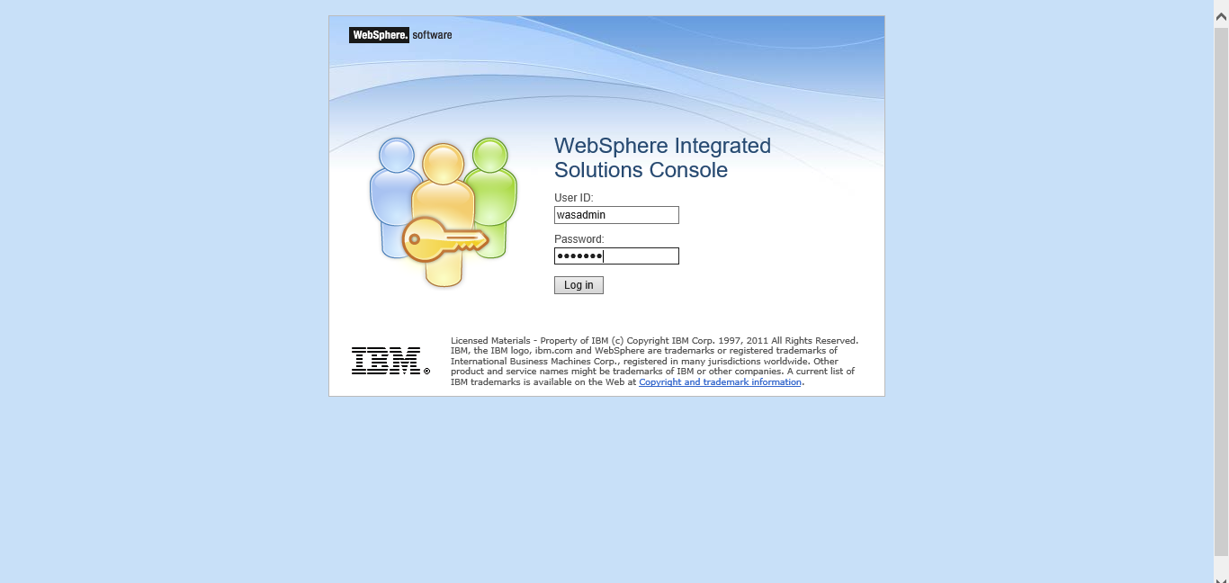
Admin console of application server

Slide 8
WAS Environments
Development/Test phase process:
Create a cell profile
It creates both a deployment manager and an application server profile. The application server node is federated to the cell
Both are on the same system
This method can be used in a development/test environment
Production Environment:
Firstly, we need to create a deployment manager profile
We need to create one or more custom node profiles
These nodes can be federated during profile creation, or manually later
These nodes may exist in the deployment manager system, or in another OS instance

Slide 9
Development Environment:
Deployment manager profile to be created
one or more application server profiles to be created
Federate these profiles into deployment manager
It adds nodes and application servers into the deployment manager cell
These nodes may exist in the deployment manager system, or in another OS instance
This method can be used in development/small configurations.

Slide 10
Application deployment
The application deployment can be done in two ways:
Administrative console wizard:
This is a GUI mode in which we can be deploy the banking applications on application server which supports WAR, EAR, JAR and SAR modules. Which is suitable for production environment
In administrative console page navigate to applications->WebSphere enterprise applications ->install
Choose the file to be deployed ->. ear file
Select the type of deployment based on the requirement.
We need to the select the servers which we want to deploy the application
Once installed successfully we can start the application
We can get the port of the server by navigating to application servers->demoserver->ports
Now we would be able to access the application through the browser as https://localhost:portnumber/appname

Slide 11
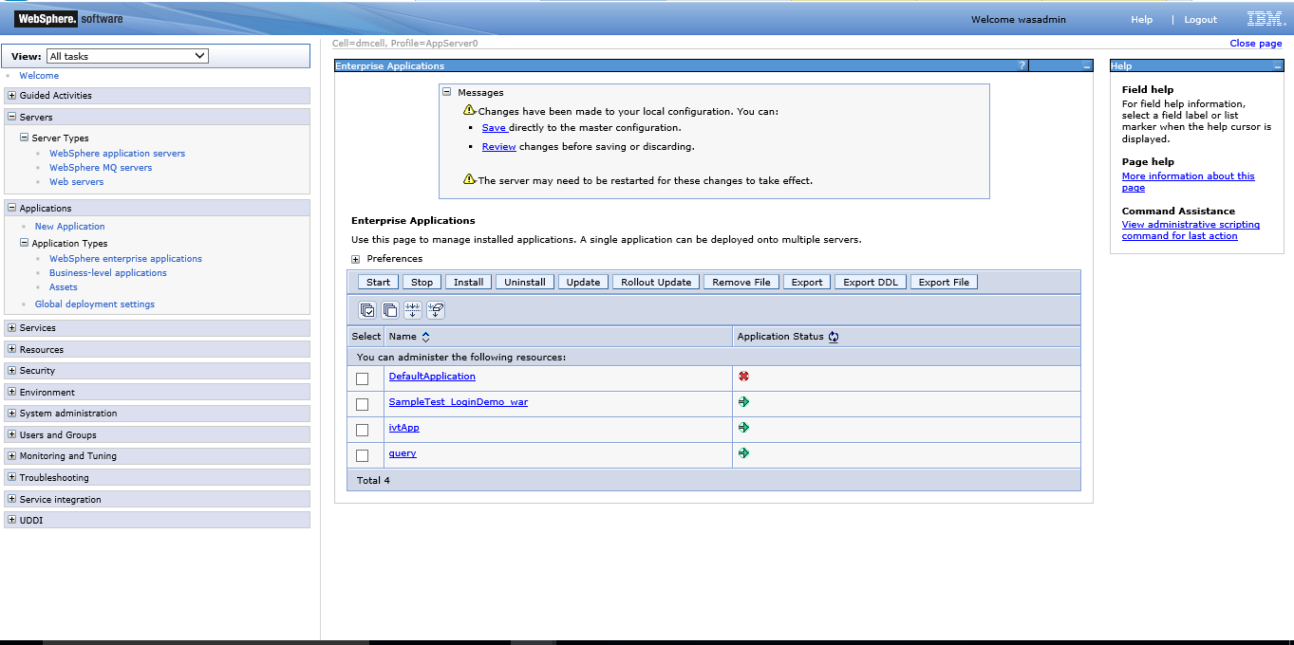

Slide 12
Importing SSL certificates into WAS
Keytool is the utility to be run in order to import the certificates into WAS
We need to export the certificate to the file path where the application server resides
Below is the path:
path_to_WebSphere/WebSphere/AppServer/java/jre/bin directory
import the certificate into the keystore as below:
keytool -import -alias KeyAlias -file path_to_certificate_file -keystore cacerts -storepass changeit
for windows environment below is the command:
Windows: path_of_keytool -import -alias ExchangeCert -file path_of_cert -keystore cacerts -storepass changeit
For Linux environment:
Linux: path_of_keytool -import -alias ExchangeCert -file path_of_cert -keystore cacerts -storepass changeit
The alias can be of any string which point to the configuration
Keytool path is the path where the appserver is resided in which folder
Changeit is the default password of cacertificates

Slide 13
Logging in websphere
Websphere application server provides many logging options and the significant incidents are recorded in log files.
Below are the levels of logging:
Basic Logging:
The basic logging deals with
java virtual machine logs –systemout.log,systemerr.log
Diagnostic trace-trace.log
Service log files
The commonly named log files are SystemOut.log, SystemErr.log, trace.log, and activity.log.
Advanced logging:
This deals with high performance extensible logging(HPEL) which is the feature introduced in WebSphere application server 8.5
This provides three repositories:
Log Data repository:
This repository specifies the data related to the log files as SystemOut.log, SystemErr.log, or java. util. logging at higher level.
Trace Data Repository:
This repository specifies the data related to the log files as java. util. logging at low level.
Text log:
This is the plain text with logs and traces provided
The HPEL formats the text data into binary format
No need to clear the logs each time when the server is restarted

Slide 14
Exporting and importing a configuration archive:
We can use the ConfigArchiveOperations command group to export and import server
configurations or entire cell configurations as a compressed archive (CAR) file. You can use
this capability to replicate server or profile configuration.
The general procedure to use an archived file is:
Export a WebSphere Application Server configuration into a compressed archived file
containing the server configuration.
Optionally, extract the files for browsing or updating for use on other systems, for example,
For updating resource references.
Upload the archive file to the target system.
Import the archive file. The import process requires that you identify the object in the
configuration you want to import and the target object in the existing configuration. The
target can be the same object type as the archive or its parent. Consider the following information as below:
If we want to import the application server configuration to another application server then the configurations would be merged.
If we want to import a server archive to a node, then the server is added to the node.

Slide 15
Profile Archive:
exportWasprofile command to export the entire cell configuration to a configuration archive. This archive file can be used to restore the configuration or clone the original profile on another machine or system.
Note: Only a base server configuration with a single node is supported by the
exportWasprofile command.
exportWasprofile command in the AdminTask object can be used to export profile
configuration. The command needs to be executed through wsadmin from the profile_root/bin directory
creates an archive of a profile.
Below is the command which create an archive for the profile created.
Need to navigate to application server profile directory and then run the command ./wsadmin.sh
wsadmin>$AdminTask exportWasprofile {-archive /tmp/was85_archive/Node01_archive_0622.car}
here the node01 is the profile being archived. The above command wsadmin is used by jacl scripting

Slide 16
Import Was profile
The importWasprofile command in the AdminTask object imports and overwrites the profile
with the archive file configuration is below:
wsadmin>$AdminTask importWasprofile {-archive
/tmp/was85_archive/Node01_archive_0622.car -deleteExistingServers true}
wsadmin>$AdminConfig save
The -deleteExistingServers parameter is optional. It deletes existing servers from the target
profile. Consider that when importing a profile with multiple servers, the node has to contain
exactly the same number of servers. If the number of servers is not the same, the following
error message occurs:
ADMB0016E: The number of servers in the configuration archive does not match the
number of servers in the system configuration. The product only supports
importWasprofile for profiles with the same number of servers.

Slide 17
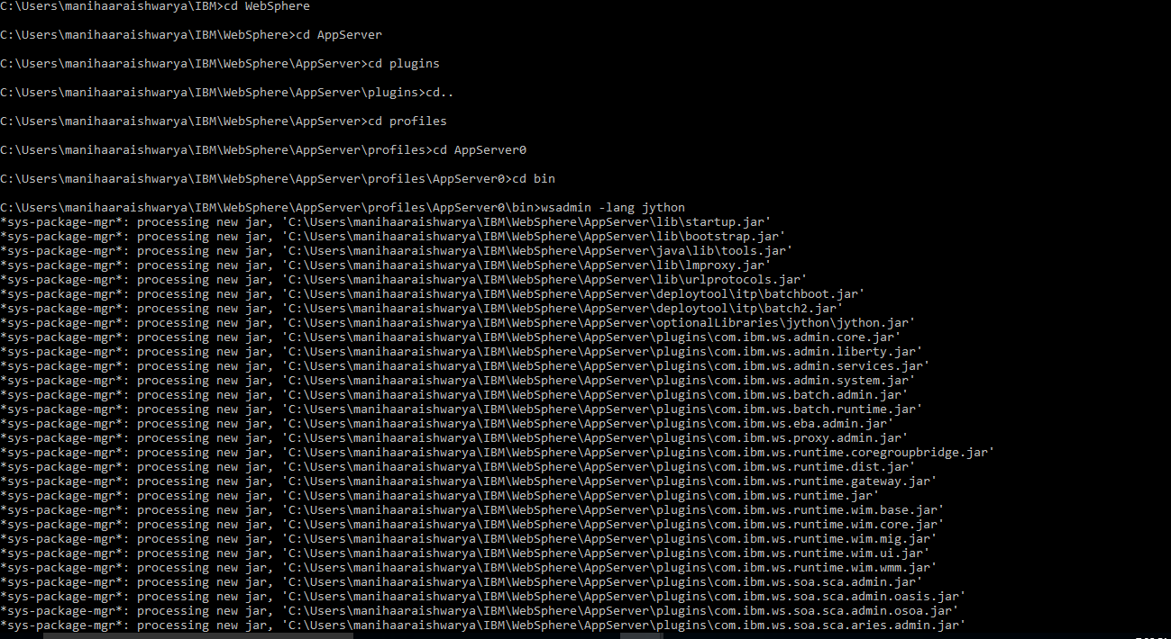

Slide 19
Thank You

