Slide 1

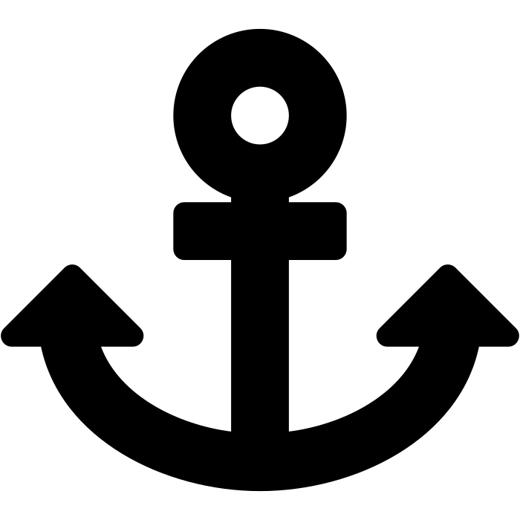
PORT OPERATIONS PLATFORM
Seaport Management System
A centralized web application for tracking ships, docks, cargo, and arrivals in real time
Final Year Project Defense
Student Name | Supervisor Name | Department
Notes:
Good [morning/afternoon]. My name is [Name] and today I'll be presenting my project: the Seaport Management System — a web application built to digitize and centralize port operations. This presentation will take about 5 to 10 minutes, covering the objective, features, technology stack, database design, and a live demo.

Slide 2
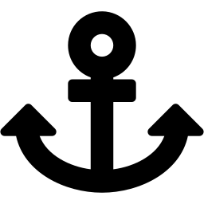
Project Objective
Why a Seaport Management System?
THE PROBLEM
THE OBJECTIVE
Ship arrivals, dock assignments, and cargo records are tracked manually or in scattered spreadsheets
No single source of truth — hard to check dock availability or cargo status quickly
Manual records are error-prone and slow to search or report on
Build a centralized, web-based system that lets port staff record and monitor ships, docks, cargo, and arrival/departure activity from one place — in real time, with validated data entry and instant search.
One system. Every vessel, dock, and shipment.
Notes:
Ports generate a constant stream of activity — ships arriving, cargo being unloaded, docks changing status. Without a central system, this is often tracked manually, which makes it slow to answer simple questions like 'which dock is free' or 'where is this shipment now.' My objective was to replace that manual process with a single web application that centralizes ships, docks, cargo, and arrivals, with proper validation and instant search.

Slide 3





System Features
Core capabilities available to port staff
Ship Management
Dock Management
Cargo Management
Register ships with capacity, flag, owner, and operational status
Track dock number, location, capacity, type, and availability
Log cargo type, weight, owner, and hazardous-material flags
Arrival Tracking
Search & Filter
Secure Access
Link a ship, dock, and cargo record to an arrival with dates & status
Find ships by name, or filter arrivals by ship and status
Login-gated management pages; public info pages stay open
Notes:
The system covers six core capabilities: ship management, dock management, and cargo management each support full create, read, update, and delete operations. Arrival tracking ties a ship, a dock, and a cargo record together with arrival and departure dates and a status. There's search and filtering for quickly finding records, and the management pages sit behind a login so only authorized staff can make changes.

Slide 4

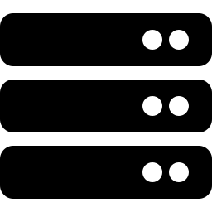
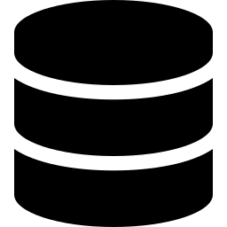

Technologies Used
A two-tier architecture: React client, ASP.NET Core API
FRONTEND
BACKEND
DATABASE
React 19
Vite build tooling
React Router 7 (routing & guards)
Axios (HTTP client)
ASP.NET Core 8 Web API
Microsoft.Data.SqlClient (ADO.NET)
Parameterized SQL queries
Swagger / OpenAPI docs
Microsoft SQL Server
4 relational tables
Server-side validation on every write
REST API
(JSON over HTTP)
Notes:
The system uses a standard two-tier web architecture. The frontend is a React 19 single-page app built with Vite, using React Router for navigation and route guarding, and Axios to call the API. The backend is an ASP.NET Core 8 Web API — I used raw ADO.NET with Microsoft.Data.SqlClient rather than an ORM, writing parameterized SQL directly, which also protects against SQL injection. Swagger is enabled so the API is self-documenting and testable. The database is Microsoft SQL Server with four related tables.

Slide 5
Database Design
SeaportManagementDB — 4 tables, Arrivals as the linking record
Ships
Docks
Cargo
ShipID (PK)
ShipName, ShipType
Capacity, FlagCountry
OwnerName, Contact
Status
DockID (PK)
DockNumber, Location
MaxCapacity
DockType, Status
CargoID (PK)
CargoType, Weight
OwnerName/Email
IsHazardous
Arrivals (links Ship + Dock + Cargo)
ArrivalID (PK)
ShipID (FK), DockID (FK), CargoID (FK)
ArrivalDate, DepartureDate
Status (Pending / Arrived / Departed)
Notes
Referential integrity (e.g. can't delete a ship with existing arrivals) is enforced in application code before each write/delete.
Notes:
The database has four tables. Ships, Docks, and Cargo each hold their own attributes — for example Ships stores capacity, flag country, and status. Arrivals is the linking table: it references a ShipID, DockID, and CargoID together with arrival date, departure date, status, and notes, which is how the system represents 'this ship brought this cargo and docked here on this date.' Since I'm not using an ORM, referential integrity — like preventing deletion of a ship that still has arrival records — is enforced in the controller code before each write.

Slide 6

System Demonstration
Live walkthrough plan
1
2
3
4
5
6
Login
Add a Ship
Add a Dock
Add Cargo
Record Arrival
View Report
Sign in to unlock the management area
Register a new ship with its details
Create a dock and mark its status
Log a cargo record for the shipment
Link ship + dock + cargo with dates
Show the consolidated report view
Swagger UI is available at /swagger to demonstrate the raw API endpoints directly, if requested.
Notes:
For the live demo, I'll walk through a typical workflow: log in, register a ship, create a dock, log a cargo record, then create an arrival that links all three together with dates and a status, and finally show the report view that pulls it all together. I can also open the Swagger UI to show the underlying API endpoints directly if the committee would like to see the request/response format.

Slide 7

Thank You
Questions & Discussion
Seaport Management System • React 19 + ASP.NET Core 8 + SQL Server
Notes:
That concludes the presentation. To summarize: the Seaport Management System centralizes ship, dock, cargo, and arrival tracking into one validated web application, built with React, ASP.NET Core, and SQL Server. I'm happy to take any questions from the committee now.

