Slide 1
PERSONAL
BUDGET PLANNER
A simple, persistent and visual way to take control of monthly spending.
Budget
Track
Understand
Set a monthly spending limit.
Log expenses with category, date and description.
See totals, remaining budget and category spending.
Python • Streamlit • Persistent CSV/JSON storage • IBM AI/Cloud capabilities

Slide 2
01 | Problem Statement
Why everyday personal finance management is still difficult
In today’s fast-paced digital economy, many individuals—especially students and young professionals—struggle to achieve financial stability due to a lack of visibility and real-time control over daily spending.
Traditional methods such as spreadsheets or paper notebooks are tedious, prone to human error, and often fail to provide actionable insights or visual breakdowns of recurring versus discretionary spending.
Visibility Gap
Manual Effort
No Actionable Insight
Users often do not know where their money is going until the month is nearly over.
Paper notes and spreadsheets require continuous effort and maintenance.
Raw spending records do not automatically become useful decisions.
PERSONAL BUDGET PLANNER • HACKATHON SUBMISSION
02

Slide 3
01 | Specific Pain Points
The gaps identified in the existing budgeting experience
No budget tracking
No expense logging
No clear monthly spending limit is set.
Spending is forgotten or not recorded.
No category visibility
No overspend warning
Users cannot quickly see which area costs the most.
No alert when the budget is exceeded.
Limited categories
Only Food, Travel, Shopping and Education were available; Healthcare and Entertainment were missing.
PERSONAL BUDGET PLANNER • HACKATHON SUBMISSION
03

Slide 4
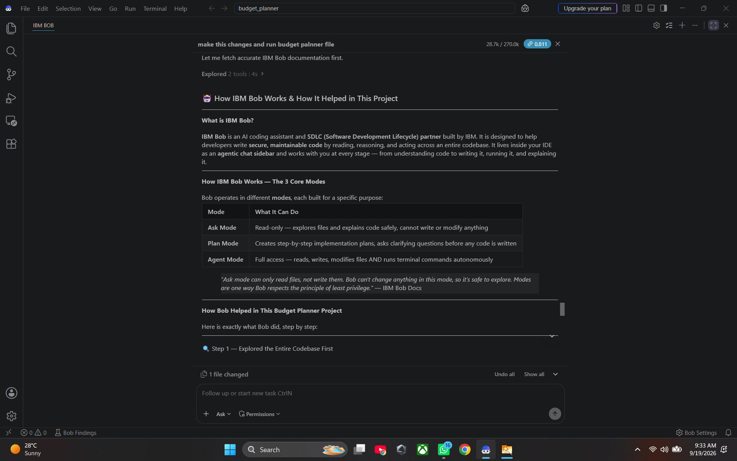
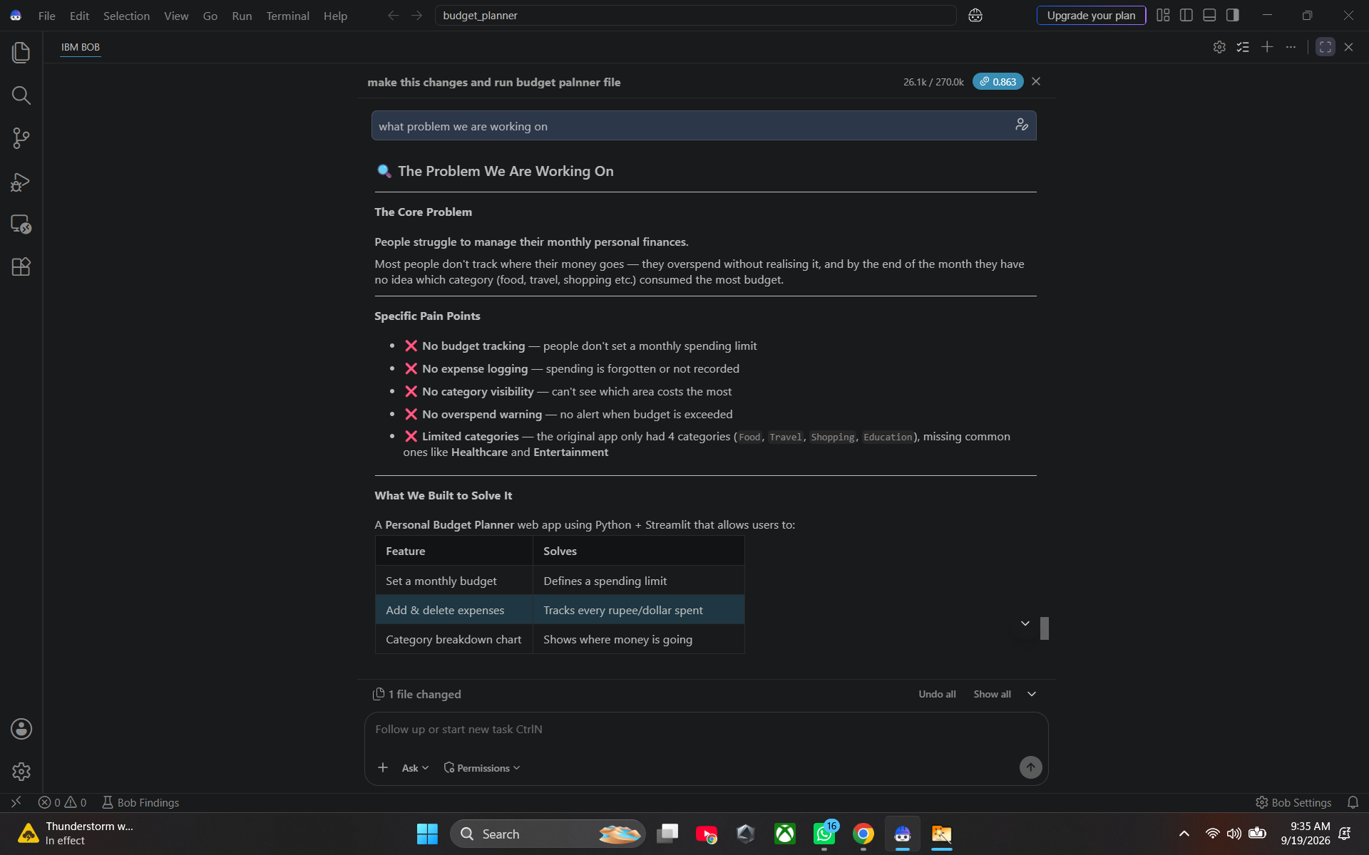
01 | Problem Statement — Evidence
Screenshots from the project documentation
PERSONAL BUDGET PLANNER • HACKATHON SUBMISSION
04

Slide 5
02 | Solution Statement
A practical budgeting workspace that turns spending records into visibility and control
We built a Personal Budget Planner web app using Python + Streamlit that gives users control of their monthly finances in one place.
01 Set Budget
02 Add Expenses
03 Manage
04 Analyze
Define a monthly spending limit and persist it across refreshes.
Record amount, category, description and date.
View and delete incorrect entries with real-time updates.
See budget, total spent, remaining budget and category charts.
The result: a simple, persistent and visual budget-management tool for everyday spending.
PERSONAL BUDGET PLANNER • HACKATHON SUBMISSION
05

Slide 6
02 | Core Features
What the implemented application does
Monthly Budget
Expense Tracking
Validation
User enters a planned monthly budget; it is persisted in budget.json.
Each entry captures amount, category, description and date.
Invalid input is rejected with clear error messages.
Persistent Storage
Delete / Edit Flow
Overspend Warning
Expenses are stored in expenses.csv and survive refreshes.
Users can remove incorrect expense entries instantly.
A visual warning appears when spending exceeds the budget.
PERSONAL BUDGET PLANNER • HACKATHON SUBMISSION
06

Slide 7
02 | Analytics & Better Coverage
From raw transactions to quick financial awareness
Summary Dashboard
Budget health
Three at-a-glance metrics: Monthly Budget, Total Spent and Remaining Budget.
Monthly Budget
$2,000
Category Breakdown
Total Spent
$850
A bar chart shows how spending is distributed across categories.
Remaining
$1,150
Expanded Categories
Healthcare and Entertainment were added alongside Food, Travel, Shopping and Education.
PERSONAL BUDGET PLANNER • HACKATHON SUBMISSION
07

Slide 8
02 | Intelligent Extension
AI, cloud and predictive capabilities described for the solution
AI-Driven Insights & Automation
Scalable & Secure Infrastructure
Intelligent Analytics Dashboard
IBM watsonx / Watson AI capabilities can parse natural-language transaction inputs such as “spent 500 on groceries”, automatically categorize spending, and provide personalized financial tips.
IBM Cloud databases/services are intended to support secure, encrypted financial-data storage with real-time accessibility.
Transaction history can be processed for budget forecasts and visual alerts when spending approaches preset category limits.
These capabilities extend the core budgeting workflow from recording expenses toward assisted financial awareness.
PERSONAL BUDGET PLANNER • HACKATHON SUBMISSION
08

Slide 9
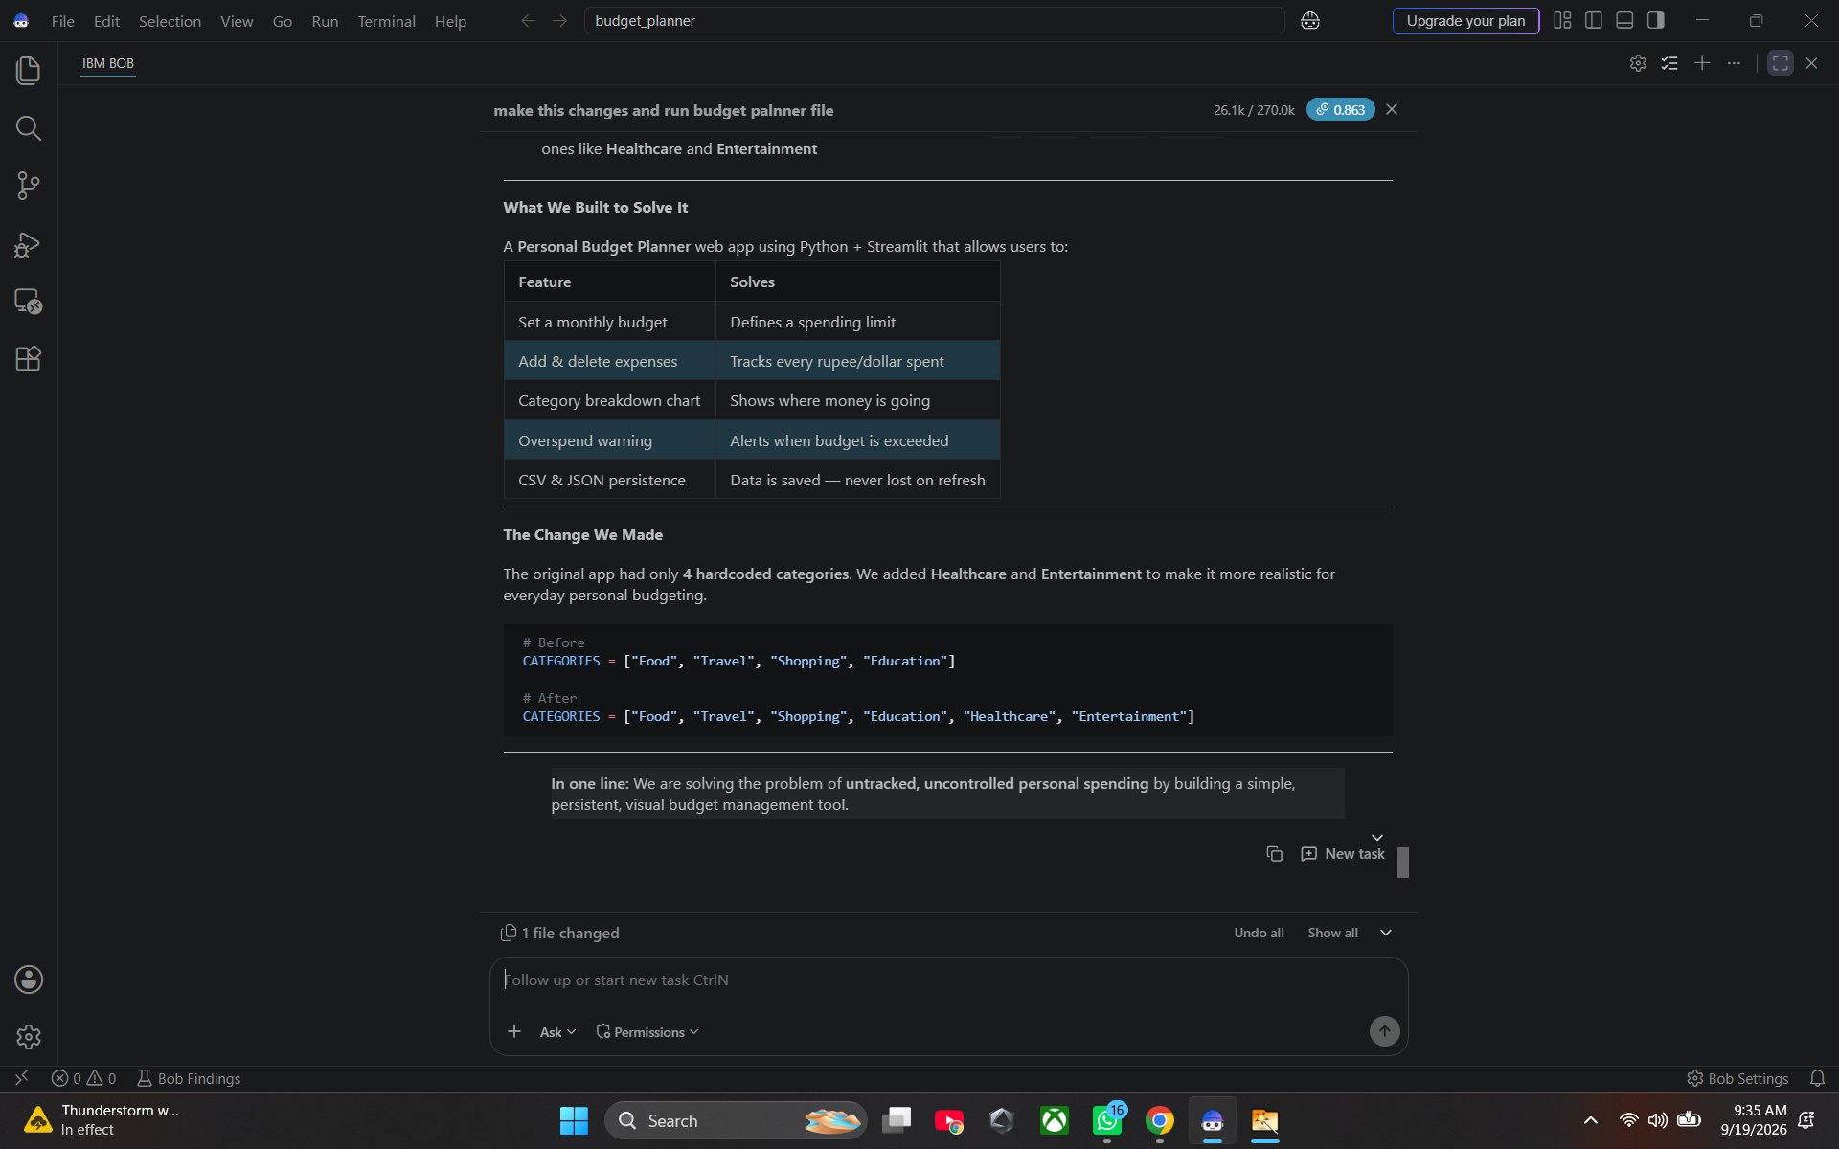
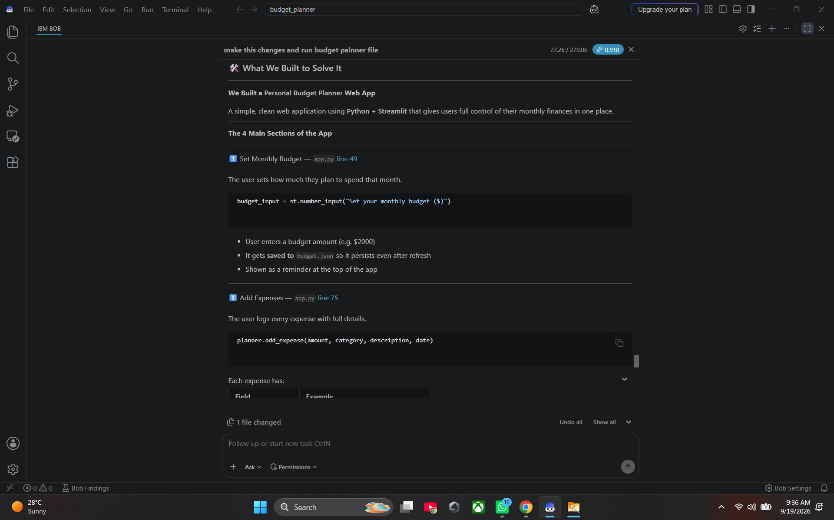
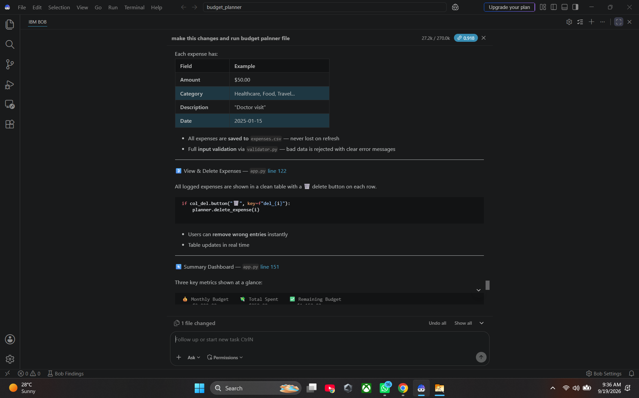
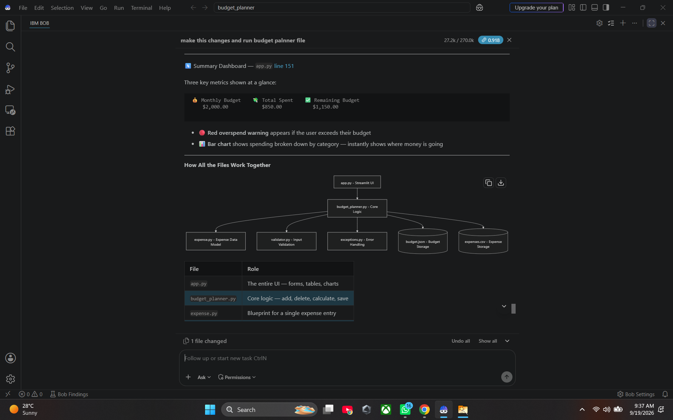
02 | Solution — Implementation Evidence
Screenshots of the implemented solution and architecture
PERSONAL BUDGET PLANNER • HACKATHON SUBMISSION
09

Slide 10
03 | Technical Architecture
Separation of UI, business logic, validation and persistence
app.py
budget_planner.py
Storage
Streamlit UI
Core Logic
JSON / CSV
expense.py
validator.py
exceptions.py
Expense data model
Input validation
Error handling
OOP-based business logic stays separate from the Streamlit presentation layer, making the application easier to validate, maintain and extend.
PERSONAL BUDGET PLANNER • HACKATHON SUBMISSION
10

Slide 11
04 | Problem → Solution Mapping
Each major pain point is addressed by a concrete feature
PROBLEM
SOLUTION
USER VALUE
No budget tracking
Monthly budget input + persistent budget
Budget becomes an explicit spending limit.
No expense logging
Add expense workflow + persistent CSV
Spending is captured instead of forgotten.
No category visibility
Category fields + breakdown chart
Users can see where money goes.
No overspend warning
Budget comparison + visual alert
Users are warned when spending exceeds budget.
Limited categories
Healthcare + Entertainment added
The model better reflects everyday expenses.
PERSONAL BUDGET PLANNER • HACKATHON SUBMISSION
11

Slide 12
FROM SPENDING DATA
TO FINANCIAL AWARENESS
A focused budgeting experience that makes monthly spending easier to record, understand and control.
Simple
Persistent
Insightful
Clean workflow built around everyday budgeting.
Budget and expenses remain available after refresh.
Dashboards and alerts make spending patterns visible.
THANK YOU

