Slide 1
Stock Predictor
Moe Fadaee & Vejey Gandyer
Mohammad Ardalanasl

Slide 2
Agenda
Part-1: Business Case
Hook
Elevator Pitch
Option Presentation
Background & Competitors
Main Phases of Project
Benefits
Risks
Resources Required
Part-2: Predictor Model
Literature Review
ML Canvas
Hyper-parameter Tuning
Model Benchmarking
Model Deployment
Demo
Q&A

Slide 3
Part-1: Business Case
Assumptions
Working in an AI-based company
The Company decided to invest in developing tools for Stock Market
Providing a Proposal for my managers
Main Business Requirement?
To have a successful investment in the financial market
How?
Developing an AI-Powered Stock Prediction Platform

Slide 4
Hook
Have you ever wished for a crystal ball to predict the stock market's next move?
What if I told you that with our AI-powered platform, you can get the next best thing?
Welcome to the future of stock market forecasting.

Slide 5
Elevator Pitch
Imagine an AI platform that can predict stock values with remarkable accuracy, accessible to everyone for free.
With a low-cost, low-risk approach
Attract a wide range of users
Generate revenue through advertisements and premium services
Targets:
Establish our presence in the financial market
Provide a foundation for expansion into more sophisticated services

Slide 6
Option Presentation
Option 1: Providing Private Services for Big Companies
Option 2: Providing Free Services for Public Users
Option 3: Combination of Both Options
Preferred Option: Option 2
Low cost and low risk
Quickly entering the market
Monetizing through advertisements
Provide a foundation for premium services

Slide 7
Background & Competitors
A long history of financial advising
Different advisor companies: Free & Non-free
Is it a challenge or an opportunity?
Opportunity for creating a Predictive Hub
Collecting all valuable predictions in the market in one place
Showing our capability
Providing a larger view for users
Attract more users for free services

Slide 8
Main Phases of Project
Planning Phase
Prototype Testing
Development Phase & Offering basic free services
User Engagement and Feedback
Developing more sophisticated services
Continuous Improvement

Slide 9
Benefits
Showcasing AI Capabilities
Establishing Market Presence
Low Cost, Low Risk
Revenue Generation
User Engagement and Loyalty
Competitive Advantage

Slide 10
Risks
Efficiency of Prediction Models → Prototype Testing
Cost of the Project → Start with smaller models and features
Competition and Market Saturation → Predictive Hub
Monetization Challenges → Advertisements
User Engagement and Retention → Free Services

Slide 11
Resources Required
Human Resources → Available in the company
Financial Resources → Limited and acceptable
Technological Resources → Available in the company
Data Resources → Available in the market
Marketing Resources → Limited and acceptable

Slide 12
Part-2: Predictor Model
Target:
Creating a Prototype Predictor Model
How?
Train the model using historical data of 100 symbols
Evaluate the model using test data
Deploy the model to the Cloud

Slide 13
Literature Review
Similar projects:
Alpha Vantage, Sentient Technologies, Kensho Technologies (acquired by S&P Global), Numerai, Kavout, Ayasdi, Lucena Research, Trade Ideas, Estimize
Drawbacks:
Market Volatility, Regulatory Risks, Bias

Slide 14
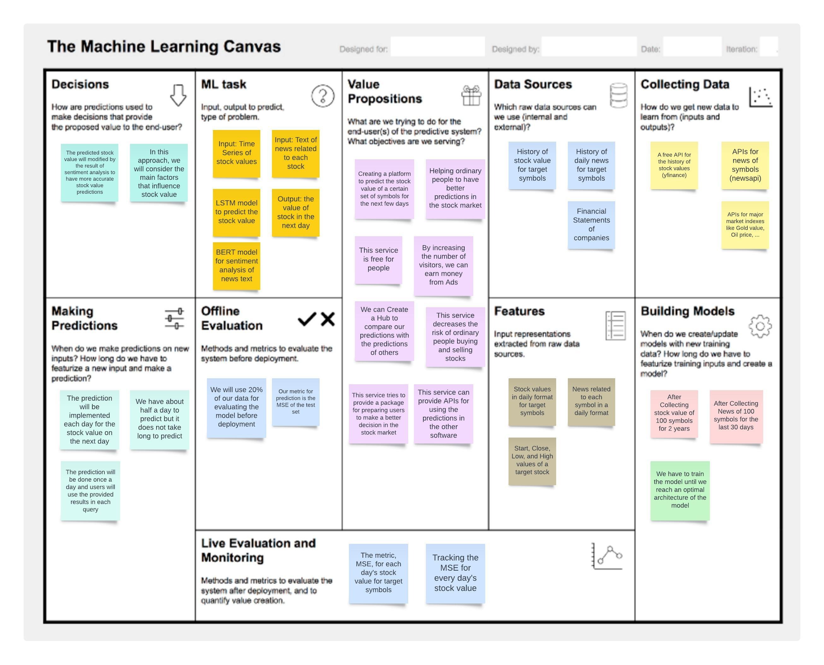
ML Canvas

Slide 15
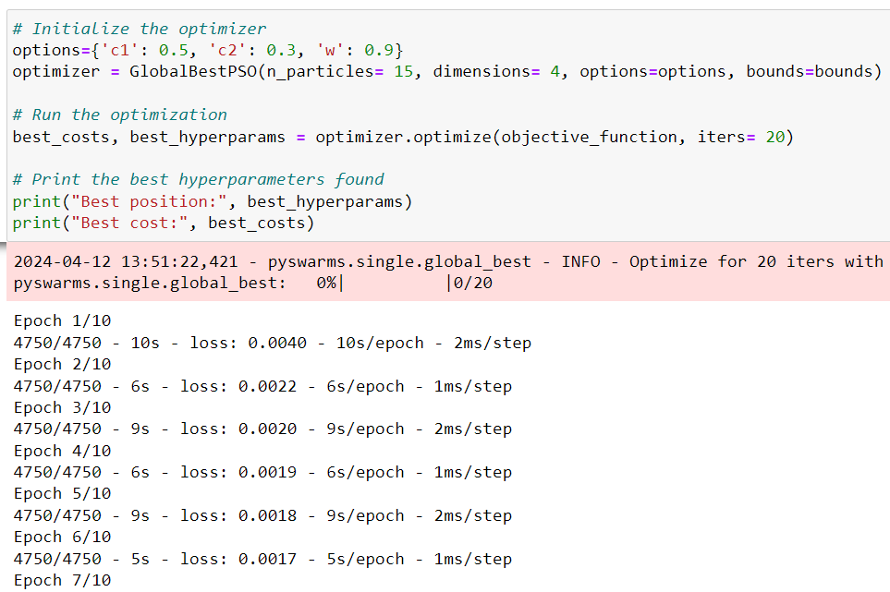
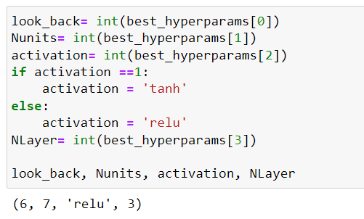
Hyper-parameter Tuning
Using Particle Swarm Optimization (PSO)
Finding the Optimal Architecture of model

Slide 16
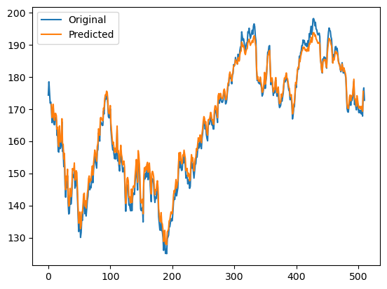
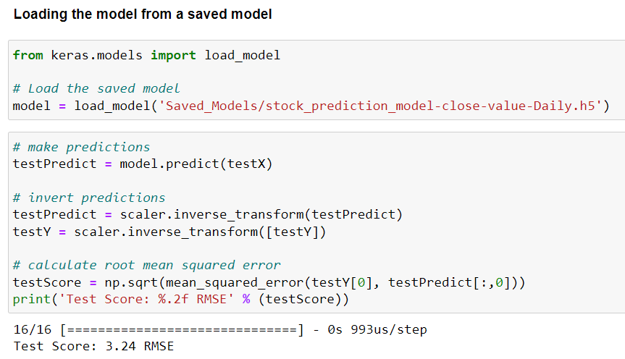
Model Benchmarking AAPL – Last 2 years

Slide 17
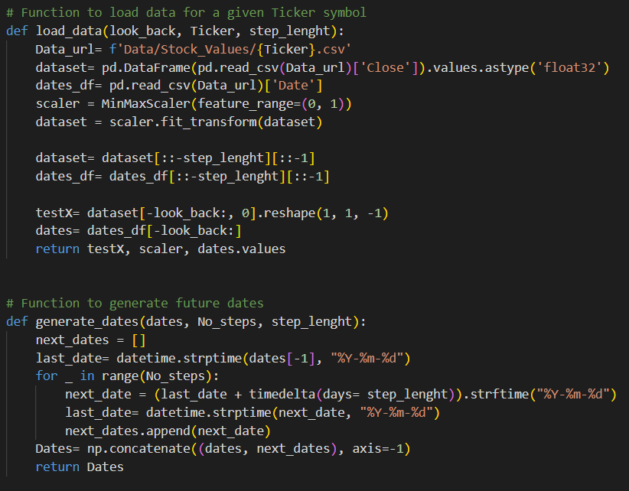
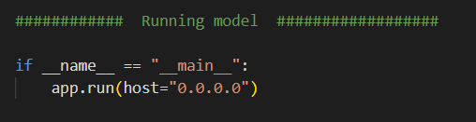
Model Deployment Script

Slide 18
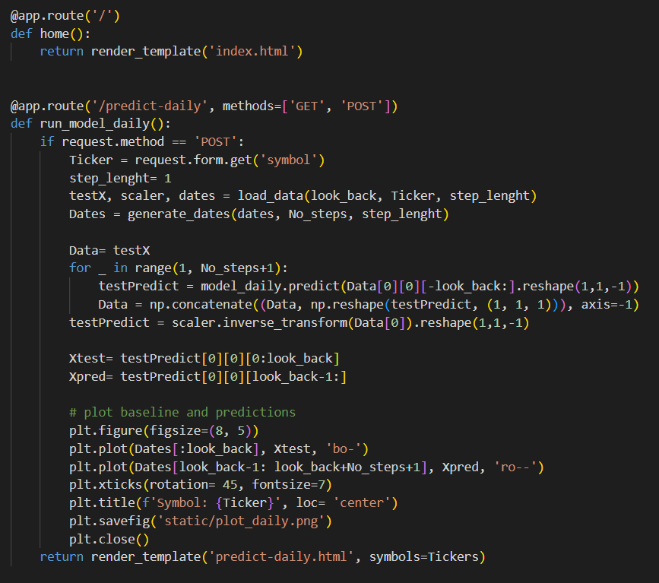
Model Deployment Flask

Slide 19
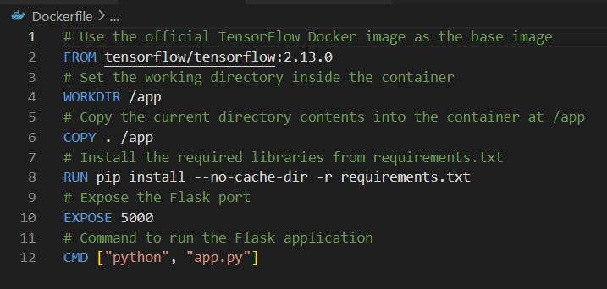
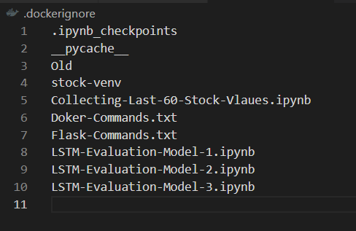
Model Deployment Docker

Slide 20
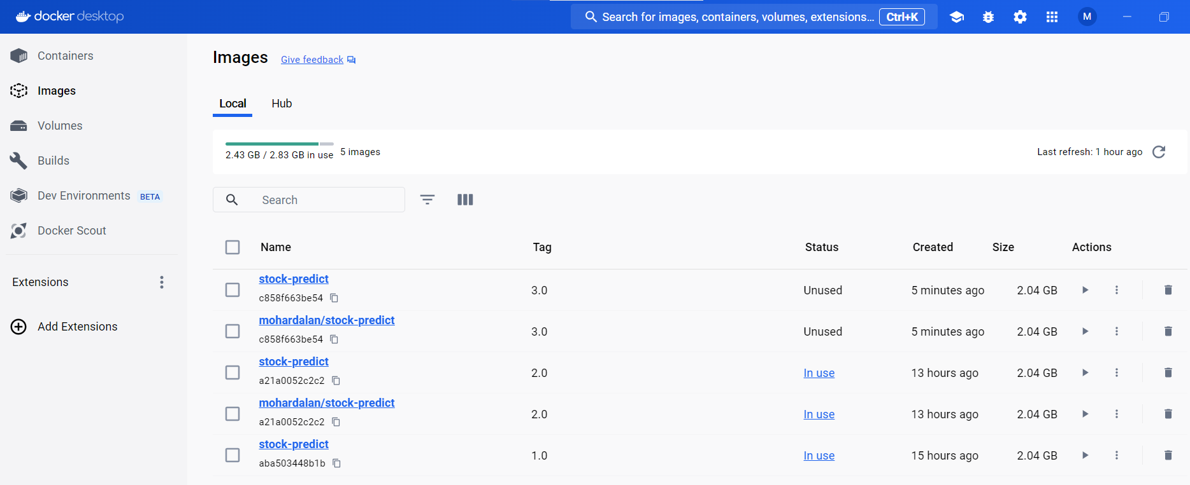
Model Deployment Docker

Slide 21
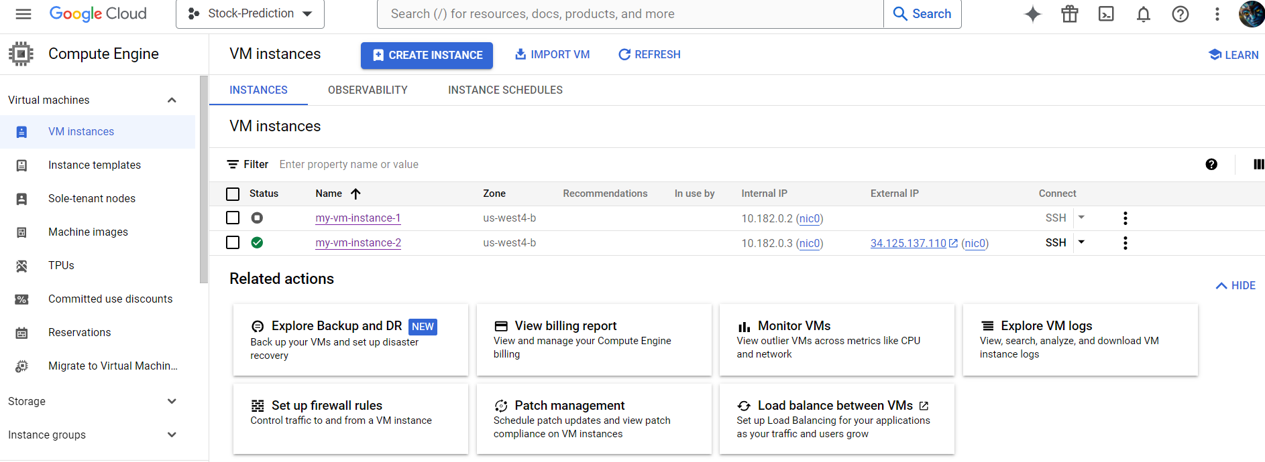
Model Deployment Host in cloud

Slide 22
Challenges & Issues
Docker base image conflicts:
Using official TensorFlow Docker image:
FROM python:3.8.10 → FROM tensorflow/tensorflow:2.13.0
Docker version conflicts:
tensorflow/tensorflow:latest → tensorflow/tensorflow:2.13.0
flask==2.2.5

Slide 23


Slide 24


