Slide 1

SMaRT MUNICIPAL CORPoRATION SYSTEM

Slide 2

CONTENT
Problem Statement
Solution
Important Use Cases
Scope

Slide 3
PROBLEM STATEMENT
In day to day life, Citizens face lots of problems like Electricity failure, Water Supply Failure or Construction/Road related issues
For every issue, they need to visit the Municipal office to register the complaint which takes efforts and time
The registered complaints also need to be followed up by visiting the Municipal office
The manually registered complaints are tough to keep track off for the resolution
A Smart System is required to provide an efficient solution

Slide 4


SOLUTION
Registering the complaints from citizens online
Assigning the complaints to correct organizations
Processing the similar public requests and assigning single to the engineer
Notifying engineers for the public requests assigned to them with location
Escalating the requests pending for longer time

Slide 5
APPROACH
Register Citizens and authenticate using OTP sent to mobile numbers
Accept work requests from citizens which can fall in personal and public category
Assign requests to specific municipal corporation department based on the nearest employee available in particular area
Organization employee gets notification on phone about work request and exact location
Fix the request and notify the citizen

Slide 6
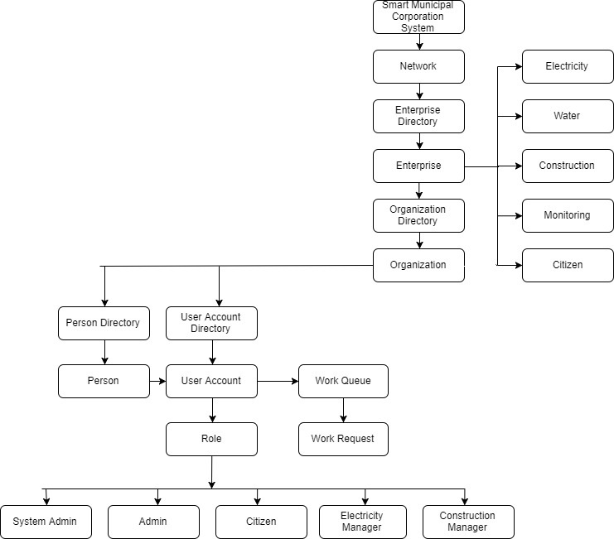
OBJECT MODEL

Slide 7
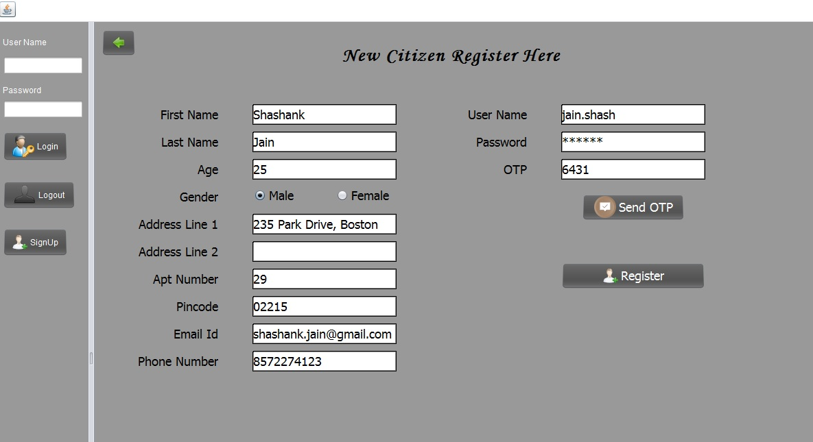
USE CASE 1
Register Citizen and authenticate using OTP sent to the Unique mobile number

Slide 8
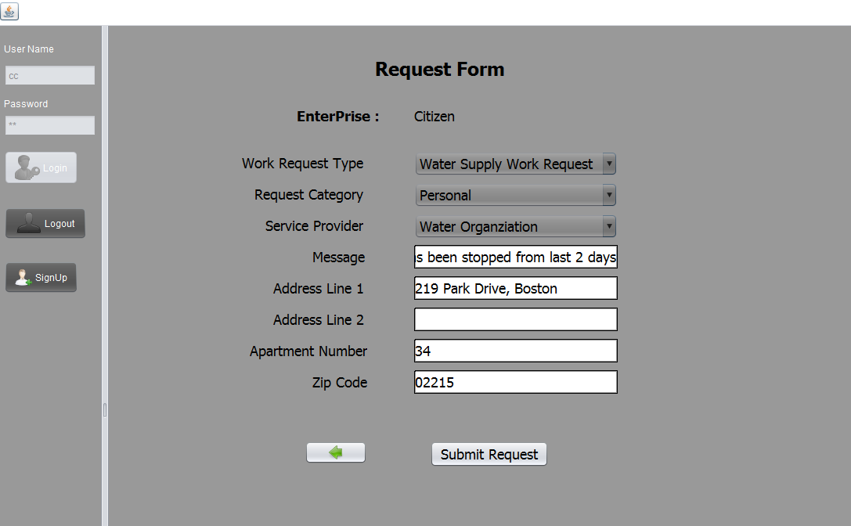
USE CASE 2
Registered Citizens creates request as per the request type and service provider. The public and private requests goes to different organizations.

Slide 9
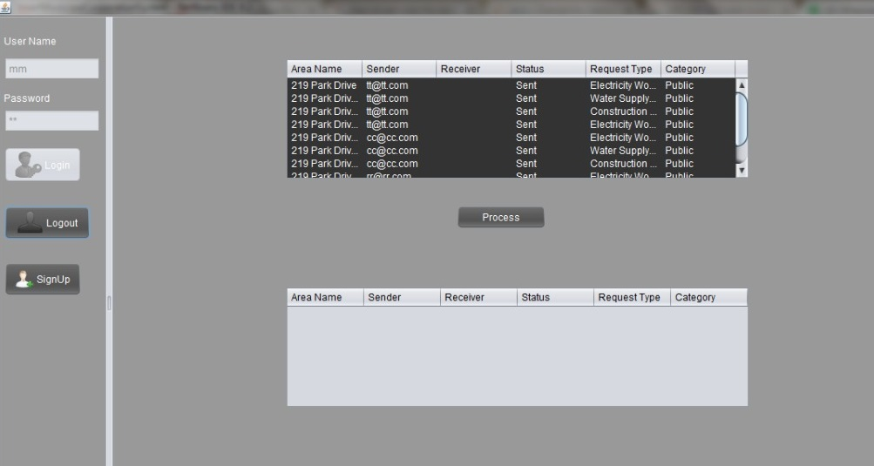
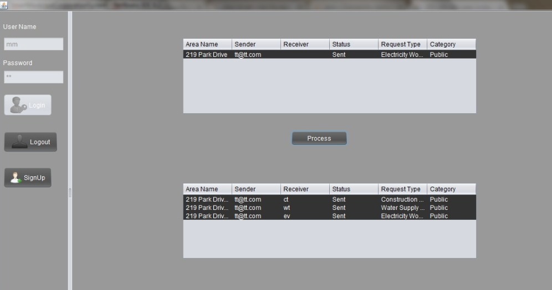
USE CASE 3
Similar public requests are processed to a create single request and assigned to engineer

Slide 10
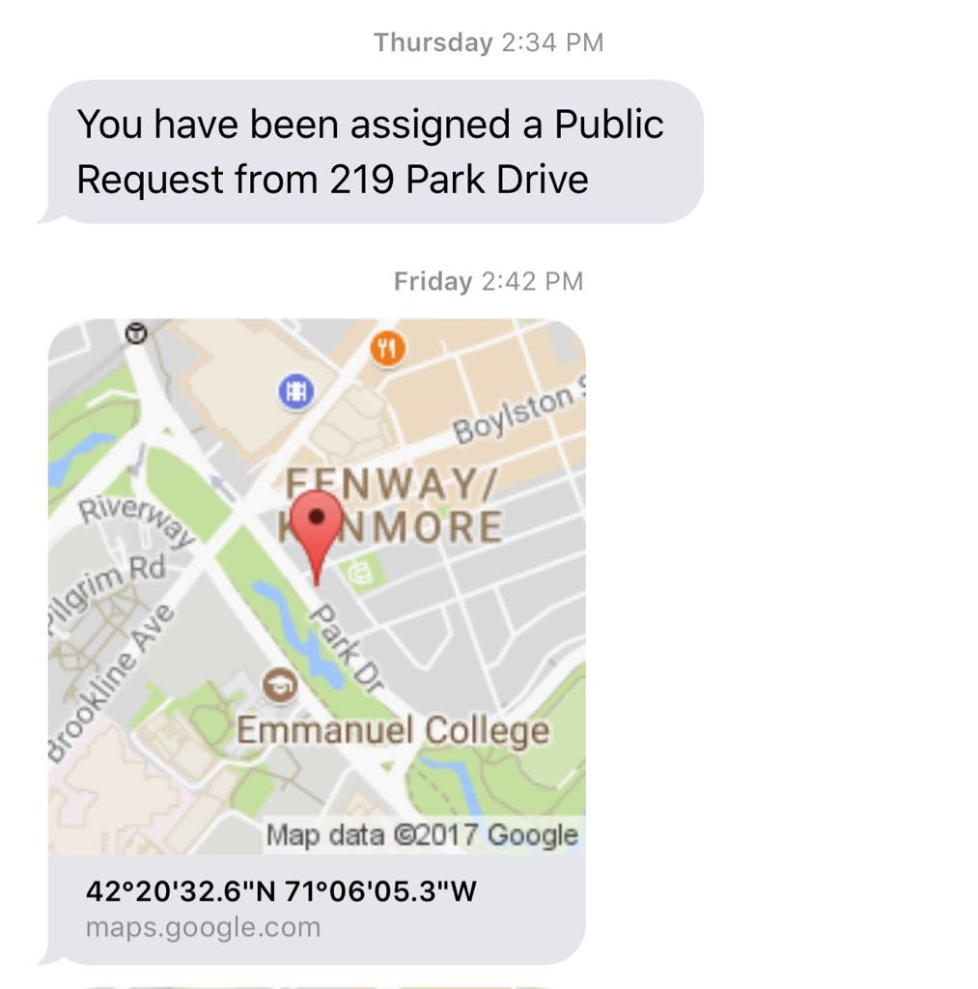
USE CASE 4
The engineer will get a notification containing address and the location of the complaint assigned to him with theGoogle GeoCoding

Slide 11
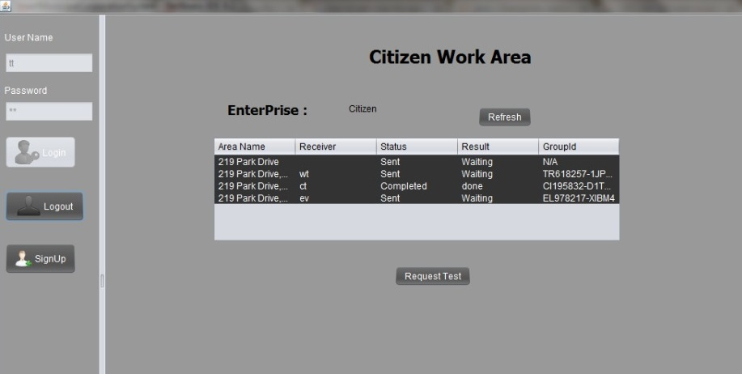
USE CASE 5
The completed public request will be updated for all the Citizens requesting same

Slide 12
USE CASE 6
All the processed and pending complaints will be visualized for the tracking purpose

Slide 13


SCOPE
Registering, resolving and notifying complaints become easier and takes less time and efforts
SMCS can be applied to any Municipal Corporation and it will simplify the way Municipals work now

Slide 14
THANK YOU
Mohit arya
Amogh chakkarwar
Harshal girme

