Slide 1
Stereo-Depth-Map-Reconstruction
Name: Saja Khalid Nima
Third Stage
N

Slide 2
Slide 2: What is Stereo Vision
Definition: The process of extracting 3D information from a pair of 2D images.• The Inspiration: It mimics Human Binocular Vision, where the brain merges two slightly different views from our eyes to perceive depth.• Outcome: A Depth Map, where each pixel represents the distance from the camera to the object.

Slide 3
Slide 3: Basic principles &Geometry
🛠️• Epipolar Geometry: The geometric relationship between two cameras.• Baseline (B): The horizontal distance between the two camera centers.• Focal Length (f): The distance between the lens and the image sensor.• Disparity (d): The shift in the position of an object between the left and right images.

Slide 4
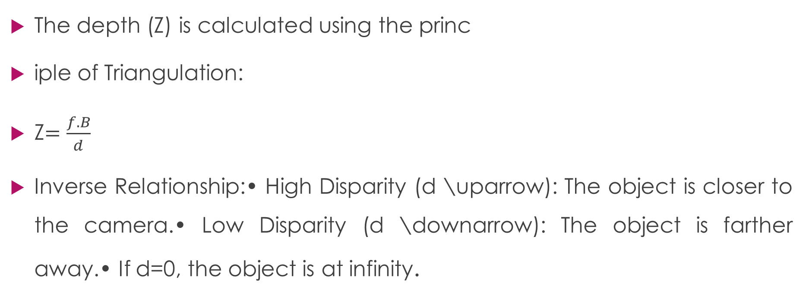
Slide 4: The Marhematical Formula
The depth (Z) is calculated using the princ
iple of Triangulation:
Z$=\frac{f.B}{d}$
Inverse Relationship:• High Disparity (d \uparrow): The object is closer to the camera.• Low Disparity (d \downarrow): The object is farther away.• If d=0, the object is at infinity.

Slide 5
Slide 5: The Reconstruction Pipeline
1. Calibration: Correcting lens distortions (making sure straight lines look straight).2. Rectification: Aligning the images so that matching points lie on the same horizontal row.3. Stereo Matching: Searching for corresponding pixels (finding "where did this pixel go in the other image?").4. Depth Map Generation: Applying the math to create the final 3D representation.

Slide 6
Slide 6 : Stereo Matching Algorithms
Local Methods (Block Matching):• Simple and fast.• Compares small square windows of pixels.• Global Methods (SGM - Semi-Global Matching):• More accurate and robust.• Considers the entire image to maintain consistency.• Deep Learning (AI):• Uses Neural Networks (e.g., PSMNet) to "guess" depth in difficult areas.

Slide 7
Slide 7: Challenges in the Real Word
• Textureless Areas: It's hard to match pixels on a plain white wall or a clear sky.• Occlusions: When an object is visible to the left camera but blocked for the right one.• Reflections: Glass and mirrors confuse the matching logic.• Lighting Changes: Different brightness levels between the two cameras.

Slide 8
Slide 8: Applications
Self-Driving Cars: To detect pedestrians and obstacles.• Robotics: For "Pick and Place" tasks in factories.• Drones: For autonomous navigation and crash avoidance.• Medical Imaging: For 3D reconstruction of organs during surgery.

Slide 9
Slide 9: Conclusion
• Stereo Depth Reconstruction is the "Eyes" of modern AI.• While it has challenges, combining it with AI/Deep Learning is making it faster and more reliable than ever.• The Future: Moving towards real-time, high-definition 3D mapping for every device.

Slide 10
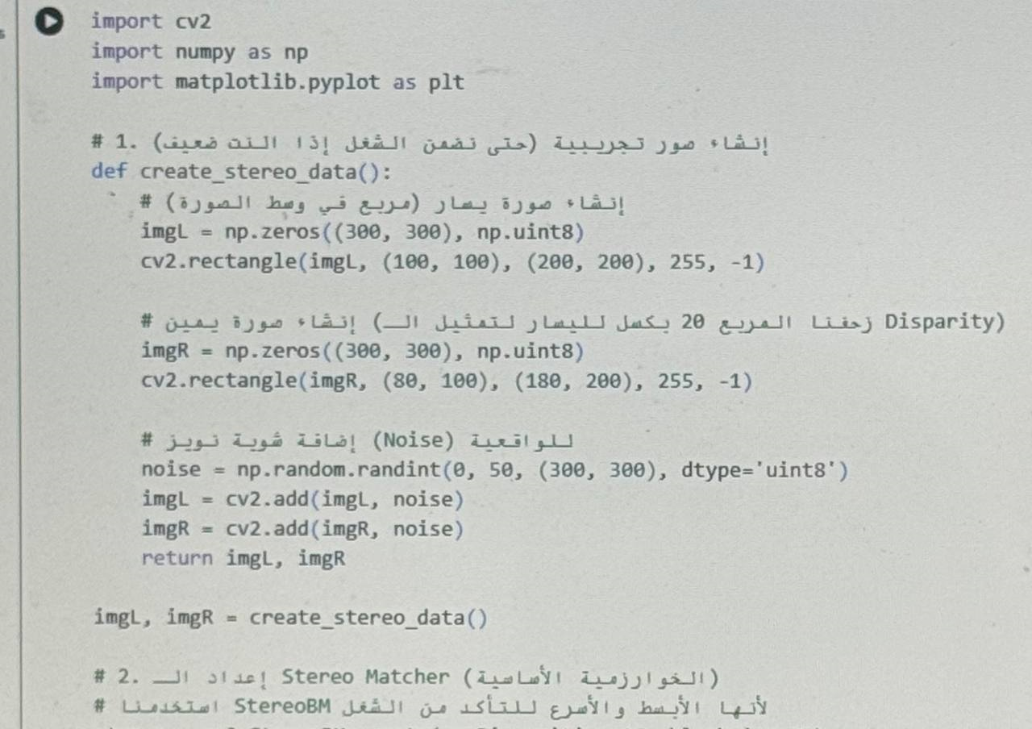

Slide 11
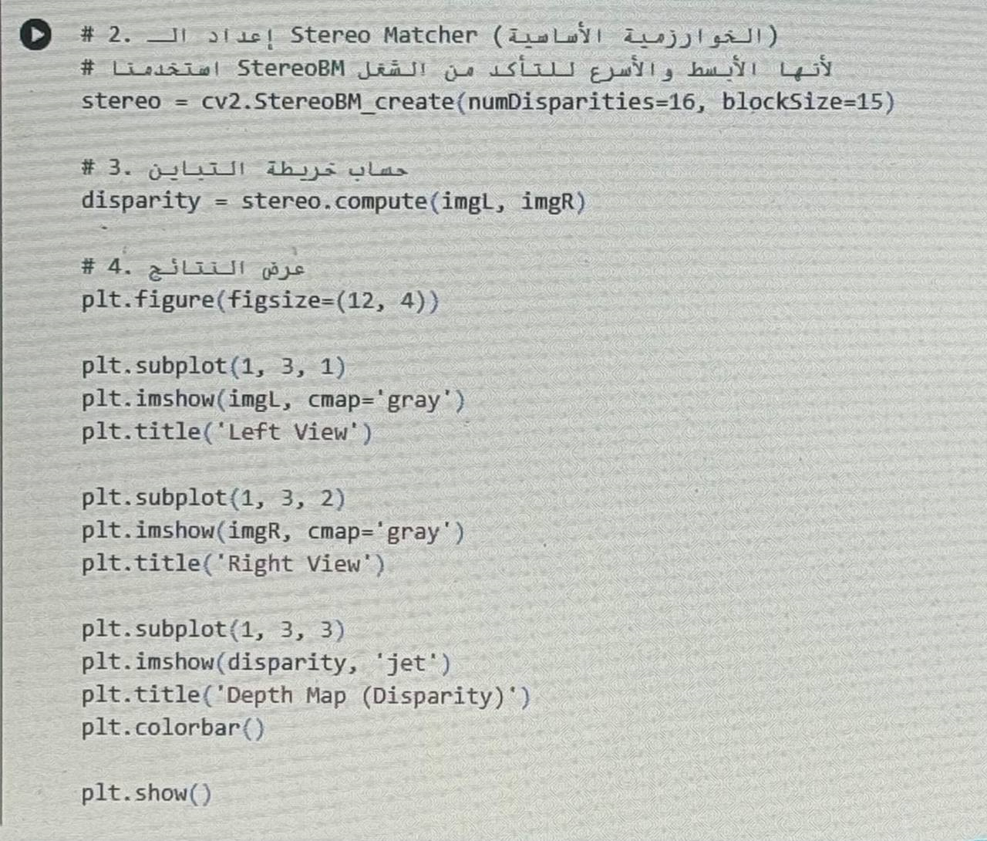

Slide 12
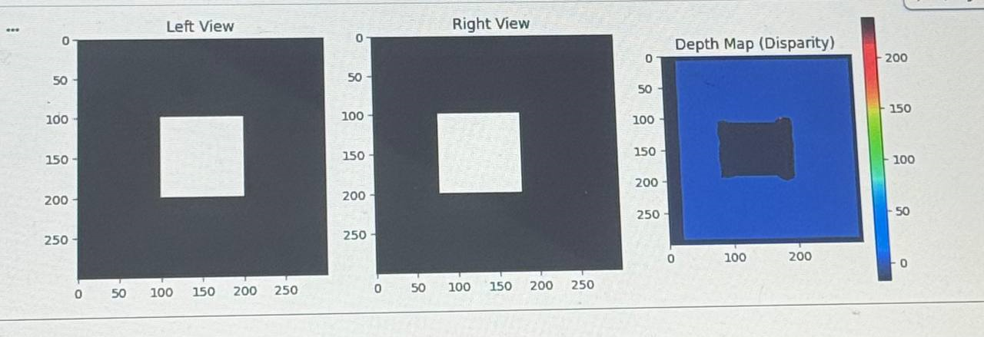

Slide 13
Thank you
If you have any questions, I’d be happy to answer
https://github.com/mohasaja1993/Stereo-Depth-Map-Reconstruction-.git

