Slide 1
PPT
Machine learning for web content Classification
.QA use case for registered domains web content classification
By Mohaseenkhan Chinwal

Slide 2
Table of contents
Brief overview.
Use case details as per Data science Life Cycle.
Business Understanding.
Data Collection.
Data preparation.
Exploratory Data analysis.
Modeling.
Model Evaluation.
Model Deployment.
Scope of improvement.
Use case work flow.
Q/A.

Slide 3
The Big picture
Problem Statement : Classification of web content of .QA registry domains in terms of business and non-business content.
Solution: Building a mechanism to predict the probability of a website being hosted for either commercial or non commercial purpose.
Expected Outcome: Study of domain usage patterns by the domain owners, analyzing the gaps between Registry-Registrar model and consumers in terms of domain registration and its use.
Usage: The problem statement can be expanded (sub-scaled) on the classification front, which can be derived from the web content.
1

Slide 4
Overview of underlying technologies
Business Understanding
Data Science
Artificial Intelligence
Model Deployment
Data Collection
Big Data
Machine learning
Data Science Life Cycle
Data Analysis
Model Evaluation
Data Preparation
Deep learning
Modelling
Exploratory Data analysis
2

Slide 5
Machine learning is branch of AI which deals with teaching machines to learn from experiences based on training them in terms of data. There are various types of machine learning techniques such as supervised, unsupervised reinforcement and deep learning.
Supervised learning.
unsupervised learning.
Reinforcement.
Deep Learning
Machine Learning
Supervised Learning
Unsupervised Learning
Reinforcement Learning
Deep Learning
3

Slide 6
Business Understanding:
DNS registry actively registered domain web-content sites segregation in terms of defined category
by the business.
Domain owners are encouraged/motivated/requested to use .com.qa for business use.
Websites hosted for commercial purposes under .qa needed to be approximated for further study.
This study helps us to enhance our process to reverse this trend.
Data Collection:
Data was collected from various sources like data world, Kaggle and Data network, which has websites url lists segregated in various categories.
A pre-classified data from these sources was used
Category (Labelled dependent value) | Text Content(Independent value)
Class_1(Commercial ) (1) | Business and Industry. Finance. Shopping.
Class_2(Non-Commercial) (0) | Home and garden. Law and government. People and society. Pets.
4

Slide 7
Data Preparation
Web scraping to collect text content of home page of websites.
Removal of special characters, stop words, tokenizing words and letters case normalization.
Stemming words using Lancaster algorithm
Creating training dataset manually with keywords based segregation.
ID | URL | Strings
1 | https://www.6sqft.com | What you need to know about Columbus Day an...
2 | https://www.aerofarms.com | The Future of Farming? No Sun, No Soil, But...
3 | https://www.durrell.org | Membership Cafes Latest Rewilding Islands M...
ID | URL | Strings | Class_1 | Class_2 | Word match count | Category
1 | https://www.6sqft.com | real estate trends Greenpoint….. | 80.0 | 20.0 | 10 | Class_1
2 | https://www.aerofarms.com | The Future of Farming?.... | 100.0 | 0.0 | 12 | Class_1
3 | https://www.durrell.org | Membership Cafes Latest Rewilding…. | 13.8 | 86.111 | 36 | Class_2
5

Slide 8
Exploratory data analysis
Less Keywords Run1
More Keywords Run2
Most Keywords Run3
 | Class_1 | Class_2 | Total_matches
count | 4540.0 | 4540.0 | 4540.0
mean | 26.43 | 12.97 | 11.63
std | 37.62 | 24.51 | 26.71
min | 0.0 | 0.0 | 0.0
25% | 0.0 | 0.0 | 0.0
50% | 0.0 | 0.0 | 0.0
75% | 60.0 | 16.6 | 11.0
 | Class_1 | Class_2 | Total_matches
count | 4540.0 | 4540.0 | 4540.0
mean | 23.29 | 17.59 | 13.97
std | 34.34 | 29.03 | 33.41
min | 0.0 | 0.0 | 0.0
25% | 0.0 | 0.0 | 0.0
50% | 0.0 | 0.0 | 0.0
75% | 50.0 | 30.0 | 13.0
 | Class_1 | Class_2 | Total_matches
count | 4576.0 | 4576.0 | 4576.0
mean | 22.5 | 19.09 | 16.07
std | 33.4 | 30.33 | 40.40
min | 0.0 | 0.0 | 0.0
25% | 0.0 | 0.0 | 0.0
50% | 0.0 | 0.0 | 0.0
75% | 46.26 | 35.08 | 15.0
Classes | Count
Class_1 | 1349
Class_2 | 438
Classes | Count
Class_1 | 1149
Class_2 | 705
Classes | Count
Class_1 | 1089
Class_2 | 782
6

Slide 9
Exploratory data analysis
 | Class_1 | Class_2 | Total_matches
mean | 26.43 | 12.97 | 11.63
std | 37.62 | 24.51 | 26.71
75% | 60 | 16.6 | 11
 | Class_1 | Class_2 | Total_matches
mean | 23.29 | 17.59 | 13.97
std | 34.34 | 29.03 | 33.41
75% | 50 | 30 | 13
 | Class_1 | Class_2 | Total_matches
mean | 22.5 | 19.09 | 16.07
std | 33.4 | 30.33 | 40.4
75% | 46.26 | 35.08 | 15
7

Slide 10
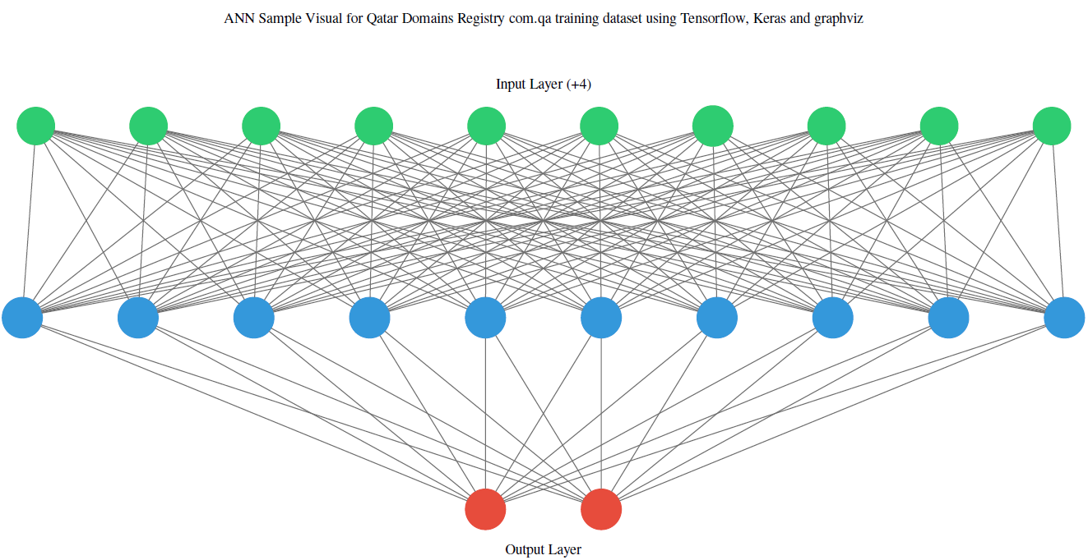
Modelling
The designed models uses bag of words approach to feed data to neural network computations.
Has one hot vector encoding. The inputs layer size equal to the word count of the entire corpus.
It uses five models for aggregation with 10,000 iterations per model.
One hidden layer with 10 neurons. Uses sigma function for squashing and its derivative for correcting weights during back propagation.
8

Slide 11
Model Evaluation
Test No | Model | Training document count | Vocabulary word count | Confusion Matrix | Model accuracy | Test data class samples | Training data split | Test-train-set-overlap
1 | Model 1 | 50 | 5238 | [[ 419 227] [1227 1472]] | 0.5653 | Class 2:646 Class 1:2699 | 25:class1 25:class2 | overlap
2 | Model 2 | 100 | 5759 | [[ 370 276] [ 724 1975]] | 0.7010 | Class2:646 Class1:2699 | 50:class1 50:class2 | overlap
3 | Model 2 | 100 | 5759 | [[ 27 23] [ 17 102]] | 0.7633 | Class2:50 Class1:119 | 50:class1 50:class2 | distinct
4 | Model 3 | 15678 | 61933 | [[ 0 50] [ 0 119]] | 0.7041 | Class2:50 Class1:119 | No split | distinct
5 | Model 4 | 1450 | 51894 | [[23 13] [82 58]] | 0.46 | Class2:36 Class1:140 | 725:class1 725:class2 | distinct
9

Slide 12
Scope of improvement
Use of reliable and accurate training data generation methods.
Use of large training data in effective way to generalize the results of the model.
Widening the scope of categories from dual to multiple labels.
Use of better data encoding algorithms.
Redesigning and Tuning ANN parameters.
Use of better data parsing and cleansing techniques.
10

Slide 13
Use case work flow:
Start
Evaluate model accuracy with split test(overlap) and independent test(distinct) data
Gather and Prepare data
Build keyword based Training data
Split data set with training and test sets
Train Model with training dataset
Accuracy > 75
No
Yes
Keep the dataset for generalization for future trainings
End
11

Slide 14
Web data extraction: (Stage 1) (prepare training data set)
The first part reads from list of domains, downloads the html content from its URL and extracts the text content of each domain which only contain English words.
Outcome of this process to get the URL (domain name) links and associated web site home page text based keywords.
Output:
12

Slide 15
Data classification: (Stage 2) (prepare training data set)
The second part takes the input from the previous module compares them with the predefined words and calculates the percentage of words falling into different data class. Outcome of this process is to get the url(domain name) and number of matching keywords in each class its percentages.
The domains are allocated to a particular category (class_1,class_2 and none).
Output:
13

Slide 16
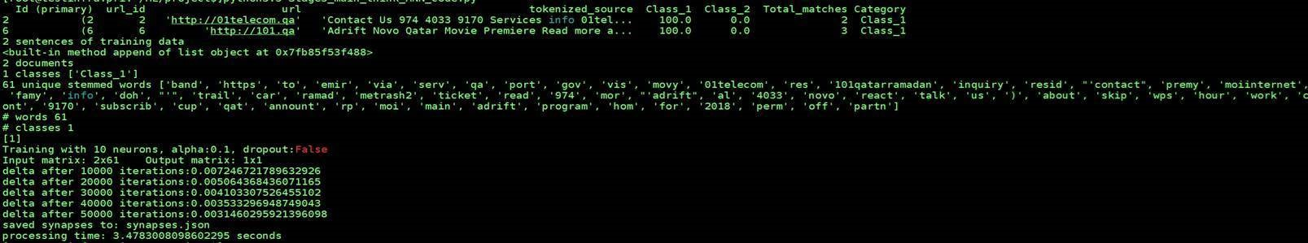
Producing training data set, running the training data on artificial neural network algorithm and writing the predicted numerical values on a file (synpase). (Stage 3) (train the model with training data set)
The is third part, uses the category , domains and text contents. The website text data relating to all domains in the list is broken-down into a word list.
The word list is converted into numerical notations for ANN(Artificial Neural Network) to work.
The next parts follows the mathematics needed to build the model, train it and write its predictions. Such as sigmoid, its derivative , data cleansing, think and activation functions.
Training of the model with training dataset happens in this part.
ANN algorithm starts learning with data given to which was manually produced in data classification and starts writing its learning to a synapse file. ( Acts its memory to apply its learning to production dataset in our case .qa domain list websites)
Output:
14

Slide 17
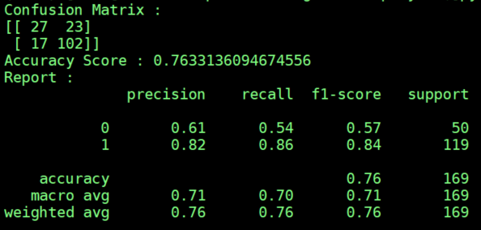
With the production dataset(actual data whom we need to classify) we use stage1 and stage2 to generate the classification data(data in a format used by the ANN algo).
Then we use stage4 to make predictions using the model on production dataset which is already trained on large data set in stage 3. (The accuracy of model completely depends on abundance of training data and text extraction from the web content)
Output:
15

Slide 18
Q/A

Slide 19
THANK YOU

