Slide 1
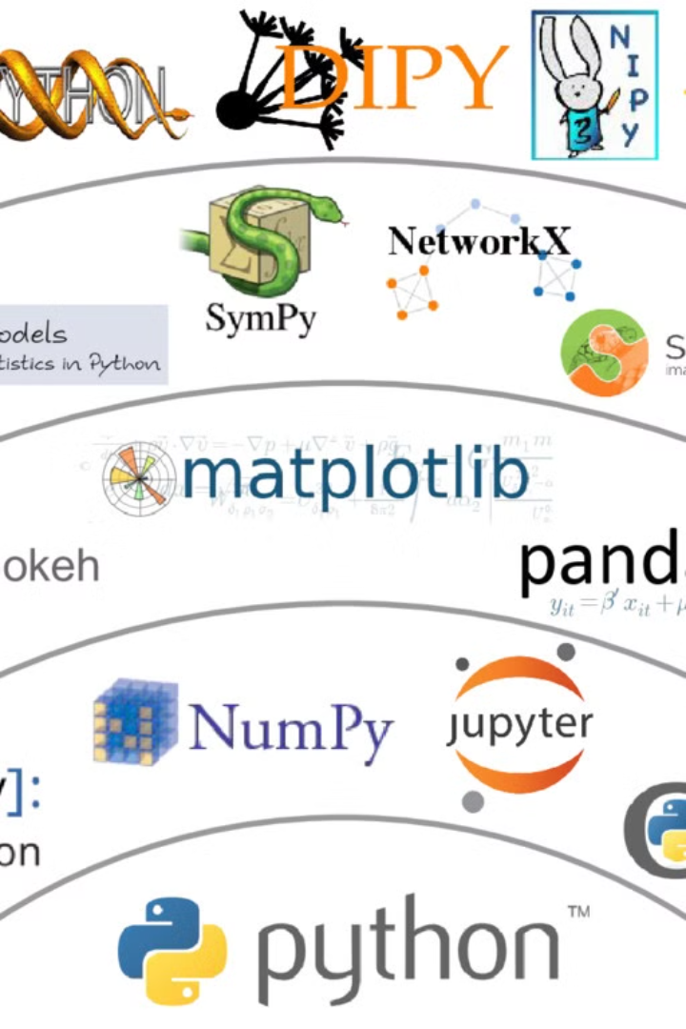

Introduction to Numpy, Pandas, and Scikit-learn
Numpy, Pandas, and Scikit-learn are essential libraries for data analysis and machine learning in Python. They provide powerful tools for handling data, performing mathematical operations, and implementing machine learning algorithms.

Slide 2
Features and Capabilities of Numpy
Efficient Data Manipulation
Broad Range of Mathematical Functions
Numpy enables fast and efficient manipulation of large, multi-dimensional arrays and matrices, making it ideal for scientific and numerical computing.
It provides a wide range of mathematical functions, including linear algebra, statistics, and Fourier analysis, that are essential for data analysis and modeling.

Slide 3
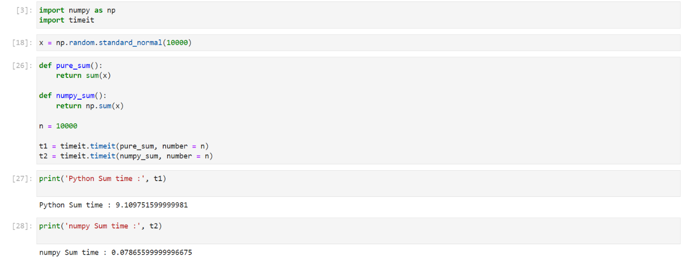
Speed example :

Slide 4
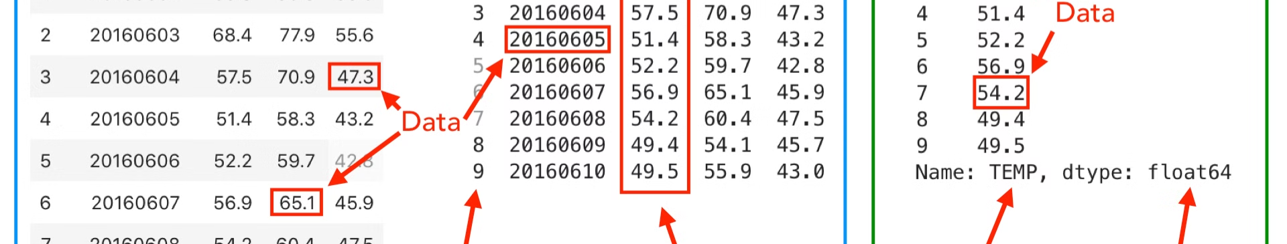
Features and Capabilities of Pandas
1
Data Alignment and Handling
2
Time Series Analysis
Pandas simplifies data alignment, handles missing data, and offers robust data manipulation tools, such as filtering, grouping, and pivoting.
It provides extensive capabilities for working with time series data, making it convenient for tasks like data aggregation, windowing, and statistical analysis over time.

Slide 5
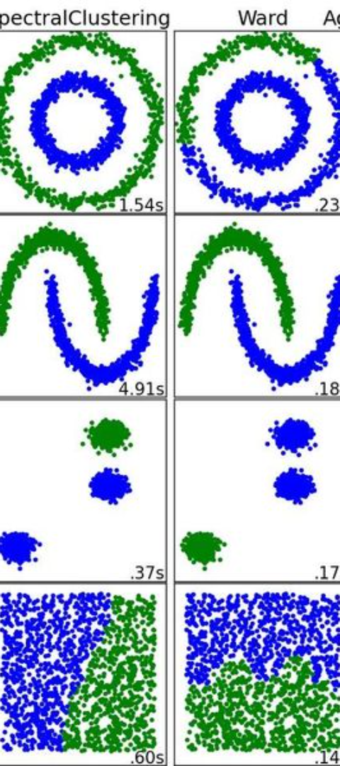
Features and Capabilities of Scikit-learn
Robust Machine Learning Algorithms
Model Selection and Evaluation
It provides tools for model selection and evaluation, cross-validation, and hyperparameter tuning to build and optimize predictive models.
Scikit-learn offers a wide range of machine learning algorithms, including classification, regression, clustering, and dimensionality reduction techniques.

Slide 6
Scikit-learn map :

Slide 7
Use Cases and Applications of Numpy, Pandas, and Scikit-learn
10K
7
Data Analysis Projects
Machine Learning Applications

Slide 8
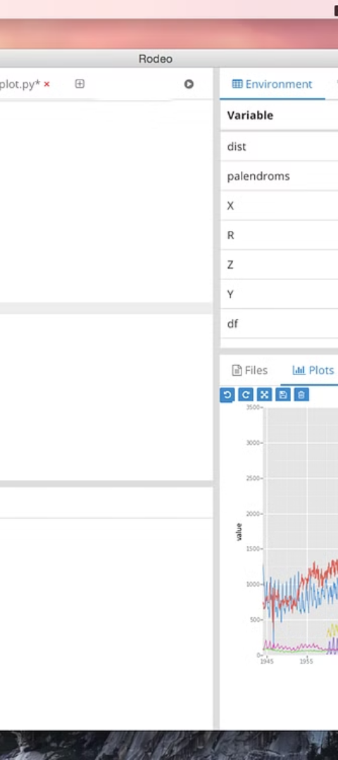
Benefits of Using these Libraries in Data Analysis and Machine Learning
1
Streamlined Workflow
Numpy, Pandas, and Scikit-learn streamline the entire data analysis and machine learning workflow from data preprocessing to model deployment.
2
Reuseable Codebase
They enable the development of reusable code for data processing, model training, and deployment, reducing development time and effort.

Slide 9
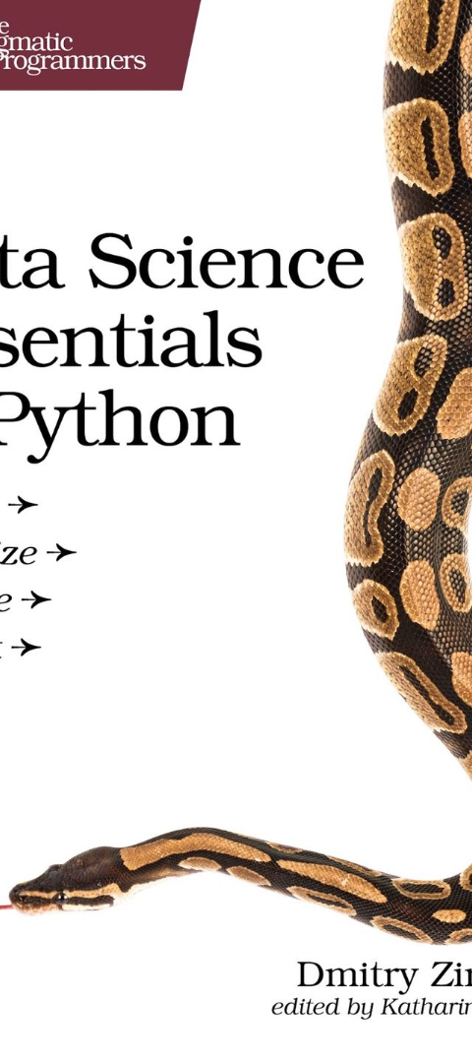



Resources and Documentation for Learning Numpy, Pandas, and Scikit-learn
Official Documentation
Each library provides comprehensive official documentation with examples, tutorials, and API references.
Community Forums
Engage with the community through forums, discussion groups, and social media channels to seek help and contribute to discussions.
Chatgpt
Discuss with AI to make AI.

Slide 10
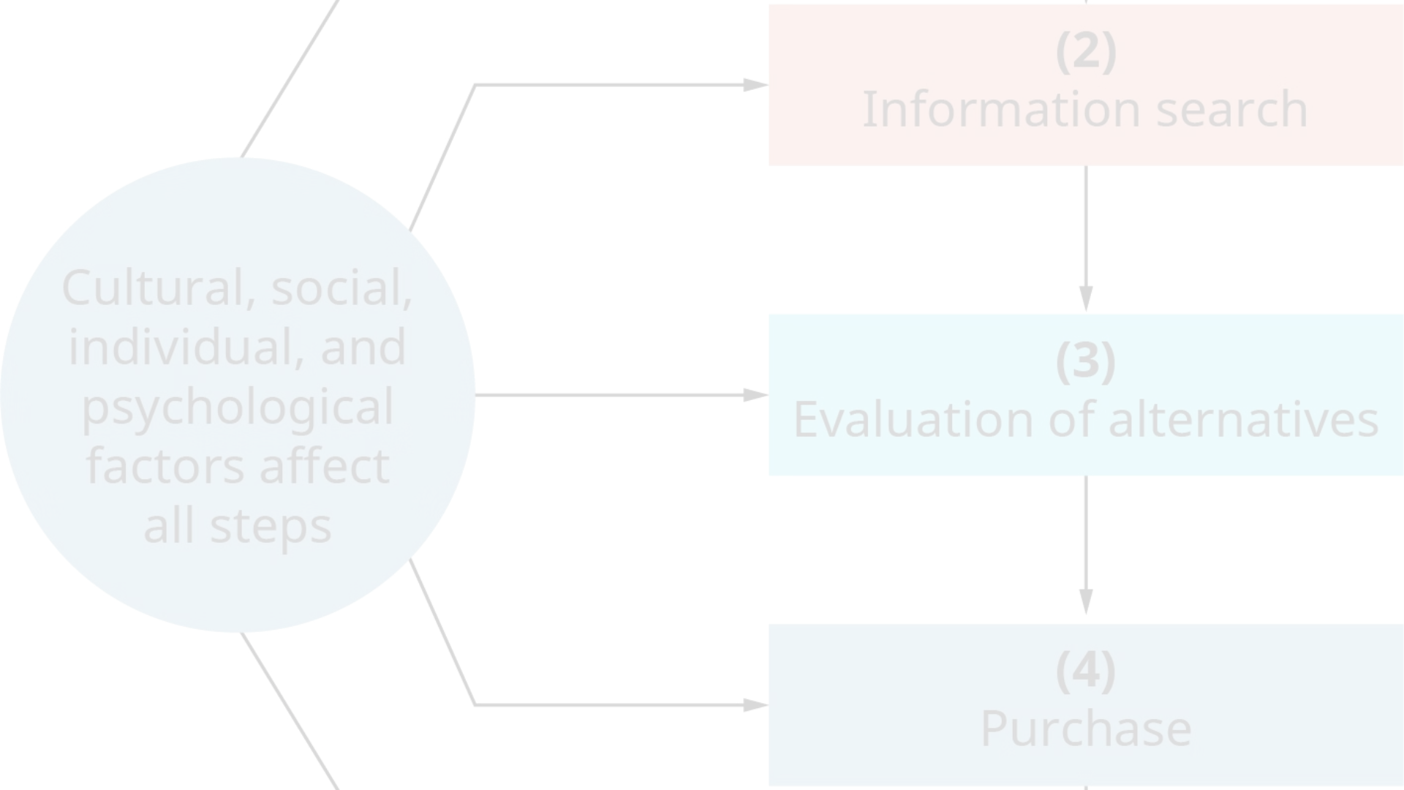
Conclusion and Next Steps
Understanding Numpy, Pandas, and Scikit-learn is crucial for anyone entering the field of data science and machine learning. By leveraging these libraries, professionals can build powerful solutions for complex real-world problems while continuously enhancing their skills and knowledge.

