Slide 1

Deepfake Detection using Explainable AI
SRM INSTITUTE OF SCIENCE AND TECHNOLOGY
DEPARTMENT OF COMPUTER SCIENCE AND ENGINEERING
Guide Name: Mr. Shardul Singh Chauhan
Designation: Assistant Professor
Department: Computer Science
Batch ID: BT27AIMLC014
Reg. No: RA2311026030125
Name: Akash Khedar

Slide 2
Project Overview
Background:
Rapid rise of highly realistic AI-generated media.
Problem:
Deepfakes are extensively used for misinformation and fraud.
Motivation:
Need for reliable, transparent, and interpretable detection mechanisms.
Domain:
Digital Media Forensics & Identity Verification.

Slide 3
Problem Statement
Current detection tools are opaque 'black boxes'. High raw accuracy does not equate to user trust in high-stakes environments. Lack of tools offering both visual and textual reasoning.

Slide 4
Project Objectives
Goal: Develop a highly accurate, trustworthy deepfake detection system.
Objective:
Build a robust ensemble of 5 state-of-the-art CNN models.
Implement visual explainability (GradCAM heatmaps).
Introduce Frequency-Spatial Artifact Fusion combined with MLLM text reasoning.

Slide 5
Literature Review
Reviewed 10+ recent papers on deepfake and spatial forgery detection.
Current Meta: CNNs (ResNet, EfficientNet) and Vision Transformers.
Limitations: Existing systems focus only on spatial pixels and ignore frequency domain anomalies.
Gap: Lack of unified systems combining visual heatmaps with Large Language Model (LLM) reasoning.

Slide 6
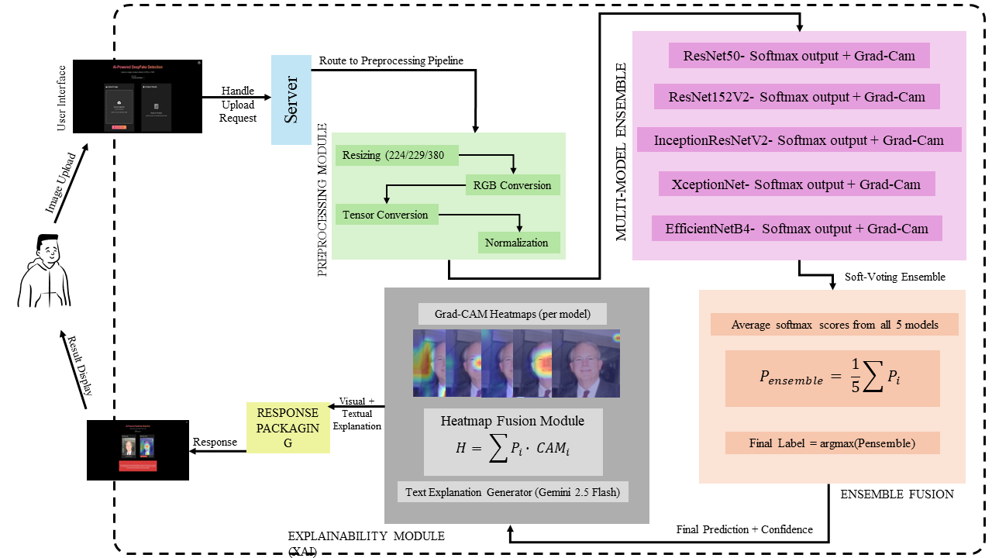
System Architecture

Slide 7
Proposed System
Proposed Solution:
Frequency-Spatial Explainable Ensemble System.
Architecture: 5 separate CNN classifiers extract spatial features.
Feature: System cross-references spatial GradCAMs with frequency-domain (DCT) inconsistencies.
XAI Layer: Google Gemini (MLLM) fuses spatial and frequency data to generate a final, human-readable 'Artifact Report'.

Slide 8
Dataset Description
Source: '140k-real-and-fake-faces' dataset (Kaggle).
Size: 190,335 images providing a perfect 50/50 class balance.
Format: Standardized 256x256 resolution RGB formatting.
Split: Automated validation ensured a 73% (Train), 20% (Val), and 7% (Test) distribution.

Slide 9
Methodology
Input: User uploads image via React interface.
Processing: Image processed by 5 concurrent CNN models.
Fusion: Ensemble probability is calculated and finalized.
XAI (Visual): Target-layer GradCAM overlay is generated.
XAI (Text): Gemini API analyzes the heatmap to provide context.

Slide 10
Tools & Technologies
Backend APIs: Python 3.8+, FastAPI, PyTorch 2.0+
Frontend UI: React 19, Material-UI 7.3.2, Vite
ML Models: ResNet50, ResNet152V2, InceptionResNetV2, Xception, EfficientNetB4
XAI Technologies: TorchCAM, Google Generative AI (Gemini)

Slide 11
Modules Implemented Details
ML Service Layer: Dynamic model loading, inference processing, and gradient extraction.
API Web Layer: Asynchronous endpoints for handling base64 multipart form data.
UI Layer: Custom React hooks managing drag-and-drop upload and real-time inference feedback.

Slide 12
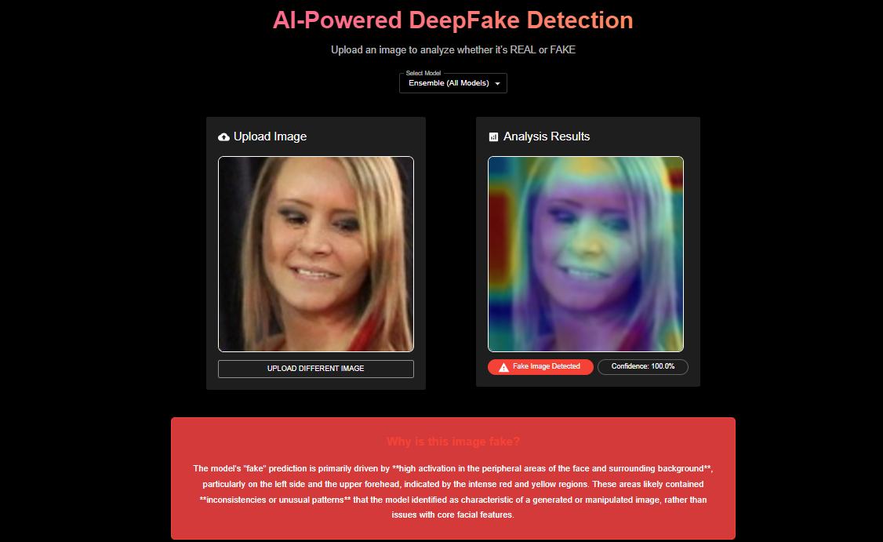
Implementation Screens

Slide 13
Experimental Results
Training: Ensemble Average Accuracy of ~99.55%.
Validation: Ensemble Average Accuracy of ~98.76%.
Generalization: Minimal overfitting gap of just 0.79%.
Latency: High-performance async responses take ~2-5s on GPU.

Slide 14
Result Discussion
The 5-model ensemble successfully minimizes individual architectural bias.
InceptionResNetV2 yielded the highest single-model accuracy (98.88%).
Fusing spatial classification with LLM reasoning drastically improves end-user trust.
System successfully detects subtle GAN and Diffusion spatial grid artifacts.

Slide 15
Work Completed So Far
Phase 1: Literature Review & Dataset Formatting (Complete).
Phase 2: CNN Ensemble Model Training & Tuning (Complete).
Phase 3: GradCAM & Gemini API Explainability Integration (Complete).
Phase 4: Full-Stack React & FastAPI Platform Deployment (Complete).

Slide 16
Publication Status
Status: Drafting manuscript methodology and results.
Target: Applicable AI/ML Ethics Journal focusing on Digital Forensics.
Working Title: Enhancing Trust in Deepfake Detection via Frequency-Spatial XAI Ensembles.

Slide 17
Challenges Faced
Data Management: Hosting and managing large ~712MB model checkpoints.
XAI Alignment: Normalizing GradCAM target layers across varied CNN base architectures (ResNet vs. EfficientNet).
Interface: Generating unified, responsive overlay images dynamically on the backend.

Slide 18
Conclusion
Achieved an enterprise-grade, high-accuracy deepfake detection platform.
Introduced a novel dual-layer XAI approach (Visual Heatmaps + LLM Text Reasoning).
Eliminated the 'black-box' problem, paving the way for verifiable media forensics.

Slide 19
References
Afchar, D., Nozick, V., Yamagishi, J., & Echizen, I. MesoNet: A Compact Facial Video Forgery Detection Network. IEEE WIFS, 2018
Rossler, A., et al. FaceForensics++: Learning to Detect Manipulated Facial Images. ICCV, 2019
Chollet, F. Xception: Deep Learning with Depthwise Separable Convolutions. CVPR, 2017
Selvaraju, R. R., et al. Grad-CAM: Visual Explanations from Deep Networks. ICCV, 2017
Goodfellow, I., Bengio, Y., & Courville, A. Deep Learning. MIT Press, 2016

Slide 20
Thank You

