Slide 1
Graph Theory An Introduction
https://github.com/mohawk2/presentations

Slide 2
Introduction
Things
Connections between things
Not charts

Slide 3
Introduction
Why
What
How (in computing)
Algorithms (why bought ticket)
Resources
Exercises

Slide 4
Why
Network routing (paths)
Social media
Machine learning
Genetics
Software build systems such as make (example of hypergraph)

Slide 5
What
Directed
Undirected
Hypergraphs (both above)

Slide 6
UNEXPECTED MATHS
https://en.wikipedia.org/wiki/Graph_theory

Slide 7
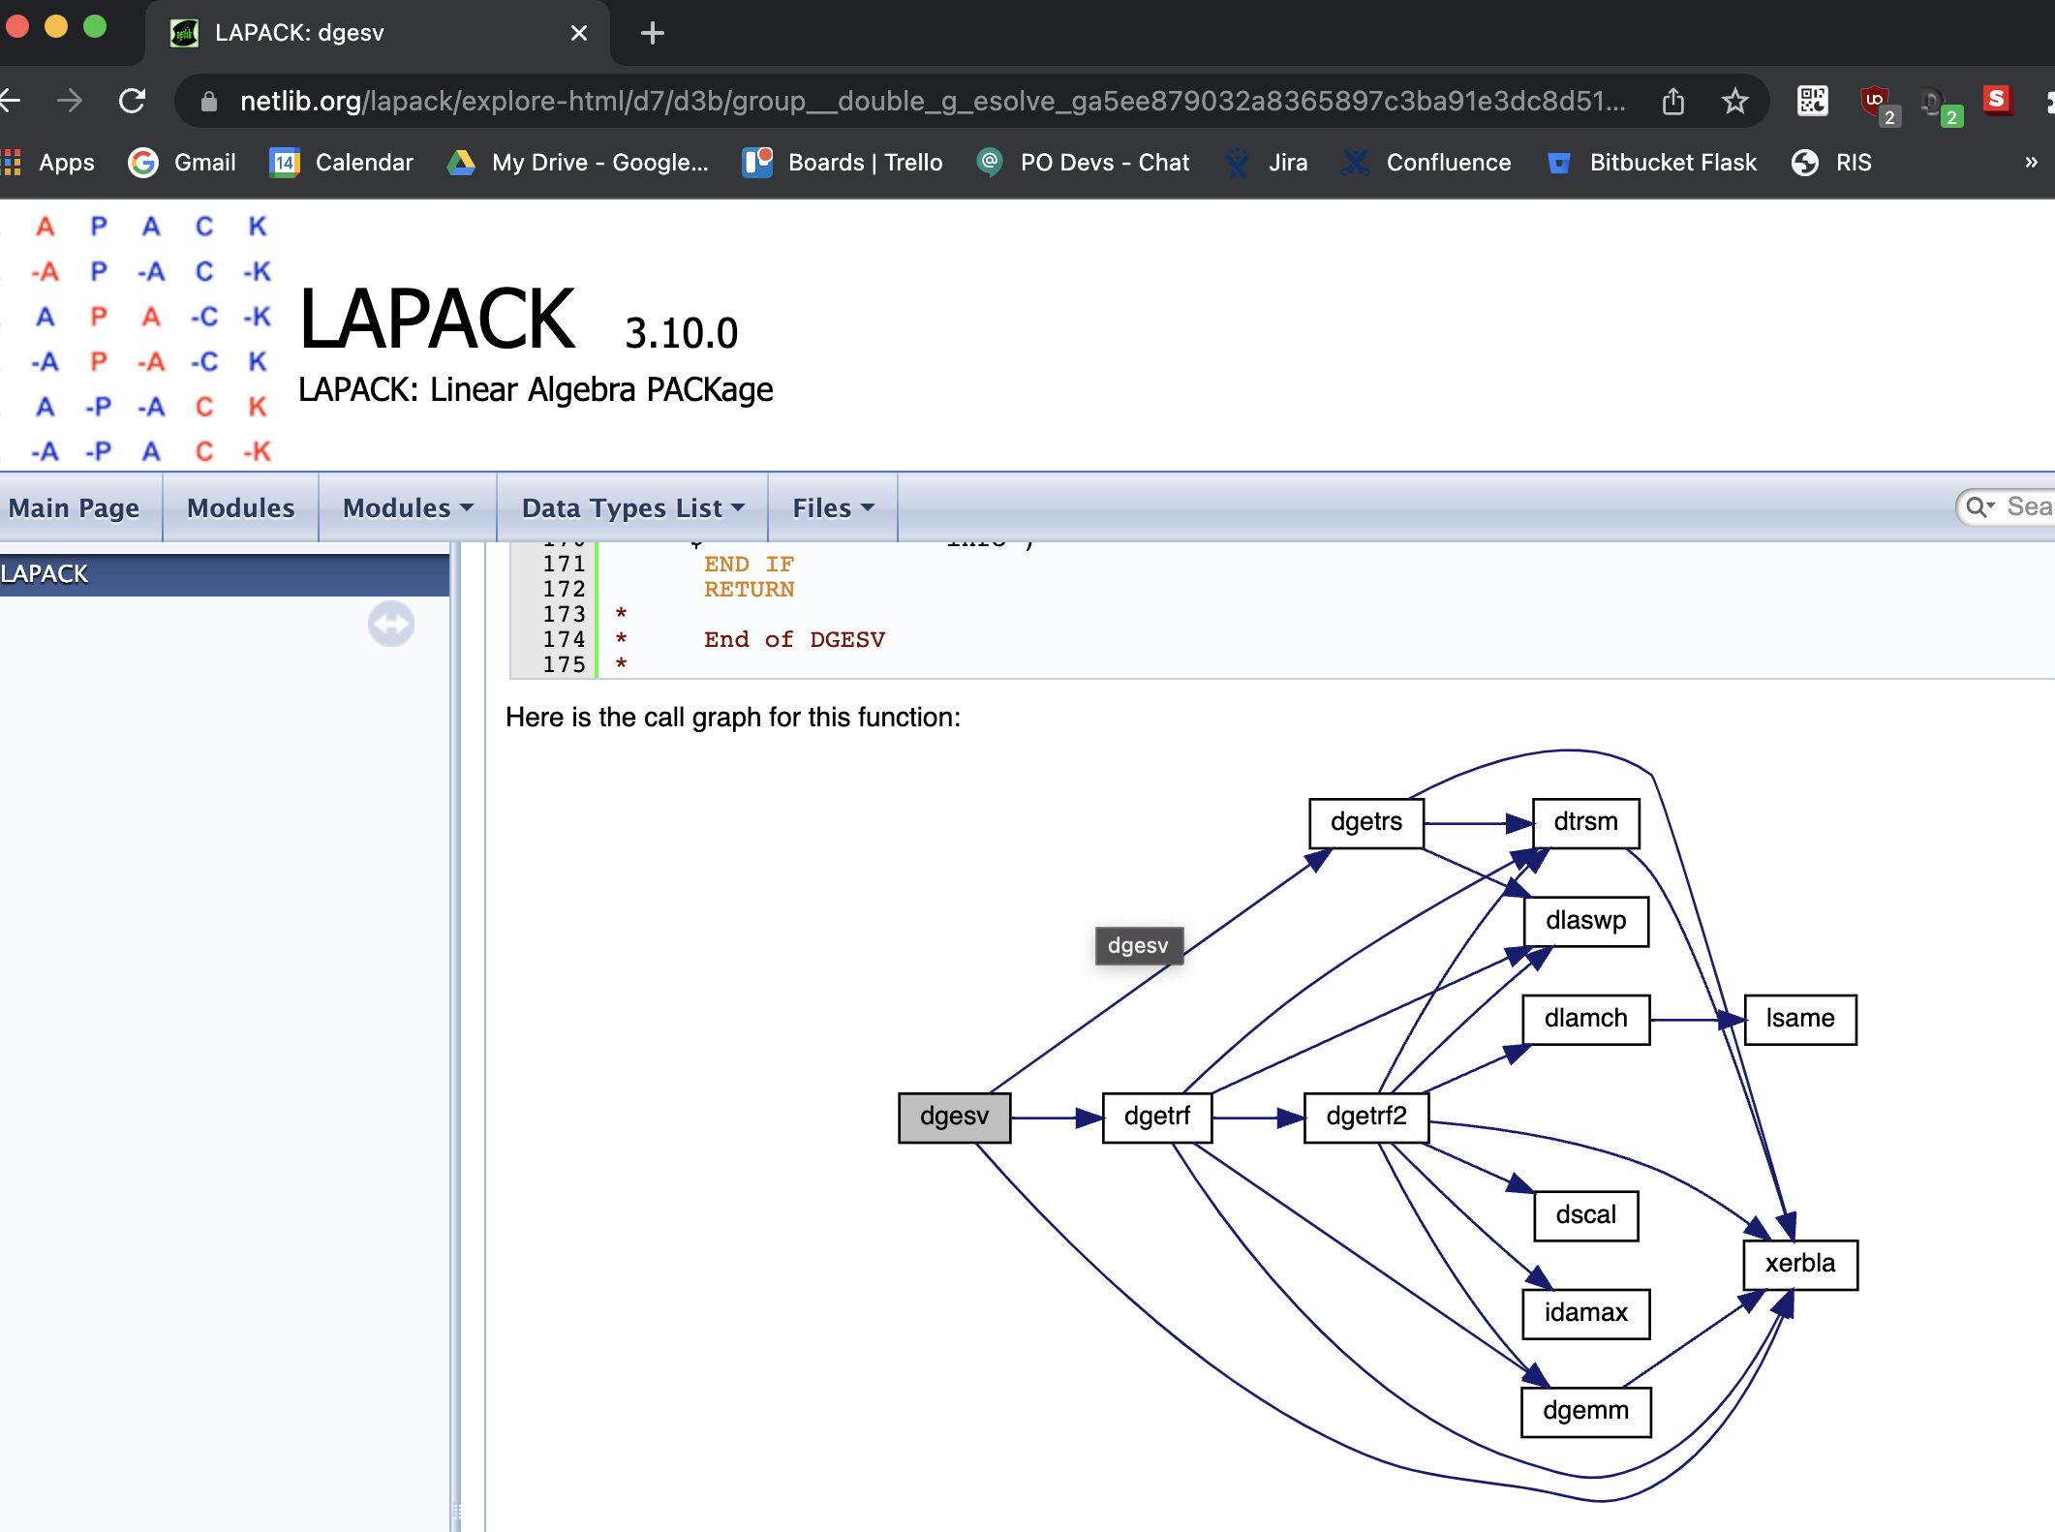
Directed
https://www.netlib.org/lapack/explore-html/d7/d3b/group__double_g_esolve_ga5ee879032a8365897c3ba91e3dc8d512.html
Type to enter a caption.

Slide 8
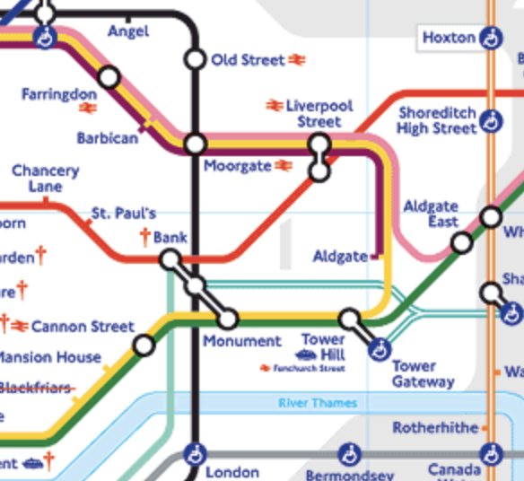
Undirected
Type to enter a caption.

Slide 9
Directed hypergraph
https://gitlab.com/graphviz/graphviz/-/issues/1911

Slide 10
Graph classification
Directed? Cyclic? Multi? Hyper?
Social media
Transport networks
Software build systems

Slide 11
How
Matrix: adjacency (undirected = symmetrical)
Matrix, sparse/hypergraph: incidence
Linked lists of V, E
Dictionary of E

Slide 12
Adjacency matrix
https://en.wikipedia.org/wiki/Adjacency_matrix

Slide 13
Incidence matrix
https://en.wikipedia.org/wiki/Incidence_matrix

Slide 14
Graph as dictionary (pseudocode)
class Graph:
nodes = []
edges = {}
def add_node(v):
nodes.push(v)
def add_edge(v1, v2):
if not v1 in node:
throw(“invalid node {v1}”)
if v2 in nodes:
throw(“invalid node {v2}”)
edges[v1][v2] = 1

Slide 15
Algorithms
Floyd-Warshall
Topological sorting

Slide 16
Floyd-Warshall
let dist be a |V| × |V| array of minimum distances
initialized to ∞ (infinity)
for each edge (u, v) do
dist[u][v] ← w(u, v) // The weight of the edge (u, v)
for each vertex v do
dist[v][v] ← 0
for k from 1 to |V|
for i from 1 to |V|
for j from 1 to |V|
if dist[i][j] > dist[i][k] + dist[k][j]
dist[i][j] ← dist[i][k] + dist[k][j]
end if
https://en.wikipedia.org/wiki/Floyd%E2%80%93Warshall_algorithm
https://metacpan.org/pod/PDL::MATLAB#COMPARISON:-FLOYD-WARSHALL-ALGORITHM

Slide 17
Topological sorting
L ← Empty list that will contain the sorted elements
S ← Set of all nodes with no incoming edge
while S is not empty do
remove a node n from S
add n to L
for each node m with an edge e from n to m do
remove edge e from the graph
if m has no other incoming edges then
insert m into S
if graph has edges then
return error (graph has at least one cycle)
else
return L (a topologically sorted order)
https://en.wikipedia.org/wiki/Topological_sorting

Slide 18
Summary
Graphs: things and connections between things
What, why, how
Algorithms

Slide 19
Resources
https://en.wikipedia.org/wiki/Graph_theory
https://en.wikipedia.org/wiki/Hypergraph
https://graphviz-perl.github.io/
https://github.com/mohawk2/presentations

Slide 20
Questions?

Slide 21
Exercises
Floyd-Warshall
Topological sorting

