Slide 1
Closing the Gaps
Inter-Module Synergy
Ed J (mohawk)
London Perl Workshop 2014

Slide 2
Introduction
Modules: generalities
Example: Inline, ExtUtils::Depends
Slides available on web

Slide 3
Modules
Each encapsulates functionality
Assembly
Interaction

Slide 4
Example: XS support
Writing XS is hard
Writing the build system is hard
Writing XS that uses other XS modules is hard
Why must it be so hard?
WHY?

Slide 5

And... breathe

Slide 6
Gimp-Perl: Before
Has own XS for GIMP C libraries
Uses other XS: Gtk2, PDL
Each had own way of providing build system info (paths etc)
GP build system was “challenging”

Slide 7
Gimp-Perl: Before
my %gimpcfg = ExtUtils::PkgConfig->find("gimp-2.0");
require PDL::Core::Dev;
my $pkg = new ExtUtils::Depends qw(Gimp Gtk2);
$pkg->set_inc(join ' ',
$gimpcfg{"cflags"}, &PDL::Core::Dev::PDL_INCLUDE);
$pkg->set_libs(join('', `$gimptool –libs`));
WriteMakefile($pkg->get_makefile_vars);

Slide 8
Gimp-Perl: Vision
my $pkg = ExtUtils::Depends->new(
qw(Gimp Alien::Gimp Gtk2 PDL));
WriteMakefile($pkg->get_makefile_vars);

Slide 9
Vision: Obstacles
Me understanding EU::D workings
Making PDL support EU::D
Making EU::D support easy
Getting PDL buy-in
Getting EU::D buy-in

Slide 10
ExtUtils::Depends
Previously support was “black box”
$pkg->save_config('Gimp/IFiles.pm');
Now API can conform to
package PDL::Install::Files;
require PDL::Core::Dev;
$inc = &PDL::Core::Dev::PDL_INCLUDE;

Slide 11
Opportunity
PDL uses Inline
Inline use requires PDL boilerplate
Inline doc talks about “with”:
use Inline with => 'Event';
Inline has interface to encapsulate XS build info:
sub Event::Inline { … }
Why not make EU::D work with that

Slide 12
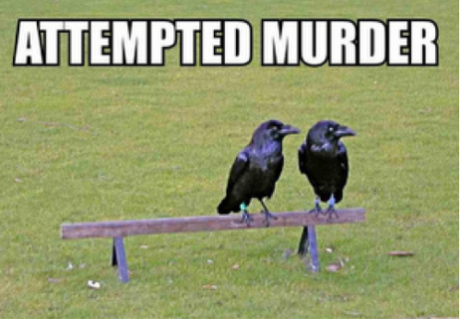

Slide 13
Execution
Make EU::D::save_config output:
  sub Other::Install::Files::Inline { … }
Make EU::D::load_config also call the Inline method

Slide 14
Result
Other modules can just support Inline and get free EU::D support):
  package PDL::Install::Files;
  sub Inline { … }
Gimp's Makefile.PL can be:
  my $pkg = ExtUtils::Depends->new(qw(Gimp Gtk2 PDL));
  WriteMakefile($pkg->get_makefile_vars);
Can use for Inline code like this:
  use Inline with => 'PDL', C => “...”;

Slide 15
And Alien::Gimp?
Subclassing from Alien::Base enables easy Alien modules to encapsulate XS build info
Why not make that work with EU::D and Inline
Now it does!

Slide 16
Synergy
Making these modules work together took work
Save lots of other module-writers lots of duplicated effort
Benefit:
  module-writers
  module-users
  program users

Slide 17
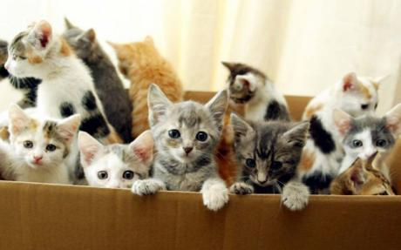

Slide 18
Conclusions
Working with other module-writers can be like herding cats
Source of ideas
Helps find bugs
Makes your module more valuable

Slide 19
Further reading
Inline
ExtUtils::Depends
Alien::Base
https://github.com/mohawk2/lpw2014-slides

Slide 20
Questions?

