Slide 1
Closing the Gaps
Inter-Module Synergy
Ed J (mohawk)
London Perl Workshop 2014

Slide 2
Introduction
Modules: encapsulation
Assemble together into programs / other modules
Example: Inline, ExtUtils::Depends
Ideas on how to find other “gaps”
Slides available on web

Slide 3
Modules
Each encapsulates functionality
Assembly
Interaction

Slide 4
Example: XS support
Writing XS is hard
Writing the build system is hard
Writing XS that uses other XS modules is hard
Why must it be so hard?
WHY?

Slide 5
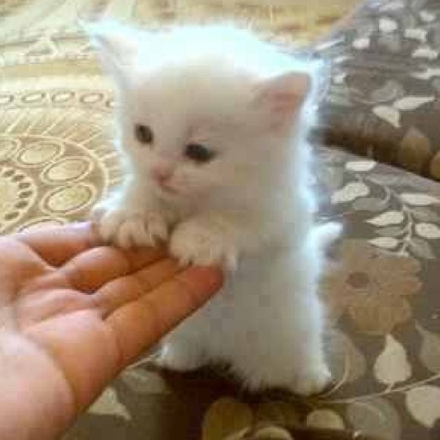
And... breathe

Slide 6
Gimp-Perl: Before
Has own XS for GIMP C libraries
Uses other XS: Gtk2, PDL
Each had own way of providing build system info (paths etc)
GP build system was “challenging”

Slide 7
Gimp-Perl: Before
my %gimpcfg = ExtUtils::PkgConfig->find("gimp-2.0");
require PDL::Core::Dev;
my $pkg = new ExtUtils::Depends qw(Gimp Gtk2);
$pkg->set_inc(join ' ',
$gimpcfg{"cflags"}, &PDL::Core::Dev::PDL_INCLUDE);
$pkg->set_libs(join('', `$gimptool –libs`));
$pkg->save_config('Gimp/IFiles.pm');
WriteMakefile($pkg->get_makefile_vars);

Slide 8
Gimp-Perl: Vision
my $pkg = ExtUtils::Depends->new(
qw(Gimp Alien::Gimp Gtk2 PDL));
$pkg->save_config('Gimp/IFiles.pm');
WriteMakefile($pkg->get_makefile_vars);

Slide 9
Vision: Obstacles
Me understanding EU::D workings
Making PDL support EU::D
Making EU::D support easy

Slide 10
ExtUtils::Depends
Previously support was “black box”
$pkg->save_config('Gimp/IFiles.pm');
Now API can conform to
package PDL::Install::Files;
require PDL::Core::Dev;
$inc = &PDL::Core::Dev::PDL_INCLUDE;

Slide 11
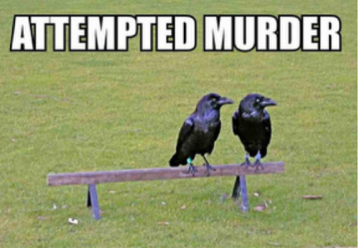

Slide 12
Further reading
Inline
ExtUtils::Depends
https://github.com/mohawk2/lpw2014-slides

