Slide 1
GraphQL in Perl
The Story So Far
Ed J (mohawk)
London Perl Workshop 2017

Slide 2
Introduction
GraphQL: What & Why
What's now available for Perl 5
Lessons learned
Still to do: Return of the Perl 5
Resources

Slide 3
GraphQL: What & Why
“Seriously, why?”
REST: Attack of the Requests
GraphQL: A New Hope

Slide 4
REST: Attack of the Requests
Pros
    Simple
    Consistent(ish)
Cons
    Not rigorous (though OpenAPI)
    Many requests for foreseeable cases

Slide 5
GraphQL: A New Hope
“Type system with query language attached”
Save network traffic
Save time
Save programming effort on frontend

Slide 6
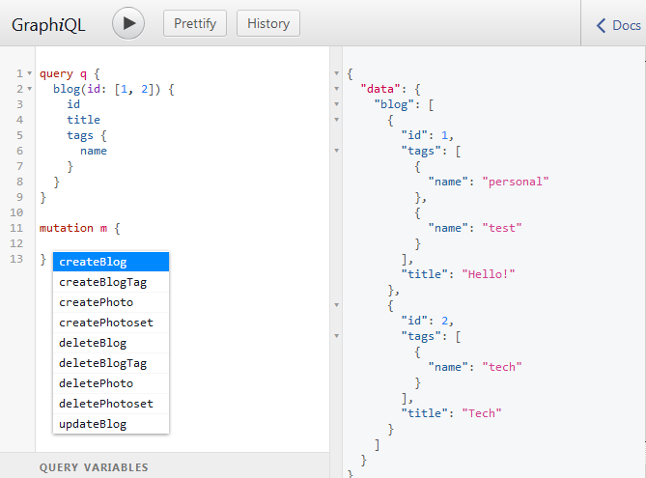
GraphQL: A New Hope

Slide 7
What's now available for Perl 5
CPAN Modules
Sample applets

Slide 8
CPAN Modules
GraphQL
SQL::Translator::Producer::GraphQL
Dancer2::Plugin::GraphQL
Mojolicious::Plugin::GraphQL
GraphQL::Plugin::Convert::DBIC
GraphQL::Plugin::Convert::OpenAPI

Slide 9
CPAN Modules (links)
https://metacpan.org/pod/GraphQL
https://metacpan.org/pod/SQL::Translator::Producer::GraphQL
https://metacpan.org/pod/Dancer2::Plugin::GraphQL
https://metacpan.org/pod/Mojolicious::Plugin::GraphQL
https://metacpan.org/pod/GraphQL::Plugin::Convert::DBIC
https://metacpan.org/pod/GraphQL::Plugin::Convert::OpenAPI

Slide 10
Sample applets
Mojolicious
Dancer2
Tempire's MojoExample for DBIC
Tutorial

Slide 11
Sample applets: Mojolicious
use Mojolicious::Lite;
get '/' => sub {
my $c = shift;
$c->render(template => 'index');
};
plugin GraphQL => {
convert => [ 'Test' ],
graphiql => 1,
};
app->start;

Slide 12
Sample applets: Dancer2
use Dancer2;
use Dancer2::Plugin::GraphQL;
set charset => 'UTF-8';
set template => 'simple';
set plugins => { 'GraphQL' => { graphiql => 1 } };
get '/' => sub {
send_as html => template 'index', {
title => 'Perl-GraphQL demo app',
};
};
graphql '/graphql' => [ 'Test' ];

Slide 13
Sample applets: MojoExample
use Mojolicious::Lite;
helper db => sub {
return Schema->connect('dbi:SQLite:' . ($ENV{TEST_DB} || 'test.db'));
};
plugin GraphQL => {
convert => [ 'DBIC', sub { app->db } ],
graphiql => 1,
};
app->start;

Slide 14
Sample applets: MojoExample

Slide 15
Sample applets (links)
https://github.com/graphql-perl/sample-mojolicious
https://github.com/graphql-perl/sample-dancer2
https://github.com/mohawk2/MojoExample
http://blogs.perl.org/users/ed_j/2017/10/graphql-perl---graphql-js-tutorial-translation-to-graphql-perl-and-mojoliciousplugingraphql.html

Slide 16
Lessons learned
Pegex
Immutable data

Slide 17
Still to do: Return of the Perl 5
Finish async
Make DBIC plugin support Relay like JS postgraphql
Federate GraphQL services (and REST microservices)
Sample app with React/Relay

Slide 18
Summary
GraphQL: What & Why
What's now available for Perl 5
Lessons learned
Still to do: Return of the Perl 5
Resources

Slide 19



















Slide 20
Resources
https://github.com/graphql-perl
https://github.com/mohawk2/presentations
http://blogs.perl.org/users/ed_j/

Slide 21
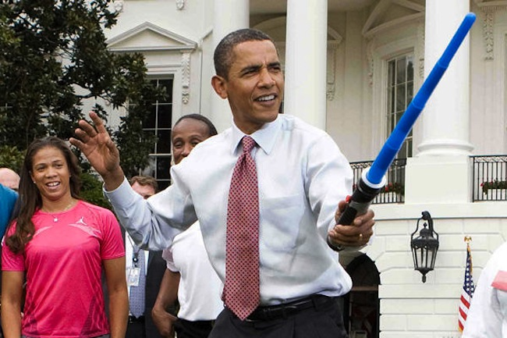
Questions?

